Slide 1
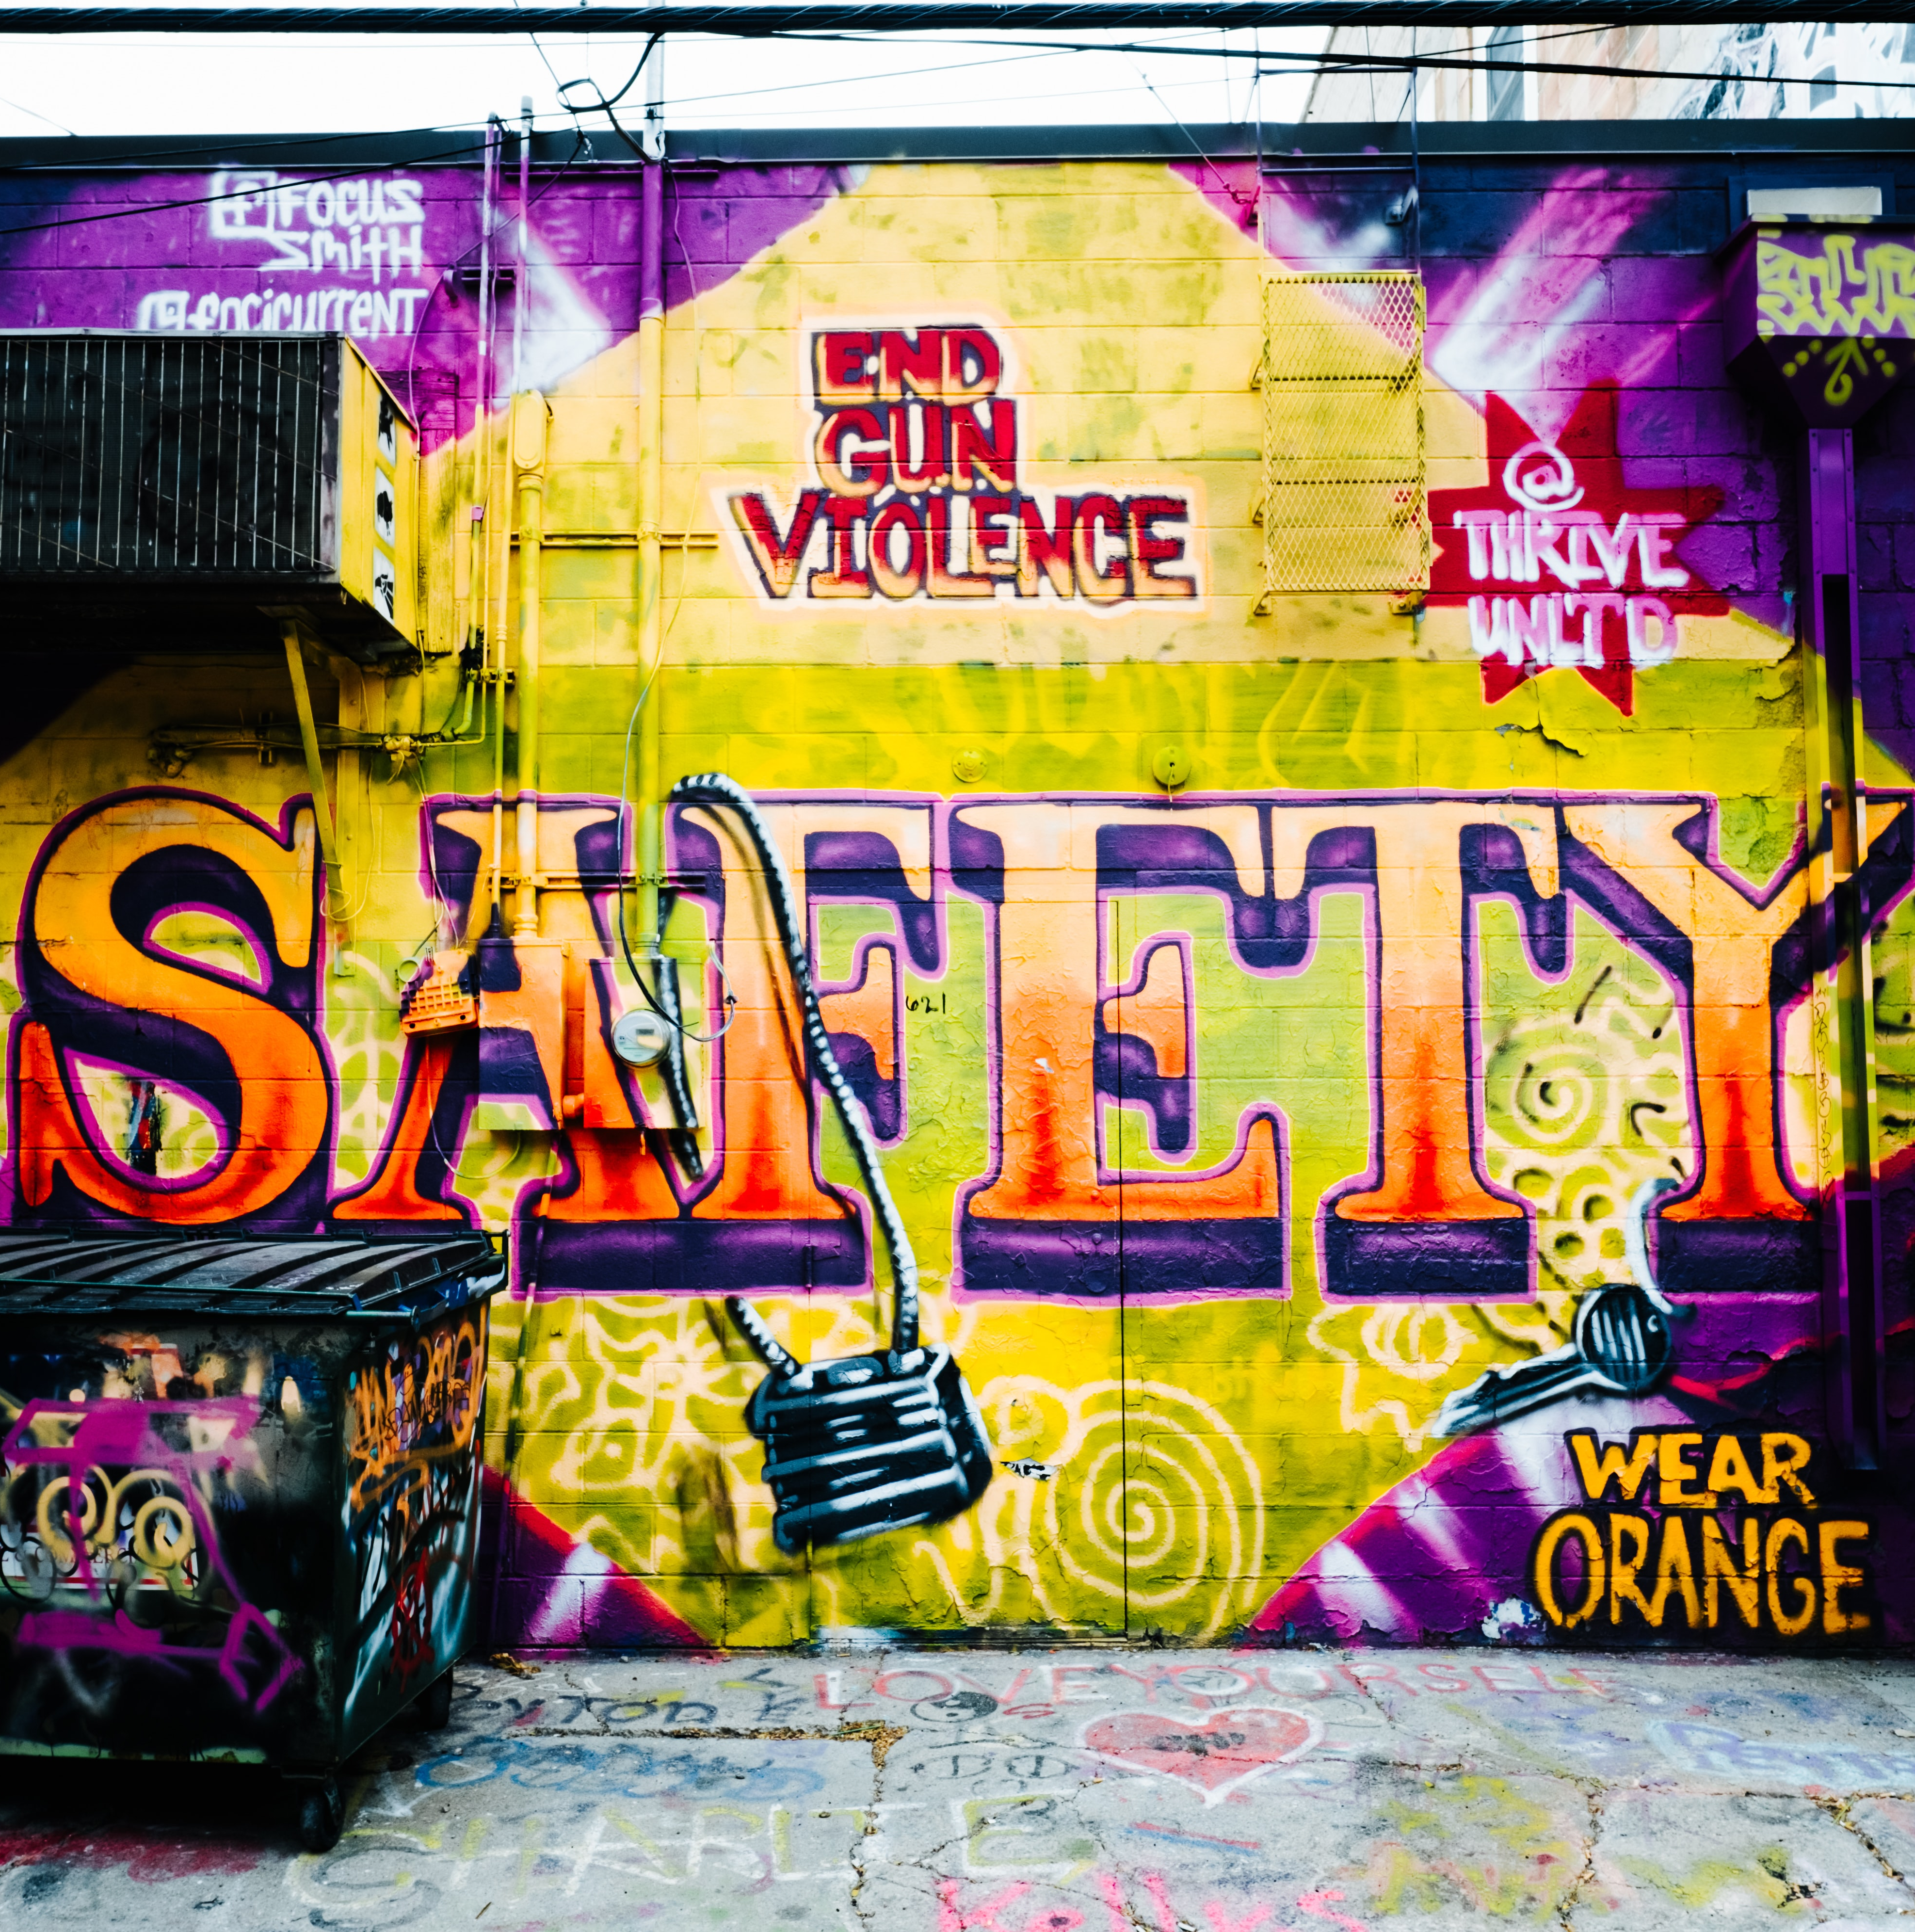

Violent Crime Trends: How to Talk About Them, What To Do About Them
Thomas Abt Senior Fellow, Council on Criminal Justice Chair, Violent Crime Working Group November 16, 2021

Slide 2
About the council
The Council on Criminal Justice launched in July 2019
Invitational membership organization and think tank, serves as a center of gravity for policy and leadership in criminal justice field
Advances understanding of criminal justice policy choices facing nation through nonpartisan research, task forces, and working groups

Slide 3
About the working group
The Council’s Violent Crime Working Group launched in July 2021
Addresses the most pressing issues concerning crime and violence
Includes a diverse range of members meeting on rolling basis, tackling different challenges each session
Meetings summarized then released
Also produces reports, holds webinars, etc.

Slide 4
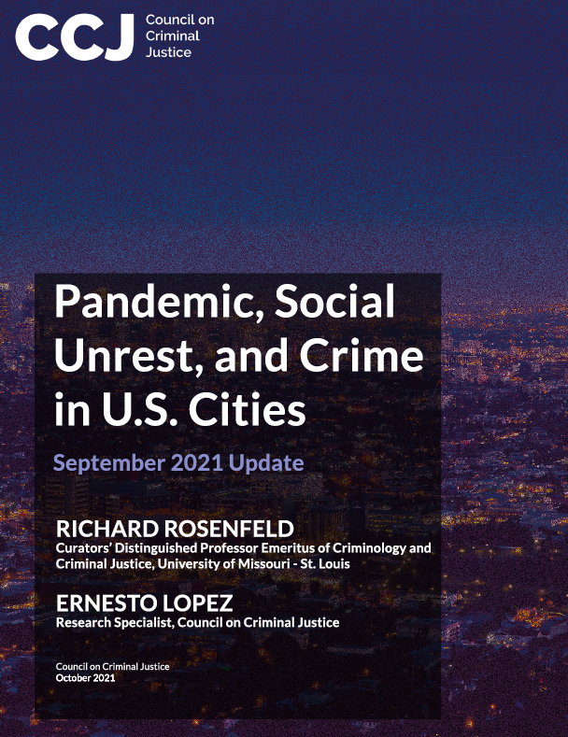
Trends in violent crime THROUGH September 2021
In 2020, homicides rose 29% compared to 2019; violent crime generally rose by 5.6%
In first 9 months of 2021, homicides rose 4% compared to 2020; aggravated and gun assaults 3% and .4% higher
Property and drug crimes – other than motor vehicle theft – fell significantly in 2020 and 2021

Slide 5
putting the trends in context
Important to emphasize that:
In 2021, homicide rates are still rising, but the rate of the increase is slowing
In 2020, the homicide rate of increase was historic, but absolute rates remain below historic highs
In both cases, saying one without the other can be misleading
There is no “crime wave” in the U.S. – property and drug crime are down – but there is a “violence wave” driven by community gun violence

Slide 6
explaining the trends – what we know
Violent crime has increased in most U.S. cities, but not in other countries
During pandemic, large majority of U.S. cities in the U.S. experienced significant increase in homicides, suggesting national factors drove increase
Homicide and other violent crime rates did not increase in other countries.

Slide 7
explaining the trends – what we know
Homicides increased mostly due to community gun violence, i.e. violence in community settings involving firearms
Increases occurred in poor communities of color where violence already; little evidence indicates spreading to other areas
Multiple factors converged simultaneously to increase violence - no single explanation for why
Based on current data, impossible to tell exactly which factors mattered most, or how they interacted

Slide 8
explaining the trends – what we know
Pandemic contributed to increase in violence, but unclear how
Criminological theories (routine activities, strain, etc.) suggest different, even contradictory, reactions to pandemic
More specifically, pandemic halted provision of critical services to those at the highest risk for violence
Sharp increase in violence following murder of George Floyd in late May 2020, but unclear exactly why
Evidence suggests both “de-policing” and “de-legitimization” played a role

Slide 9
explaining the trends – what we know
Firearm purchases rose dramatically during pandemic, but impact on violence is questionable
Recent purchases not associated with increases in gun violence, at least not in near term - likely because average “time to crime” for legally purchased firearms is 5-7 years
More specifically, a surge in illegal carrying of firearms may have been impactful; in Chicago and elsewhere, police recovering more illegal guns despite fewer arrests

Slide 10
explaining the trends – what we know
Jail/prison releases increased dramatically during pandemic, but little evidence those releases or reforms contributed to violence
Most releases occurred before violence spiked in June
Recidivism/rebooking rates for pandemic releasees lower
Little evidence currently supporting claims that changes to bail processes, “defunding” police departments, or other criminal justice reforms are driving violence – increases also happening in places without reforms

Slide 11
explaining the trends – what to do
Community gun violence is driving the increase in violent crime generally, and homicide in particular, so policymakers and practitioners should focus efforts on addressing this particular form of violence

Slide 12
Understanding violent crime – what we know
Many decisionmakers inside and outside government fail to properly understand the problem of community gun violence
Some focus on the wrong things, such as emphasizing juvenile crime when the majority of gun violence involves adults. Others fail to focus at all, only considering root causes
Many believe their local violence problem to be unique, but community gun violence looks the same across jurisdictions
These misunderstandings represent the single biggest impediment to reducing community gun violence in cities around the country

Slide 13
Understanding violent crime – what we know
Study after study finds that crime, and especially violence, concentrates among small networks of people and places
This is true in every, or nearly every, U.S. city
In Oakland, 60 percent of murders occur within a social network of approximately 1,000 to 2,000 individuals—about 0.3 percent of the city’s population
In Boston, 70 percent of all shootings over three decades concentrated in areas covering five percent of the city.

Slide 14
Understanding violent crime – what we know
Strategies associated with the most immediate, measurable, and concrete anti-violence outcomes (fewer homicides, gun-related injuries, etc.) have something in common: they focus on the small networks that are disproportionately involved in violence
Any strategy, or set of strategies, intended to curb community gun violence in the short run must be intensely focused in this way

Slide 15
Understanding violent crime – what we know
Being focused does not mean only using law enforcement approaches – both law enforcement and community-based approaches can engage high-risk people and places
Being focused does not mean ignoring early prevention, which can be cost-effective in controlling future crime and violence, or the root causes of such violence – short-term tactics can be accompanied by long-term strategies

Slide 16
Understanding violent crime – what to do
Every serious effort to address community gun violence should begin with a rigorous problem analysis. Problem analyses identify the key people and places driving violence locally and establish a shared, fact-based understanding to guide responses
Problem analyses are typically developed using law enforcement intelligence and data, then reviewed by outside individuals such as trained street outreach workers
Only a few organizations are currently capable of conducting these analyses, creating a significant scaling challenge

Slide 17
Community-based strategies – what we know
Cognitive behavioral therapy (CBT) teaches people to manage emotions, address conflicts, and think before acting
CBT helps even the highest-risk individuals improve their thinking and behavior in order to avoid crime and violence.
CBT is supported by a strong base of evidence that includes multiple studies using the most rigorous study designs
While CBT “works” to reduce violent crime, access to quality providers can be challenging in many jurisdictions.

Slide 18
Community-based strategies – what we know
Street outreach or “credible messenger” programs recruit frontline workers to help those at risk mediate disputes. They also connect individuals to social supports and services
The evidence concerning street outreach is promising but mixed. Neighborhoods in Chicago, New York City, Los Angeles, and Philadelphia experienced significant reductions in shootings, but in Baltimore and Pittsburgh there were increases
When implemented properly, street outreach is a powerful anti-violence tool; when implemented poorly, it can have minimal or even negative effects

Slide 19
Community-based strategies – what we know
Hospital-based Violence Intervention Programs (HVIPs) combine the efforts of medical staff and community partners to provide services and care to those at the highest risk for repeat injury
Typically, these programs aim to intervene during crucial “teachable moments” of an individual’s recovery from a violent incident, while leveraging the caregiver trust and goodwill
The evidence for HVIPs is promising but more research is needed. There are a wide variety of HVIP models, many with differing approaches. Some are capable of working with high-risk patients, others are not

Slide 20
Community-based strategies – what we know
Environmental crime prevention strategies involve changing the physical appearance of a location to prevent crime
The evidence concerning these strategies is best described as mixed. Some strategies, such as “cleaning and greening,” installing street lighting, and changing traffic patterns show promise
Other strategies, such closed-circuit television cameras, have proven less successful, and few environmental crime prevention strategies focus specifically on improving anti-violence outcomes

Slide 21
Community-based strategies – what to do
Get training and technical assistance. Resist the temptation to “go it alone" without consulting outside experts on best practices
Focus on the highest risk people and places. Use limited resources efficiently by working only with likely to become involved in violence
Support workers with the necessary resources. Create viable career pathways and provide needed mental health services
Manage and evaluate the work. Encourage partnerships with culturally competent researchers to assess program outcomes and continue to learn what is necessary for success

Slide 22
enforcement-based strategies – what we know
Focused deterrence mobilizes community residents, service providers, and law enforcement officials in response to chronic crime conditions. The best-known application of focused deterrence is known as the Group Violence Intervention (GVI) or Ceasefire
Focused deterrence and GVI/Ceasefire are supported by a strong base of evidence showing large impacts on violence
That said, the strategy can be difficult to implement. To be successful, focused deterrence initiatives require close coordination across multiple partners. Another challenge is maintaining the right balance of sanctions and supports

Slide 23
enforcement-based strategies – what we know
Proactive policing refers to police strategies intended to prevent and reduce crime. The most widely implemented and evaluated versions of proactive policing are hot spots and problem-oriented policing
Generally speaking, proactive policing is effective in reducing crime and violence, but overly broad or aggressive approaches are a risk. NYC’s controversial experience with “stop-and-frisk” is an example of proactive policing gone awry
Strong oversight and management of these strategies is crucial to ensure a tight focus on the highest risk people and places

Slide 24
enforcement-based strategies – what we know
The percentage of homicides involving firearms has increased over time, reaching a peak of 77% in 2020
Police strategies to reduce illegal gun carrying can be implemented quickly without new legislation. Such measures generally involve encouraging officers to make pedestrian and car stops to search for illegal weapons (other “supply-side” measures deserve consideration as well)
As with proactive policing strategies, evidence suggests that crackdowns illegal gun carrying can reduce violence, but such strategies come with an even greater risk of misuse or abuse

Slide 25
enforcement-based strategies – what we know
In 1976, the homicide clearance rate was 82%. In 2020, it was 50%. Clearance rates for non-fatal shootings are half as high
Low clearance rates frustrate efforts to hold offenders accountable, provide victims with justice, and disrupt cycles of retaliation. Declines are due to more difficult cases, lack of community trust, and not enough attention to investigations
Recent research indicates that more resources, improved management, and better oversight can increase clearance rates for even the most difficult cases

Slide 26
enforcement-based strategies – what to do
Get training and technical assistance. Resist the temptation to “go it alone" without consulting outside experts on best practices
Focus on the highest risk people and places. Limit aggressive enforcement to those closely associated with violence. Avoid indiscriminate tactics such as making lots of low-level arrests
Work with partners. Engage partners such as community members, street outreach workers, service providers, researchers, and others
Establish trusting relationships with impacted communities. Without trust, community members provide less information, making police less effective. Commit to engaging, even when it’s hard

Slide 27
the case for collaboration
Strong evidence supports BOTH community- and police-led strategies to reduce community gun violence, but NONE of these strategies are effective enough to work alone
No city has reduced violent crime with only arrests or programs (e.g. Boston, Oakland, LA, NYC)
Too much of today’s criminal justice conversation is framed in “either/or” terms, must move to “both/and” discussion
Too much advocacy is accepted uncritically by the media, contributing to an increasingly toxic political and policy environment

Slide 28
Thank you! Questions?

Slide 29
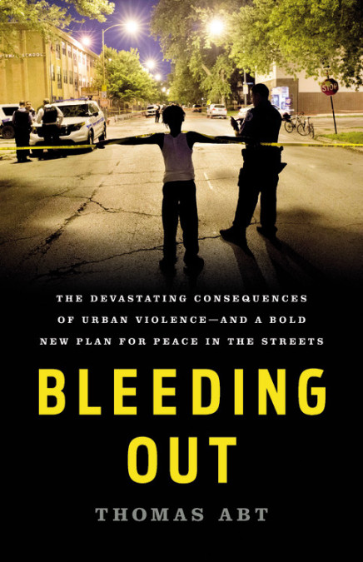
For more information
Council on Criminal Justice (CCJ): https://counciloncj.org/
CCJ Communications Director Jen Warren: jwarren@counciloncj.org
Violent Crime Working Group: https://counciloncj.org/violent-crime-working-group/
Bleeding Out: The Devastating Consequences of Urban Violence – And a Bold New Plan for Peace in the Streets: https://www.basicbooks.com/titles/thomas-abt/bleeding-out/9781541645714/

