Slide 1
Bail reform and the role of the press:
A case study of backlash to New York’s 2019 bail law
Insha Rahman, Esq.
Vice President, Advocacy and Partnerships
Vera Institute of Justice

Slide 2
Founded in 1961, the Vera Institute of Justice works to build just and accountable government institutions and to tackle and provide solutions to the most pressing injustices of our day—from ending mass criminalization and incarceration, reckoning with the loss of public confidence in our legal systems, and securing safety in our communities.

Slide 3
Agenda
Today’s agenda
An overview of bail and pretrial justice fundamentals
A case study of New York’s 2019 bail law
Tips for holistic reporting on bail and pretrial reform

Slide 4
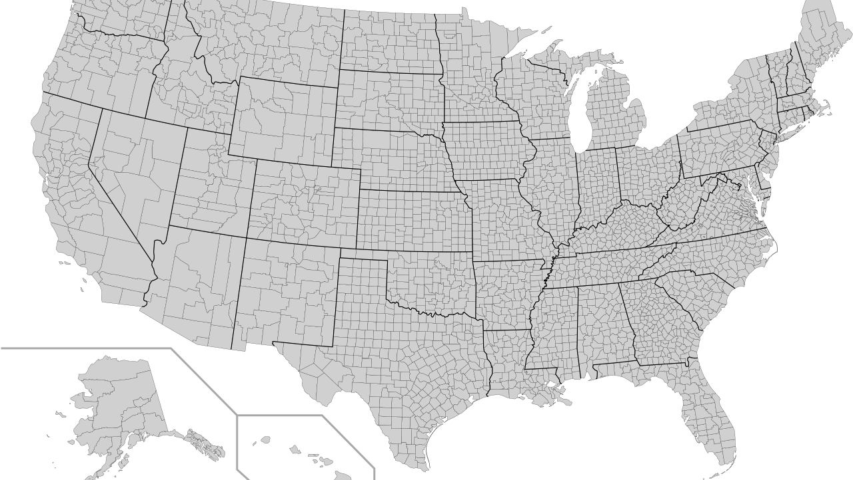
Bail practices are shaped by state law and courtroom custom
There are more than 18,000 police departments, 2,300 prosecutor offices, and 3,000 jails across the U.S.

Slide 5
Not all changes to bail are good—there is a standard for good bail reform
Eliminates wealth and profit as the basis for pretrial release or detention;
Results in fewer people behind bars;
Addresses racial disparities; and
Importantly, protects public safety.

Slide 6
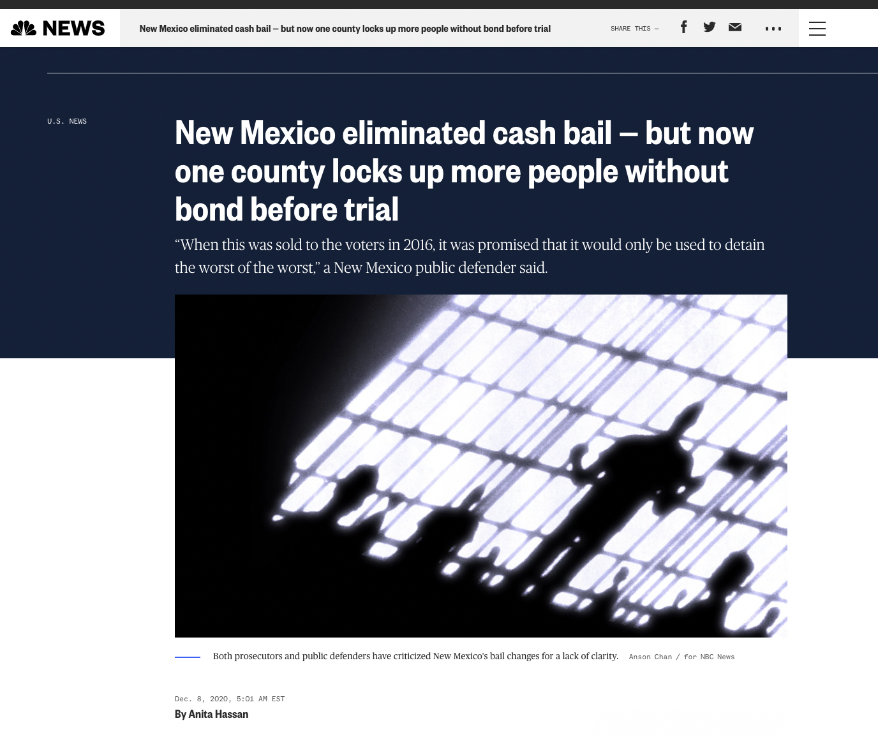
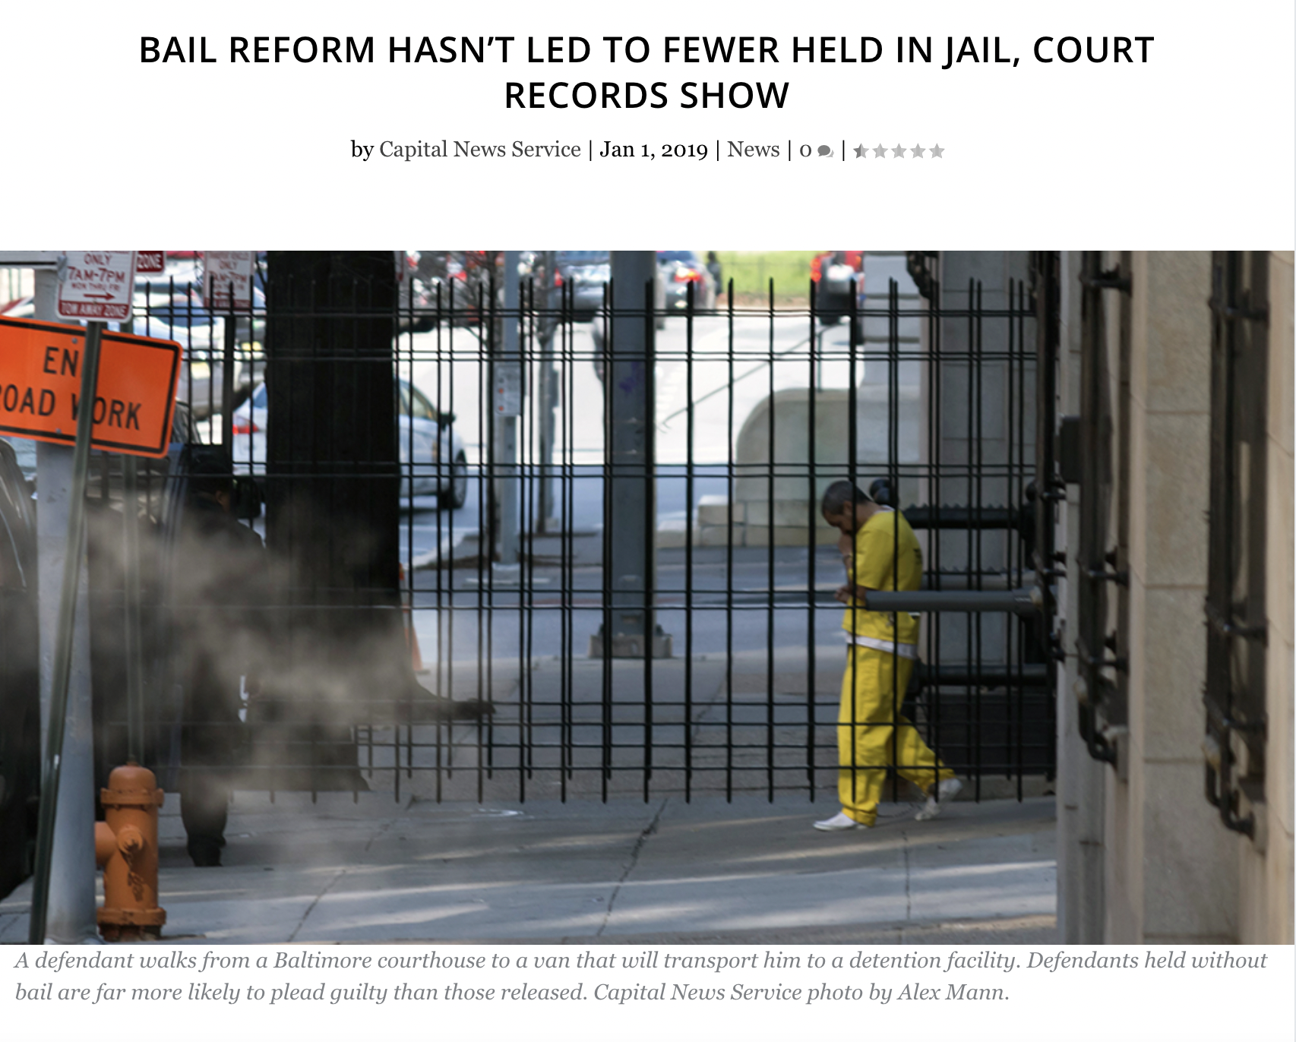
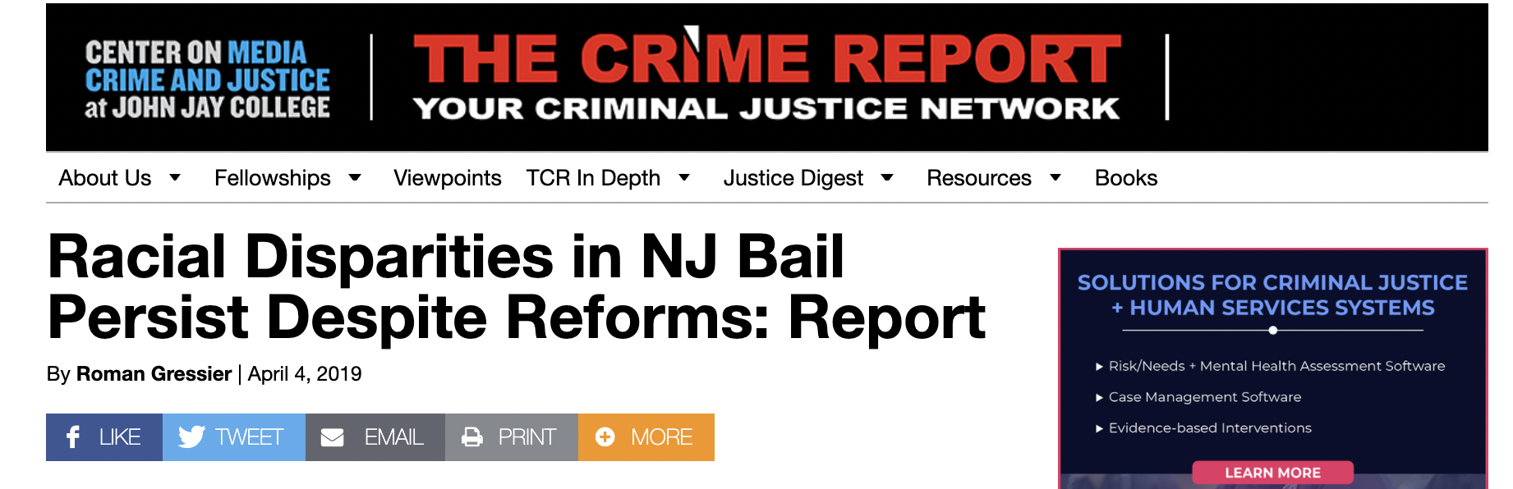
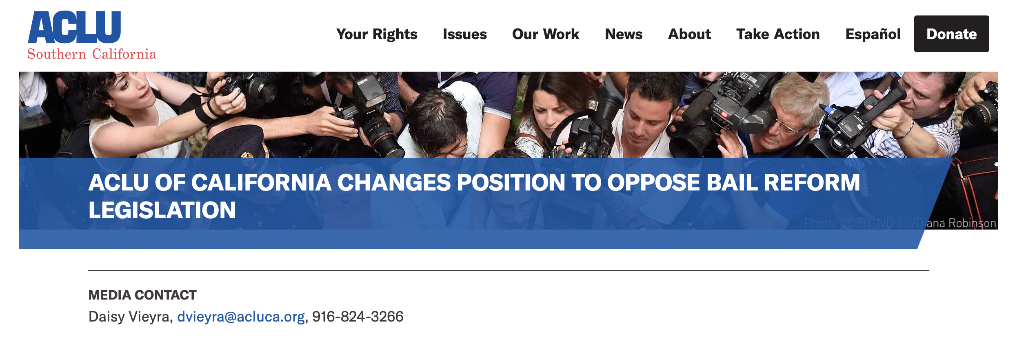

Slide 7
An overview of bail and
pretrial justice fundamentals

Slide 8
“
”
Bail is the right to release pretrial.
U.S. Supreme Court
Stack v. Boyle (1951)

Slide 9
For centuries, the only justification for
setting money bail was to address
failure to appear.
After the U.S. Supreme Court decided Salerno in 1987, courts could legally consider
public safety when setting bail.

Slide 10
Every rigorous study on bail and pretrial practices has found that money bail has no correlation with public safety. It also has little impact on failure to appear.

Slide 11
Race/ethnicity
Composition of U.S. population versus jail population
Source: Alison Walsh, Criminal Justice Racial Disparities, Prison Policy Initiative (2016)

Slide 12
40%
Over
of Americans would struggle to cover a
$400
emergency expense.
Source: U.S. Federal Reserve, Report on the Economic Well-Being of U.S. Households (2019)

Slide 13
Even as little as two days in jail can have so great of a destabilizing effect on a person’s employment, housing, and familial responsibilities that it increases the likelihood in the future of missing court or a new arrest.
Source: Lowenkamp et al., Hidden Costs of Pretrial Detention (2013)

Slide 14
Research shows that a person detained pretrial is 18% more likely to be convicted and receive a jail or prison sentence than someone who is released.
Source: Dobbie et al., Effects of Pretrial Detention on Conviction, Future Crime, and Employment (2016)

Slide 15
New York’s 2019 bail reform law—
a case study in transformative change, media coverage, and backlash

Slide 16
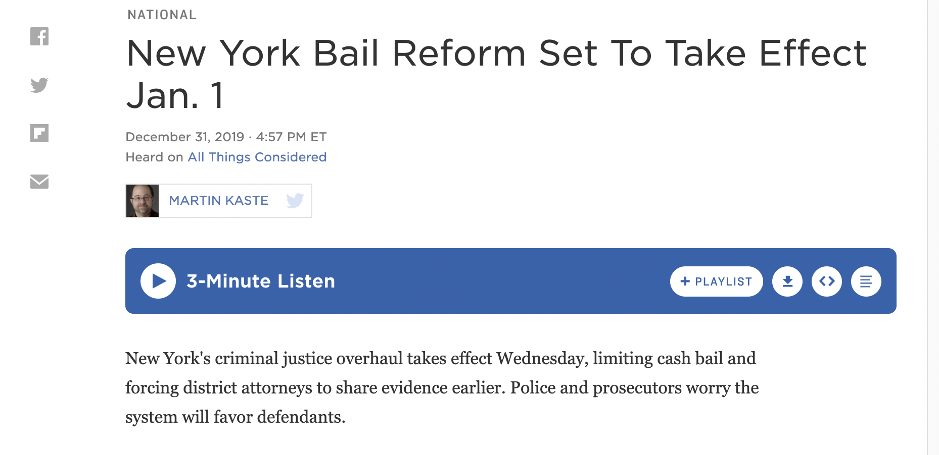

Slide 17
Mandatory appearance tickets
Mandatory release on a wide swath of cases
Parsimony in the conditions imposed on release
Discrete role of risk assessment instruments
Mandate for ability to pay and more affordable forms of bail

Slide 18
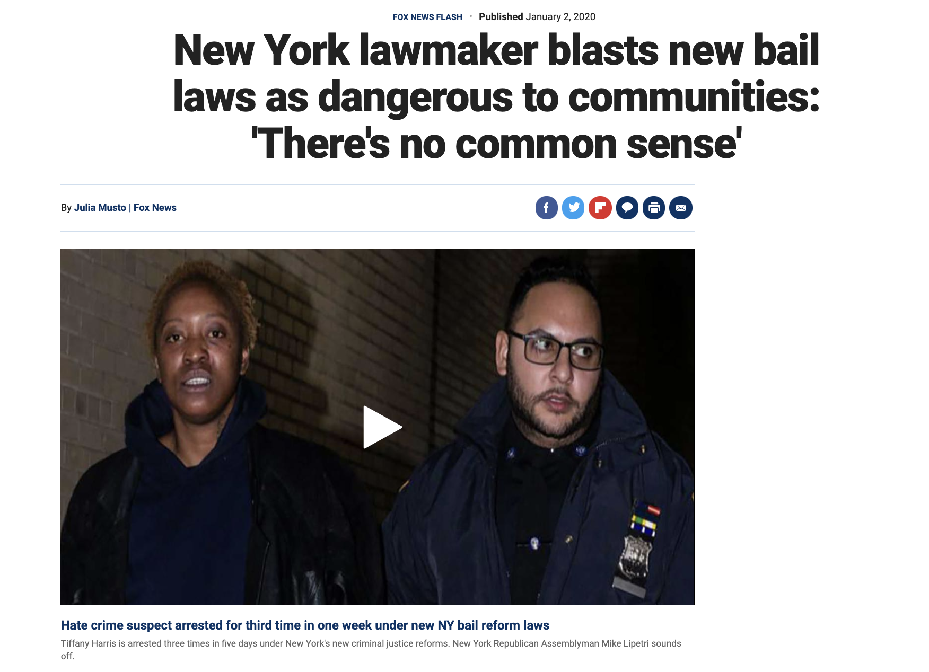

Slide 19
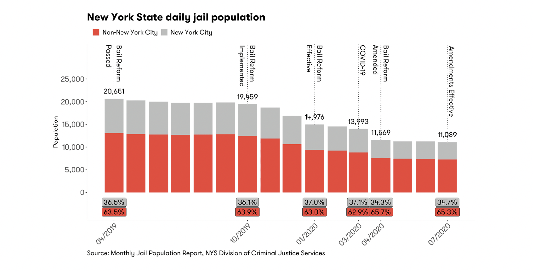

Slide 20
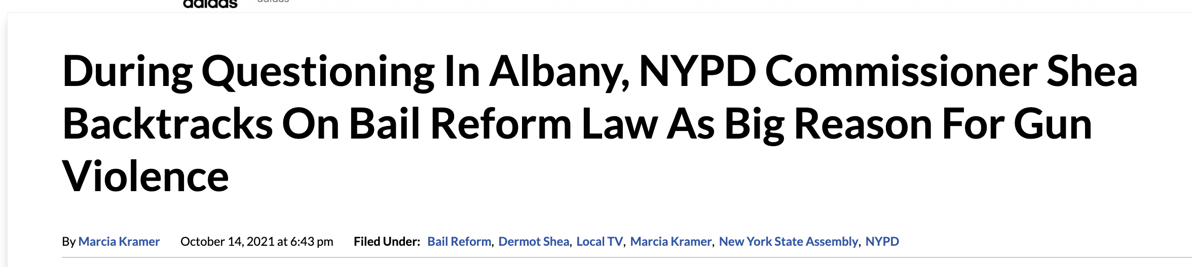
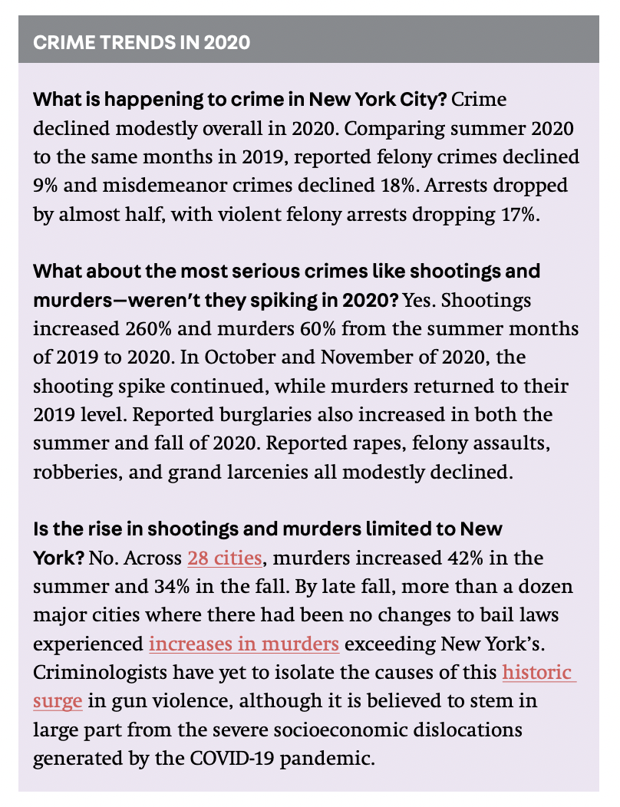
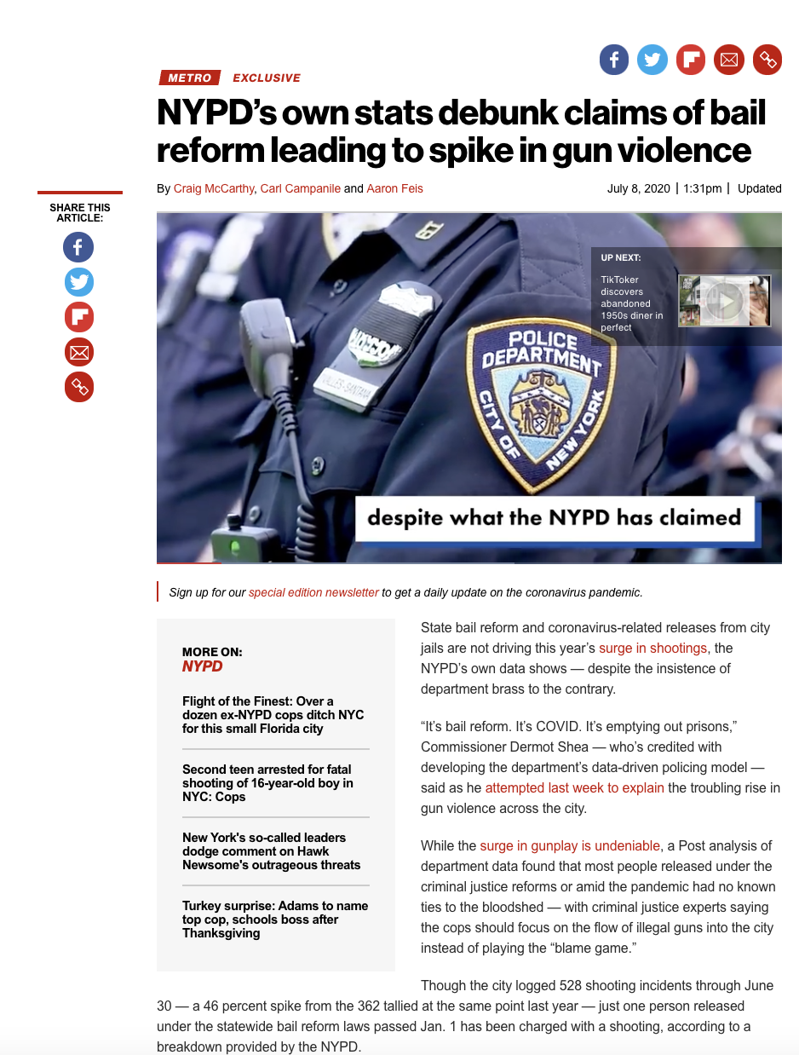
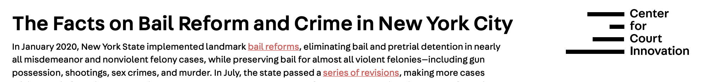
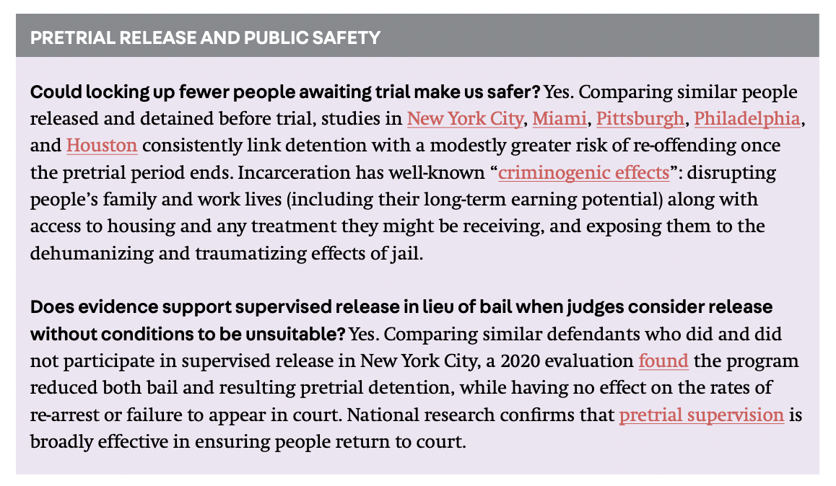

Slide 21
Tips for holistic reporting on bail
and pretrial reform

Slide 22
Report facts and statistics on bail overall, not individual outlier cases.
Use people-first, humanizing language when reporting on high-profile cases and beware of dog whistle caricatures.
Consult practitioners, researchers, and advocates in addition to law enforcement sources when reporting on bail changes.
Request data and evidence when opponents of bail reform claim it negatively impacts court appearance rates and public safety.

Slide 23
Thank you! Questions? Comments?

Slide 24
Insha Rahman
Vice President of Advocacy and Partnerships
irahman@vera.org
(646) 284-8221

