Slide 1
Investigate
the criminal justice system
with open data
Weihua Li / wli@themarshallproject.org / @Weihua_Li1

Slide 2




Anna Flagg
Andrew R. Calderon
David Eads
Ilica Mahajan
Weihua Li (that’s me!)

Slide 3
Take full advantage of open, publicly available data.

Slide 4
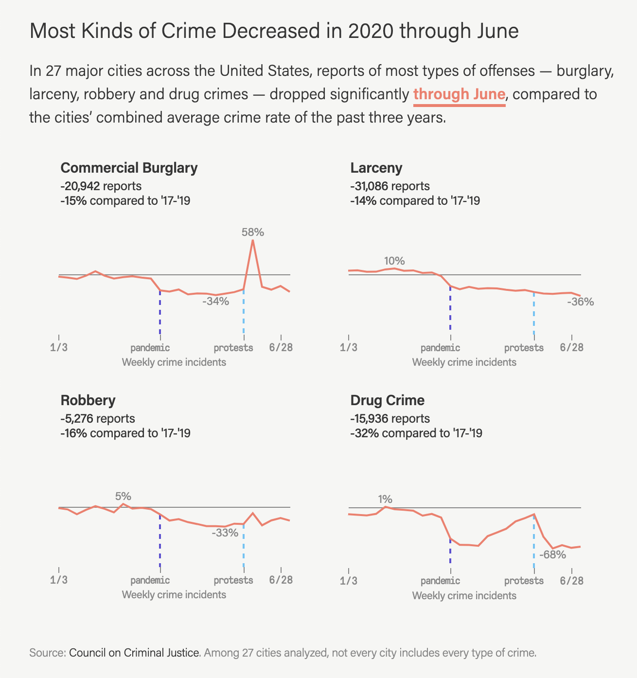
Local data
Where to find them?
  Agency dashboards
  City Open Data portals (it’s fun to explore)
What can they include?
  Use of force, crime incidents, arrests, jail daily population, hate crime.
Notes:
They are usually up-to-date. It’s easier to find analysts in government agencies.

Slide 5
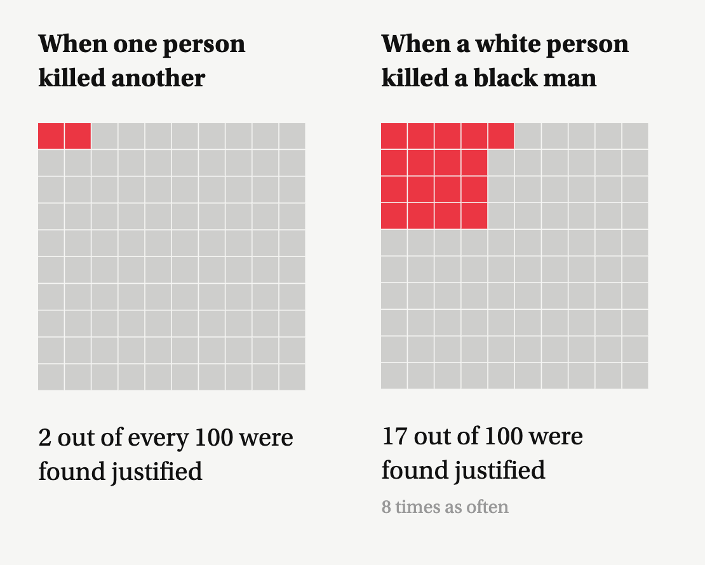
National data
What’s available?
  FBI’s UCR and NIBRS reports (crime, clearance, victim)
  Bureau of Justice Statistics (courts, prison, policing, )
  News organization/Think tank (WaPo’s police shooting dataset)
Notes:
A lot of them at least a year behind. Make sure you understand how they tried to uniform and deal with local agencies’ quirks.

Slide 6
Unusual sources
The criminal justice system is part of the society.
Which means criminal justice data exist in other general datasets as well.

Slide 7
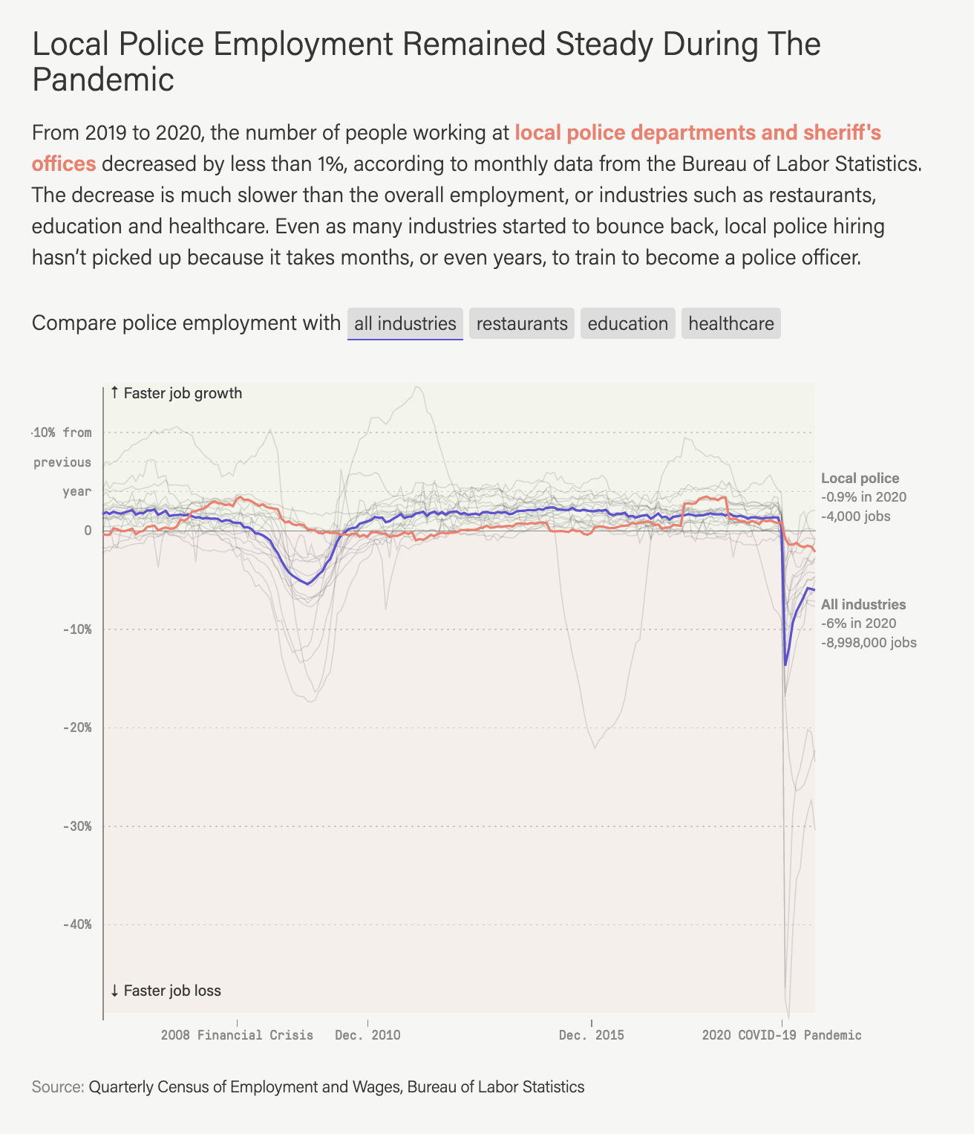
Unusual sources
Labor and economics data from the Bureau of Labor Statistics
Did police officer leave in droves last year?

Slide 8
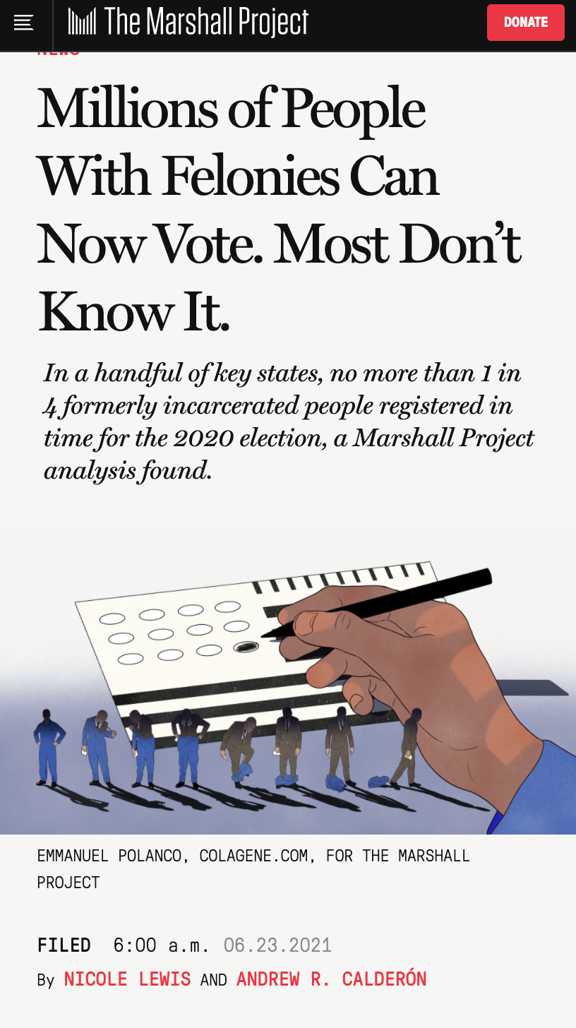
Unusual sources
Voting records
How many people with felony record voted in 2020 after they are re-enfranchised?

Slide 9
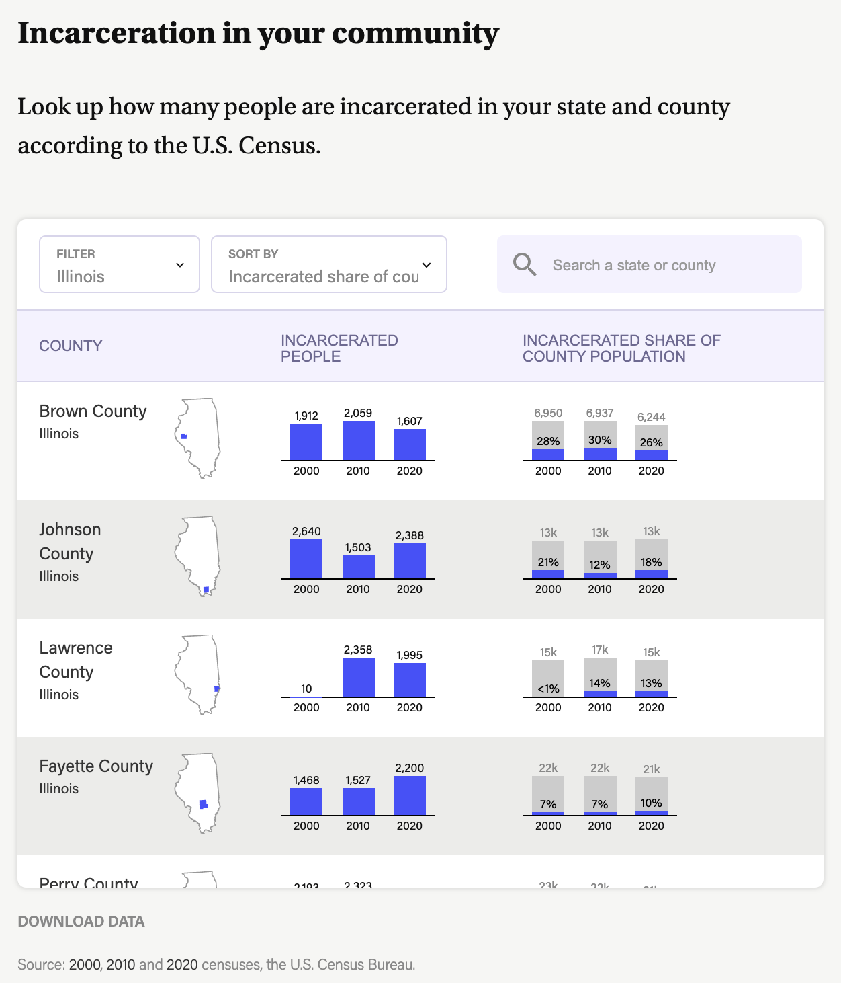
Unusual sources
Census (police/court/correction spending, prison population)
How many people are incarcerated in your county?

Slide 10
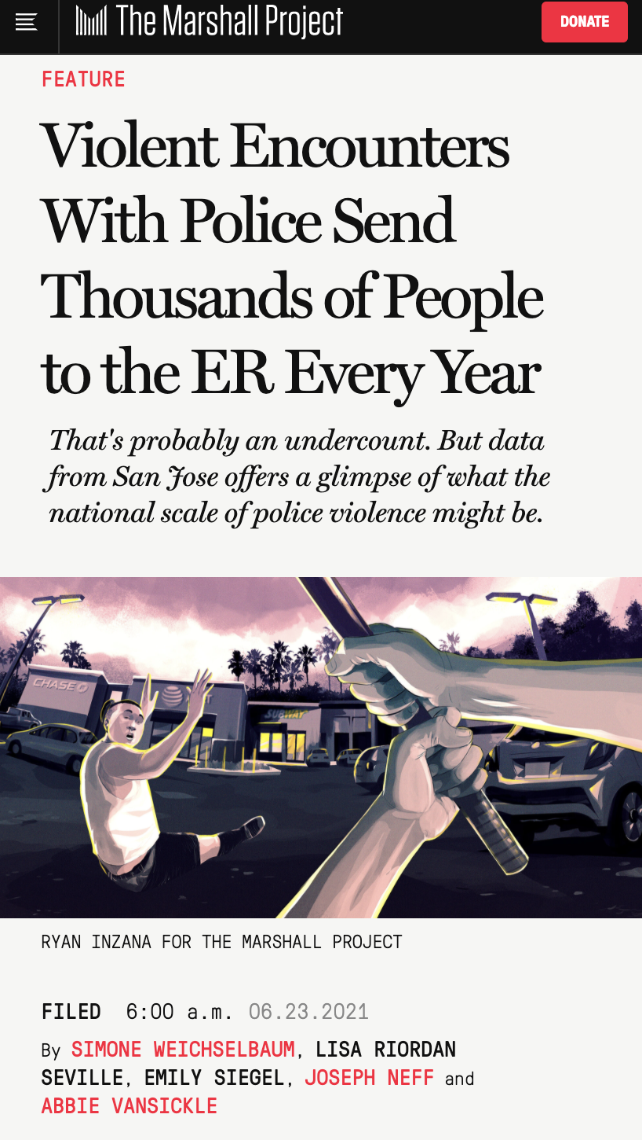
Unusual sources
CDC data (homicides, use of force injuries)
Did police officer leave in droves last year?

Slide 11
Every dataset is its own unique snowflake
Who collects this information?
Why are they collecting it?
How far away is this from the universal truth?
  Let’s look at murder as an example
  CDC tracks the number of people killed each year
  FBI tracks how many of the cases police knew and solved
  But how many people are arrested?
  Put on trial? Incarcerated?

Slide 12
Questions?
Weihua Li / wli@themarshallproject.org / @Weihua_Li1

