Slide 1
Understanding Gangs: . The Myths and The Realities .
David C. Pyrooz, PhD
Department of Sociology
Institute of Behavioral Science
University of Colorado Boulder
David.Pyrooz@Colorado.edu
@dpyrooz

Slide 2
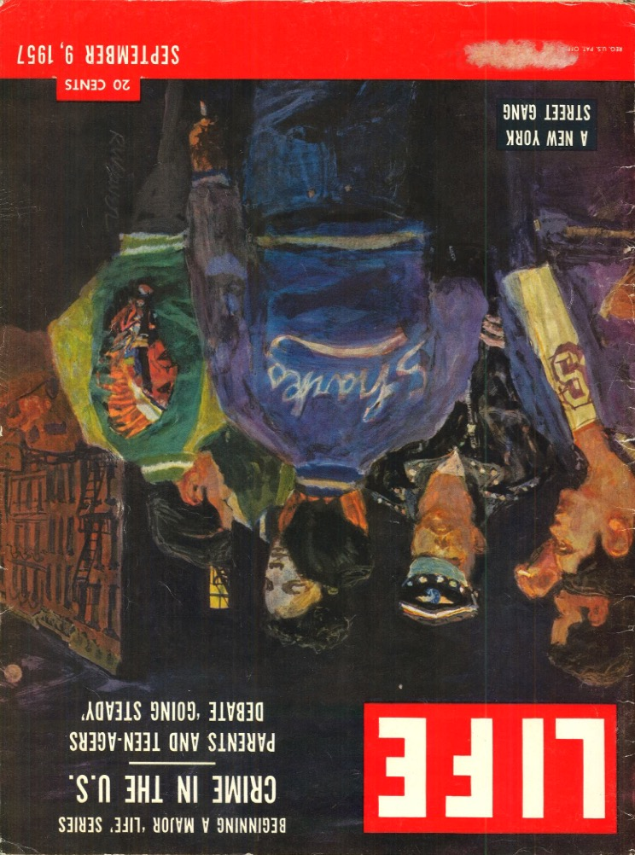
Overview .
Structure “the macro”
Deindustrialization
Migration, assimilation, and segregation
Mass incarceration (+ legislation)
Firearm availability
Internet/social media (+ globalization)
Context “the micro”
Joining, staying, and leaving
Race, ethnicity, and gender
Forms and functions
Violence
Nothing works

Slide 3


Overview .
Structure “the macro”
Deindustrialization
Migration, assimilation, and segregation
Mass incarceration (+ legislation)
Firearm availability
Internet/social media (+ globalization)
Context “the micro”
Joining, staying, and leaving
Race, ethnicity, and gender
Forms and functions
Violence
Nothing works

Slide 4

Overview .
Structure “the macro”
Deindustrialization
Migration, assimilation, and segregation
Mass incarceration (+ legislation)
Firearm availability
Internet/social media (+ globalization)
Context “the micro”
Joining, staying, and leaving
Race, ethnicity, and gender
Forms and functions
Violence
Nothing works

Slide 5
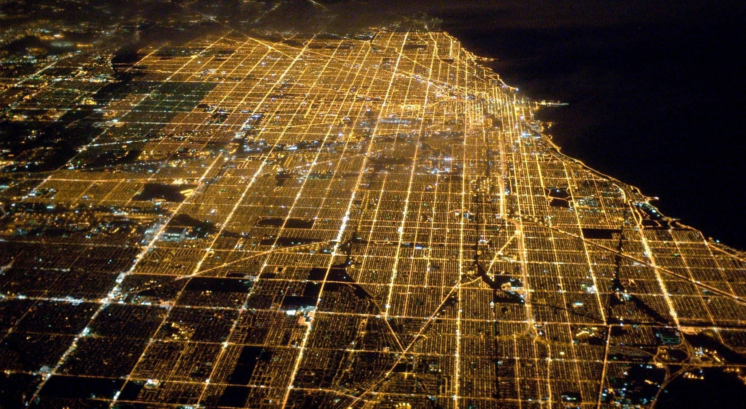
Structure

Slide 6
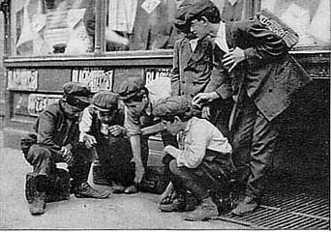
From Play Groups to Problem Groups .
“The gang, therefore, while it lasts, is for the boy one of the three primary groups [along with neighborhood and family]; but for the normal boy the play group is the gang…Like all such instinctive associations, the gang appears useless or stupid to those who have never felt the inner impulse which caused it, or who, having felt, have forgotten”
- J. Adams Puffer (1912), The Boy and His Gang
“The gang is an interstitial group originally formed spontaneously, and then integrated through conflict. It is characterized by the following types of behavior: meeting face to face, milling, movement through space as a unit, conflict, and planning. The result of this collective behavior is the development of tradition, unreflective internal structure, esprit de corps, solidarity, morale, group awareness, and attachment to local territory”
- Frederic M. Thrasher (1927), The Gang

Slide 7
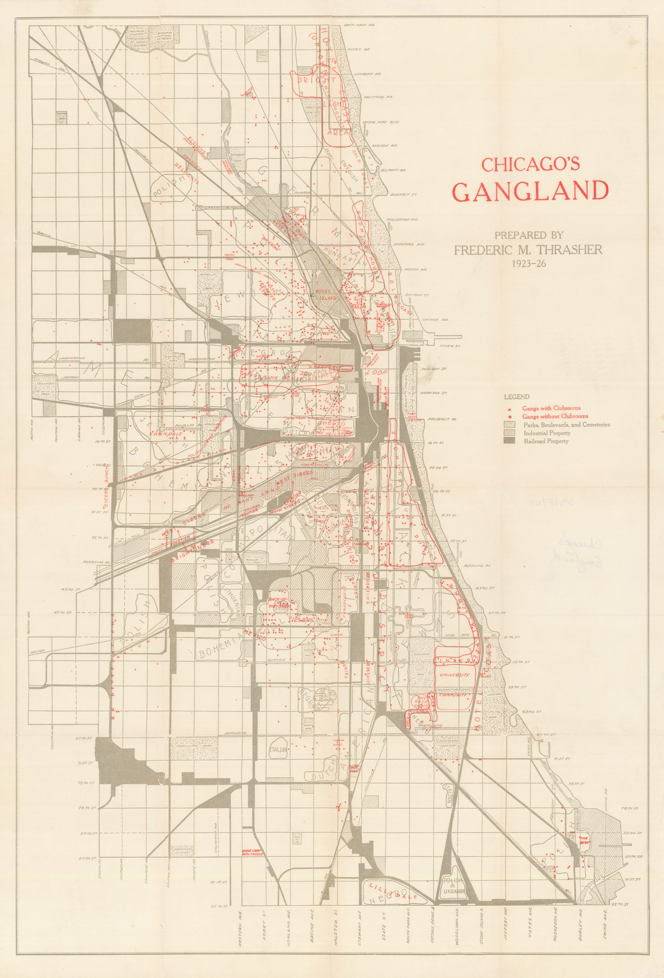
From Play Groups to Problem Groups .
“The gang, therefore, while it lasts, is for the boy one of the three primary groups [along with neighborhood and family]; but for the normal boy the play group is the gang…Like all such instinctive associations, the gang appears useless or stupid to those who have never felt the inner impulse which caused it, or who, having felt, have forgotten”
- J. Adams Puffer (1912), The Boy and His Gang
“The gang is an interstitial group originally formed spontaneously, and then integrated through conflict. It is characterized by the following types of behavior: meeting face to face, milling, movement through space as a unit, conflict, and planning. The result of this collective behavior is the development of tradition, unreflective internal structure, esprit de corps, solidarity, morale, group awareness, and attachment to local territory”
- Frederic M. Thrasher (1927), The Gang

Slide 8
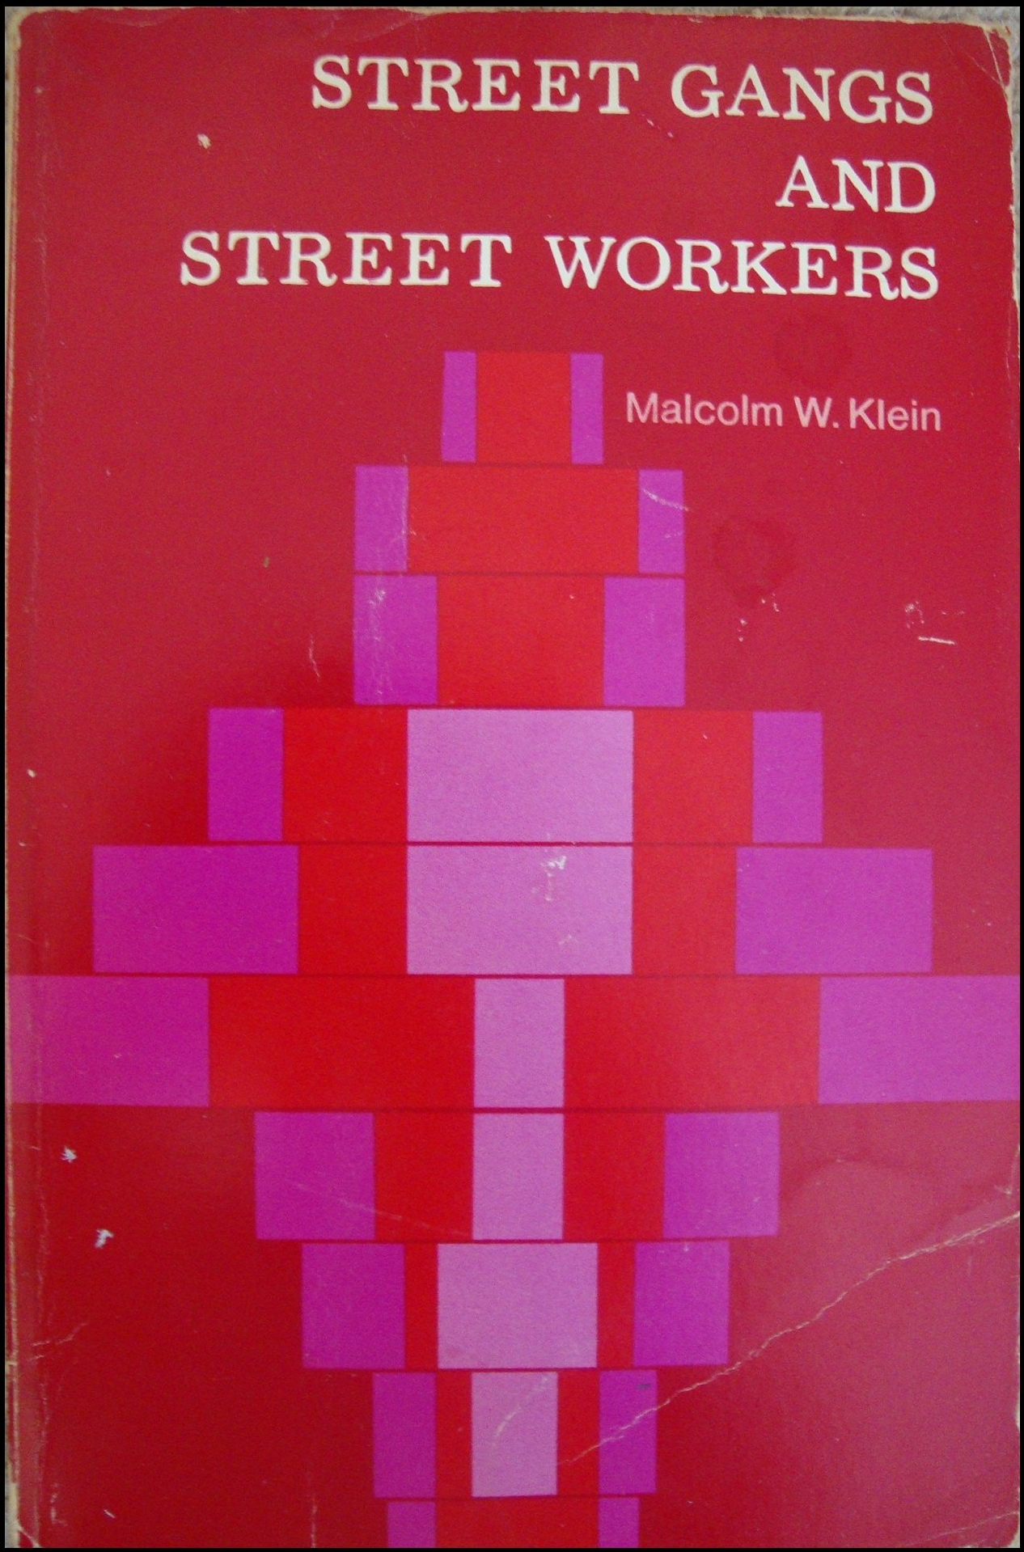

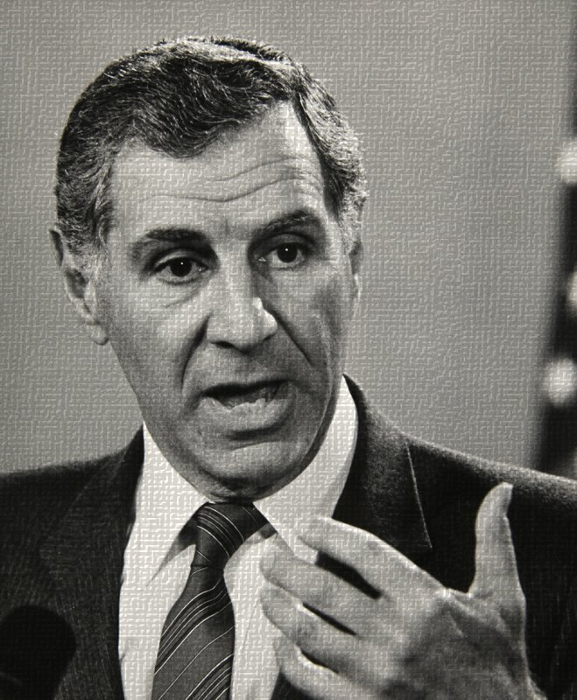
From Play Groups to Problem Groups .
[A juvenile gang is] any denotable adolescent group of youngsters who
are generally perceived as a distinct aggregation by others in their neighborhood,
recognize themselves as a denotable group (almost invariably with a group name), and
have been involved in a sufficient number of delinquent incidents to call forth a consistent negative response from neighborhood residents and/or enforcement agencies
- Klein (1971: 13), Street Gangs and Street Workers
“Criminal street gang” means any:
ongoing organization, association, or group of three or more persons,
whether formal or informal,
having as one of its primary activities the commission of one or more of the criminal acts enumerated in paragraphs (1) to (25), inclusive, or (31) to (33), inclusive, of subdivision (e),
having a common name or common identifying sign or symbol, and
whose members individually or collectively engage in, or have engaged in, a pattern of criminal gang activity.
- California PC Street Terrorism Enforcement and Prevention Act 186.22 (f)

Slide 9


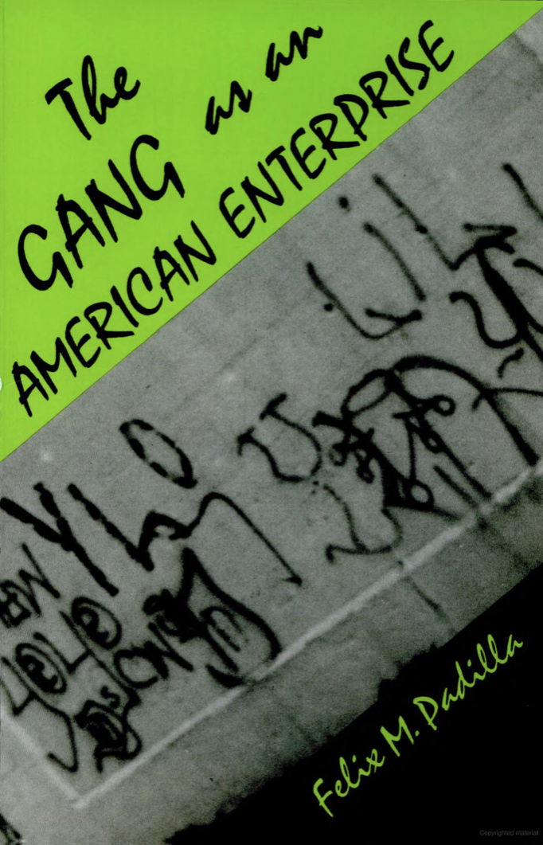
Deindustrialization .
1987 1991 1992

Slide 10
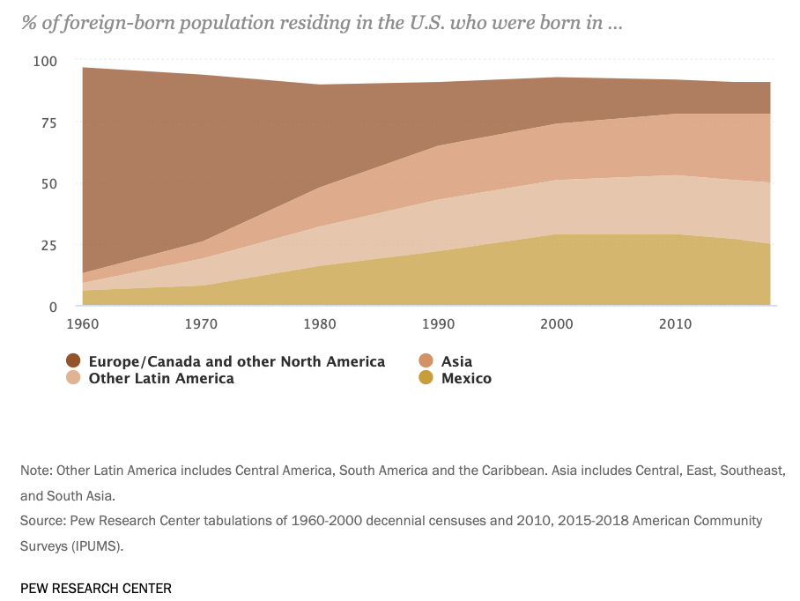
Migration, Assimilation, and Segregation .
The rise of hypersegregation
Emerging underclass
Stuck in place
End of “White” urban street gang
European migration diminished
Ethnic Europeans became White Americans
White flight
The rise of Asian and Latino immigration
Straight-line assimilation
Segmented assimilation
Consonant
Dissonant
Selective

Slide 11
Migration, Assimilation, and Segregation .
The rise of hypersegregation
Emerging underclass
Stuck in place
End of “White” urban street gang
European migration diminished
Ethnic Europeans became White Americans
White flight
The rise of Asian and Latino immigration
Segmented assimilation
Consonant
Dissonant
Selective
1920s Chicago | Gangs Count | Share of gangs
Mixed nationality | 351 | 40%
Polish | 148 | 17%
Italian | 99 | 11%
Black | 63 | 7%
American White | 45 | 5%
Jewish | 20 | 2%
Slavic | 16 | 2%
Bohemian | 12 | 1%
German, Swedish, Lithuanian, etc. | 26 | 4%
2010 | NYGS Gang Share | USA Pop. share
Black | 35% | (13%)
White | 12% | (64%)
Latino | 46% | (16%)
Other | 7% | (7%)

Slide 12
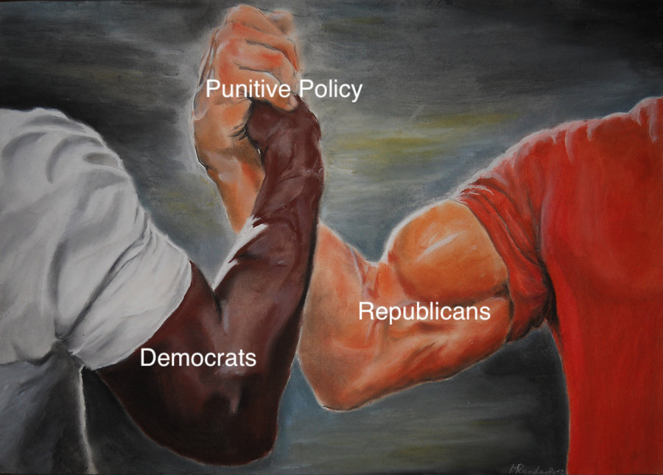
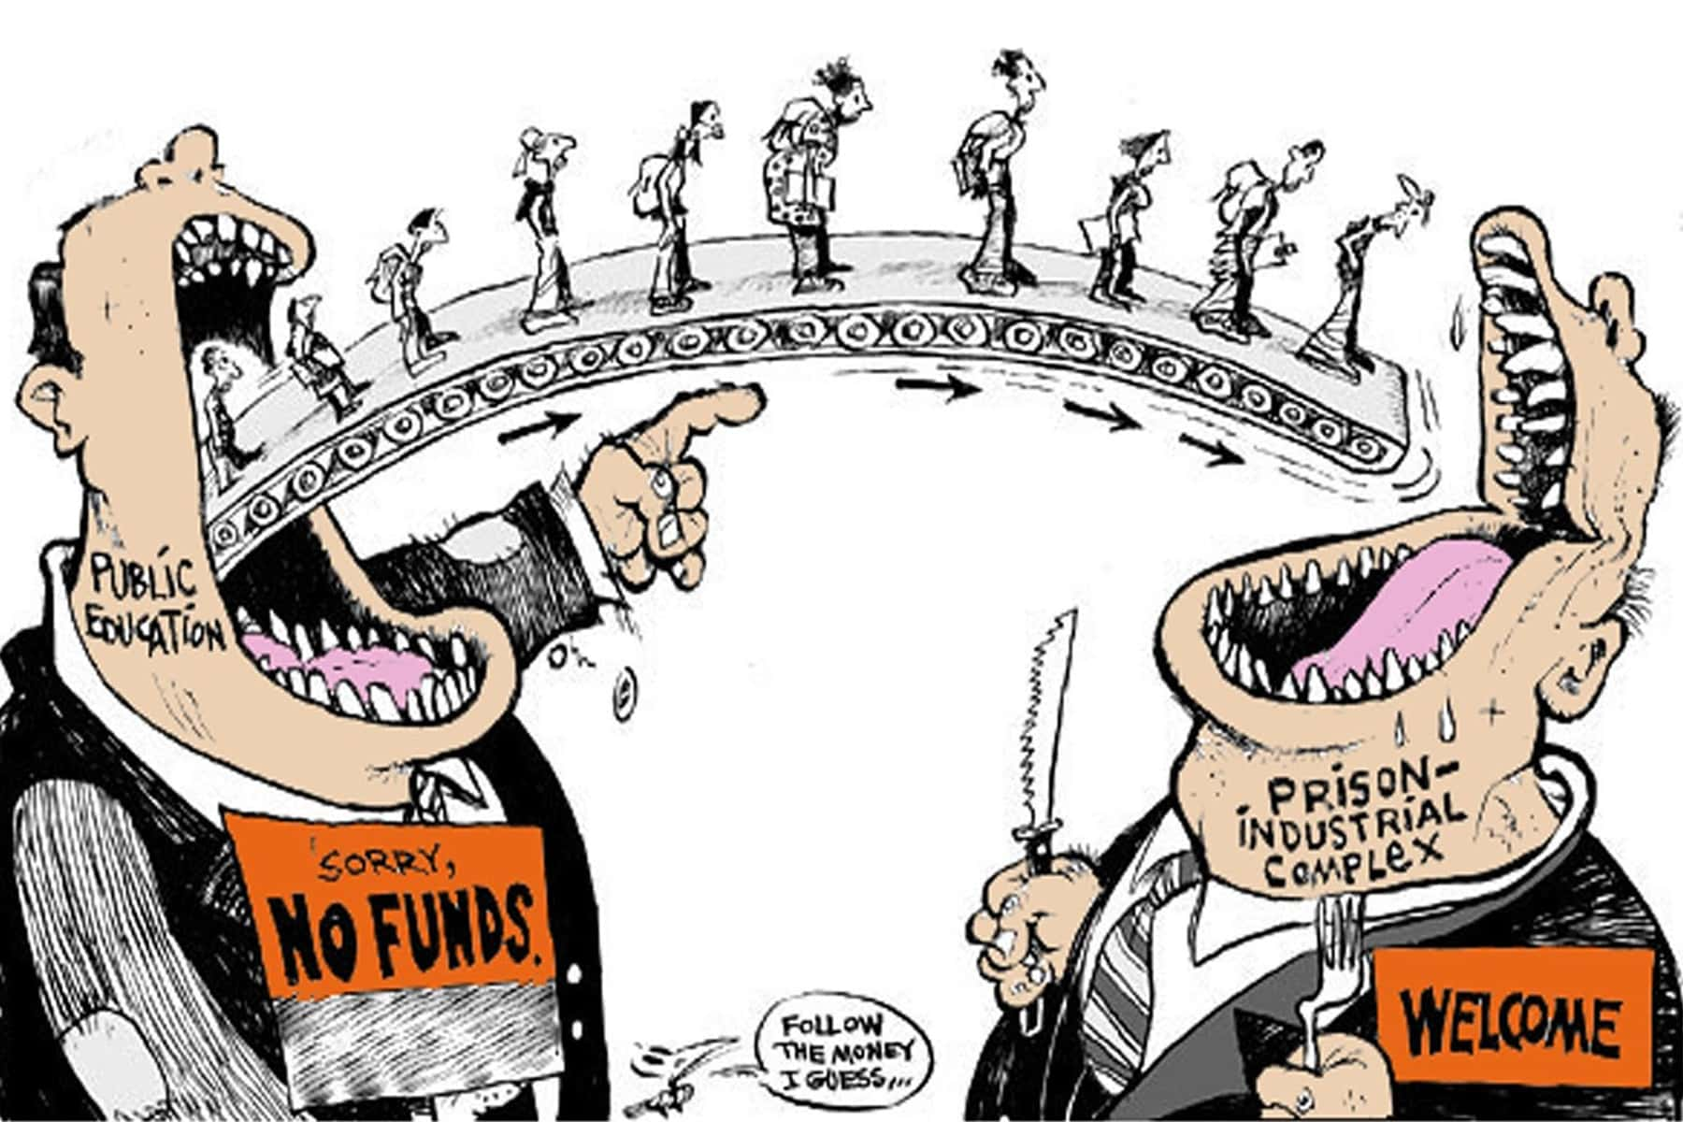
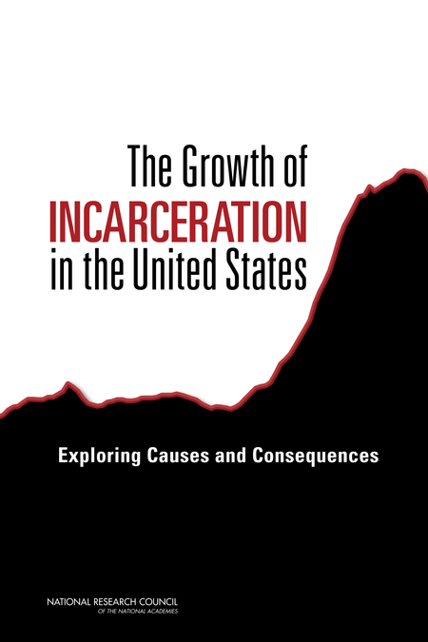
Mass Incarceration and the Rise of the Punitive State .

Slide 13
Mass Incarceration and the Rise of the Punitive State .
Definitions
Gang: 46
Member: 18
Databases: 12
Enhancements
Felony: 33
Misdemeanor: 5
Criminalization
Recruitment: 36
Membership: 14
“[T]he State of California is in a state of crisis which has been caused by violent street gangs whose members threaten, terrorize, and commit a multitude of crimes against the peaceful citizens of their neighborhoods...It is the intent of the Legislature in enacting [STEP Act] to seek the eradication of criminal activity by street gangs.”
- California Penal Code 186.21
Notes:
What happened after 1988? A lot.
In the matter of 25 years, another 44 states and the federal government enacted legislation
Regional influence?
Pacific west, Atlantic South, Midwest, South (western), Midwest, Midwest, West (Mountain), South (Western)
Northeast? Connecticut in 1993, Massachusetts in 1996
Political orientation
Mixed bag in terms of political part (CA was Republican governor in a Democratic state, Florida a Democratic governor in a Republican state. It’s something worth looking into more, but remember: get tough neoliberalism was sweeping the country

Slide 14
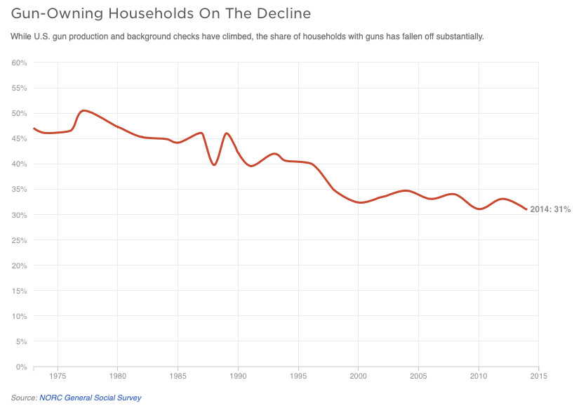
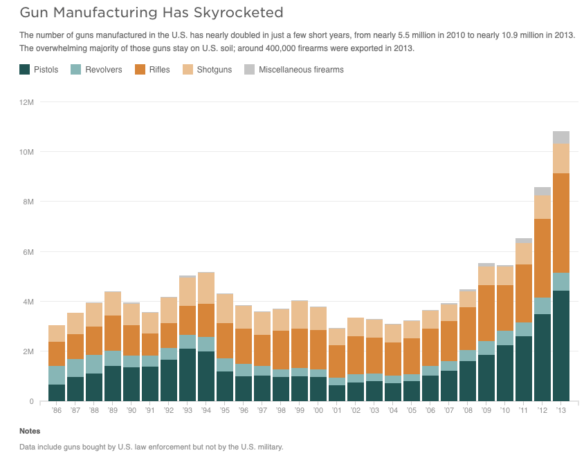
Gun Availability .

Slide 15
Gun Availability .

Slide 16
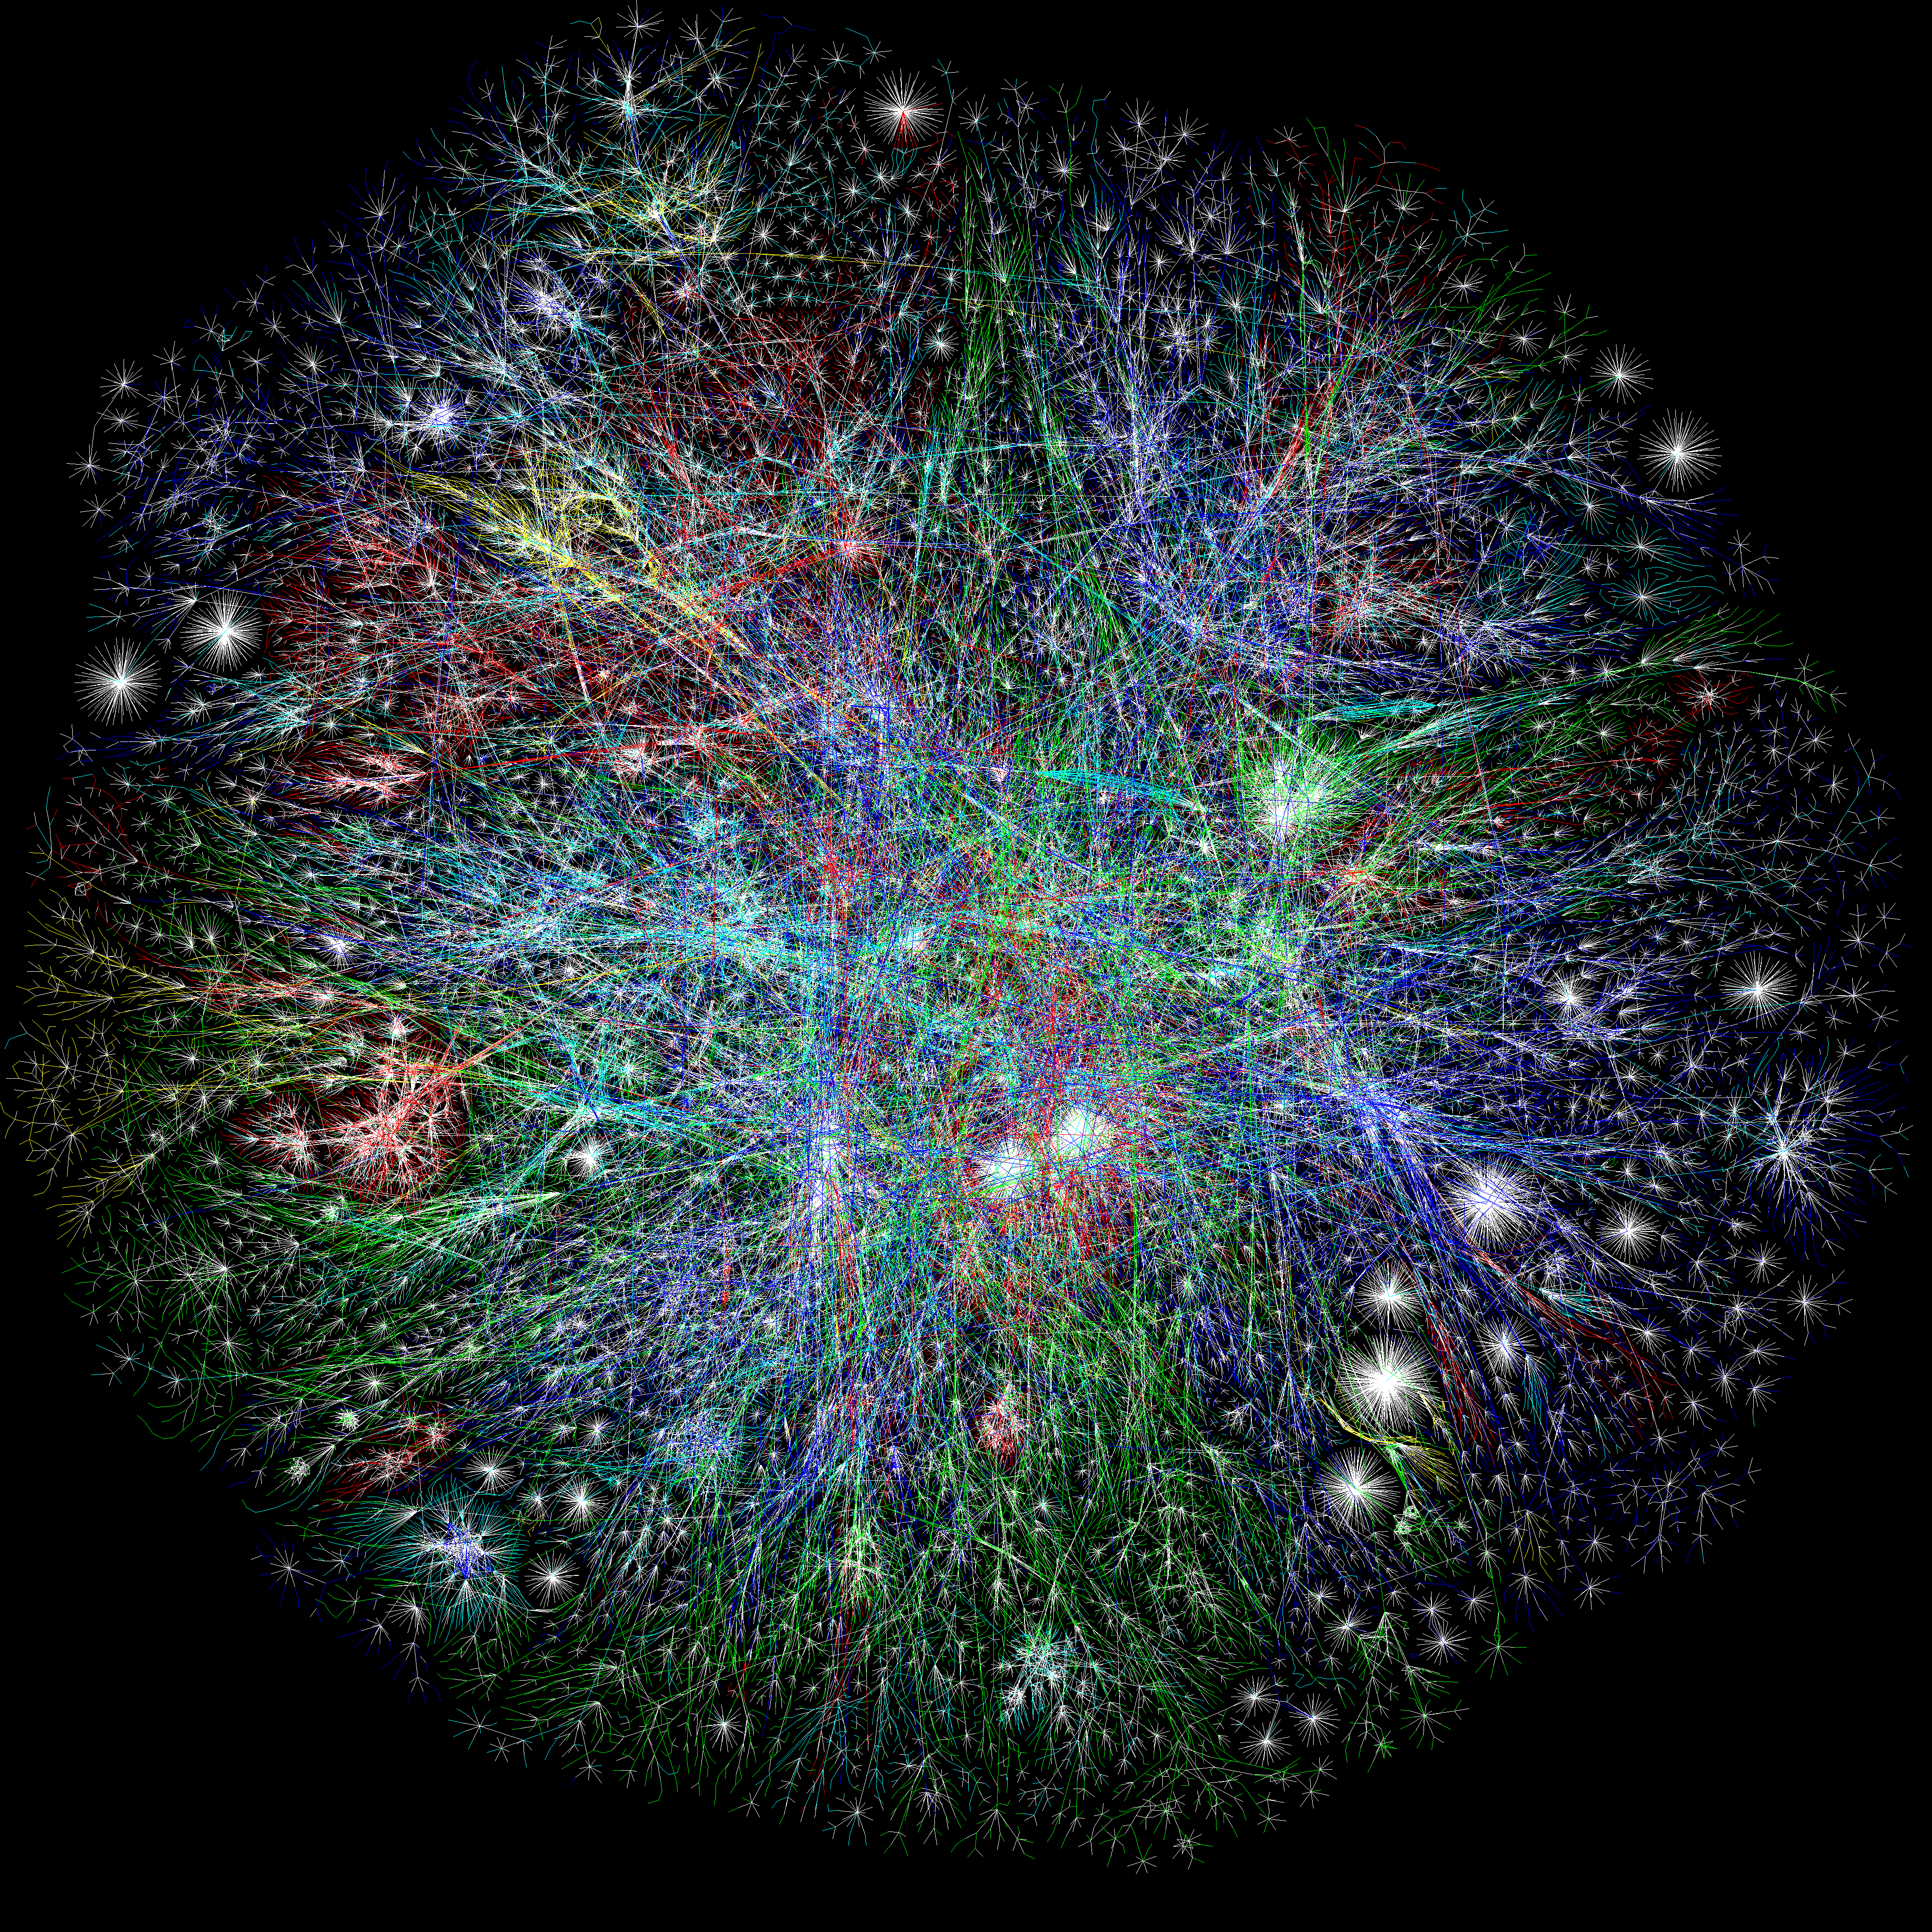
Internet and Social Media .
“Still, few gang members ever discuss or mention the Internet. Many don’t possess the hardware, software, or technical skills (not to mention the necessary telephone line) to manage the web.”
- Papachristos (2005)
“What the fuck is a Facebook”
-Latina, 33, former gang member, Los Angeles 2011, interviewed after serving 11-year prison sentence)

Slide 17
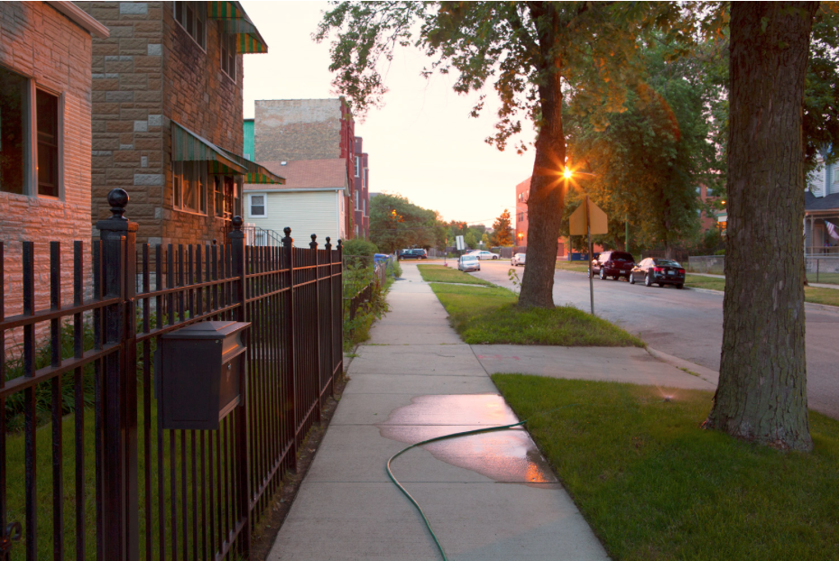

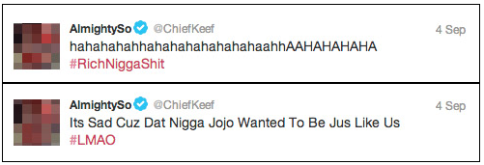
Internet and Social Media .
Fall 2012
Chief Keef
Black Disciples gang
rapper, $6m Interscope record deal
In song, 3HUNNA:
“Fucka Tooka gang, I’m 3hunna”
Lil JoJo
Gangster Disciples gang
rapper
In song, 3HUNNAK:
“Niggas claim 300 but we BDK”
Twitter video of verbal exchange between Lil JoJo and unknown person: “Ima kill you”
Lil JoJo is shot dead shortly after, riding a bicycle

Slide 18

Context

Slide 19
The Prevalence of Gang Involvement .
Research-based
Method: survey/interview
Are you a member of a gang?
Is your group of friends a gang?
Eurogang: 5 indicators (no “g” word)
Prevalence in national studies:
NLSY97: 8% (by early 20s)
Add Health: 5% (by high school years)
Prevalence in regional studies:
G.R.E.A.T. 2: 13% (by high school years)
Rochester: 30% (by age 18)
Seattle: 15% (by age 18)
Denver: 15% (by early 20s)
Pittsburgh: 19% (boys, late teens, early 20s)
Criminal justice-based
Method: indicators/source items
Self-admission
Possessions (clothing, property)
Physical embodiments (tattoos, branding)
Associations (photos, communication, graffiti)
Observations (court records, informants, co-offending)
Prevalence in national studies:
Police/NYGS (2012): 0.3%, or 0.8% (ages 10-34)
Prison (2016): 15%

Slide 20
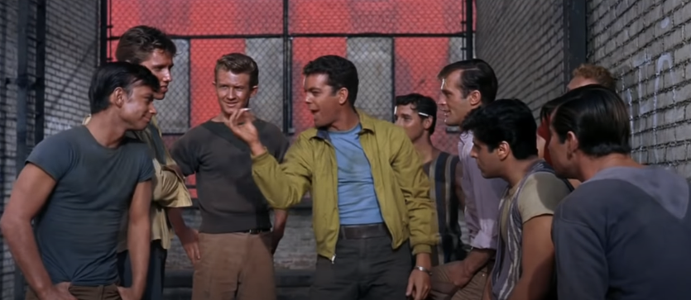
“From your first cigarette to your last dyin’ day” .

Slide 21
Duration of Involvement .
Authors (Year) | Study Years, Site | Sample Type | N | 1 year | 2 years | 3 years | 4+ years
Thornberry et al. (2003) | 1988-1992, Rochester, NY | High-risk, Youth | 207 | 55% | 28% | 12% | 5%
Hill et al. (2001) | 1988-1993, Seattle, WA | High-risk, Youth | 124 | 69% | 17% | 11% | 3%
Leverso & Matsueda (2019) | 1989-1998, Denver, CO | High-risk, Youth | 226 | 57% | 22% | 12% | 10%
Gordon et al. (2004) | 1991-2002, Pittsburgh, PA | High-risk, Youth | 165 | 48% | 25% | 27% | ---
Melde et al. (2012) | 1995-1999, 6 U.S. cities | School, Youth | 140 | 58% | 34% | 6% | 2%
Pyrooz (2014) | 1997-2005, USA | Population, Y/A | 726 | 49% | 23% | 11% | 17%
Pyrooz et al. (2013) | 2000-2010, Philadelphia-Phoenix | Delinquent, Y/A | 226 | 62% | 13% | 8% | 16%
Weerman et al. (2015) | 2002-2004, Hague, The Netherlands | School, Youth | 73 | 78% | 21% | 1% | ---
Melde & Esbensen (2014) | 2006-2011, 7 U.S. cities | School, Youth | 512 | 63% | 20% | 9% | 8%

Slide 22
Duration of Involvement .

Slide 23
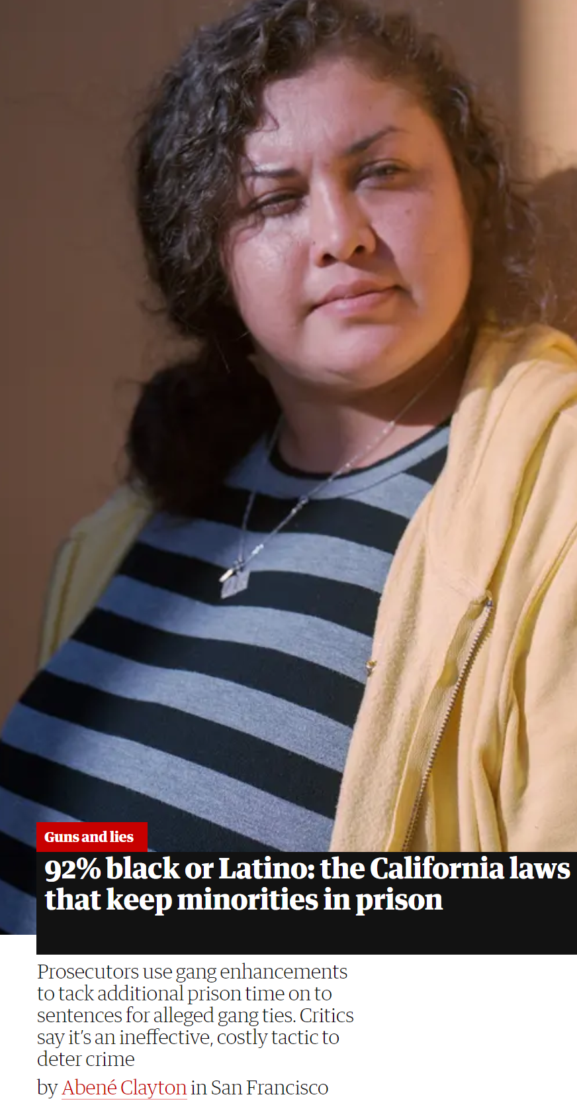
Race, ethnicity, and Gangs .
 | City | Boston¹ | Chicago² | Los Angeles³ | New York⁴ | Portland⁵
Database | Year | 2019 | 2018 | 2019 | 2018 | 2016
 | N | 5,300 | 123,242 | 19,249 | 18,084 | 359
White | % of Gang | 2.3 | 4.0 | 2.5 | <1.0 | 18.3
 | % of City | 44.5 | 32.7 | 28.5 | 32.1 | 70.5
 | Risk Ratio | 0.05 | 0.1 | 0.1 | 0.03 | 0.3
Black | % of Gang | 76.1 | 69.8 | 36.5 | 66.0 | 64.1
 | % of City | 25.3 | 30.5 | 8.9 | 24.3 | 5.8
 | Risk Ratio | 3.7 | 2.3 | 4.1 | 2.7 | 11.0
Hispanic | % of Gang | 14.1 | 25.2 | 58.2 | 31.7 | 12.8
 | % of City | 19.7 | 29.0 | 48.6 | 29.1 | 9.7
 | Risk Ratio | 0.7 | 0.9 | 1.2 | 1.1 | 1.3
Sources
1 https://www.wbur.org/news/2019/07/26/boston-police-gang-database-immigration
2 https://igchicago.org/wp-content/uploads/2019/04/OIG-CPD-Gang-Database-Review.pdf
3 CalGang LAPD data only. https://oag.ca.gov/calgang/reports
4 https://www.hrw.org/news/2020/09/22/groups-urge-nypd-inspector-general-audit-nypd-gang-database#_ftn12
5 https://projects.oregonlive.com/police/gang-list/
U.S. Census Bureau

Slide 24
Race, ethnicity, and Gangs .
 | N | % in gang | % of gang members | % of non-gang members
White | 4551 | 6.2% | 52.4% | 68.1%
Black | 1106 | 11.7% | 24.2% | 15.7%
Hispanic | 919 | 11.6% | 20.0% | 13.1%
Asian | 158 | 7.6% | 2.2% | 2.3%
Native American | 55 | 10.9% | 1.1% | 0.8%
Total | 6,748 | 7.9% | 100% | 100%

Slide 25
Gender and Gangs .
Study sample | Sample type | Gang members: % female | Reference
Gang Resistance Education and Training II (GREAT II) | School youth, ages 11 to 15, seven U.S. cities | 40% | Esbensen & Carson (2012)
Gang Resistance Education and Training I (GREAT I) | Middle school youth surveyed in 11 U.S. cities | 38% | Esbensen et al. (1999)
Ethnographic study of East Los Angeles gangs | Rosters of two gangs: White Fence & Hoyo Maravilla | 33% | Moore (1991)
National Longitudinal Survey of Youth (NLSY), 1997 | Nationally-representative sample of youth born 1980-84 | 29% | Pyrooz (2014)
Arrestee Drug Abuse Monitoring (ADAM) | Juvenile arrestees surveyed in Maricopa County, AZ facilities | 17% | Decker et al. (2008)
Fresno County, CA jail | Adult inmates surveyed in Fresno County, CA jail | 16% | Kissner & Pyrooz (2009)
Florida County jails | Adult inmates surveyed in Florida jails | 15% | Fox et al. (2010)
National Gang Center | Nationally-representative sample of 3,018 police agencies | 6% | https://www.nationalgangcenter.gov/Survey-Analysis/Demographics#anchorregm
California police departments | CalGang database, listed 2017-2018 | 6% | https://oag.ca.gov/sites/all/files/agweb/pdfs/calgang/ag-annual-report-calgang-2018.pdf
St. Louis area police departments | Police gang intelligence list, entry 1993-2003 | 2% | Tostlebe et al. (2020)

Slide 26
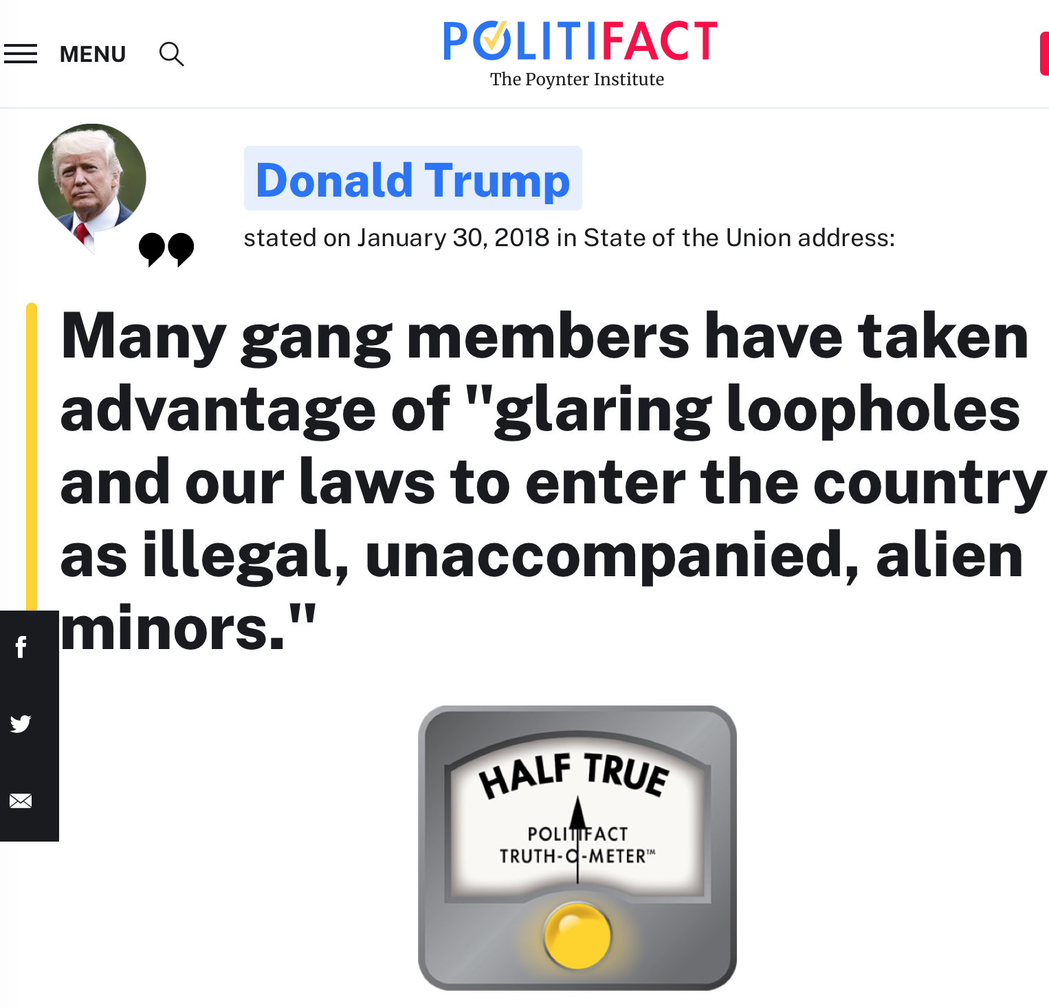
Immigrants and Gangs .
% in Gang | All Groups | White | Black | Hispanic | Asian | Native American
First gen. | 5.6% | 2.7% | 4.2% | 7.1% | 4.8% | 0.0%
Second gen.% | 7.6% | 4.7% | 13.0% | 10.1% | 4.9% | 0.0%
Third+ gen. | 7.6% | 6.0% | 11.5% | 13.7% | 22.2% | 11.9%
 | Denominators
First gen. (N) | 338 | 75 | 24 | 182 | 62 | 4
Second gen. (N) | 605 | 233 | 54 | 267 | 61 | 4
Third+ gen. (N) | 5084 | 3802 | 866 | 379 | 9 | 42

Slide 27
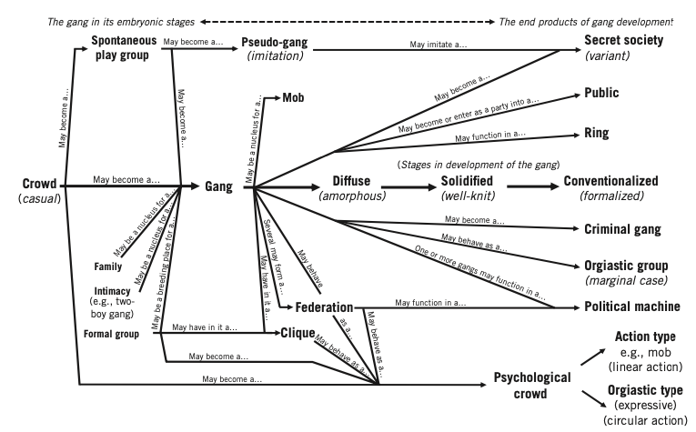
“No Two Gangs Are Just Alike” .

Slide 28
Forms and Functions .
Informal-diffuse |  |  | Instrumental-rational
Recreation Stage | Criminal Stage | Enterprise Stage | Governance Stage
Focal areas of consideration:
Leadership (centralization, chain of command)
Roles (defined, differentiation, tasks, expectations)
Rules (informal and formal, punishment, secrecy)
Meetings (coordination, planning, decision-making)
Control (territory, violence, manipulation, intelligence)
Money (monopoly, reinvestment, risk diffusion)

Slide 29
Gang Violence .
Gang-Related v. Gang-Motivated
But . . . Life in the Gang
Klein on his observations in Los Angeles:
“We learned much about gang member life which, with the occasional exception of a boisterous meeting, a fight, an exciting rumor, is a very dull life”
“For the most part, gang members do very little—sleep, get up late, hang around, brag a lot, eat again, drink, hang around some more”
“It’s a boring life; the only thing that is equally boring is being the researcher watching gang members”
Different from non-gang violence
Younger
Males
Street-based
Weapons
More suspects, more victims
No suspect/victim relationship
Gang homicides in the United States
NYGS: Around 13% of U.S. homicides are gang-related
NYGS: 25% in larger (>100k) cities
STL: gang member homicide rate 950 per 100,000
3x higher than black males in STL
50x higher than all U.S. males

Slide 30
Kinds of People? Kinds of Groups? .
Within-Persons
(Future v. Current v. Former Gang)
Crime and violence
~200 studies
Enhancement
Victimization
~ dozen studies
Enhancement
Education, employment
~ half-dozen studies
Enhancement
Mental health
~ half-dozen studies
Enhancement
Entry
Exit
Selection
Between-Persons
(Any Gang v. Non-Gang)
Delinquency
Enhancement
Facilitation
Time

Slide 31

Nothing Works? .
Inventory of effective gang interventions ~2005
.
.
.
.
.
What works? Who knows?
We have spent “over half a century responding to gang-related crime with programs and policies. It is a shame we haven’t spent nearly as much time trying to figure out if they work” (Miller 1982)
A single sentence summary of gang interventions: “You can’t find the program” (Ron Huff, late 1990s)
All interventions appear promising because they have been subject to rigorous evaluation (Klein and Maxson, 2006)
Fortunately, times have changed

Slide 32
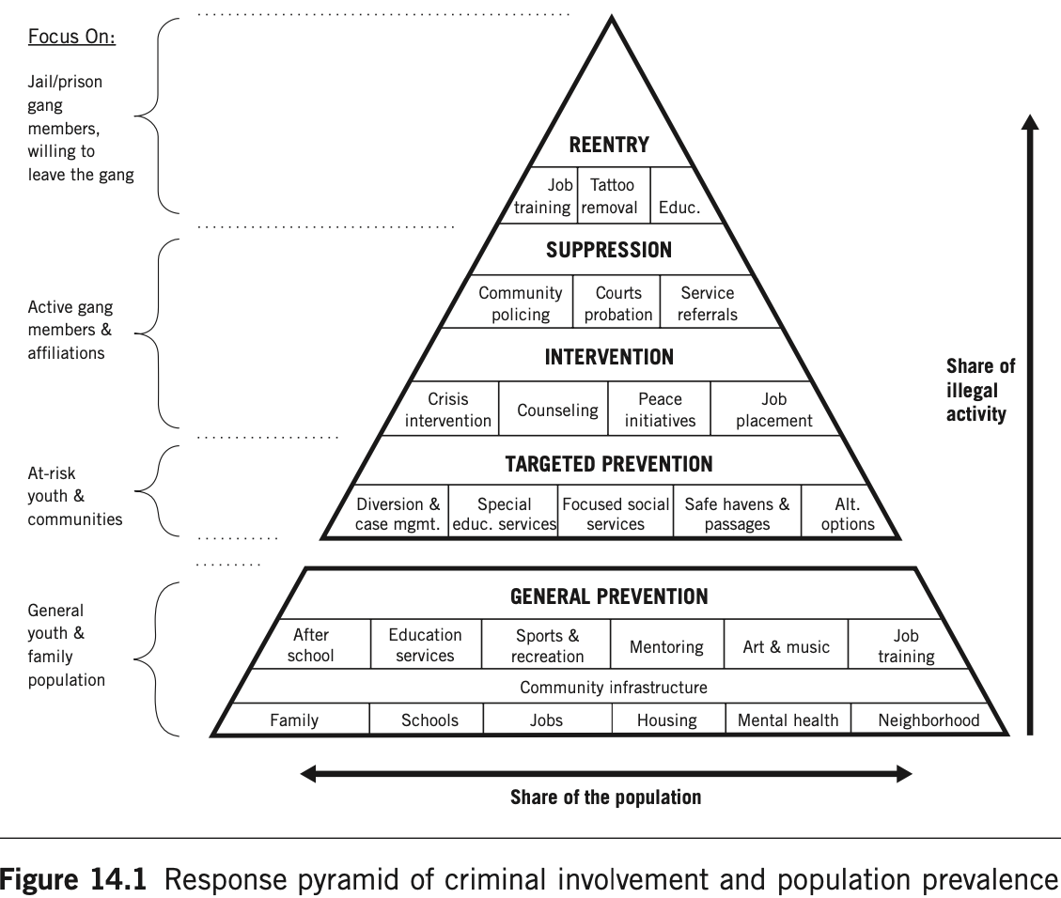
What Works? .
Experimental or Repeated Quasi-Experimental
Group Violence Intervention
Braga et al. (2018)
Boston, Chicago*2, Cincinnati*2, Indianapolis, Kansas City, Los Angeles, Lowell, New Haven, New Orleans, Rochester, Stockton
Functional Family Therapy-Gangs
Thornberry et al. (2018), Gottfredson et al. (2018)
Philadelphia
Gang Resistance Education and Training
Esbensen et al. (2012), Esbensen et al. (2013)
Albuquerque, Chicago, Dallas-Fort Worth, Greeley, Nashville, Philadelphia, Portland

Slide 33
What Looks Promising? .
One-Off Quasi-Experimental
Gang crackdowns/takedowns
Chalfin et al. (2021), Ratcliffe et al. (2017)
Los Angeles, New York City
Civil gang injunctions
Grogger (2002). Ridgeway et al. (2018)
Los Angeles
Gang Reduction Youth Development
Brantingham et al. (2018; 2021)
Los Angeles
Cure Violence
Butts et al. (2015), Fox et al. (2015), Maguire et al. (2018), Roman et al. (2018), Skogan et al. 2008
Baltimore, Chicago, Phoenix, New York City, Trinidad and Tobago
Comprehensive Gang Model
Gebo et al. (2015); Spergel (2007)
Bloomington, Chicago, Mesa, Riverside, San Antonio, Tucson

Slide 34
What Could Be Promising? .
Awaiting Further Evaluation
“Reach-in” reentry services
Cook et al. (2015)
Milwaukee
Prison-based Gang Renouncement and Disassociation
Pyrooz and Decker (2019)
Texas
Anti-gang legislation
No evaluations
45 states, federal government
Relationship-based mentorship (e.g., GRID)
Pyrooz et al. (2019)
Denver
Clinical intervention (e.g., MST)
Boxer et al. (2015; 2017)
7 eastern states
Jobs (e.g., Homeboy Industries, Conservation Corps)
Leap et al. (2010)., Sayegh et al. (2019)
Los Angeles

Slide 35
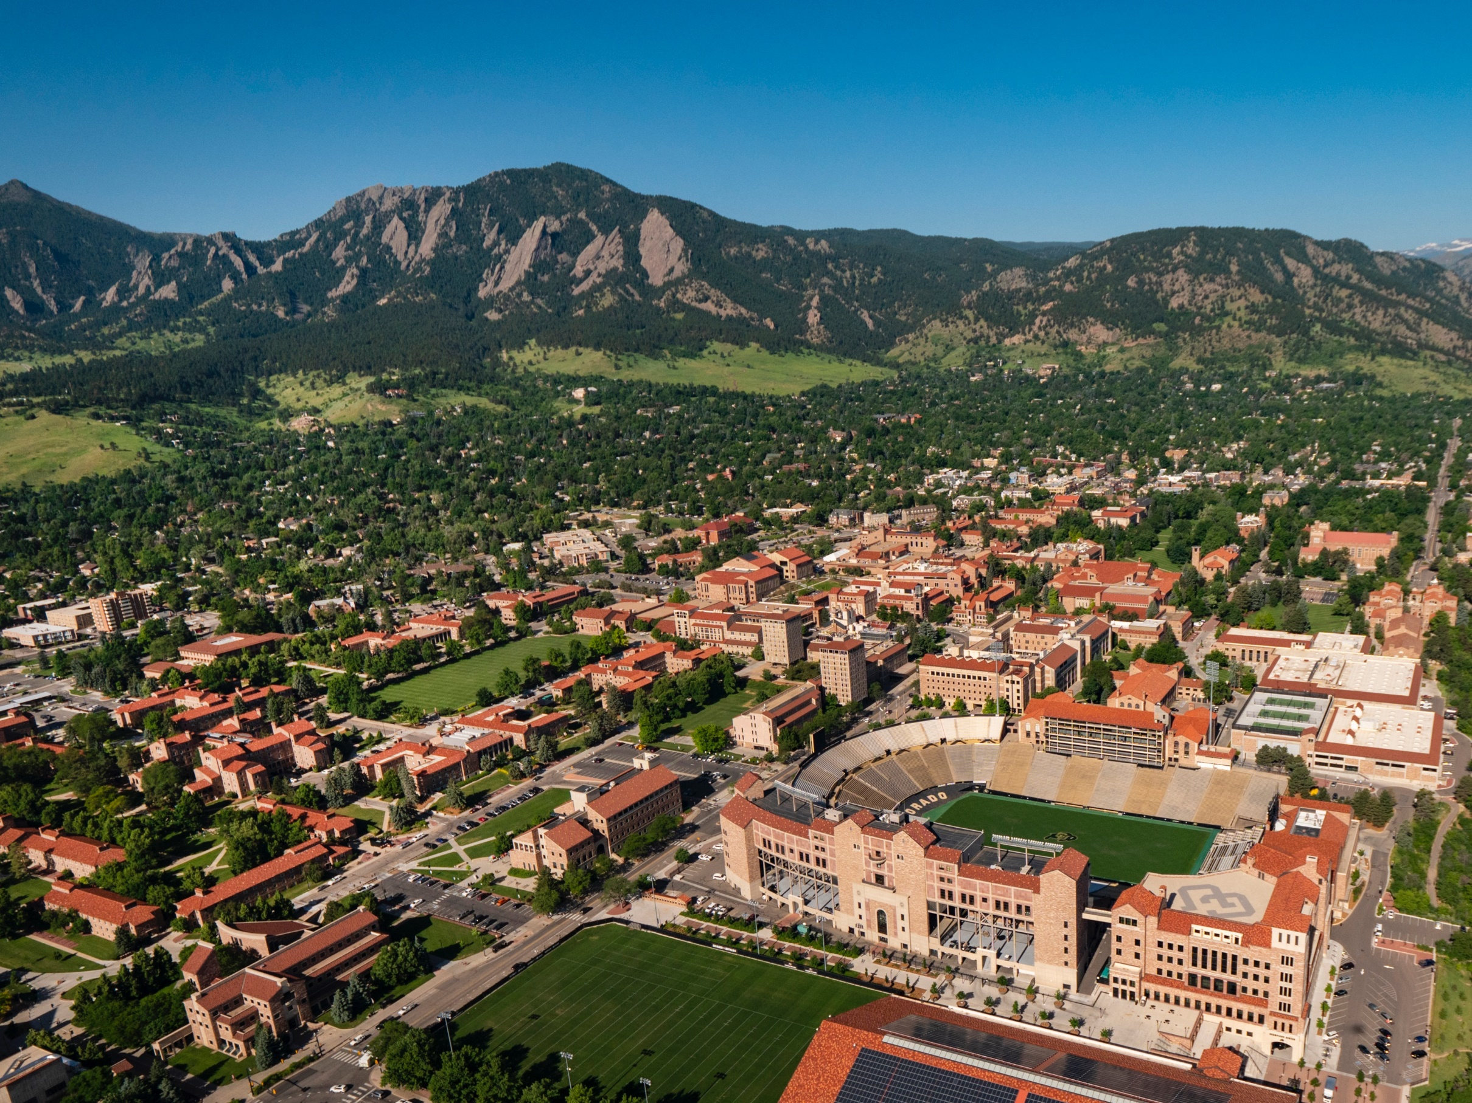
Thank you
David.Pyrooz@colorado.edu
@dpyrooz
Department of Sociology
Institute of Behavioral Science
483 UCB
Boulder, CO 80309
303-492-3241
Notes:
Add citations

