Slide 1


Slide 2

Criminal Justice in the Age of George Floyd
National Press Foundation
November 15, 2021
Walter Katz, Vice President of Criminal Justice
@wkatz_1

Slide 3

Who we are.
Arnold Ventures is a philanthropy dedicated to tackling some of the most pressing problems in the United States with the core mission of investing in evidence-based solutions that maximize opportunity and minimize injustice.

Slide 4
What we do.
We invest in sustainable change, building it from the ground up based on research, deep thinking, and a strong foundation of evidence. We drive public conversation, craft policy, and inspire action through education and advocacy.

Slide 5
Policing Framework
Policing Vision
Advance reforms with the aim that police act in service to their communities by promoting community safety with reverence for life and dignity and upholding constitutional and human rights of all persons regardless of race, ethnicity, identity, or economic status.
Issue Areas
Improving Police Accountability
Community Safety
Portfolios
Structural Barriers
Crisis Response
Violence Reduction
Gun Violence Research
Notes:
Takeaway: Remind Board of Vision and Framework for the Policing Strategy, as shared with the Board June 25.
The underlying motivator for the initiative has not changed since the summer: Policing is insufficiently accountable and long-standing structural impediments stand in the way of reform.
(We seek to advance reforms that allow police to act in service to their communities with reverence for life and dignity and upholding the constitutional and human rights of all persons.)
In our June strategy memo, we identified critical challenges in how policing is currently practiced in the United States, including: (1) policing is conducted in racially disparate ways against Black, Brown and Indigenous people, (2) law enforcement is overly reliant on punitive measures, including arrest and use of force, (3) police have resisted transparency and fail to hold themselves accountable to the people they serve, and (4) structural and cultural impediments to reform pose significant challenges to improving policing.
We will will return in the Spring with the other parts of the accountability strategy that we are developing.

Slide 6

Overarching questions.
What is happening in the criminal justice system that requires our attention?
Why does violence concentrate?
Why are victims of police violence disproportionately Black and Brown people?
With 18,000 police departments, how do we advance police reforms?

Slide 7
Why we care about violence in America
1
Violence is the leading cause of death among young black men
2
Many crimes are never reported - about 40% of Americans who were a victim of a violent crime involving a weapon did not report the crime to the police
3
More than half of all murders of black Americans never led to an arrest
4
The annual cost of gun violence to the US economy is approximately $100B
Notes:
“Many crimes are never reported - about 40% of Americans who were a victim of a violent crime involving a weapon did not report the crime to the police”
In 2018
From BJS report Criminal Victimization, 2018 (page 8, table 5)
---
Problem Statement - [Walter - Please adjust talking points as you see fit]
There are several challenges and harmful consequences associated with violence:
While violent crime has declined across the country, it is highly focused in neighborhoods with concentrated disadvantages.
And in these neighborhoods, young Black men are five times more likely to be victims of homicide
In fact, homicide is the leading cause of death among black males ages 15 to 24.
Many crimes are never reported
One reason cited for this underreporting, is a lack of confidence in police.
Many crimes go unsolved.
A Washington Post investigation found that across 52 of the nation’s largest cities over the past decade, 53% of all murders of African Americans never led to an arrest, let alone a conviction
The cost of gun violence alone is in the billions of dollars

Slide 8
PEOPLE
PLACES
.75%
5%
Baltimore
.75% group-involved but connected to 58% of homicides
Boston
70% of shootings can be attributed to 5% of street corners

Slide 9
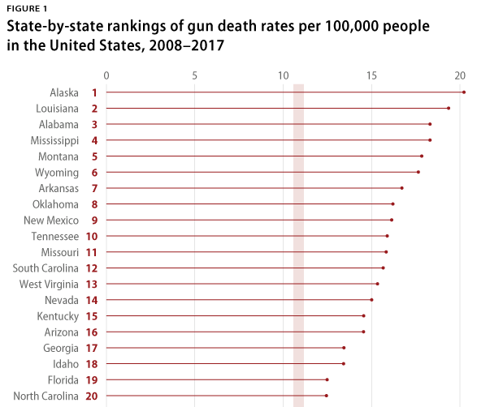
Southern and Western states dominate in gun death rates.
Source: Center for American Progress analysis of Centers for Disease Control and Prevention Data

Slide 10
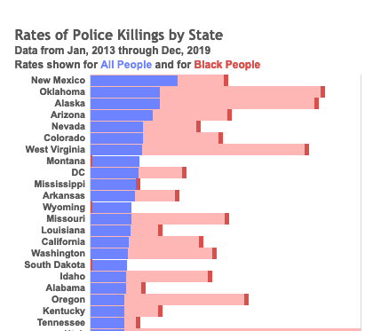
Similarly to overall gun deaths rates, Southern and Western states have higher rates of police killings.
Source: Mapping Police Violence, State Comparison Tool

Slide 11
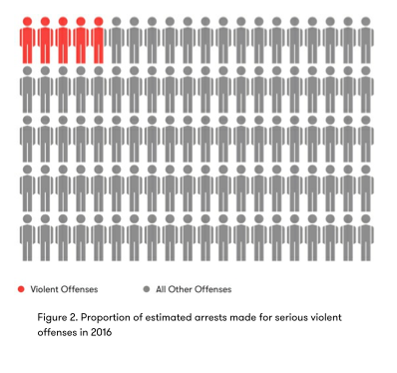
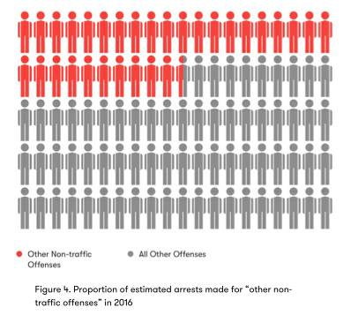
Police Activity is Often Misplaced
Source: “Every Three Seconds,” Vera Institute for Justice

Slide 12
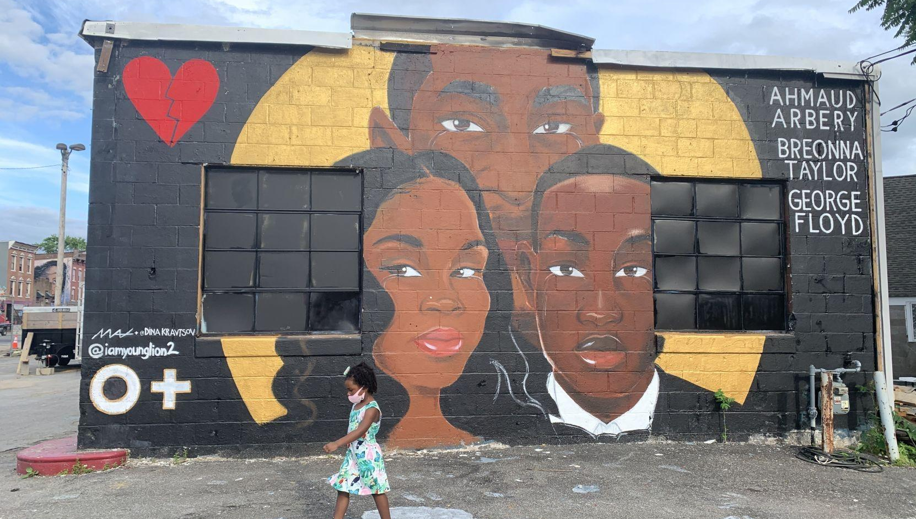


Slide 13

People Remember

Slide 14
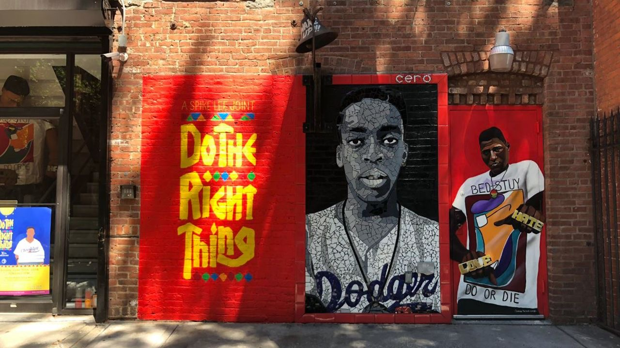

Slide 15

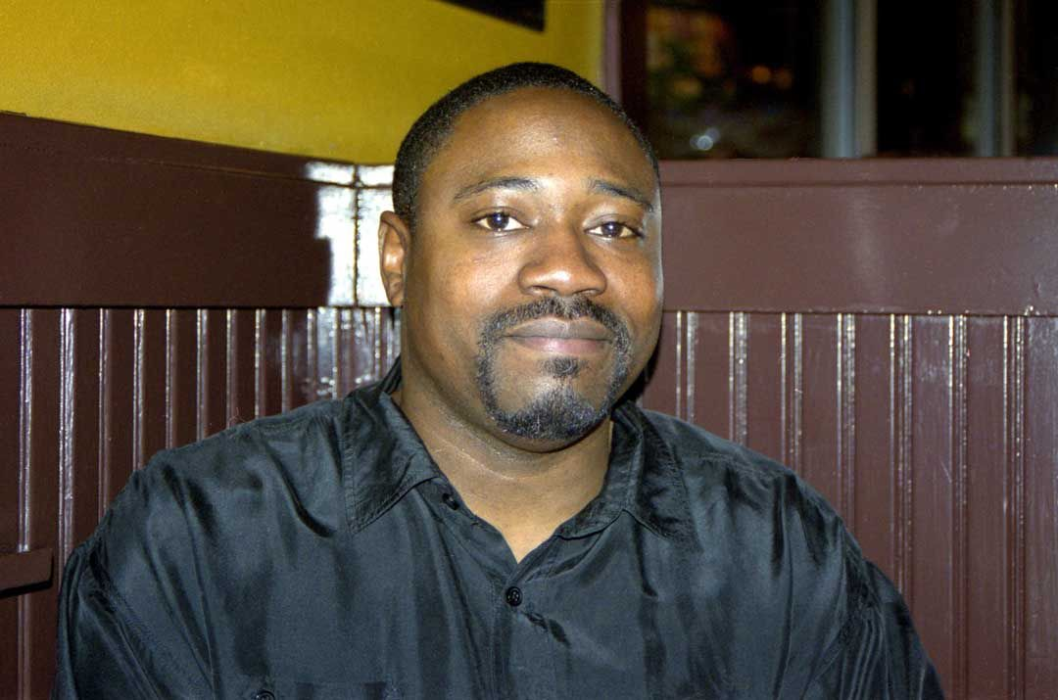
Communal History
Walter Scott, 1965-2015
Jonathan Ferrell, 1988-2013

Slide 16
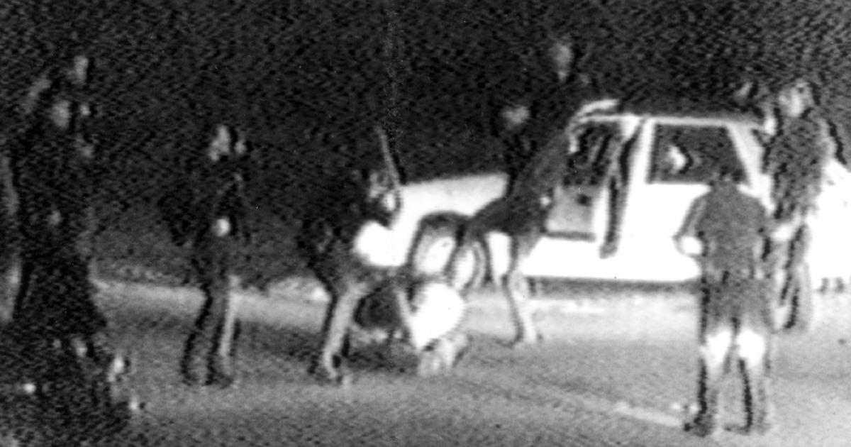
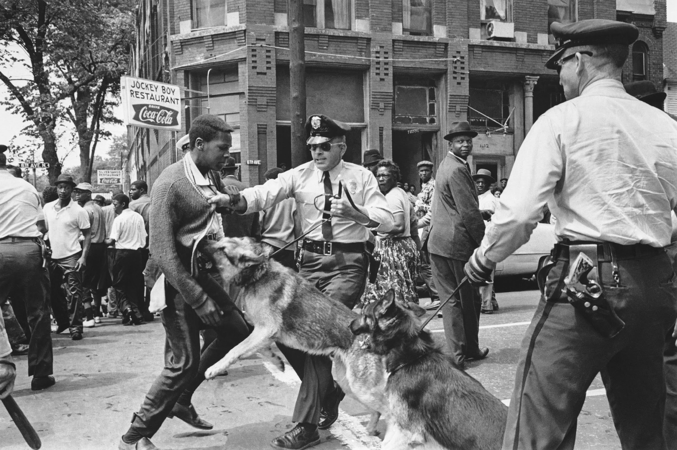
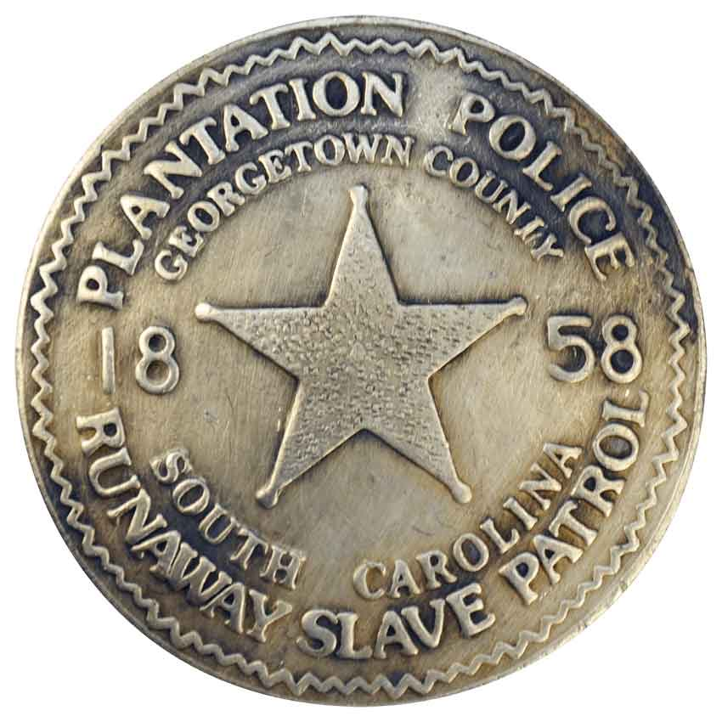
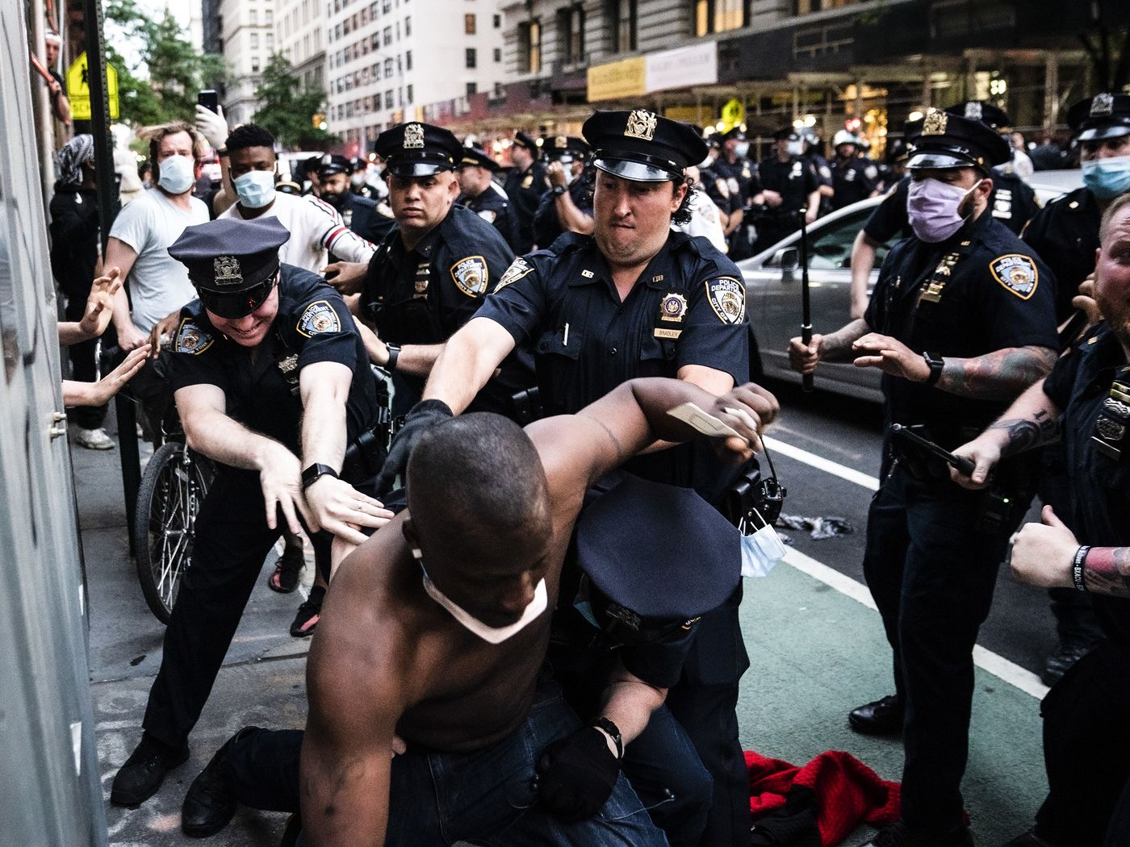
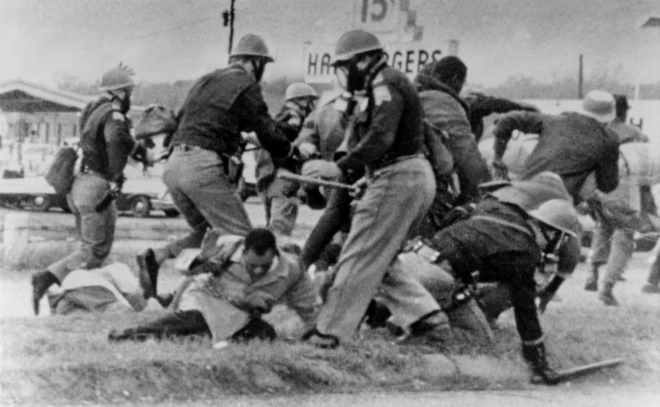
History Informs the Present

Slide 17
Accountability Strategic Priorities
1
Strengthen accountability systems
2
Increase transparency and community participation
3
Reduce use of force
4
Decrease racial disparities
Notes:
Topline: Remind Board of Vision and Framework for the Policing Strategy. We have further synthesized that goal into four strategic priorities: decrease disparatiesOur strategy continues to aim to advance policy at the state level that regulates policing and removes barriers to accountability).
Strengthen the regulation of law enforcement through use of force standards, officer certification and decertification standards, and data reporting and transparency requirements; and (2) remove provisions found in collective bargaining agreements and law enforcement officer bills of rights that inhibit accountability and transparency.

Slide 18
Three-part Accountability Strategy
1
Build the evidence base
2
Advance regulation of key aspects of policing
3
Connect policymakers with information
Notes:
Topline: Remind Board of Vision and Framework for the Policing Strategy. We have further synthesized that goal into four strategic priorities: decrease disparatiesOur strategy continues to aim to advance policy at the state level that regulates policing and removes barriers to accountability).
Strengthen the regulation of law enforcement through use of force standards, officer certification and decertification standards, and data reporting and transparency requirements; and (2) remove provisions found in collective bargaining agreements and law enforcement officer bills of rights that inhibit accountability and transparency.

Slide 19
Research and Data Gaps Persist
1
Underreporting in-custody deaths
2
Injuries are vastly undercounted
3
Rigid barriers to data and reform
4
Insufficient understanding of social harms / more nuance is needed

Slide 20
A Path Forward
1
Identify reporting gaps
2
Build administrative data infrastructure
Increase emphasis on understanding social harms through qualitative research
3
Build understanding of the mechanisms to reform and alternative responses
4

Slide 21


Case Study: Decertification

Slide 22
arnoldventures.org

