Slide 1
National Press Foundation Fellowship
Exploring Biomass and Climate Change

Slide 2

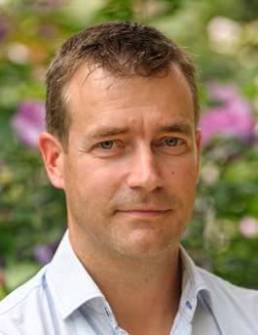
SECTION 1 PRESENTERS
Kim Cesafsky
Director of Sustainability, Enviva
Gert-Jan Nabuurs
Professor European Forest Resources, Wageningen University and Research
Lead Scientist European Forests, Wageningen Environmental Research
IPCC CLA 6AR WGIII ‘AFOLU’

Slide 3
OUR PURPOSE
Displace Coal
Bioenergy is part of an all-in strategy to reduce carbon emissions and limit dependence on fossil fuels. Wood pellets directly replace coal, providing customers around the world with a renewable fuel source that improves the environmental profile of energy generation.
Grow More Trees
Key to keeping forests as forests is strong demand for forest products. We create a market for sustainable low-value wood that encourages good forest stewardship and creates incentives for forest landowners to replant and keep their land as forest.
Fight Climate Change
The world cannot afford to delay taking decisive climate action. The Intergovernmental Panel on Climate Change has mapped out numerous pathways toward a sustainable future, and they all rely on wood bioenergy.
Notes:
Fight climate change

Slide 4
COMMITMENTS TO FIGHT CLIMATE CHANGE DRIVE MARKET GROWTH
GOLD STANDARD: United Nations Intergovernmental Panel on Climate Change (IPCC) Special Report on Global Warming of 1.5ºC:
GLOBAL
The International Renewable Energy Agency specifies that biomass in energy generation needs to increase from 3% in 2018 to 18% in 2050 in order to reach net zero in 2050¹
The International Energy Agency’s “Net-Zero Emissions by 2050 Scenario” shows output of bioenergy rising to 100 exajoules (EJ) in 2050 from less than 40EJ in 2020, enough to meet almost 20% of the world's total energy needs²
“Bioenergy use is substantial in 1.5°C pathways with or without BECCS due to its multiple roles in decarbonizing energy use.”
EU
EU Commission’s taxonomy recognizes bioenergy used for power and heat as making a substantial contribution to climate mitigation, alongside solar and wind
All 27 EU member states agreed to raising EU’s 2030 GHG emission reduction target from 40% to 55%³, as compared to 1990 levels, and RED II⁴ calls for renewables to account for at least 32% of EU’s gross consumption by 2030
European Climate Law sets legally binding target of net zero by 2050⁵

Slide 5
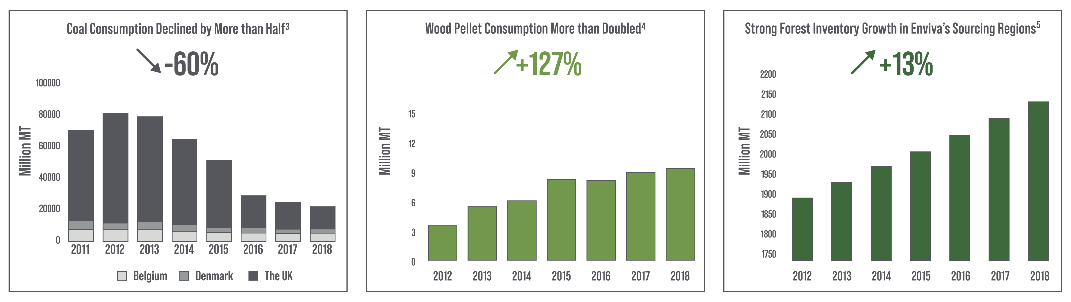
Sustainable wood biomass is a unique solution because, done properly, it displaces coal, grows more trees, and fights climate change at scale
Through 2019, wood pellets supplied by Enviva have effectively displaced 14 million metric tons (“MT”) of coal and will be on track to displace another 86 million MT of coal by 2044.

Slide 6
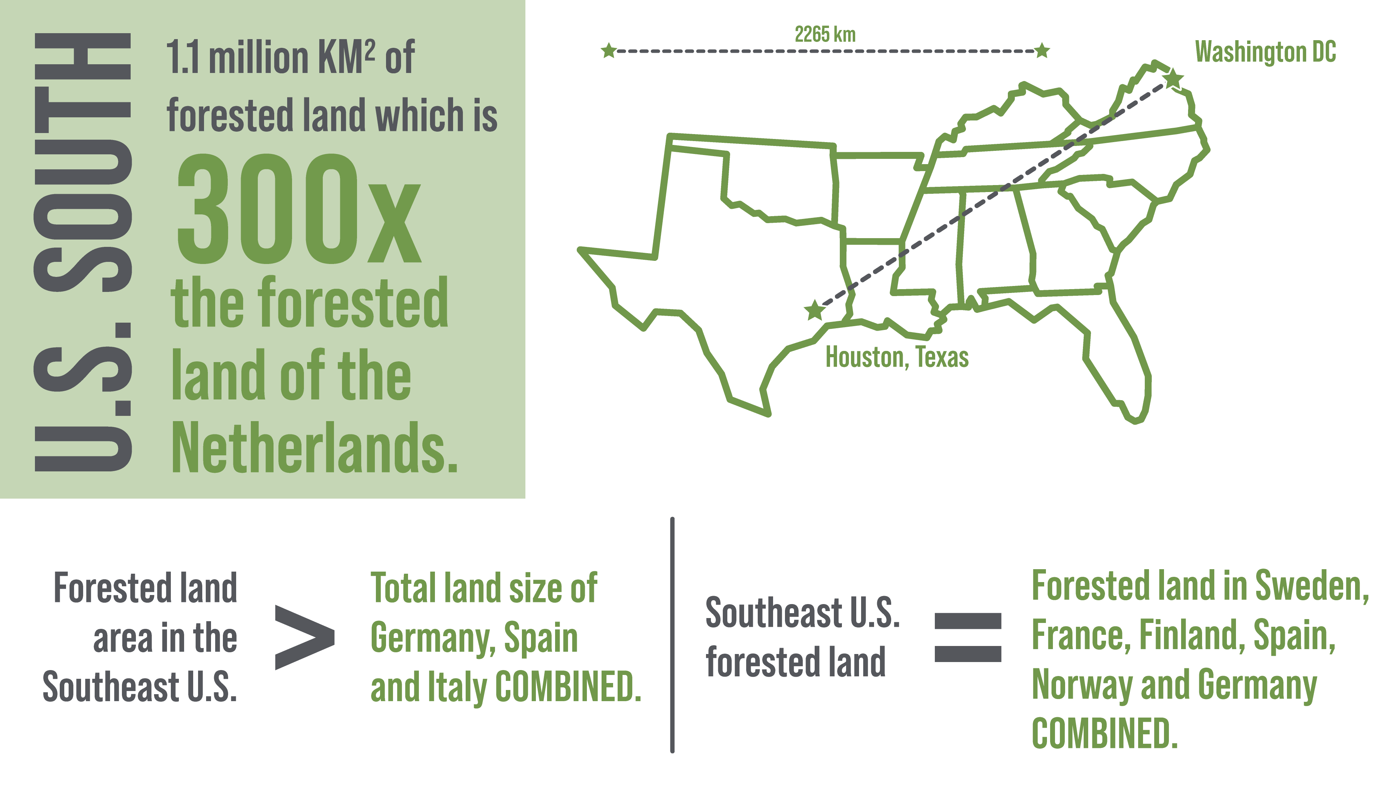
THE U.S. SOUTHEAST IS ONE OF THE WORLD’S LARGEST
FOREST REGIONS

Slide 7
WHAT IS "GOOD" BIOMASS?
Good biomass is made from low-value wood that is a by-product of a sawmill operation or a planned traditional timber harvest.
These by-products can be delivered directly from the forest, as tops, limbs, thinnings, and/or low-value smaller trees, or they can be delivered as secondary residues, like sawdust and shavings from industrial processing.
Good biomass is not made from larger, high-value trees that instead could be used for longer-lived products.
Good biomass comes from a region where forest carbon stocks are stable or increasing.
Good biomass comes from harvest practices that safeguard biodiversity.
Good biomass comes from a forest that is returned to forest after harvest, and not from land that will be converted to agriculture or development.
https://www.envivabiomass.com/the-forest-biomass-promise/
www.envivabiomass.com
7

Slide 8
Forest Economics Dictates Product Merchandizing
Higher-value markets, such as sawtimber, drive landowner harvest and planting decisions.
The average price for high-value sawtimber is up to 10 times as much as the lower-value pulp wood used by the biomass industry.
End products with permanent carbon storage, such as mass timber, telephone poles, furniture, etc. are valued highest by the marketplace.
Lower-value markets, such as biomass, benefit landowners by clearing away wood and by-products that are not of quality required for sawtimber markets, making replanting easier.

Slide 9
FOREST REMOVALS BY PRODUCT TYPE
Wood Pellets Accounted for 2.7% of Wood Removals in the U.S. South in 2017
Source: Forest2Market, Historical Perspective on the Relationship between Demand and Forest Productivity in the US South, 2017

Slide 10
BIOMASS CREATES INCENTIVES TO GROW TREES ON PRIVATE FOREST LAND
In working forests, strong demand for forest products leads to investment in forests and increasing carbon stocks. A decline in demand for forest products will lead to less forest growth, not more.​
Demand for all wood products–including biomass–drives growth in a market-driven environment like the U.S. Southeast.
Forest landowners are incentivized to protect and grow the natural resource where there are strong, long-term markets available.*
*Source: USDA Forest Service Forest Inventory and Analysis Data, July 2017. https://www.fia.fs.fed.us/tools-data/​

Slide 11
THE FOREST CONTINUES TO GROW EVEN AS WE TAKE MORE WOOD PRODUCTS FROM IT
24% increase 2000 - 2019
Source: USDA Forest Service

Slide 12
ENVIVA’S RESPONSIBLE SOURCING POLICY
SUSTAINABLE FORESTRY STANDARDS
PLEDGES IN CONSERVATION LEADERSHIP
ENVIVA WILL ONLY SOURCE PRIMARY MATERIALS FROM A SUPPLIER WHEN:
WE PLEDGE TO COLLABORATE WITH STAKEHOLDERS TO HELP:
The forest source will be replanted or regrown as forests and will not be converted to non-forest uses
Water quality in a harvest area is protected through adherence with forestry Best Management Practices (BMPs)
High Conservation Values (HCVs) are not threatened by harvest activities
Keep the amount of forestland stable or increasing at regional scales;
Conserve wetland forest ecosystems, peatland forests, and high-carbon tropical forests;
Address the conversion of forest types that provide high-quality habitat for at-risk species; and
Restore critical, threatened, or declining forest types
www.envivabiomass.com/sustainability/responsible-sourcing/responsible-sourcing-policy/

Slide 13
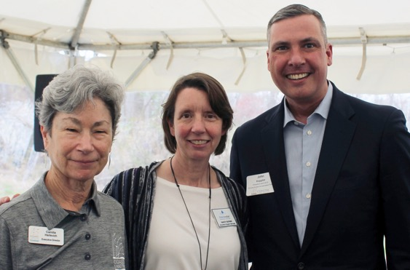
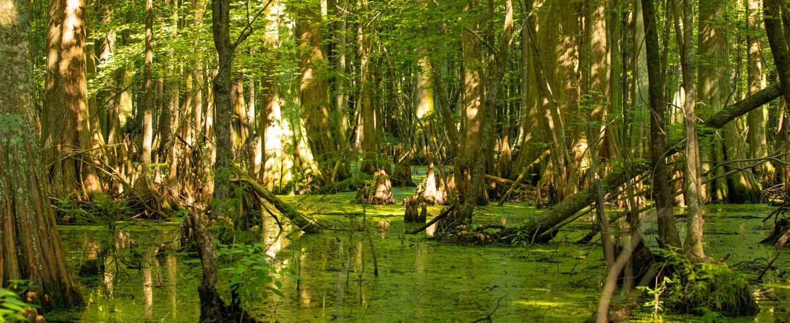
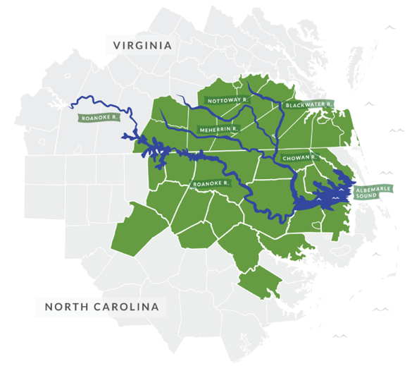
THE ENVIVA FOREST CONSERVATION FUND
A $5 million, 10-year program
Conserving working forests and sensitive bottomland ecosystems in VA and NC
Partnership with the U.S. Endowment for Forestry and Communities
Annual matching-fund grants to nonprofit organizations

Slide 14
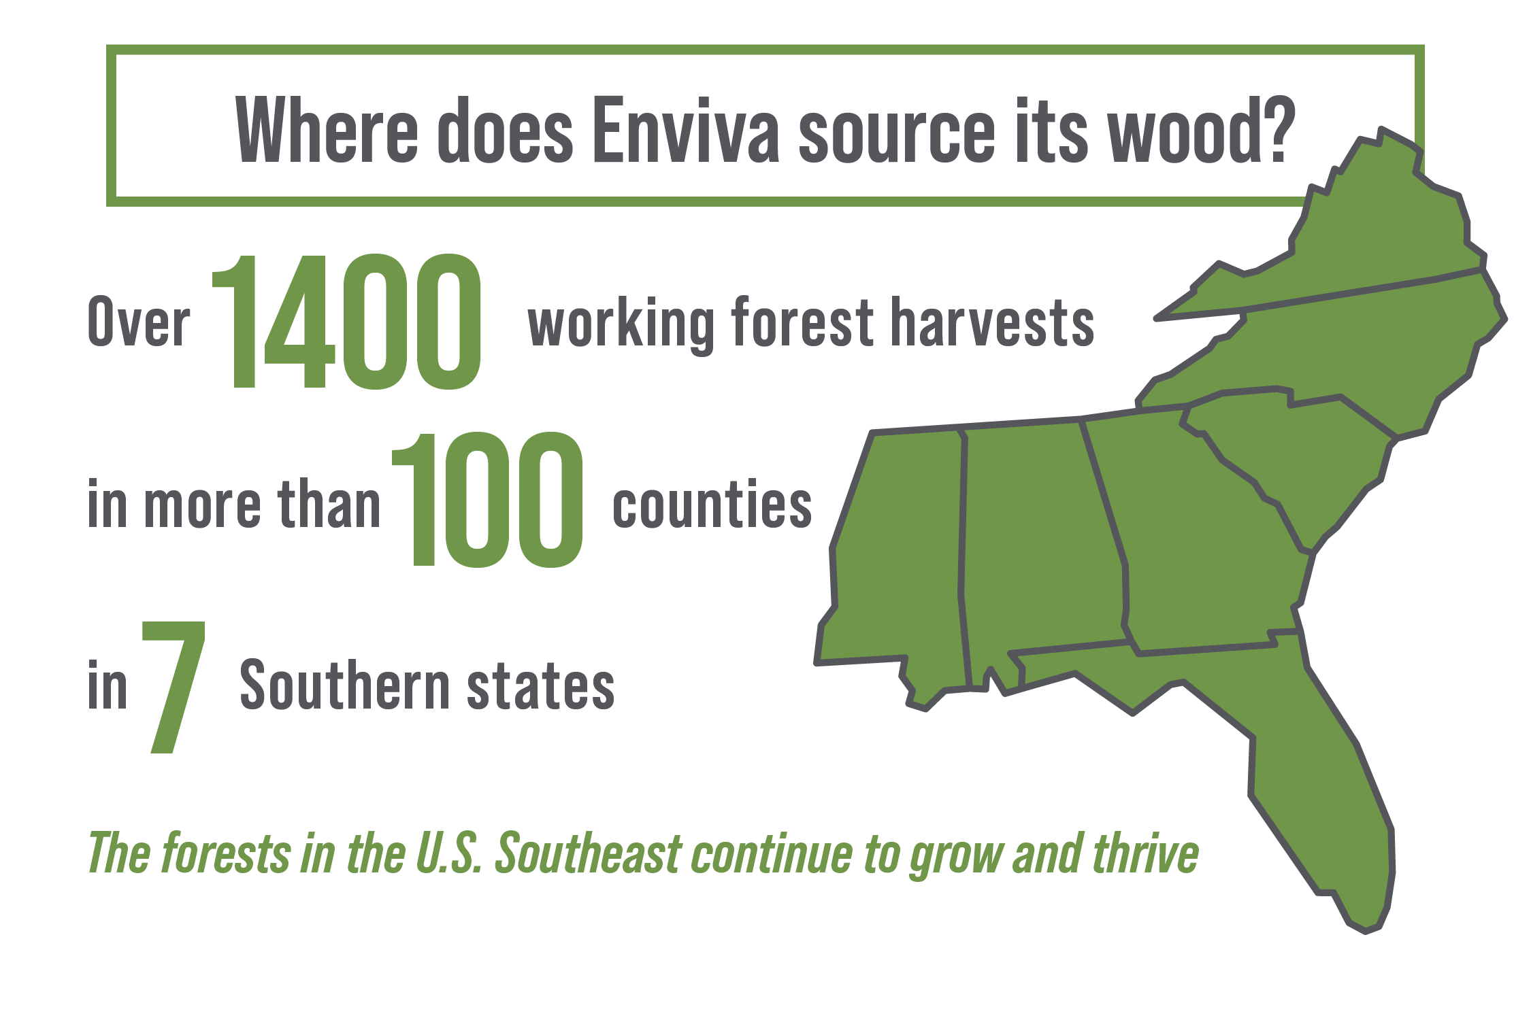
Enviva reports quarterly T&T updates and provides tract-level data on its sourcing on its website.
ENVIVA'S TRACK & TRACE ®
A leading-edge sustainable sourcing program that provides, transparent, public data and allows stakeholders to track the source of our wood to its origin in the forest or sawmill.
With Track & Trace, we can tailor our sourcing practices to the specific need of our operations and provide an unprecedented level of transparency, going above and beyond any other pellet producer or southern forest products company.

Slide 15
Accounting biomass for bioenergy Why is it done, the way it is done?
Gert-Jan Nabuurs Professor European Forest Resources IPCC coordinating lead author 6AR, WGIII, webinar 27 oct 2021

Slide 16
Contents
General principles of reporting and accounting
How is the reporting organised and done between land use sector and energy sector

Slide 17
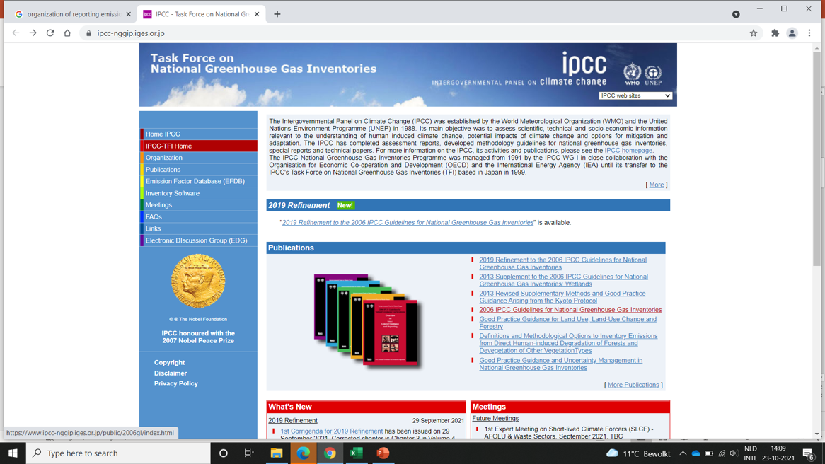
Principles of reporting and accounting
Very extensive process of harmonization, research, development, capacity building behind the UNFCCC reporting

Slide 18
Reporting is done by sectors: energy, transport, industry, agriculture and LULUCF
6 Landuse categories
Forest land
Cropland
Grassland
Wetland
Settlement
Other land
Harvested wood products
> 20 yrs in the category “Land converted to” then that parcel goes to “land remaining”, with other emission factor

Slide 19
How are energy and LULUCF connected?
Emissions of bioenergy are accounted at point of harvest

Slide 20
If we would account at smokestack, then we should not account at harvest:
account at smokestack would be a big mistake: it would open up an array of options for unsustainable harvesting !
E.g. Brazil could then also say that they don’t need to account for deforestation, because the wood goes somewhere else and decomposes in other countries

Slide 21
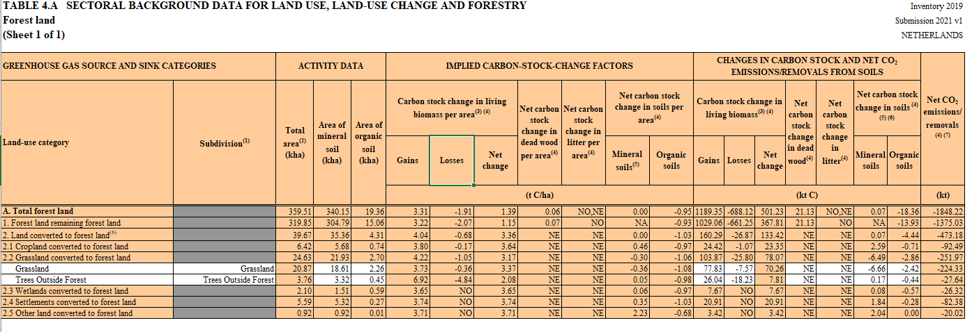
Harvesting is reported as a loss of carbon in the country of origin!
Growth is sink of 1189 kt,
harvest is loss of -668.

Slide 22
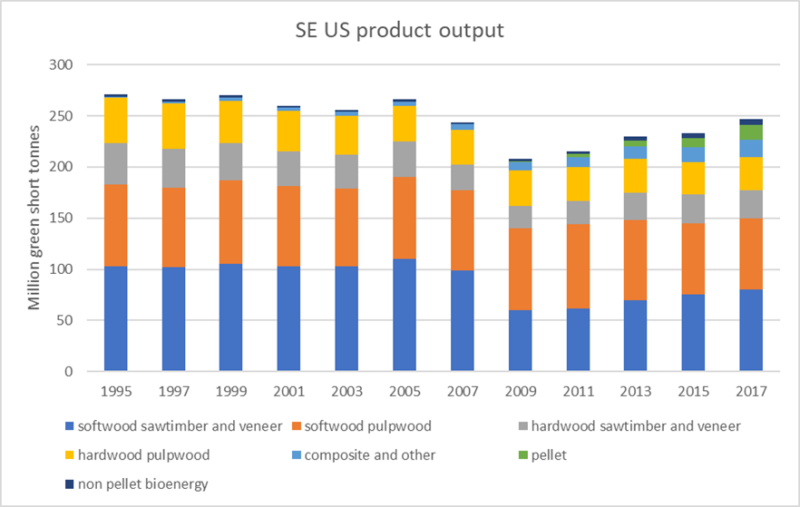
In perspective to total product output, pellets are still a very small component

Slide 23
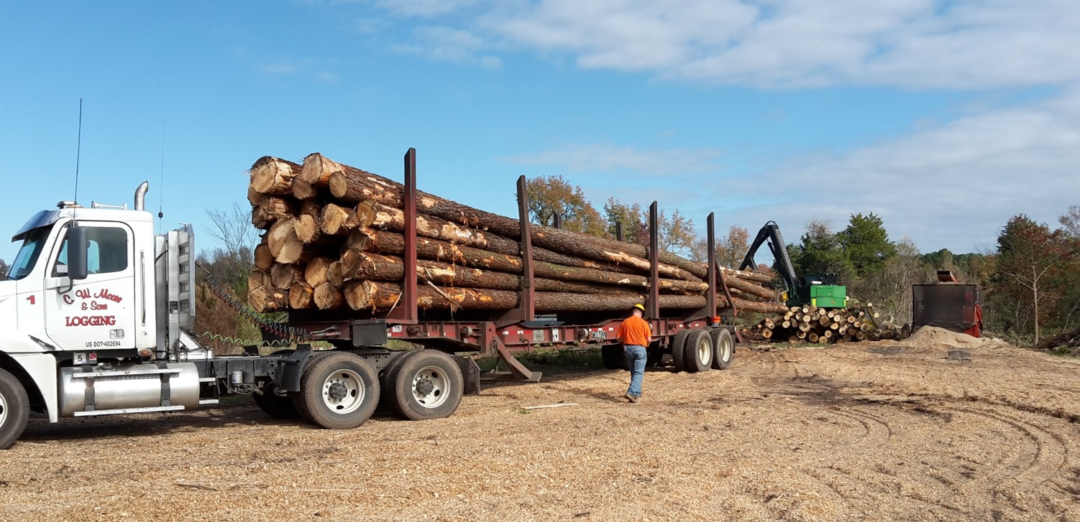
Sawlogs (on truck) go to saw mill, residues (back) are chipped and go to pellet mill

Slide 24
IPCC statements (SRCCL, SR1.5)
Biomass is part of the full forest sector
When done with safeguards, it is part of short cycle without carbon debt, forest resources are increasing!
And it does substitute fossils.
Accounting is part of LULUCF sector; harvest is accounted as emission
There are of course absolute limits to the volume available: 100-150EJ is estimated feasible, with safeguards (total global energy consumption = 550 EJ)
If we would account at smokestack, then we should not account at harvest: account at smokestack would be a big mistake: it would open up an array of options for unsustainable harvesting

Slide 25
Thank You
Gert-Jan Nabuurs Professor European Forest Resources IPCC coordinating lead author 6AR, WGIII,
Gert-jan.nabuurs@wur.nl

Slide 26
Q & A

Slide 27

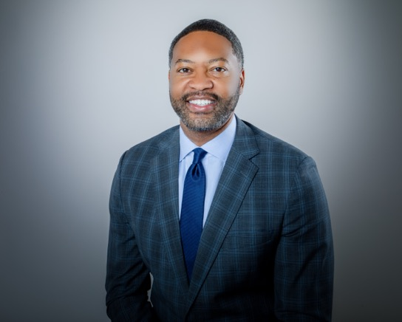

SECTION 2 PRESENTERS
Yana Kravtsova EVP, Communications, Public and Environmental Affairs Enviva
Don Calloway VP of Equity, Inclusion and Impact Enviva
Chris Brown Community Relations Sr. Manager Enviva

Slide 28
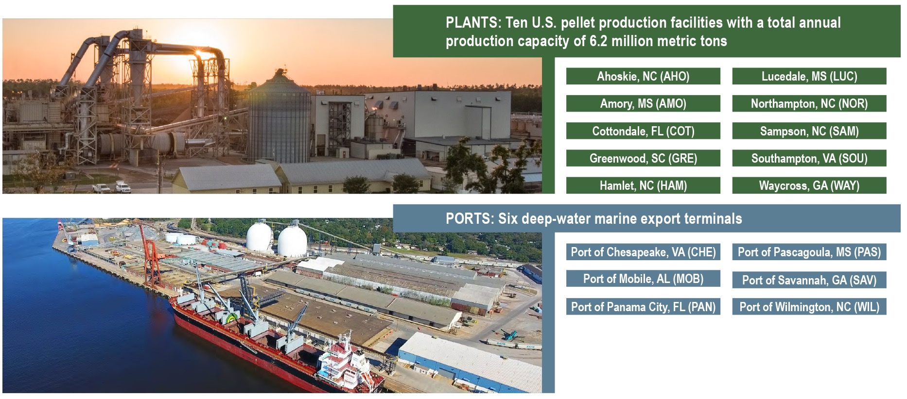
ENVIVA’S OPERATIONAL FOOTPRINT – OVERVIEW

Slide 29
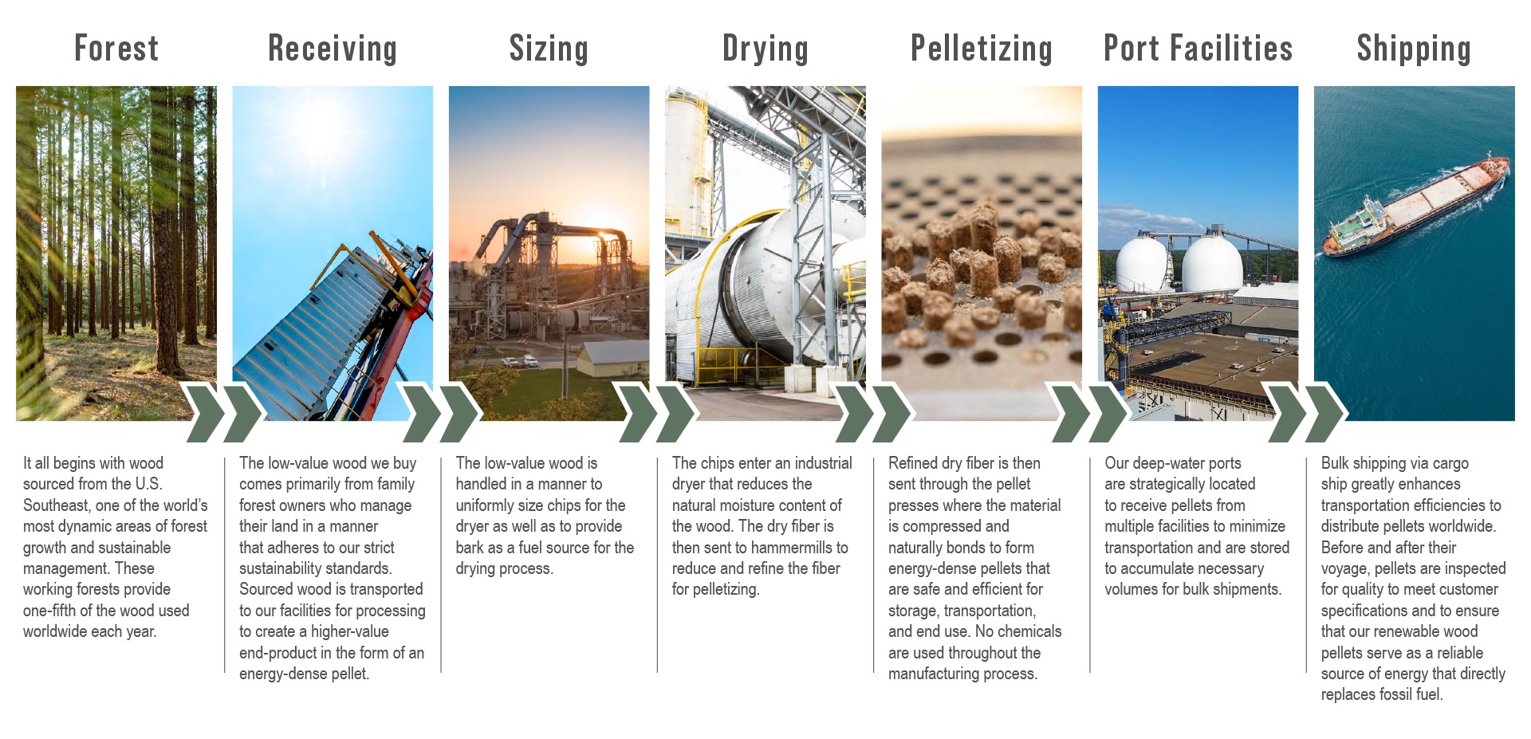
THE BUSINESS OF WOOD PELLETS

Slide 30

HOW ENVIVA OPERATES
STRICT ENVIRONMENTAL FRAMEWORK ​
Compliance: facilities are fully controlled to the highest standards and above what is required under the U.S. federal and state law and regulations, including the U.S. Clean Air Act. ​
Valid Permits: we operate in compliance with the strict environmental permits and prescribed emission limits, presenting no risk or issue to public health or the environment. ​
Testing and publicly available data: the facilities are regularly tested, all emissions are recorded and reported, the test results are submitted to the state regulators for review and approval, which then make the data publicly available.

Slide 31

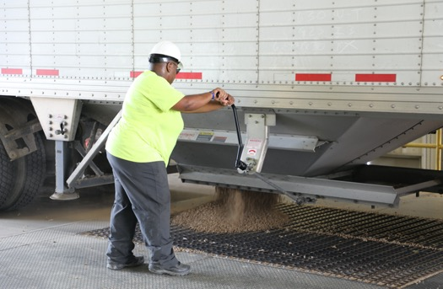
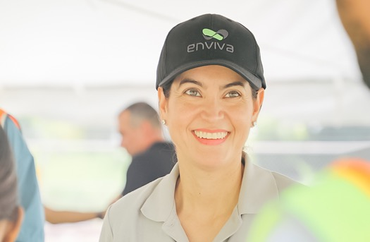
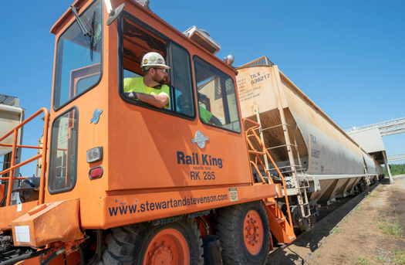
How we choose our locations
World-class fiber resources
High forest density
Abundance of softwood
Tree growth exceeds harvest (1:1.7)
Growing timber industry
Local employment
Availability of workforce at all skill levels​
Welcoming and supportive local community​
Interest of nearby colleges to partner on relevant training
Invited by local community
Logistics optimization
Access to roads & rails with high load capacity
Low-impact supply chain
Utility infrastructure
Attainment zones
Favorable business environment

Slide 32
ENVIVA’S IMPACT ON THE U.S. SOUTHEAST
Overall forest inventory in the U.S. South has increased more than 100% since the 1950s.
Across the U.S. Southeast, we are on track to create and/or support an estimated 4,200 jobs.
We have committed to net-zero operations by 2030.
We create nearly $3 billion in annual economic impact in the states where we operate.
We have displaced approximately 16 million metric tons of coal.
Our average compensation is approximately 50% higher in the counties where we operate.
31 million metric tons of carbon dioxide emissions have been avoided.

Slide 33
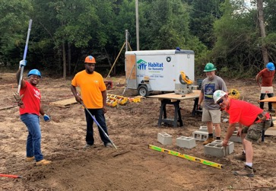


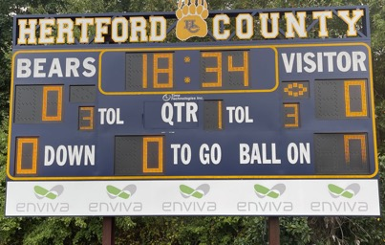


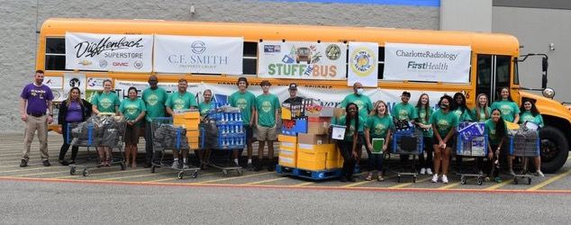
ENVIVA IN OUR COMMUNITIES
Enviva seeks to strengthen state, local, and community relationships by identifying unmet needs and providing direct support and engaging local associates to expand and amplify positive impact and engagement.​
​A Safe Space for Teens: In many of our communities, teen violence is on a troublesome upward trajectory. To combat this, teen centers are being set up to provide a safe space for recreation, gathering, and schoolwork. Enviva supports these efforts across our footprint.​
​Encouraging Vaccination: COVID-19 continues to hit rural communities harder as many continue to be unvaccinated. Enviva partnered with local organizations in Mississippi and Alabama to facilitate mass vaccination clinics. ​
​Providing Shelter: Domestic violence – a persistent issue in rural communities – has been exacerbated by COVID-19. To help provide a safe refuge for women and children experiencing unsafe conditions or new to parenting, Enviva provides support to shelters across our footprint including in the communities of Northampton, Greenwood, and Hamlet. ​
​Fostering Education: A lack of educational funding and school supplies are familiar refrains from educators across the Enviva footprint. To help support schools and local community colleges that provide a better learning experience, Enviva regularly provides school supplies, foundation support, and/or funding to expand existing facilities.​

Slide 34

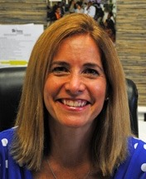
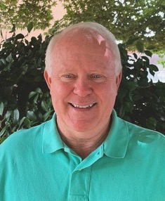
ENVIVA IN OUR COMMUNITIES
Pastor Anthony Rawlings Southampton Area Celebration Church
Amie Fraley
Executive Director, NC Sandhills Habitat for Humanity
Ray Jordan Assistant Economic Development Director, Sampson County

Slide 35
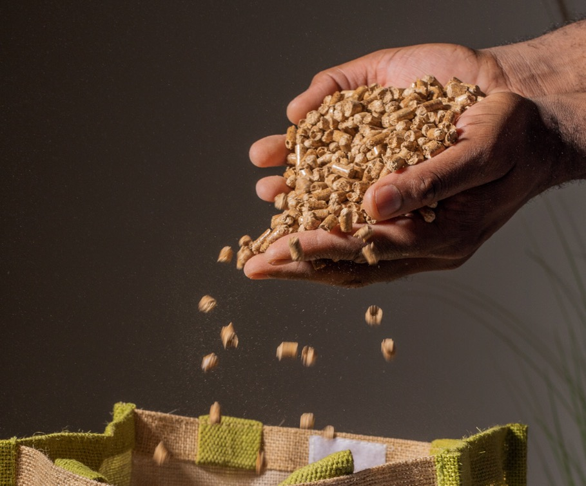
LOOKING AHEAD: FUTURE APPLICATIONS OF BIOMASS
Sustainable biomass is the ONLY renewable energy source that provides vital dispatchable power and heat today.
But as we look to the future, it will continue to expand into new applications such as decarbonizing heavy industry.
Heavy industry is the hardest sector to abate for net zero.

Slide 36
COMMITMENT TO "NET-ZERO" IN OUR OPERATIONS BY 2030
Scope 1 | direct emissions from assets owned and controlled by Enviva
Scope 2 | indirect emissions from heat, steam or electricity purchased by Enviva
Scope 3 | indirect emissions in Enviva’s upstream or downstream value chain
Transparency and Reporting
Track and report annually on all emissions
Commit to disclose climate-relevant data and risks through CDP (formerly the Carbon Disclosure Project) by the end of 2022
For Scope 1 Emissions
Immediately work to minimize the emissions from fossil fuels used directly in our operations
Offset 100% of our residual emissions through investments in projects that result in real, additional, and third-party verified net-carbon reductions
Focus on forest offsets in partnership with Finite Carbon and others
For Scope 2 Emissions
Source 100% of energy for our operations from renewable sources by 2030, with interim target of at least 50% by 2025
Maximize use of on-site renewable energy generation at our facilities, as well as develop new off-site renewable energy resources physically located in our operating regions where possible
For Scope 3 Emissions
Proactively engage with partners and other key stakeholders to adopt clean-energy solutions, including trucking, rail, and shipping logistics
Take steps to accelerate and advocate for the development of new solutions and to work with stakeholders to bring those solutions to market
We Are Committed to the Goal and Plan to Become “Net-Zero” in Our Operations by 2030

Slide 37


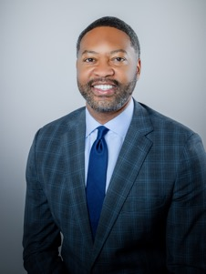


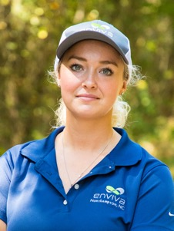
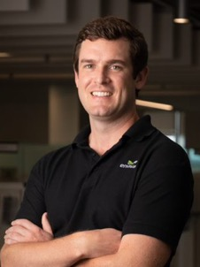

Andy Georgiou Director, Policy and Regulation Europe
Chris Brown Community Relations Sr. Manager
Don Calloway VP of Equity, Inclusion and Impact
Jason Eberstein VP, Government Relations
Kim Cesafsky Director of Sustainability
Lauren Killian Supervisor, Forestry Outreach Programs
Stephen Stroud Director, Environmental Affairs
Yana Kravtsova EVP, Communications, Public and Environmental Affairs

Slide 38
Q & A

Slide 39
Thank You

