Slide 1
~800 Scientist Letter 2018
~500 Scientist Letter 2021
+ at least 15 peer reviewed papers by different authors

Slide 2
Paper Recycling

Slide 3
RISI An Analysis of UK Biomass Power Policy . . . Prepared for AFPA 2015)

Slide 4
Picture on Georgia Biomass’ Own Website

Slide 5
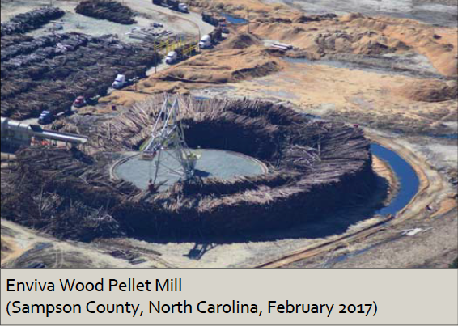
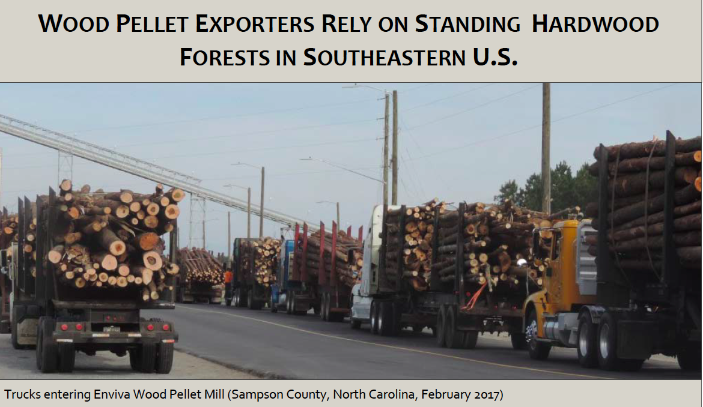
Notes:
Europe’s renewable energy directive basically allows all wood to be used in power plants and count as renewable energy. Amendments to the directive would add very mild sustainability criteria, which at best help assure that wood is renewable but does not make it low carbon. The directives have led to construction of large wood pellet facilities in the US. The pictures above show wood clearing and logs being used to make pellets in at the Enviva wood pellet facility in North Carolina. Among other things, they contract occasional claims that wood pellets are using wastes and residues. A study by the US Forest and Paper Assocation found that 76% of wood was round wood and 12% was otherwise clean sawdust that would have been used by industrtry.

Slide 6
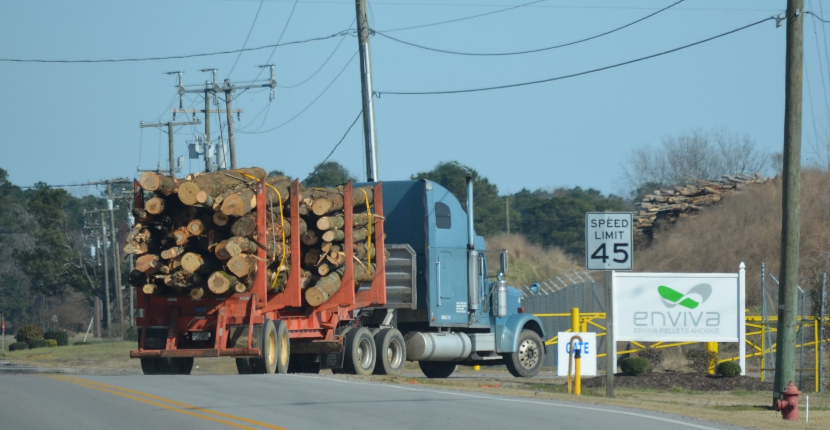

Photo courtesy Dogwood Alliance
http://www.bloomberg.com/news/videos/2015-05-20/how-green-is-biomass-power-from-forest-to-furnace

Slide 7
This is what residues look like (not big stems)

Slide 8
Truck entering Enviva Wood Pellet Plant, North Carolina
Truck entering nearby pulp mill.

Slide 10
Project ~160% global increase in
pulpwood consumption 2010 to 2050

Slide 12
Decades to Centuries

Slide 13
from Europe’s renewable energy directive poised to harm global forests, Nature Communication (2018)

Slide 14

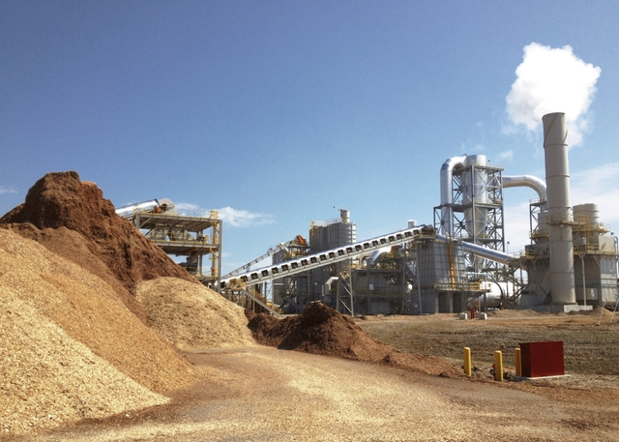
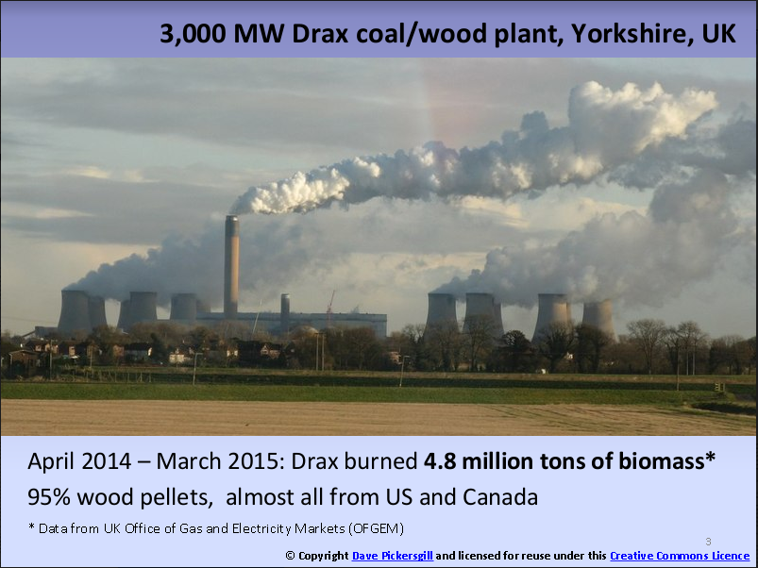
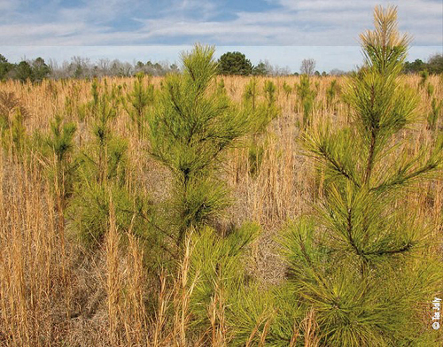
Biogenic Emissions from Wood Bioenergy
CO₂ in atmosphere
Harvest
Decay (roots,
some residues)
30%+
Drying, debarking
Pelletizing
Transport losses
15-35%
Regrowth, but . . .
Combustion for power
1.5x-3x fossil fuels
Forest
Chip/Pellet Production
Power Plant

Slide 15
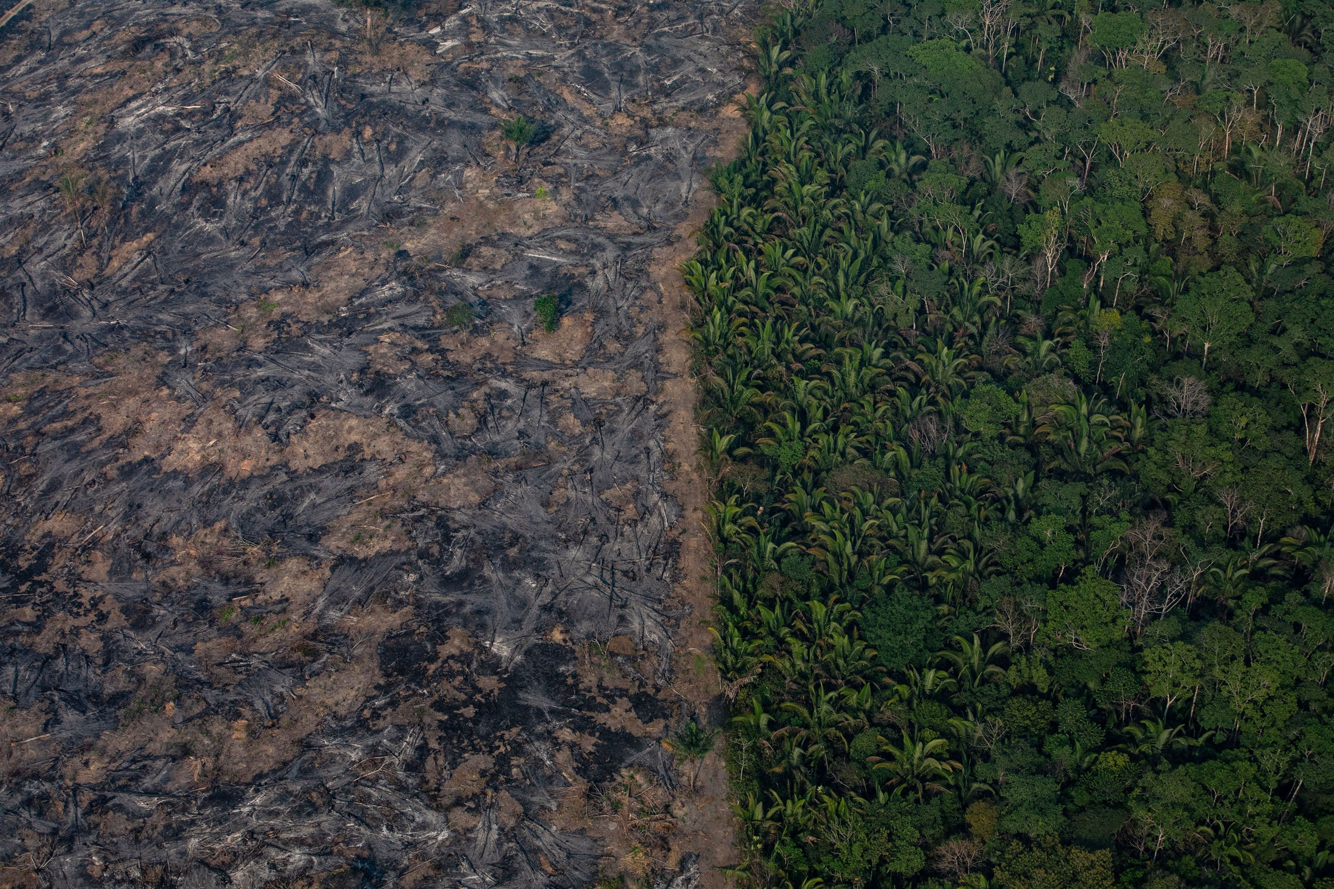
But . . .
Unharvested trees keep growing
When carbon debt on year 1 harvest repaid, newer debt remains
That is real landscape approach

Slide 16
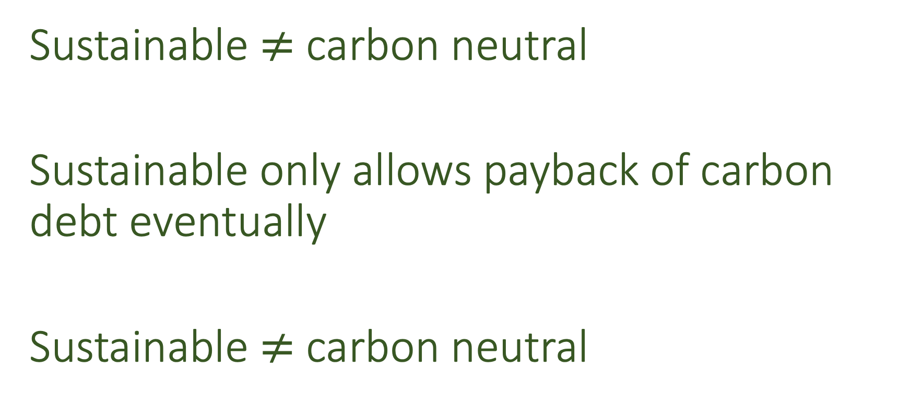
Important!
Sustainable $≠$ carbon neutral
Sustainable only allows payback of carbon debt eventually
Sustainable $≠$ carbon neutral

Slide 17
Source: USDA, FAS EU Biofuels Annual Report (2020)

Slide 18
Meeting EU Wood Pellet Demand on Sustained Basis Requires Equivalent of Harvesting All Forests in Virginia & North Carolina –
Meets ~.5-.7% of EU final energy demand

Slide 19
Japan Biomass Electricity Targets
2.1% Electricity from Biomass Today
Target ~4.2 Electricity from biomass (~1% of Japan final energy)
Requires ~2.5% of global industrial wood harvest

Slide 20
Additional 2% of global primary energy requires doubling global commercial wood harvest.

Slide 21


False landscape approach

Slide 22
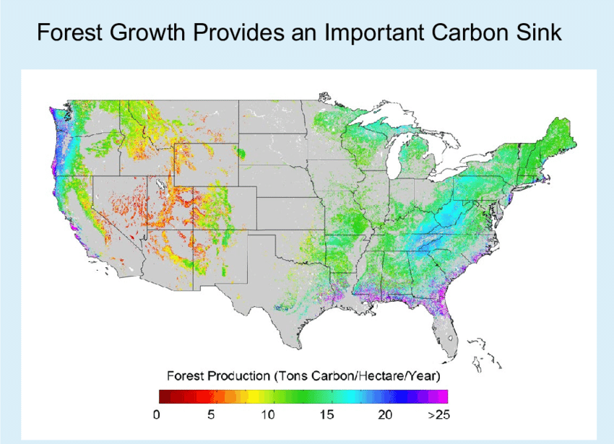
Why U.S. forest carbon sink?
Carbon dioxide fertilization (and nitrogen deposition)
Regrowth from extremely heavy logging
Reduction agricultural land

Slide 23
Source: Rephann, Economic Impact of Horse Industry in Virginia (University of Virginia 2011)

Slide 24
2.15 Billion Tons Net Forest Carbon Sink ~ 8 Billion tons CO₂
_{30% Due to Forest Regrowth}
70% Equal to Carbon Dioxide Fertilization and Other Environmental Factors

Slide 25
Burning up the forest carbon sink = increasing global warming by 50%

Slide 26

Renewable Does Not Equal Carbon Free

Slide 28
IPCC Guidelines: Count bioenergy emissions in land use sector
IPCC 2000 Land Use Report (p. 355): Because “fossil fuel substitution is already ‘rewarded’” by excluding emissions from the combustion of bioenergy, “to avoid underreporting . . . any changes in biomass stocks on lands . . . resulting from the production of biofuels would need to be included in the accounts.”

Slide 29
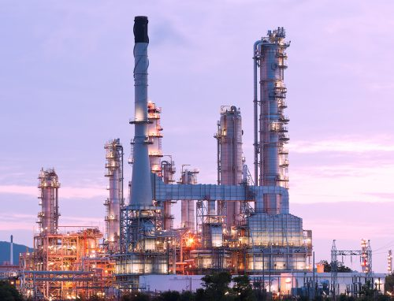
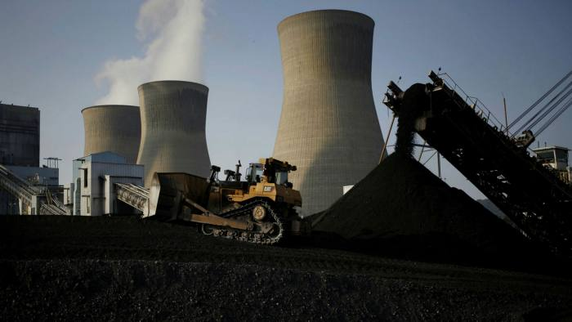
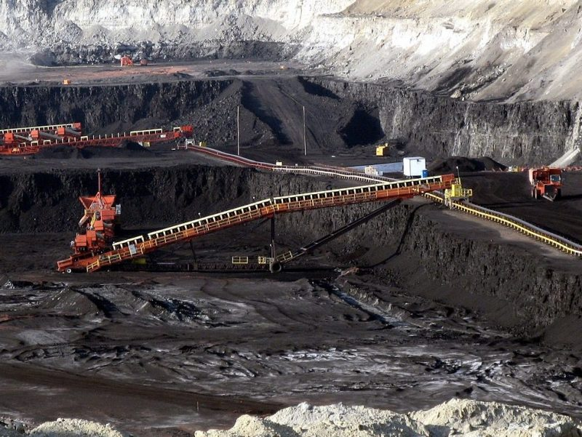
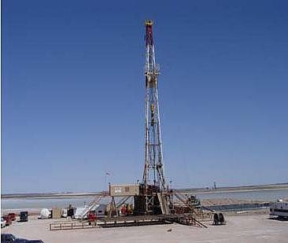
If carbon accounting worked this way, and you ran a power plant, what fuel would you burn?
50
0
0
100

Slide 30
The IPCC accounting is not intended to treat bioenergy as carbon neutral
“The IPCC approach of not including bioenergy emissions in the Energy Sector total should not be interpreted as a conclusion about the sustainability or carbon neutrality of bioenergy.” (http://www.ipcc-nggip.iges.or.jp/faq/faq.html)
“If bioenergy production is to generate a net reduction in emissions, it must do so by offsetting those emissions through increased net carbon uptake of biota and soils”.
IPCC AR5 WG III 11.13.4 GHG emission estimates of bioenergy production systems, 2014

Slide 31
Three Potential Errors
National reporting and global balance
Flawed incentives for countries
Flawed energy laws (most important)

Slide 32
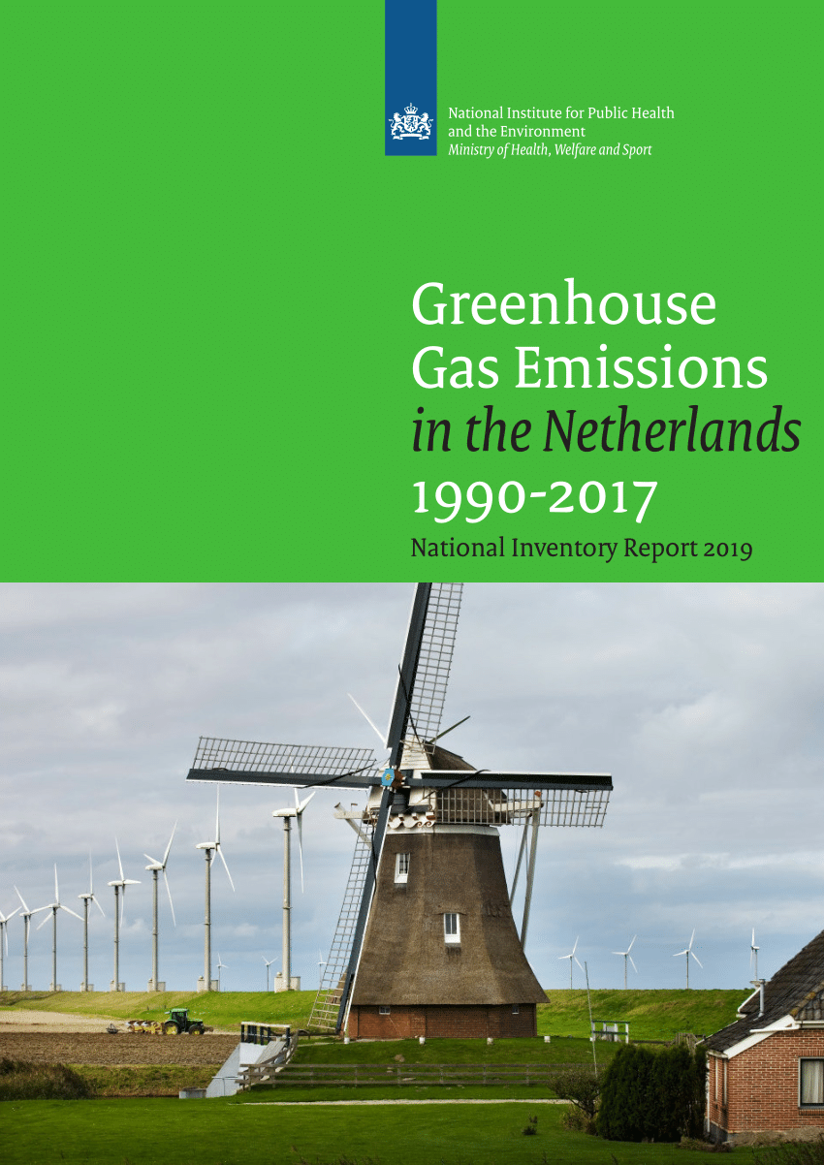
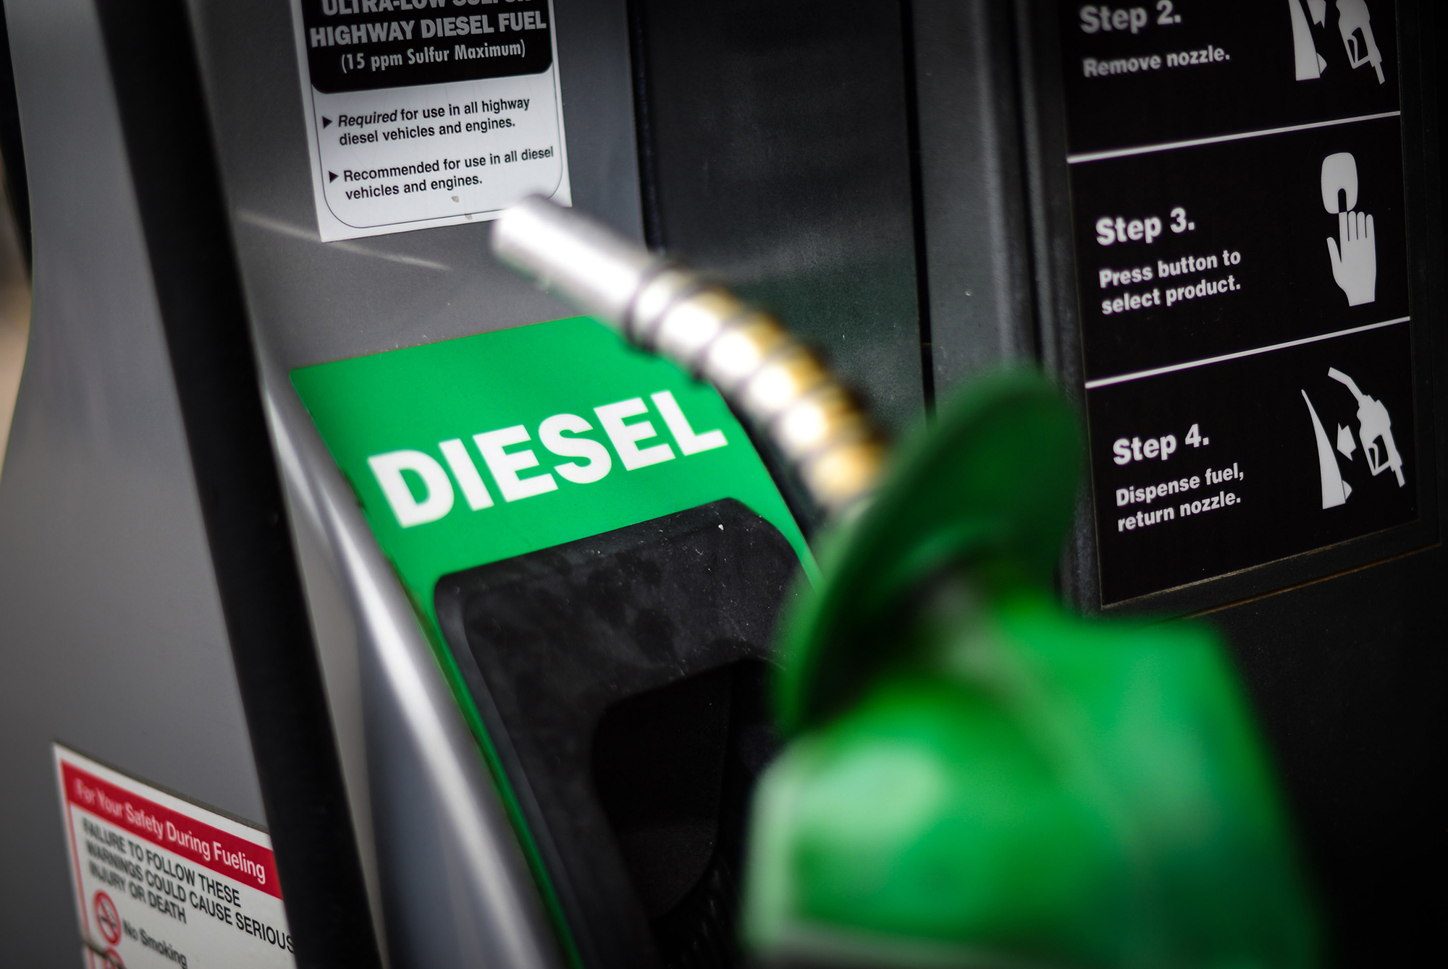
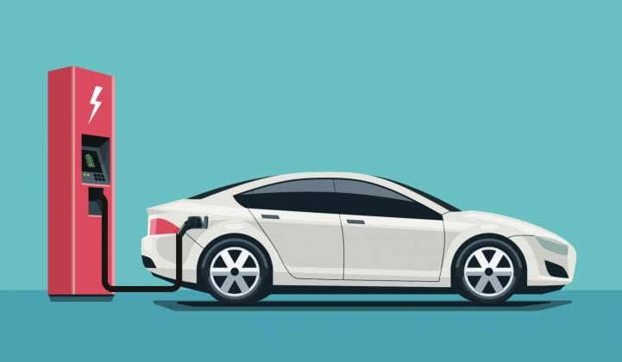
National LULUCF Accounting Cannot Not Fix Errors in Individual Climate Laws

Slide 33


Do hospital standards make faulty drug analysis ok?

Slide 34
Logic
Physical reality: harvesting + burning wood = more carbon in air
Accounting rules cannot change a physical reality
so
If accounting rules encourage harvesting + burning wood as low carbon, accounting rules must be flawed.

Slide 35
Paper Recycling

Slide 36
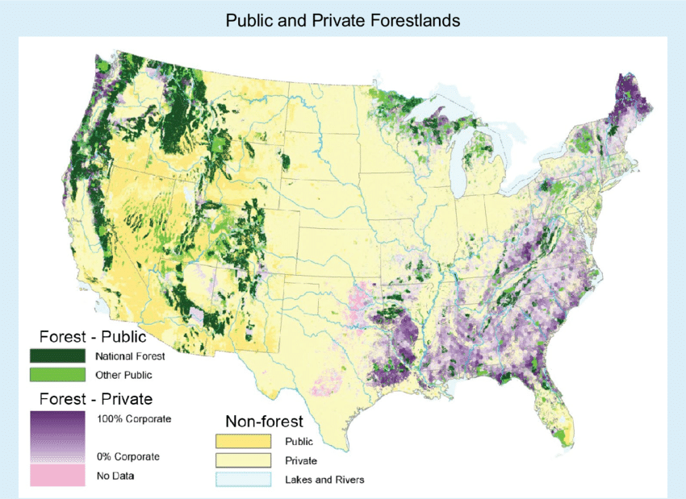

Slide 38
Economic model issues
Assume permanent and certain increase in demand
Assume at least “accessible” forests already committed to meet existing demand
  Result: Virtually must plant new forests
Best evidence is forest area response to increased forestry prices is extremely small
Models assume vast numbers of parameters

Slide 39
EPA Peer Review of FASOM Model 2011
“To judge the credibility of the model’s results and have confidence in them, one must be able to see and understand fully the model’s structure and inputs. The documentation that was provided to the review panel did not allow the panel to gain such an understanding. It provided general information about model structure and some details about model inputs and parameter values. However, much of the documentation provided simply alludes to general data sources from which information was drawn . . . rather than providing specific estimates (for example, of actual or implied elasticities) that can be judged based on other information.”
“[I]n cases where data are not available, parameter values are assumed (see, for example, p. 6-7), presumably based on expert opinion, although the basis for these assumptions/opinions is not documented.”
Many model outcomes “are driven by assumptions about future productivity growth” that are “highly questionable” as well as “assumptions about agricultural land” demand that “are highly suspect.”

Slide 40
Why Economic Models Are not Even Appropriate
We don’t discount other emissions by economic rebound effects
If benefit is planting forests, more GHG savings & cheaper just to subsidize planting forests
Overall effects cannot be relied upon

