Slide 1

A Global Threat Map of Biomass Energy Development
Ms Peg Putt
Coordinator of Policy, Campaigns, & Networking
Forests, Climate & Biomass Energy working group
Environmental Paper Network

Slide 2
Who we are
Forests, Climate & Biomass Energy working group - established late 2017
170 member NGOs in over 40 countries
All are signatories of the Biomass Delusion position statement
Subgroups geographically: Europe, East Asia, Asia-Pacific, Africa, Latin America. US, Canada, Australia covered as producers supplying to Europe and East Asia
Biomass Finance subgroup – addressing financiers of biomass energy
Parent organisation: Environmental Paper Network International www.environmentalpaper.org

Slide 3
Introduction
Focus on the wood pellet trade, central to the industry’s global expansion plans
The past decade has seen a doubling of biomass energy supply and a quadrupling of pellet production
Even more rapid growth is forecast for the coming decade – a 270 % increase in biomass demand
The rapid growth of international trade in wood pellets for energy supply demonstrates the main industry trends, both in scale (extent of forests impacted) and in geographical focus (creation of long-distance supply chains and expanding new centers of consumption)
Acceleration of large scale burning facilities for energy production: establishment and expansion of additional stand-alone generating facilities that burn wood chips or pellets to create electricity or combined heat and power (CHP), and conventional (usually coal) power plants converted to co-fire a mixture of coal and wood pellets

Slide 4
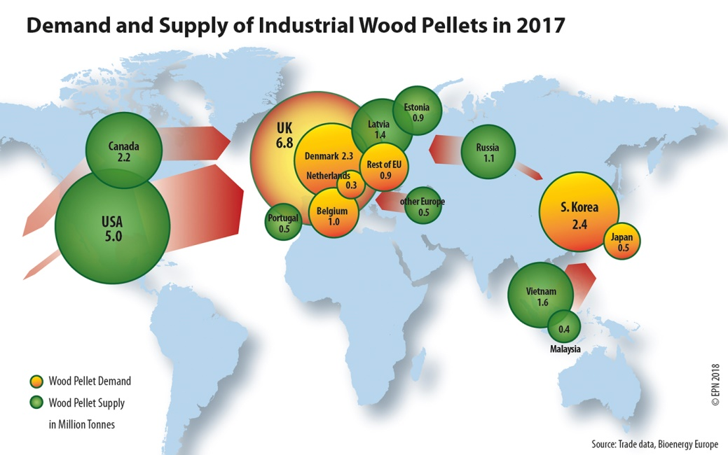
Global Threat Map of Biomass Energy Development – part 1

Slide 5
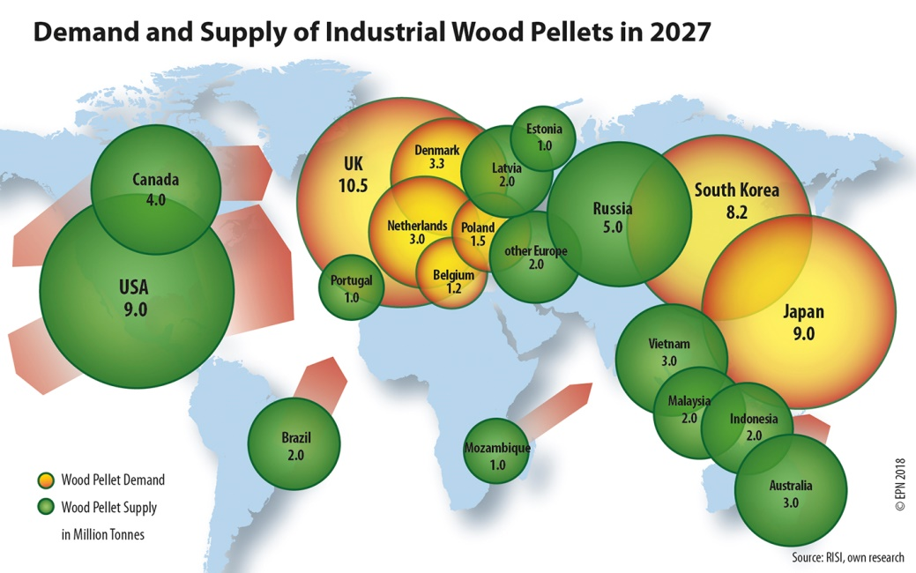
Global Threat Map of Biomass Energy Development – part 2

Slide 6
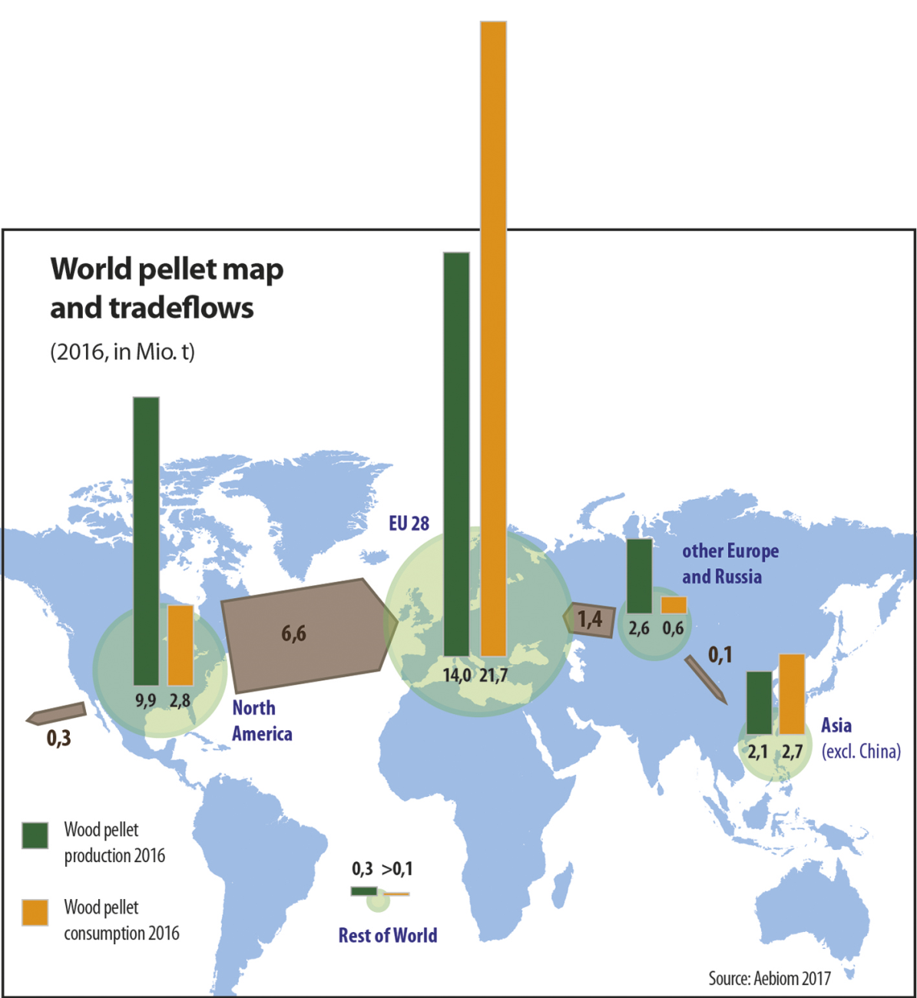
Currently, production & consumption of wood pellets is highest in Europe, while large quantities are imported from North America

Slide 7
Key Findings
Global supply of, and demand for forest biomass is predicted to increase 270 % over the next decade, having already doubled in the last ten years.
Countries in Asia are emulating European countries in encouraging large scale biomass burning for energy production.
Japan and South Korea are now also subsidising power generation from forest biomass and failing to count smokestack carbon emissions resulting from wood burning, as Europe and the UK have done.

Slide 8
Not Carbon Neutral
Burning wood for energy produces at least as much CO2 as burning coal per unit of energy produced, and usually more
Assumed that the trees and forests will grow back as part of the natural carbon cycle, reabsorbing the carbon emitted from burning – BUT a carbon debt has been created, regrowth takes decades to centuries to recover that carbon, meanwhile the GHGs emitted are in the atmosphere
This defies the Paris agreement timelines for action – decreasing emissions significantly by 2030, net zero by 2050
Not good enough to claim that forests growing somewhere else will make up for the biomass burning emissions. Those forests were growing anyway, whether or not wood was logged and burnt for bioenergy. The IPCC was very clear about this:
“If bioenergy production is to generate a net reduction in emissions, it must do so by offsetting those emissions through increased net carbon uptake of biota and soils” IPCC AR5 WG III 11.13.4 GHG emission estimates of bioenergy production systems, 2014 (https://www.ipcc.ch/site/assets/uploads/2018/02/ipcc_wg3_ar5_full.pdf p. 877)

Slide 9
Not Zero Emissions
Flawed Carbon Accounting Rules
Emissions generated by combustion of biomass for energy generation are not reported nor accounted in the energy sector of the consuming country
A zero sits alongside emissions of combustion of forest biomass, whereas figures for the emissions of combustion of fossil fuels do appear [in inventory reports and country accounts].
This creates a false impression of zero emissions of combustion for biomass energy in comparison to the emissions of burning fossil fuels
A zero emissions record in the energy sector has been misconstrued to wrongly claim that biomass energy is actually zero emissions. Many countries treat biomass energy as zero carbon at the point of combustion, and therefore give it financial and regulatory support as a ‘renewable’ energy.
Emissions are instead to be accounted for where the biomass is logged, and not at the smokestack where it is burnt. Many loopholes. Has led to gross understatement of emissions and to misplacing of responsibility for emissions.

Slide 10
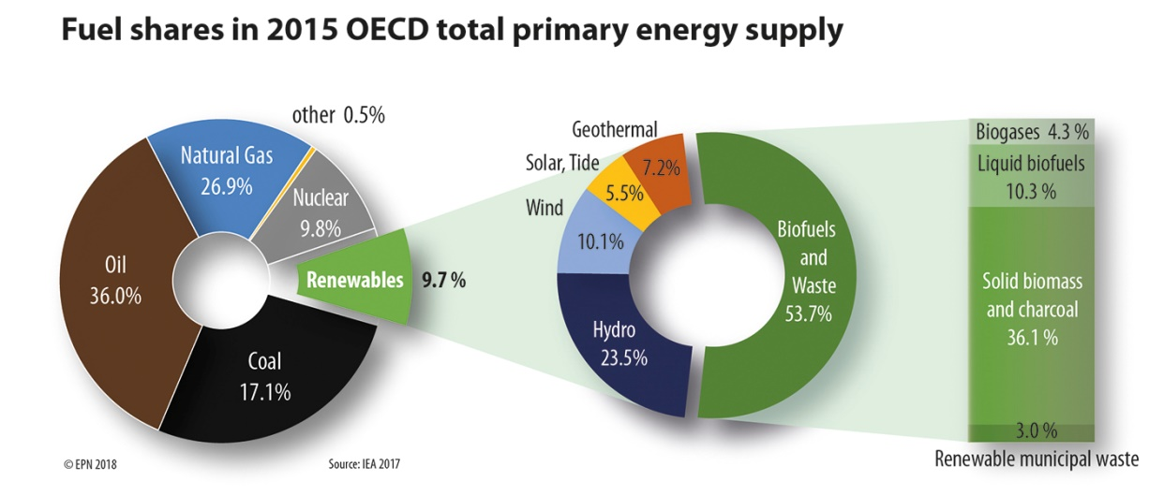
Key Findings
Biomass energy, predominantly forest biomass, dominates ‘renewable’ energy production, dwarfing wind and solar and undermining their prospects by soaking up subsidies that should be applied to such genuinely low emissions technologies

Slide 11
Key Findings
The majority of feedstock for the increasing pellet market will be supplied direct from forests, inevitably entrenching and expanding logging at higher rates over greater areas
This is in stark contrast to the findings of the Intergovernmental Panel on Climate Change Special Report regarding the urgency of protecting and expanding forests in the near term as critical for avoiding the worst impacts of climate change. Natural forests are best deployed to maintain carbon stocks and continue to sequester carbon
Growth in the industry is likely to occur by expanding supply from tropical, temperate and boreal forests in developing and developed countries, thereby posing an escalating global threat to natural forest ecosystems including those that are mega-diverse or carbon rich

Slide 12
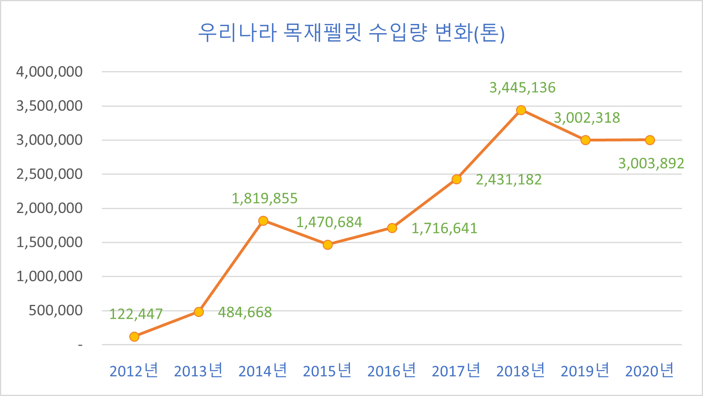
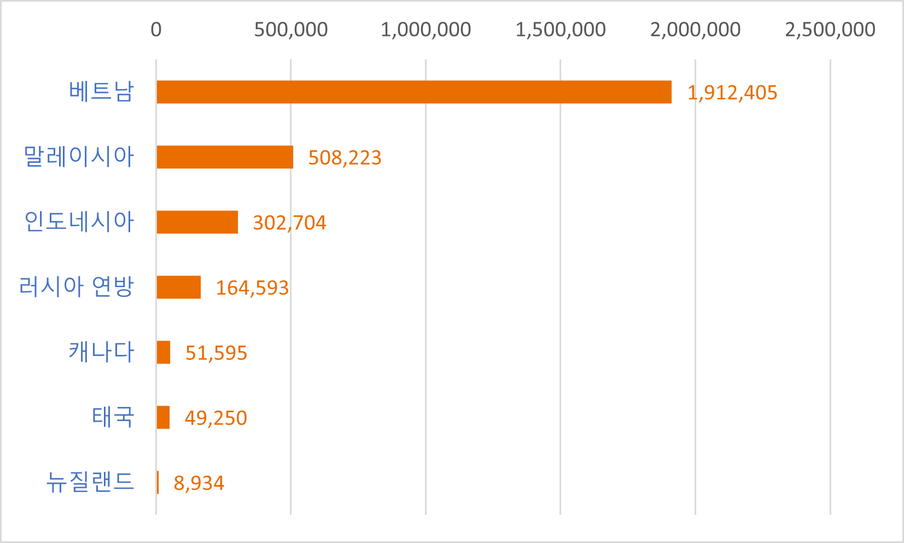
S. Korea’s biomass sourcing
S. Korea imports more than 3 million tons of wood pellets year.
Annual wood pellet imports (ton)
Vietnam
Malaysia
Indonesia
Russia
Canada
Thailand
New Zealand
Source: S. Korea Customs Office

Slide 13
(10,000t)
pellets(left)
Canada
Vietnam
Others
PKS(right)
Indonesia
Malaysia
Import Volume of PKS and Wood Pellets of Japan
From On-site Report No.454,455 Created by Biomass Industrial Society Network
※Imports from the United States are expected to increase sharply in the future
※今後は、米国からの輸入が急増する見通し

Slide 14
EU and UK
2018:
EU produced 16.9 million tonnes wood pellets & imported 10.3 million tonnes wood pellets (@60% from US)
UK consumed 8.3 million tonnes (7 mill at Drax power station)
Emissions implications:
Energy related emissions across former EU28 reported as falling 26% between 1990-2019
If emissions from all bioenergy had been included the reduction would have been 15%
Source: Chatham House & Woodwell Climate Research Centre, Oct 2021 Greenhouse gas emissions from burning US-sourced wood in the EU and UK
Burning wood is a larger emitter than coal in the UK
Burning biomass for power has been emitting more carbon dioxide in the UK than coal since 2019
Burning wood at 8million tonnes a year generates 15.6Mt of CO2
Burning coal (including coal used in steel production emitted 10Mt in 2020

Slide 15
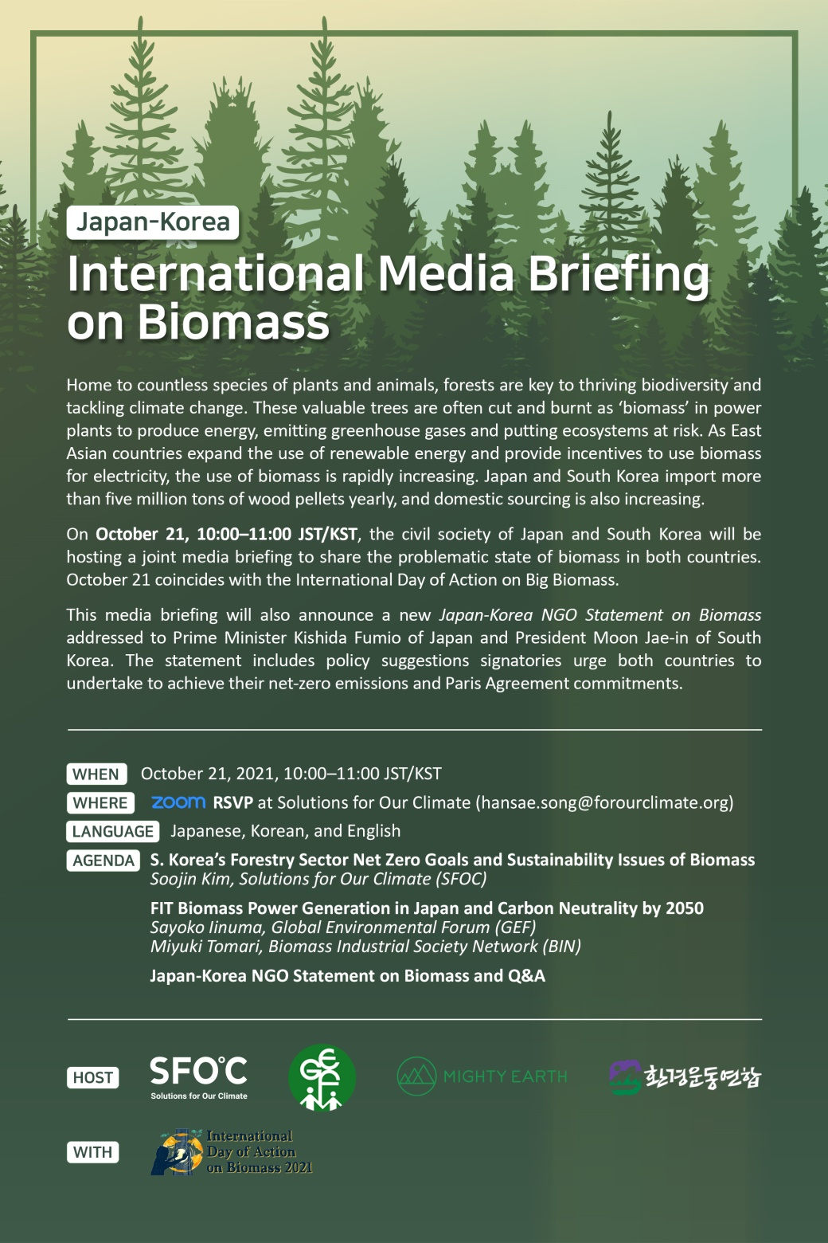

Slide 16
#BiomassDelusion position statement
Large- scale burning of forest biomass for energy:
harms the climate
- it is not low carbon
- it is encouraged by flawed carbon accounting
harms forests
- it threatens biodiversity and climate resilience
- it undermines the climate mitigation potential of forests
harms people
- it undermines community rights and interests
- it harms human health and well-being
harms the clean energy transition
- it provides a life-line for burning coal for energy
- it pulls investment away from other renewables

Slide 17
#BiomassDelusion position statement
The signatory organisations believe that we must move beyond burning forest biomass to effectively address climate change
They call on governments, financiers, companies and civil society to:
avoid expansion of the forest biomass-based energy industry,
move away from and eliminate subsidies for forest biomass energy, and
protect and restore the world’s forests as a climate change solution.

