Slide 1
Southern Forest Markets: Pellets and Forest Carbon Why You Must Consider Markets When Evaluating Pellet Impacts in the US South
Bob Abt and Justin Baker
Forest Resource Economists
NC State University
bobabt@ncsu.edu justinbaker@ncsu.edu

Slide 2
Background – Forest Market Models Objective – model the southern forest at a spatial and temporal resolution to be useful for forward-looking decisions.
Empirically driven model of the southern forest system
Sub-Regional Timber Supply Model - SRTS
Biology based on continuous forest inventory of growth, mortality, removals, and inventory by the USDA FS
By private owner group (corporate/non-corporate), forest type, age class, and species group.
Separate empirically driven market responses by sub-region, owner type, species group and product class.
An empirical model, not an optimization model

Slide 3
Key questions, in a privately owned timberland market: Demand side - how does increased demand for wood affect prices, harvest, forest inventory and forest carbon? Supply side – how are future markets affected by intensive management, hurricanes, and land use change.

Slide 4
Today’s Agenda
Brief overview of trends and current status of forest markets in the US South
This provides the market context of for the entrance of bioenergy demand for pellet exports
Expected and realized effects of pellets on forestland rents – which drive acreage, forest inventory and forest carbon.

Slide 5
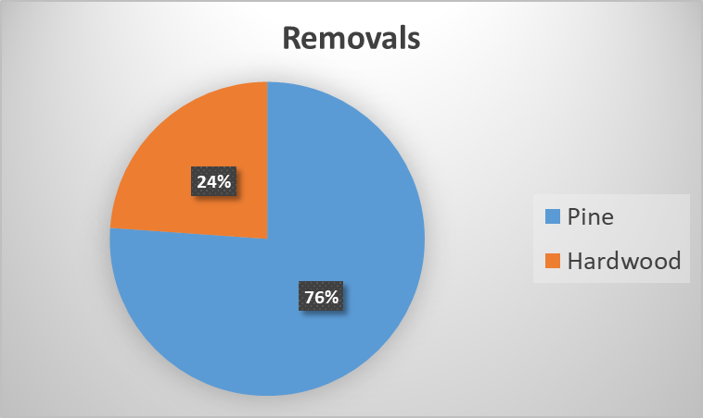
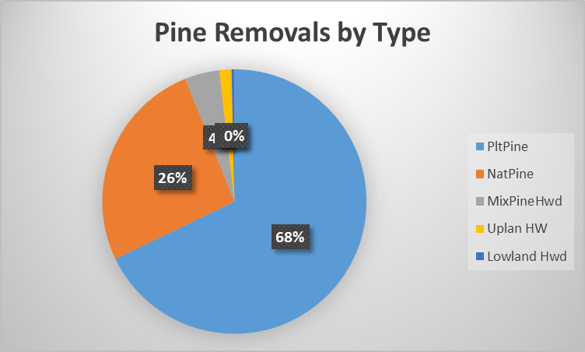
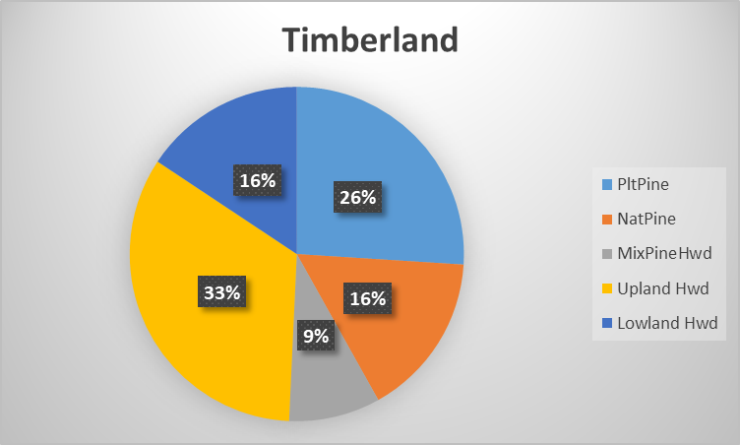
Southern Plantations 26% of timberland 53% of removals 68% of pine removals
Plantations in a Landscape Context

Slide 6
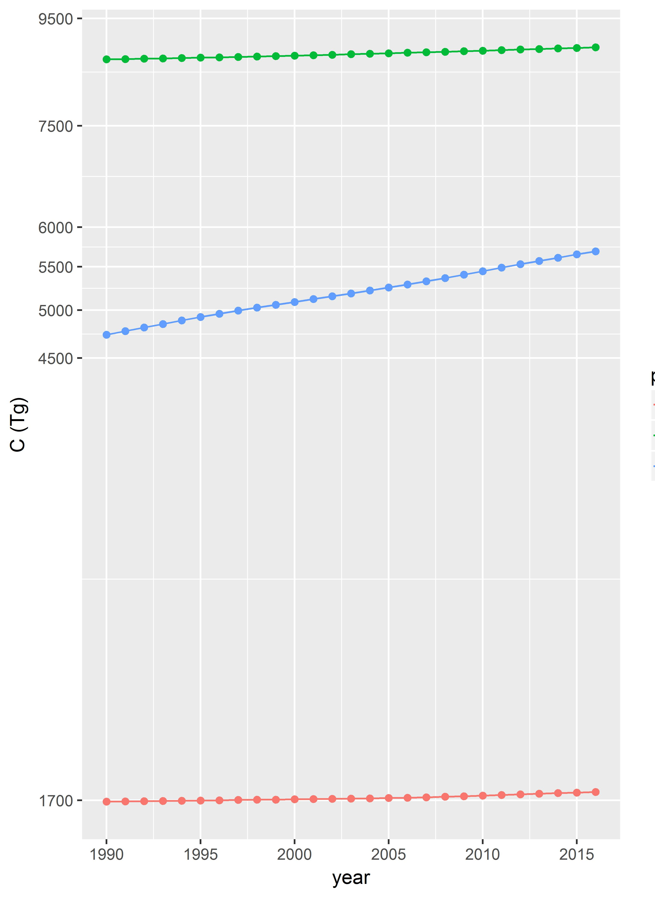
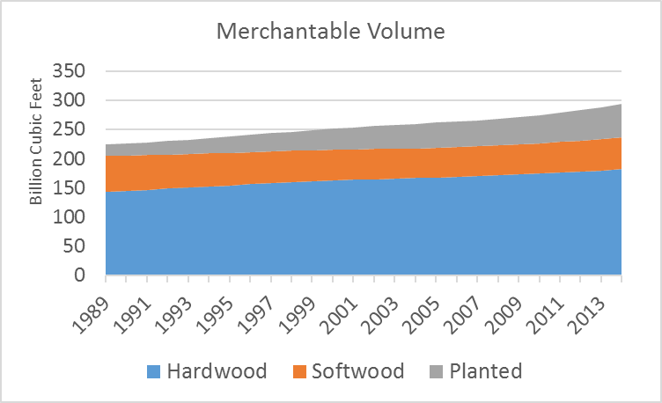
Southwide Forest Inventory/Carbon Stock Increasing
soil
tree
Coulston, et al. UFS forest carbon inventory
Forest Inventory and Analysis (FIA) plot data used in the model.
dead, litter, understory

Slide 7
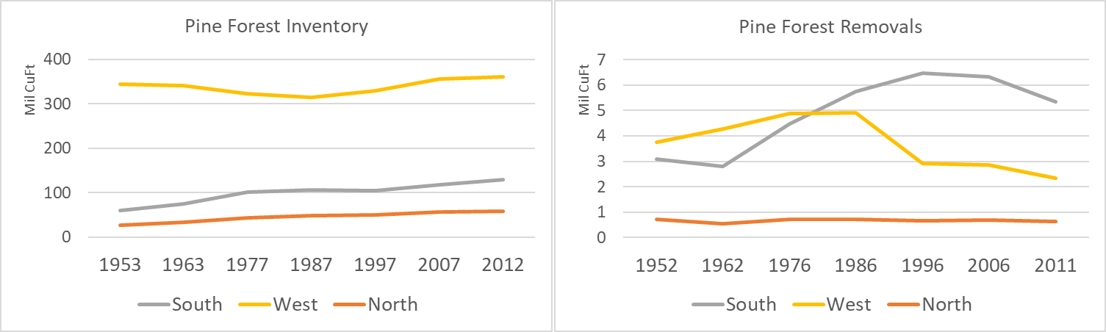
Southern Pine Forest Inventory doubles while removals double Also True For Total (Pine+Hardwood) Inventory & Removals
Pct Forest Area <40 Yrs Old
South 51%
North 20%
West 22%
Avg Acres Planted Per Year
South 2 million acres
North < .5 million acres
West < .2 million acres
Pvt Forestland Ownership
South 81%
West 22%

Slide 8
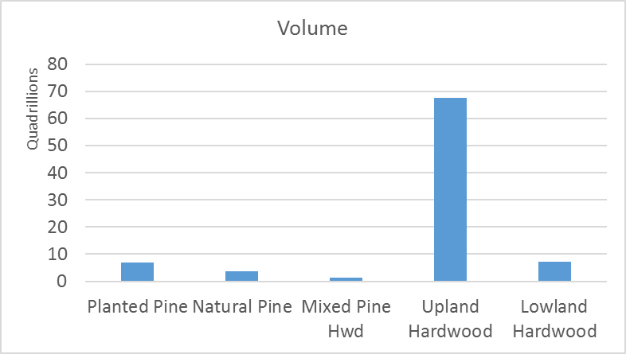
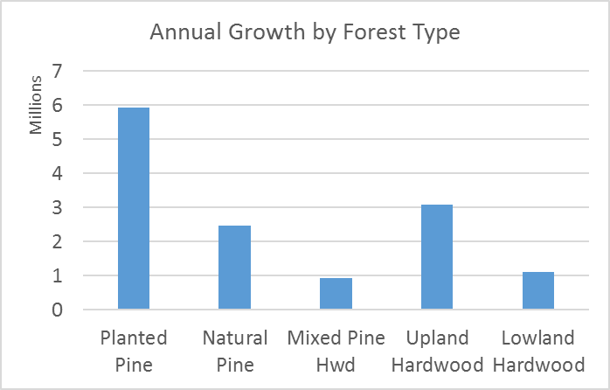
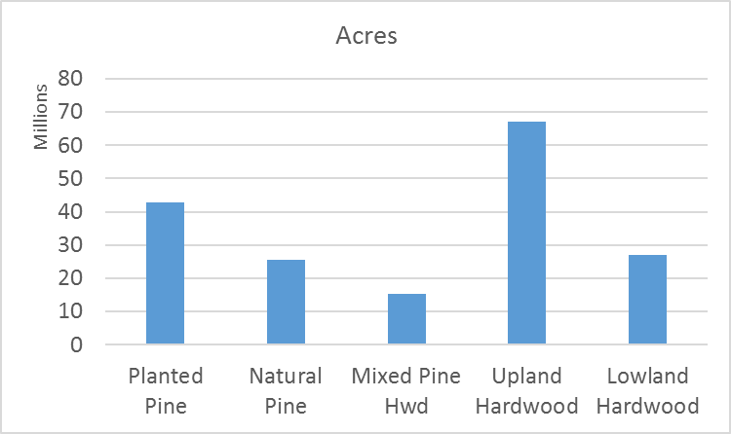
In the southern forest, where’s the carbon stock and where’s the sequestration?
Carbon Stock
Carbon Sequestration

Slide 9
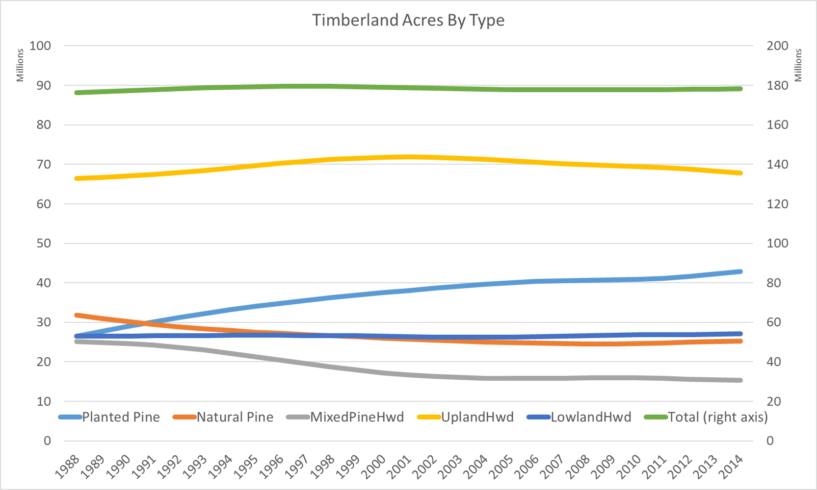
Timberland Area Steady but not Static
Note: Planted and Natural Pine have leveled off in the past two decades.

Slide 10
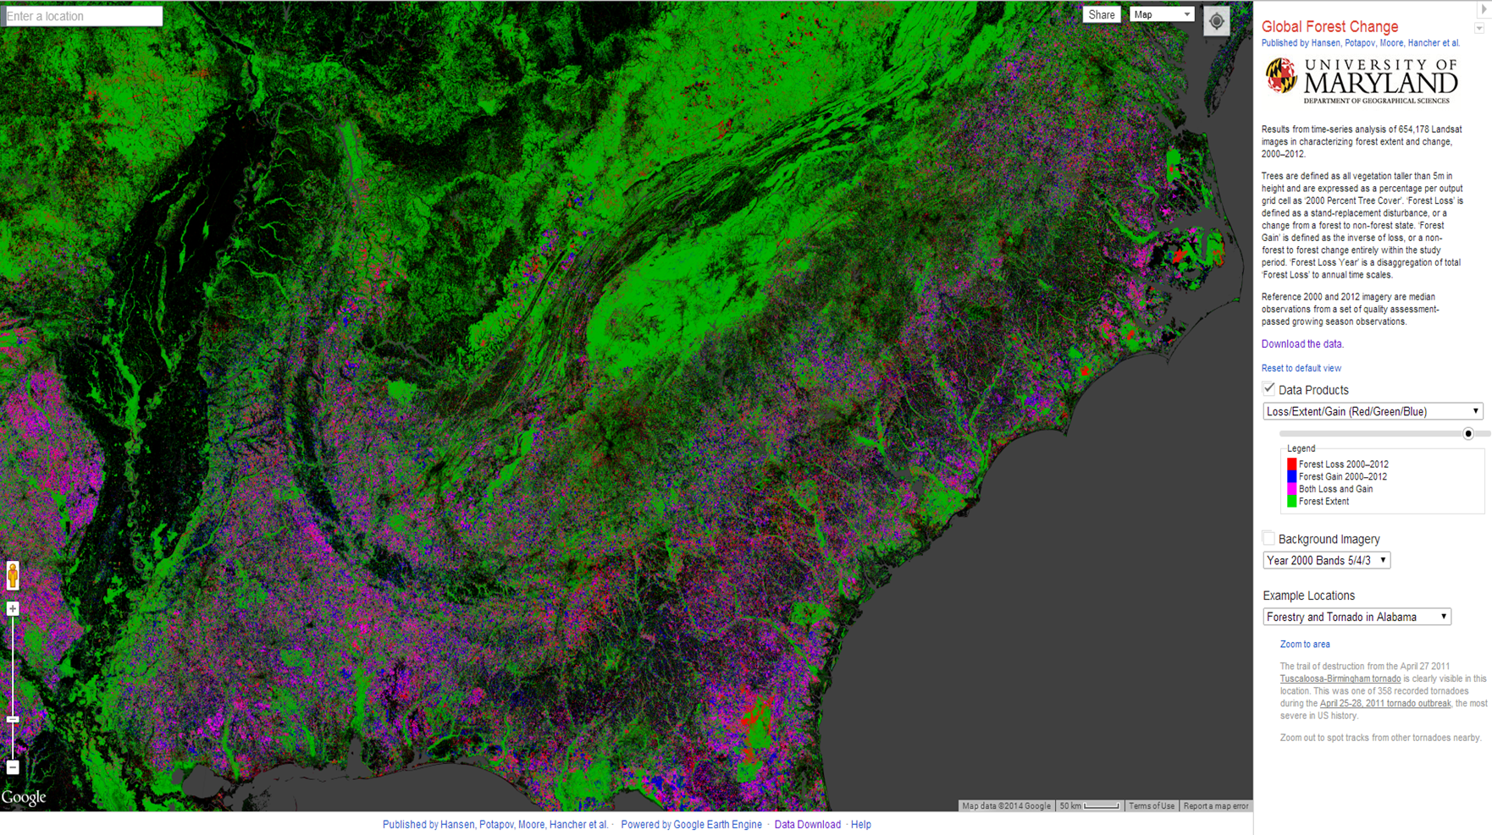
The Global Forest Change Project Shows How Rural Land in the South is Dynamic
Purple Color is Both Loss and Gain in Forest
2000-2012

Slide 11
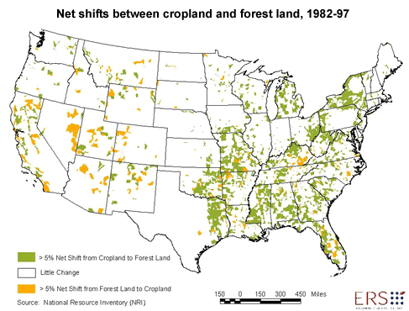
Forestland trend stable, but not static
Financial returns to landowners empirically significant explanatory variable
>5% Forest to Ag
>5% Ag to Forest

Slide 12
Southern Timberland is Dynamic Because:
This is a privately owned largely un-regulated landscape where marginal agriculture competes with forest land both at the intensive (plantations) and the extensive (marginal agriculture) margins.
“…we identified the rise in timber net returns as the most important factor driving the increase in forest areas between 1982 and 1997. This is consistent with reports that the increase in forests largely involved timberland acreage.” (Lubowski et al. 2008, Lubowski currently EDF lead economist )
What does this mean for the carbon consequences of increased demand for pellets?

Slide 13
If Timber Returns Affect Forest Area, Can Pellets Influence Returns to Forestland?
Pine Sawtimber (PST) has been the primary rent driver on southern timberlands
Low value products like pulpwood (which pellet mills use), not so much.
This matters for pellets. If demand/harvest for pulpwood (e.g. pellet feedstock) doesn’t influence returns to landowners and improve opportunities for forest management – the forest carbon benefit is reduced.

Slide 14
For Pellets to Influence Land Rents
The PST / PPW price differential needs to decrease to increase PPW influence
Pellets need to be a significant share of the market (large enough to influence prices)
Note: this is a local story, markets vary widely across the South.

Slide 15
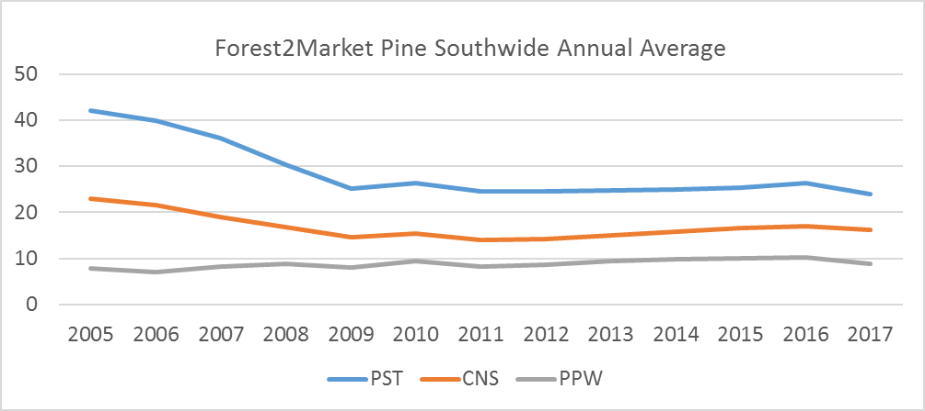

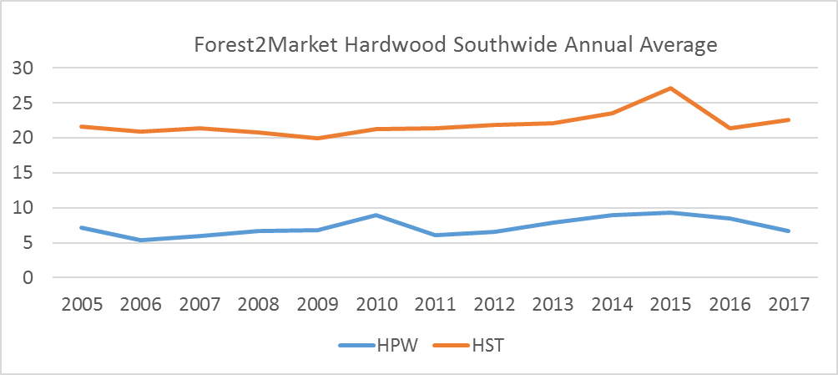
Pine Sawtimber Prices Decline Relative to Everything
PST/PPW
5:1
2.6:1
$25
$23

Slide 16
Pine Sawtimber Prices Decline Relative to Everything
PPW price becomes more important in land rent
PST/PPW
5:1
2.6:1
✓
$25
$23

Slide 17
Pellet Production
Do they have significant market share?

Slide 18
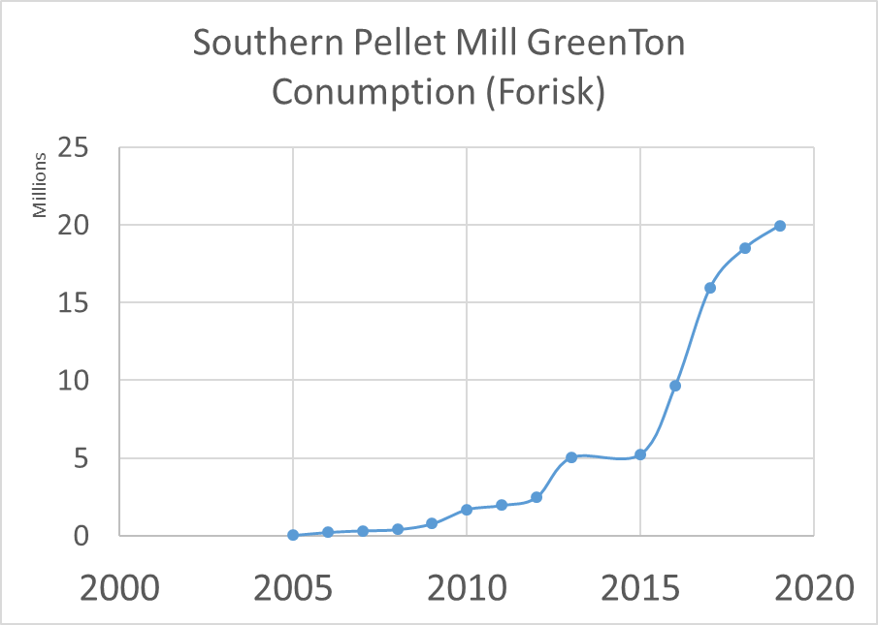

Slide 19
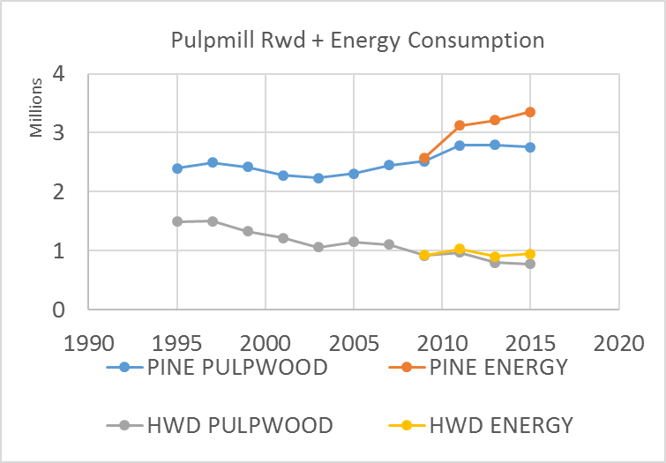
Small Proportion but Changes Trend
Energy consumption of pine pulpwood is only about 15% of total, but it is the marginal 15% on top of the highest pine pulpwood consumption ever.
TPO MCF

Slide 20
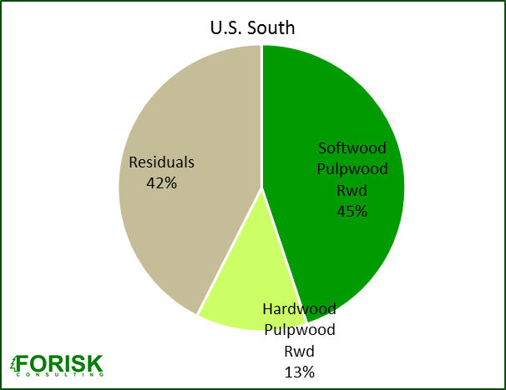
What do pellet mills use?
Enviva in NC/VA is probably about 80% hardwood – why?
Franklin VA papermill had just closed.
Logging/trucking infrastructure
Hwd PW was $2/ton.
Pellet plants that use over about 20% pine need VOC controls which cost about $1 million.
Residuals include mill residues, logging residues/dirty chips, urban wood. These are also used by pulp and OSB plants. Pine is about 80% of feedstock

Slide 21
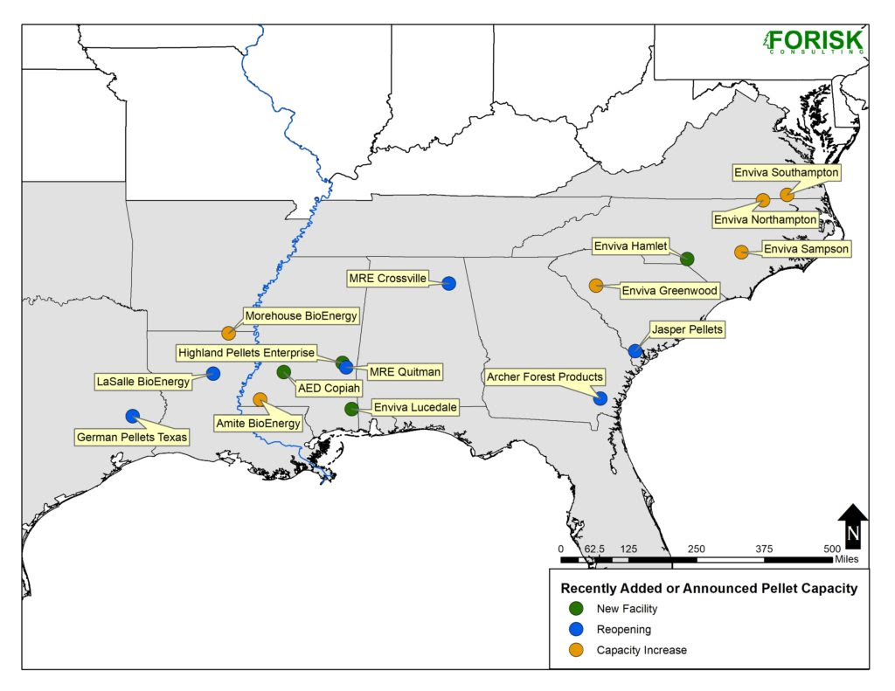
We Have Not Reached Peak Pellets: Recently Added or Announced Capacity

Slide 22
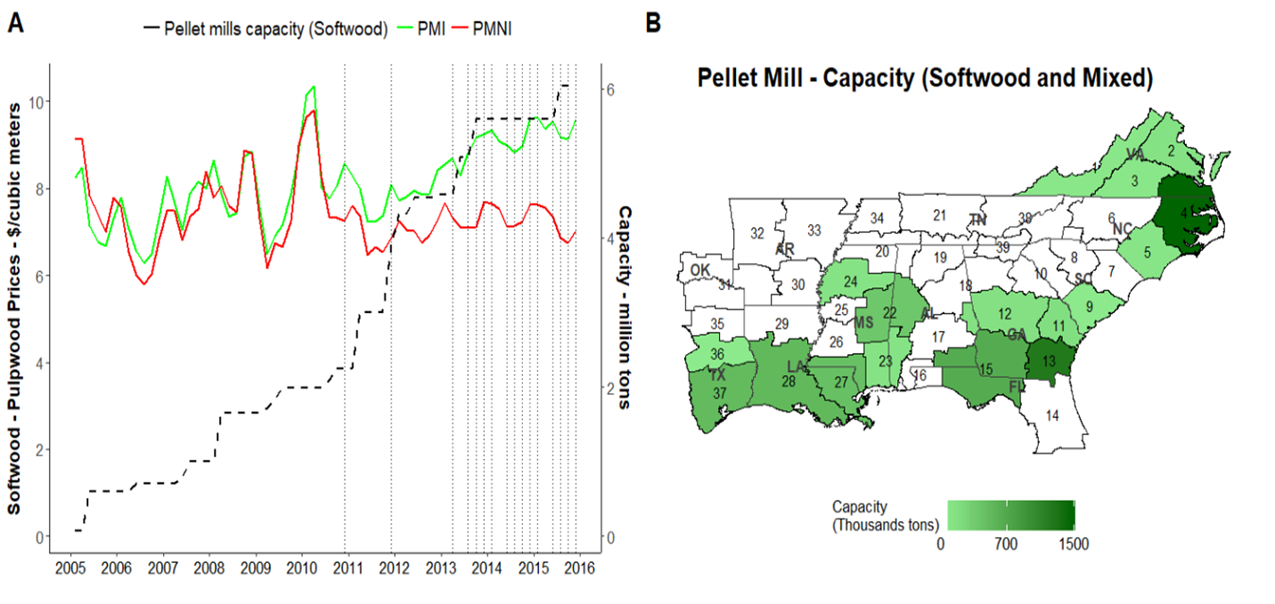
Pellet Demand and Pine Pulpwood Prices
Price
Pellet Capacity

Slide 23
Pellet Demand and Pine Pulpwood Prices
Pellets consumption large enough to affect prices
✓
Price
Pellet Capacity

Slide 24
How does pellet demand affect forest carbon?
When pellets can drive local forest returns:

Slide 25
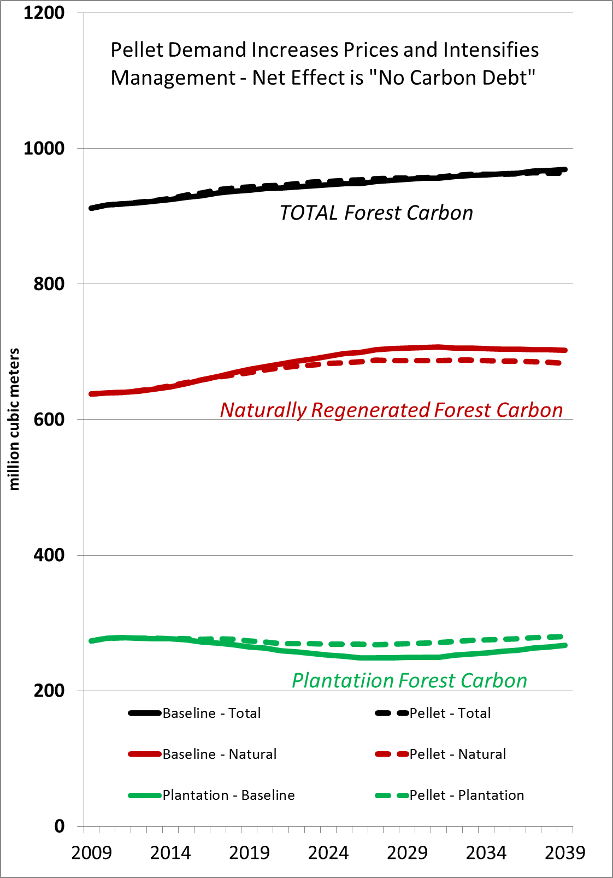
SRTS Model Results:
In the current market, increasing demand for small value trees has more land rent impact than it has historically.
Total Forest Carbon Can Actually Increase. But timing matters.
Rent affects area in forest and distribution of forest types.
Note: This is not the same as “carbon neutral”
with pellet demand
Results based on pine demand in the AL, FL, GA Coastal Plain

Slide 26
The Carbon Score of Wood for Energy Looks Worse When You Assume:
Small areas (plots) rather than landscapes – no market effects
Short time frames (20 years vs. > 100 years)
Slow growing trees with uncertain regeneration
Baselines/counterfactuals that assume trees will not be cut and continue to sequester if not used for energy
No markets, land use or management response
-The first two are affected by the modeling assumptions.
-The last three do NOT apply in the U.S. South.
The south is the world’s largest timber producer and the land/timber base is privately owned and market driven.

Slide 27
Market and Resource Summary
In a private forestland market:
Increased forest product demand leads to:
Higher prices
Land use change and management response
Net inventory/carbon response depends on local markets (shifts, substitutions, expansion)
Note: Agriculture markets matter too
– high prices reduces area of fallow ag land (and reduces CRP land remaining in forest). Ag technical change can reduce demand for ag land and marginal land reverts forest.

Slide 28
Questions? bobabt@ncsu.edu justinbaker@ncsu.edu

