Slide 1

Federal Spending and the States
Rebecca Thiess
Fiscal Federalism Initiative
The Pew Charitable Trusts
September 2021

Slide 2
Overview
Federal spending and the states
    Over 90% of federal spending happens in the states
    How federal spending fits in at the state level
Federal and state spending on natural disasters
/fiscal-federalism

Slide 3
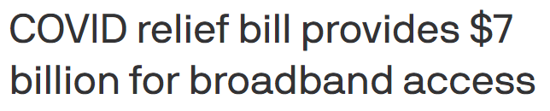
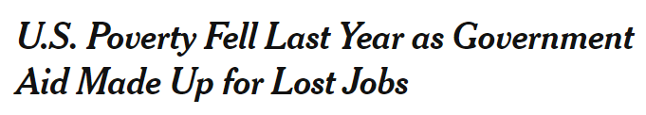

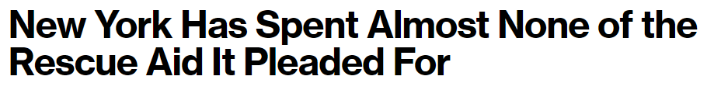

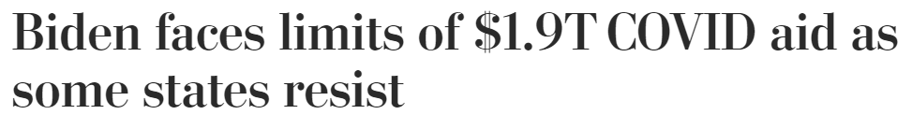
/fiscal-federalism

Slide 4
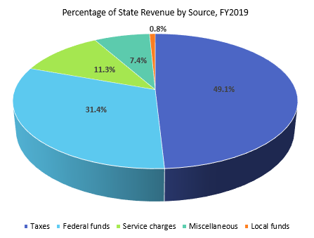
Sources of state funding
/fiscal-federalism

Slide 5
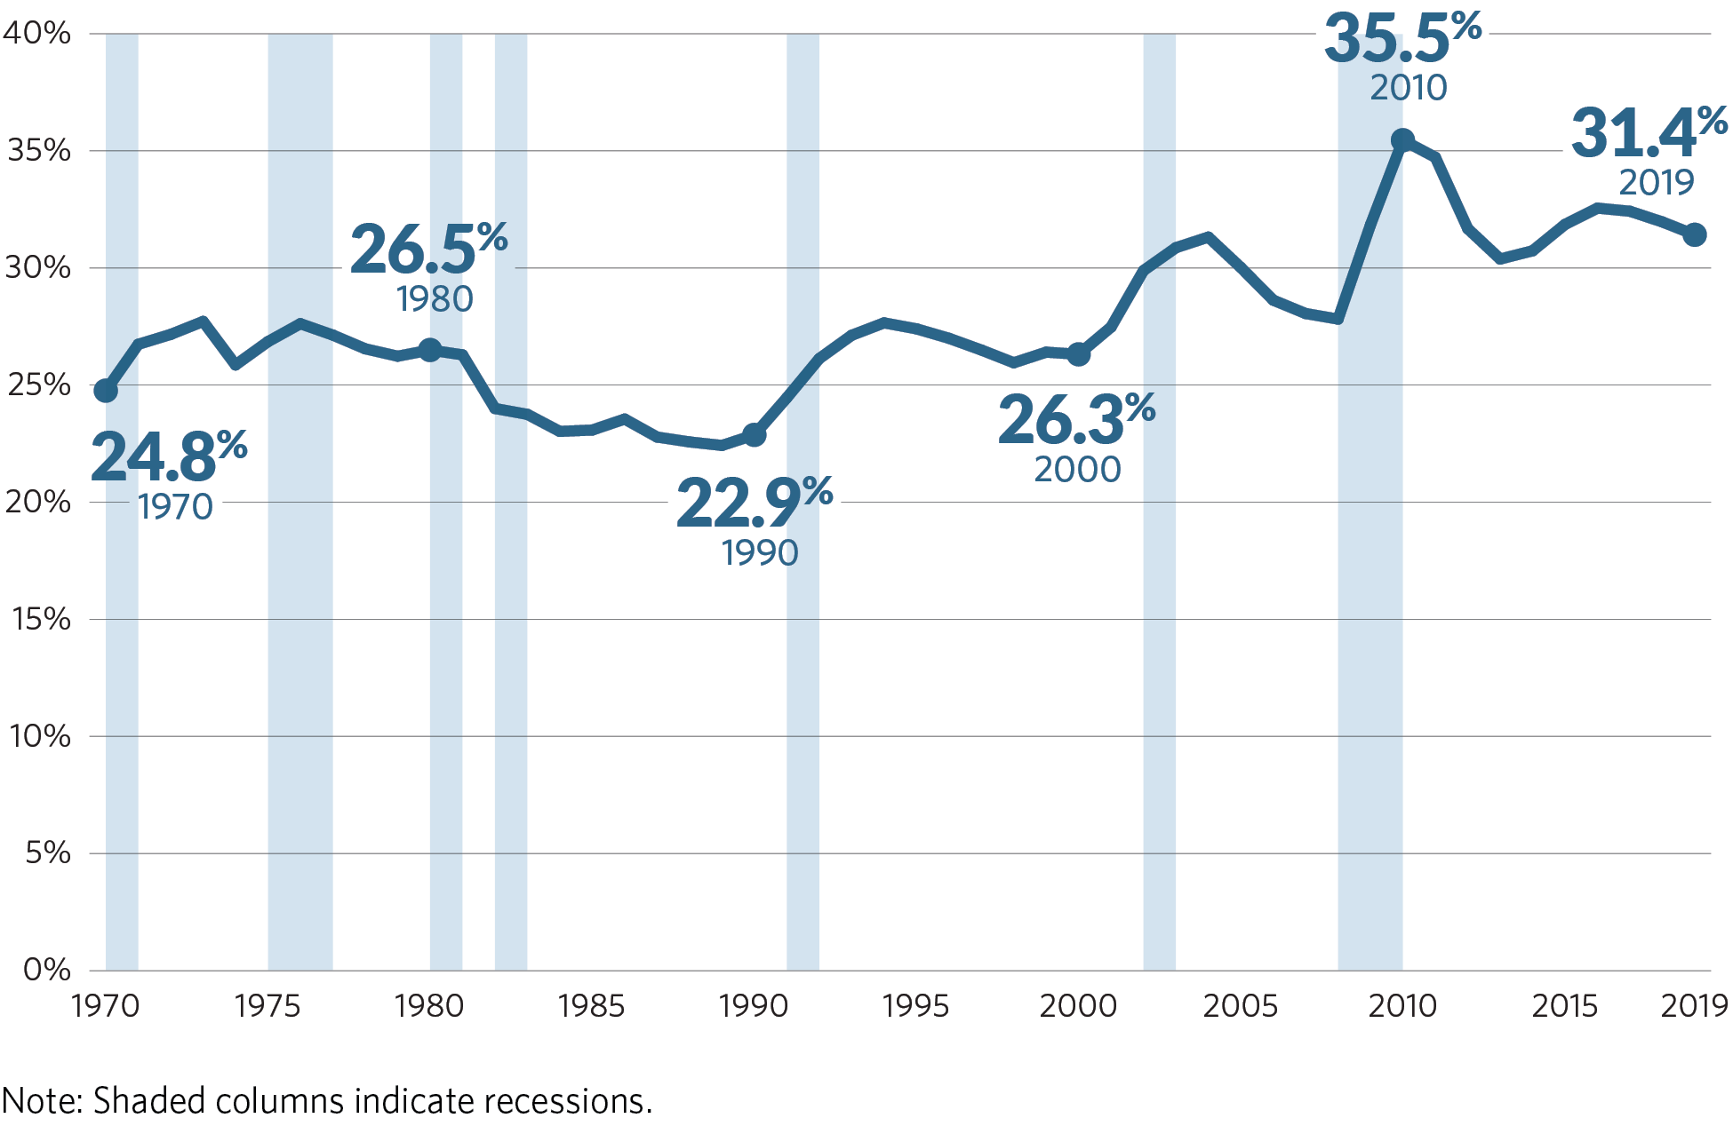
Federal grants as a share of states’ budgets
Percentage of state revenue by source, FY 1970-2019
/fiscal-federalism

Slide 6
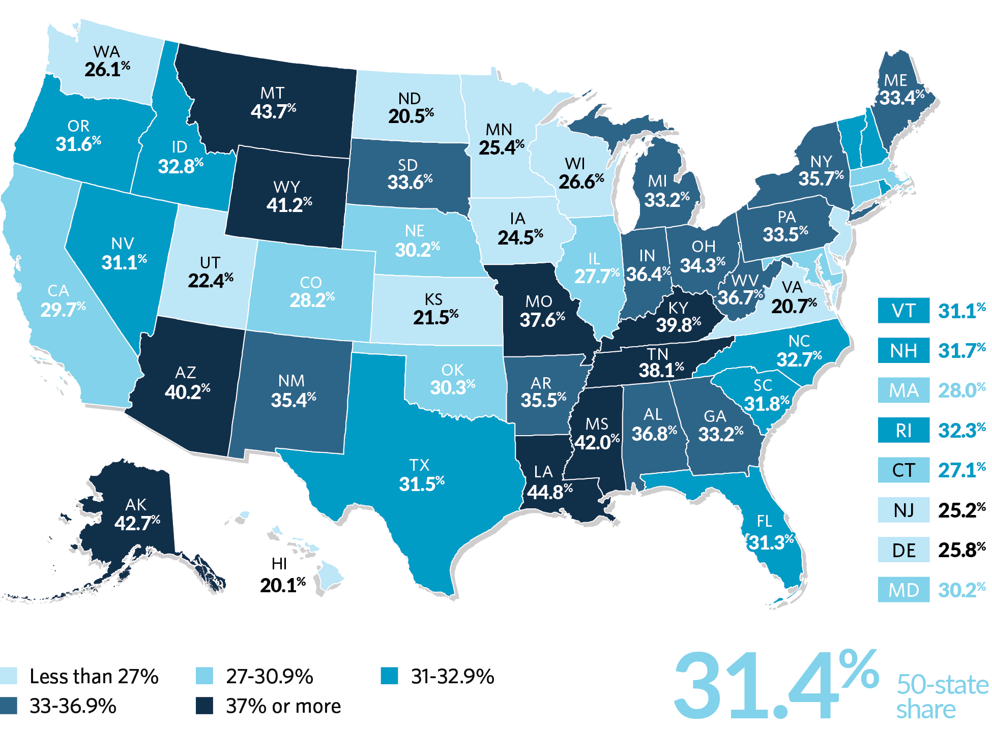
Federal grants vary as a share of state budgets
Percentage of state revenue from federal funds, state FY 2019
Note: This data is preliminary and is not yet published.
/fiscal-federalism

Slide 7
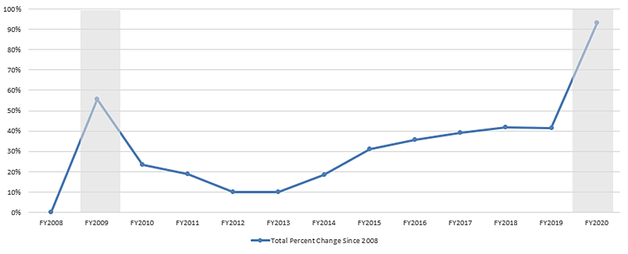
Trends in grants to states
COVID-19 Aid Caused a Sharp Rise in Federal Grants to States in 2020
Percentage change in funding relative to federal FY 2008, adjusted for inflation
/fiscal-federalism

Slide 8
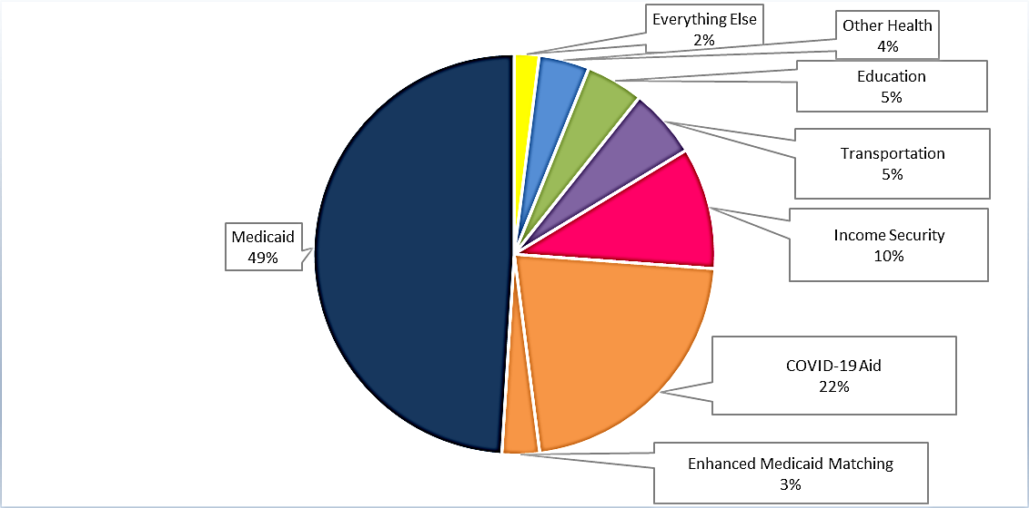
Grant aid to states now includes sizeable COVID aid
COVID-19 Spending Accounted for 25% of Federal Grants to States in 2020
Distribution of funding by program area, federal FY 2020
/fiscal-federalism

Slide 9
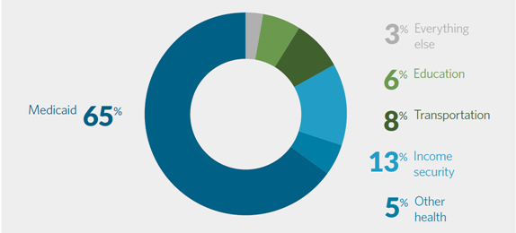
Medicaid Dominates FY2019 Grants to States

Slide 10
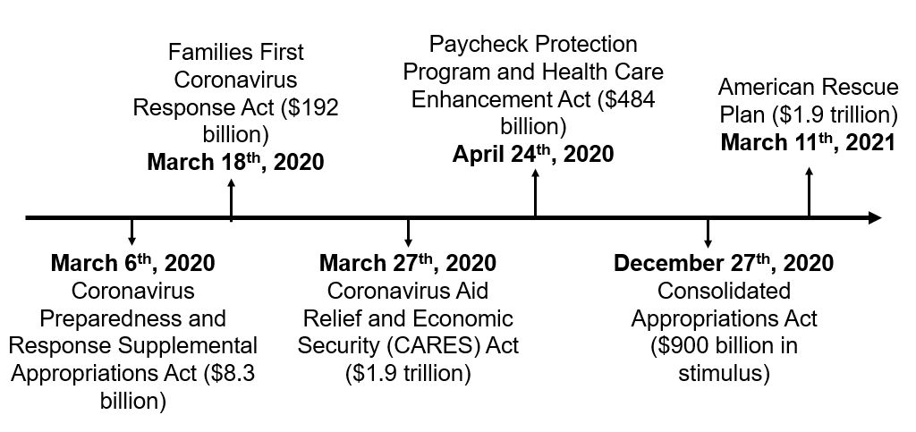
Federal pandemic aid
/fiscal-federalism

Slide 11
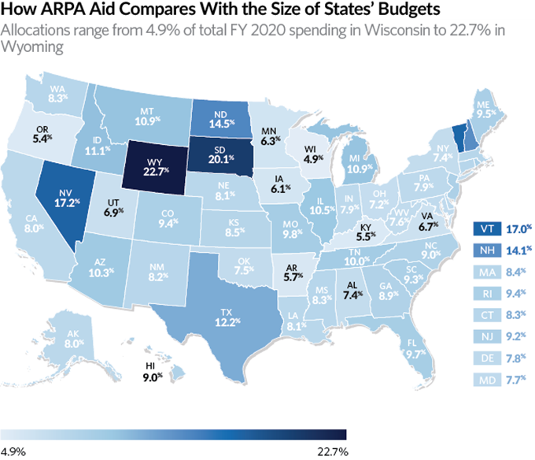
ARPA and state budgets
fiscal-federalism-initiative

Slide 12

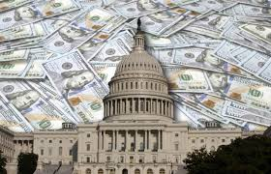
Current proposals
(Becky to fill in text here)
FY2022 Budget
Infrastructure
/fiscal-federalism

Slide 13

Becky Thiess
rthiess@pewtrusts.org
pewtrusts.org/fiscal-federalism-initiative

