Slide 1
State of the economy

Slide 2
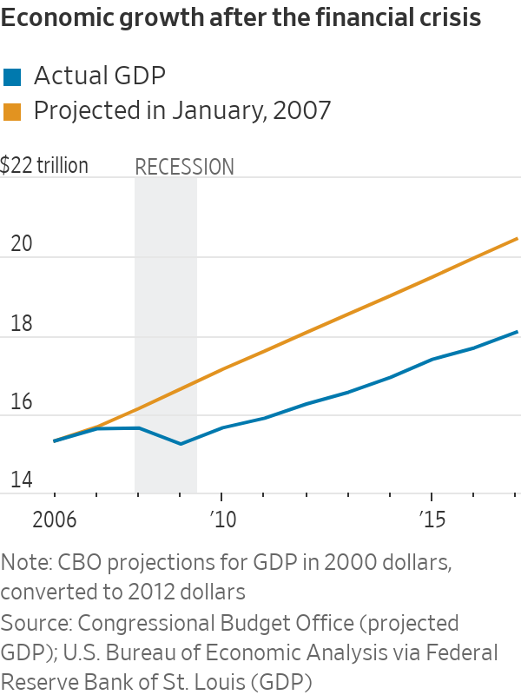
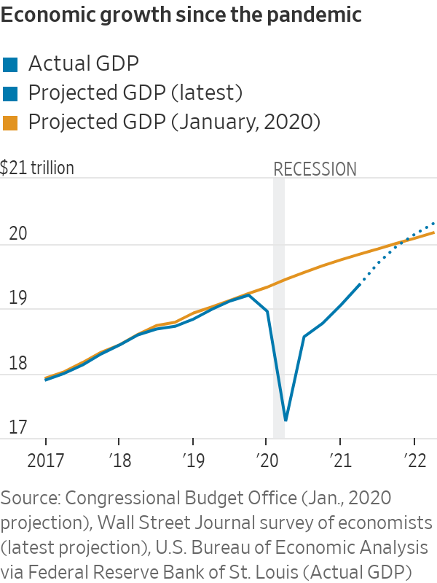

Slide 3
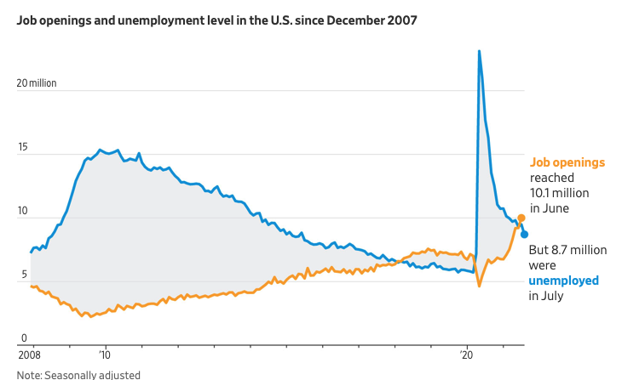

Slide 4
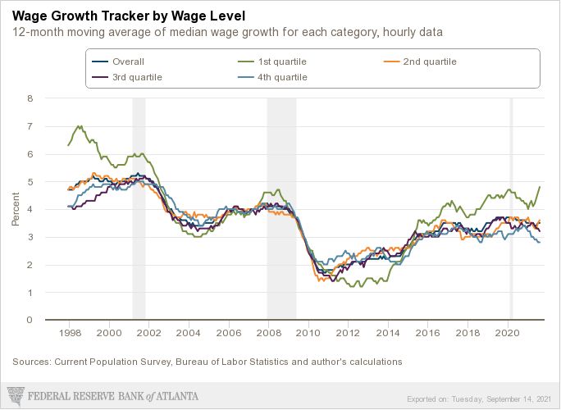

Slide 5
Monetary policy

Slide 6
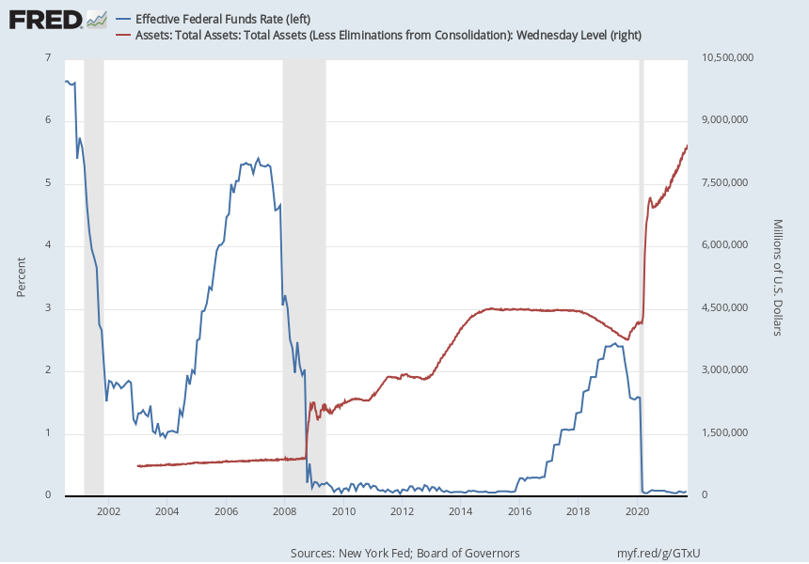
Notes:
Source:
Federal Reserve Bank of New York
Release:
Federal Funds Data
Units:
Percent, Not Seasonally Adjusted
Frequency:
Daily
For additional historical federal funds rate data, please see Daily Federal Funds Rate from 1928-1954.
The federal funds market consists of domestic unsecured borrowings in U.S. dollars by depository institutions from other depository institutions and certain other entities, primarily government-sponsored enterprises.
The effective federal funds rate (EFFR) is calculated as a volume-weighted median of overnight federal funds transactions reported in the FR 2420 Report of Selected Money Market Rates.
For more information, visit the Federal Reserve Bank of New York.
Federal Reserve Bank of New York,
Effective Federal Funds Rate [EFFR],
retrieved from FRED,
Federal Reserve Bank of St. Louis;
https://fred.stlouisfed.org/series/EFFR,
September 19, 2021.
Source:
Board of Governors of the Federal Reserve System (US)
Release:
H.4.1 Factors Affecting Reserve Balances
Units:
Millions of U.S. Dollars, Not Seasonally Adjusted
Frequency:
Weekly, As of Wednesday
Board of Governors of the Federal Reserve System (US),
Assets: Total Assets: Total Assets (Less Eliminations from Consolidation): Wednesday Level [WALCL],
retrieved from FRED,
Federal Reserve Bank of St. Louis;
https://fred.stlouisfed.org/series/WALCL,
September 19, 2021.

Slide 7
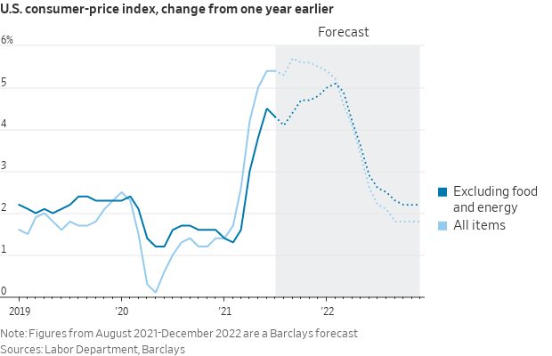

Slide 8
Fiscal policy

Slide 9
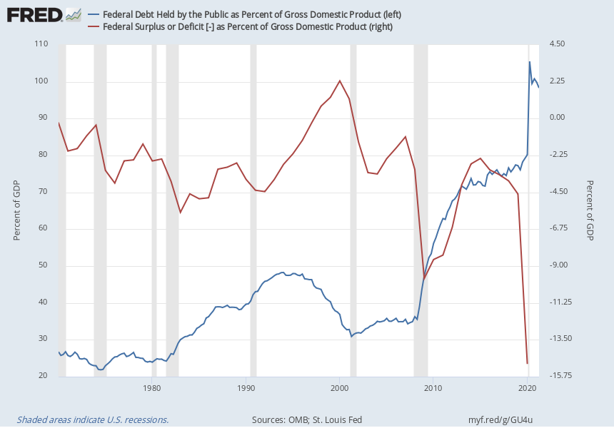
Notes:
Source:
U.S. Office of Management and Budget
Source:
Federal Reserve Bank of St. Louis
Release:
Debt to Gross Domestic Product Ratios
Units:
Percent of GDP, Seasonally Adjusted
Frequency:
Quarterly
Federal Debt Held by the Public as Percent of Gross Domestic Product (FYGFGDQ188S) was first constructed by the Federal Reserve Bank of St. Louis in October 2012. It is calculated using Federal Debt Held by the Public (FYGFDPUN) and Gross Domestic Product, 1 Decimal (GDP):FYGFGDQ188S = ((FYGFDPUN/1000)/GDP)*100FYGFDPUN/1000 transforms FYGFDPUN from millions of dollars to billions of dollars.
U.S. Office of Management and Budget and Federal Reserve Bank of St. Louis,
Federal Debt Held by the Public as Percent of Gross Domestic Product [FYGFGDQ188S],
retrieved from FRED,
Federal Reserve Bank of St. Louis;
https://fred.stlouisfed.org/series/FYGFGDQ188S,
September 19, 2021.
Source:
U.S. Office of Management and Budget
Source:
Federal Reserve Bank of St. Louis
Release:
Debt to Gross Domestic Product Ratios
Units:
Percent of GDP, Not Seasonally Adjusted
Frequency:
Annual
Federal Surplus or Deficit [-] as Percent of Gross Domestic Product (FYFSGDA188S) was first constructed by the Federal Reserve Bank of St. Louis in October 2012. It is calculated using Federal Surplus or Deficit [-] (FYFSD) and Gross Domestic Product (GDPA):FYFSGDA188S = ((FYFSD/1000)/GDPA)*100FYFSD/1000 transforms FYFSD from millions of dollars to billions of dollars.
U.S. Office of Management and Budget and Federal Reserve Bank of St. Louis,
Federal Surplus or Deficit [-] as Percent of Gross Domestic Product [FYFSGDA188S],
retrieved from FRED,
Federal Reserve Bank of St. Louis;
https://fred.stlouisfed.org/series/FYFSGDA188S,
September 19, 2021.

Slide 10
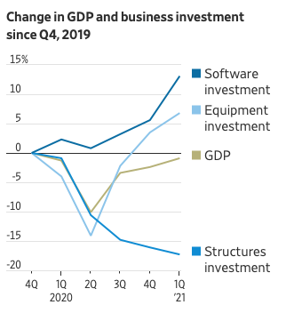

Slide 11
US vs China

Slide 12
