Slide 1
The European Commission's Proposal for a Carbon Border Adjustment Mechanism
October 26, 2021

Slide 2
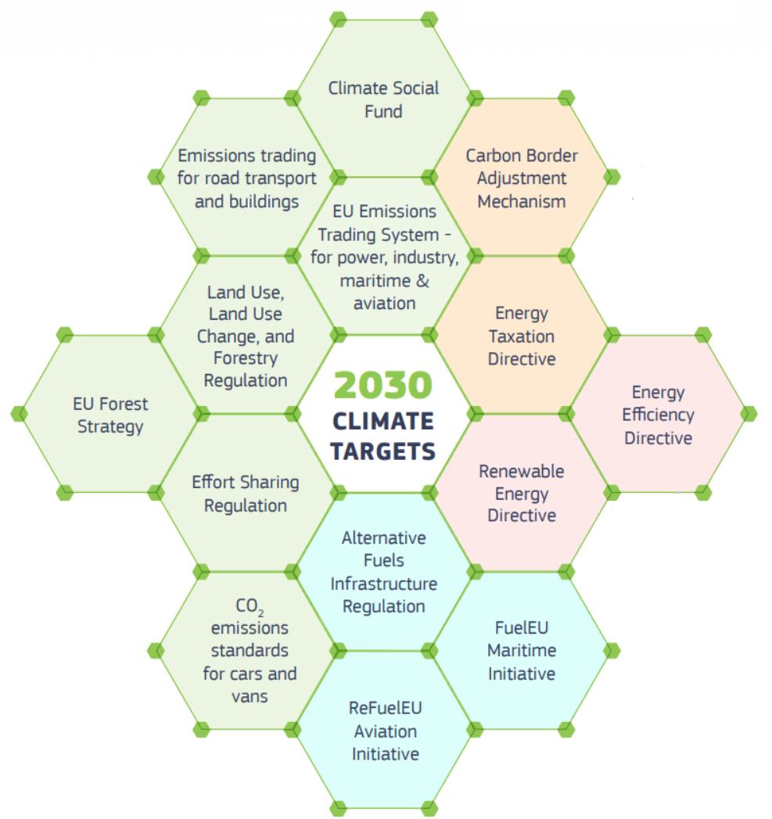

The European Green Deal, EU Climate Law, and Fit For 55
EU Green Deal is an all-encompassing industrial policy, with the aim to change the EU’s economic model.
“Fit For 55” Package
EU Climate Law requires a 55% reduction by 2030, and net neutrality by 2050.
Sectors covered by the ETS must reduce emissions by 61% by 2030 – as compared with 2005 levels.
Increased target to produce 40% of energy from renewable sources by 2030.

Slide 3
The EU’s Stated Motivation for the CBAM
“CBAM is a climate measure”
(CBAM Proposal, Recital 13.)
Carbon Leakage
Paris
Agreement
Climate Change
COP 26
(in Nov. 2021)
Art. 192 TFEU

Slide 4
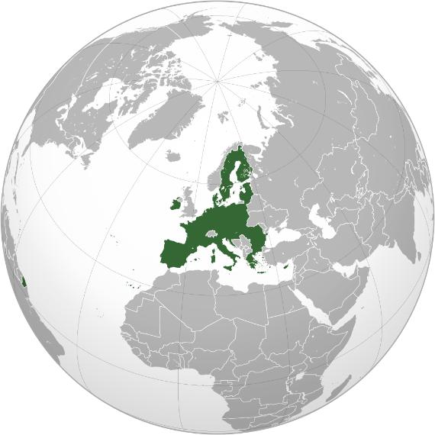
Basic Idea & Timing
Timing
Full entry into force January 2026; transitional regime with only reporting obligations as of January 2023
The CBAM’s 4 Steps
1
Registration of Authorized Declarants
2
Import Covered Goods
3
Purchase of CBAM Certificates
4
CBAM Declaration &
Surrender of CBAM Certificates

Slide 5
Covered Goods & Countries
Covered Goods
Goods considered at high risk of carbon leakage
  Steel & Iron
  Aluminum
  Cement
  Certain Fertilizers
Electricity
Covered Countries
All non-EU countries other than EEA and Switzerland
Commission may exclude third countries from CBAM if they:
  are fully integrated into the EU ETS, or
  link their cap-and-trade system to the EU ETS
Special rules for countries with electricity market integrated into the EU (“market coupling”)

Slide 6

Embedded Emissions
Scope & Methodology
Direct emissions resulting from the production process (not indirect emissions)
For complex goods, also embedded emissions of input materials.
European Commission to define system boundaries
1
Default Values
For products (other than electricity) declarants may use product methodology, otherwise use default values
Default values can be country- (even region-) specific
Default values for electricity unless declarant decides to use specific methodology
2
Embedded emissions
can be country, region, and company specific
Verification
Authorized declarants must have the embedded emissions of their imported products verified, or
Operators of industrial installations in third countries may register with the Commission and get their emissions verified (and share embedded emissions information with authorized declarants)
3

Slide 7
CBAM Certificates
€
Issued by Member State Competent Authority
Price based on weekly average price of ETS allowance
Limited Buy Back Options (No Trade)

Slide 8
Discounts & Adjustments
Discounts for “Carbon Price”
  Only for goods originating in countries with “carbon price” on embedded emissions:
    as a tax or as part of cap-and-trade scheme
  EU may conclude agreements with third countries recognizing their carbon prices
Adjustments for
EU ETS Free Allowances
  Amount of CBAM certificates to surrender must be adjusted to take account of free ETS allowances granted to competing domestic industry
  Proposed Amendment of ETS includes phase-out of free allowances with an annual reduction of 10 percentage points between 2026 and 2035

