Slide 1
Carbon border taxes
What is in them for developing countries?
Harun Onder
World Bank

Slide 2





No carbon price – single sector
Price & the value of marginal product of emissions in the developing economy
Price & the value of marginal product of emissions in the advanced economy
$$A^{∗}$$
$$A$$
$$O$$
$$E_{0}$$
$$O^{∗}$$
Developing economy emissions
Advanced economy emissions

Slide 3






A common carbon price- single sector
Price & the value of marginal product of emissions in the developing economy
Price & the value of marginal product of emissions in the advanced economy
$$A^{∗}$$
$$A$$
$$C$$
$$C^{∗}$$
$$p_{1}^{∗}$$
$${ p}_{1}^{∗}$$
$$O$$
$$E_{1}$$
$$E_{0}$$
$$E_{1}^{∗}$$
$$O^{∗}$$
Developing economy emissions
Advanced economy emissions

Slide 4















No carbon price in the developing country – single sector
Price & the value of marginal product of emissions in the developing economy
Price & the value of marginal product of emissions in the advanced economy
$$A^{∗}$$
$$A$$
The policy choice will vary by country!
$$B$$
$$p_{2}$$
$$C$$
$$C^{∗}$$
$$p_{1}^{∗}$$
$${ p}_{1}^{∗}$$
$$D$$
$$O$$
$$E_{1}$$
$$E_{2}$$
$$E_{0}$$
$$E_{1}^{∗}$$
$$O^{∗}$$
Developing economy emissions
Advanced economy emissions

Slide 5

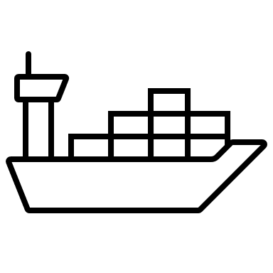


Multiple sectors
Scale
effect
In some circumstances, developing country emissions can increase as a result of the CBAM!
Composition
effect
Technique
effect

