Slide 1
Artificial Intelligence (whatever that means) advances in diagnosing and treating rare diseases
Ben Solomon
September 14, 2021

Slide 2
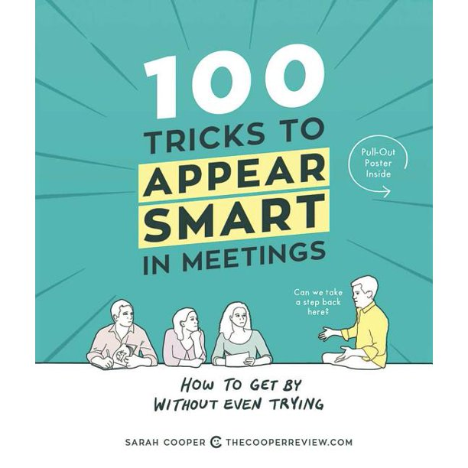
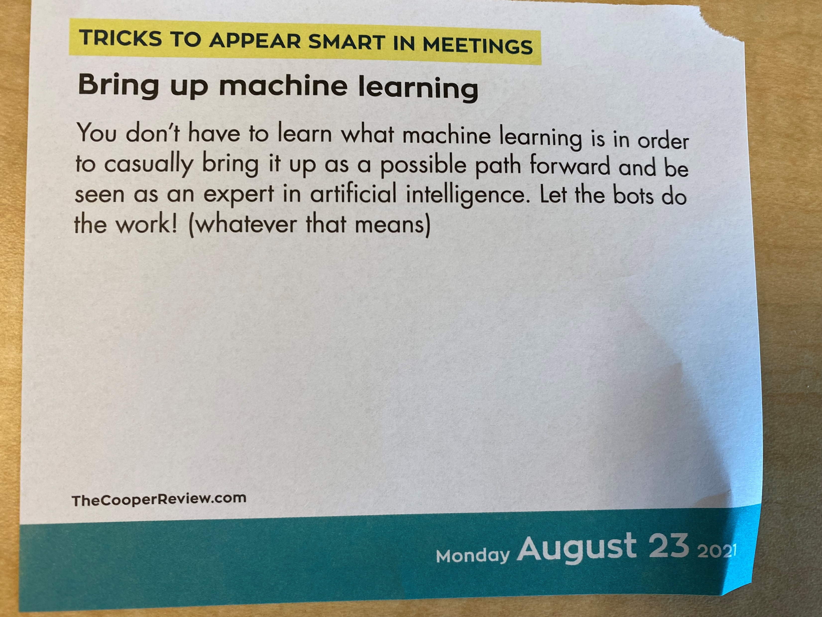

Slide 3
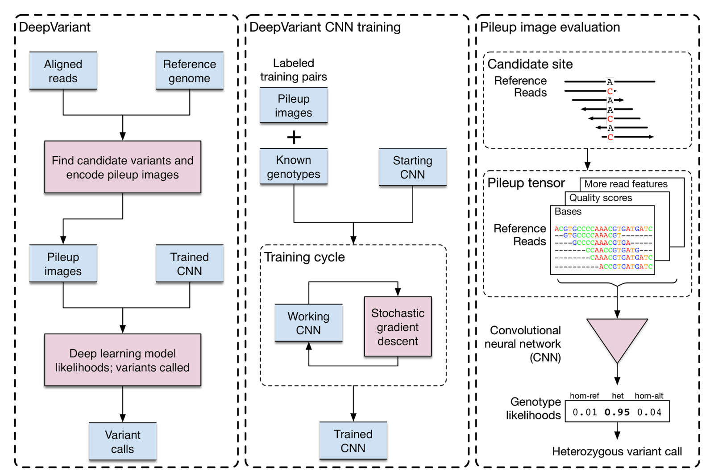
I went to a recent talk on genomic analyses…

Slide 4
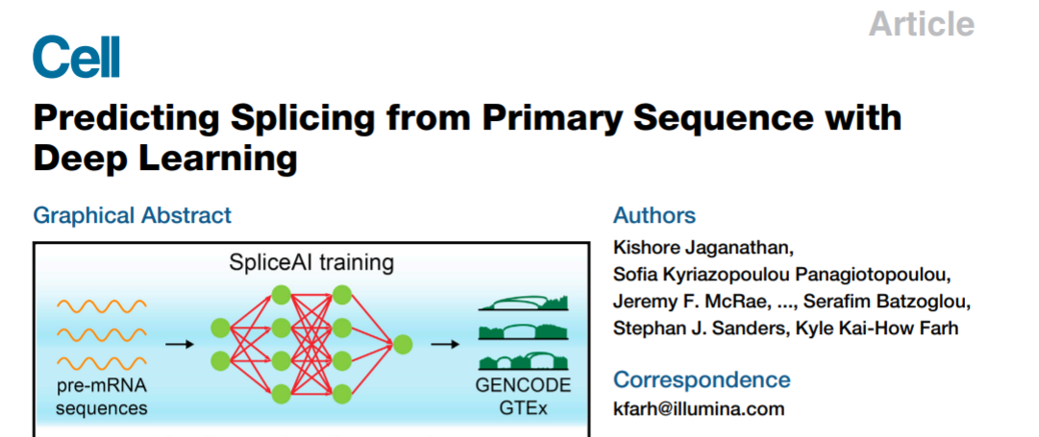

Slide 5
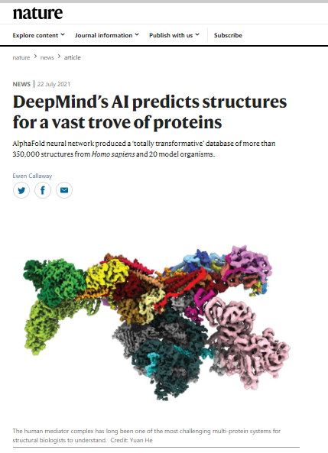
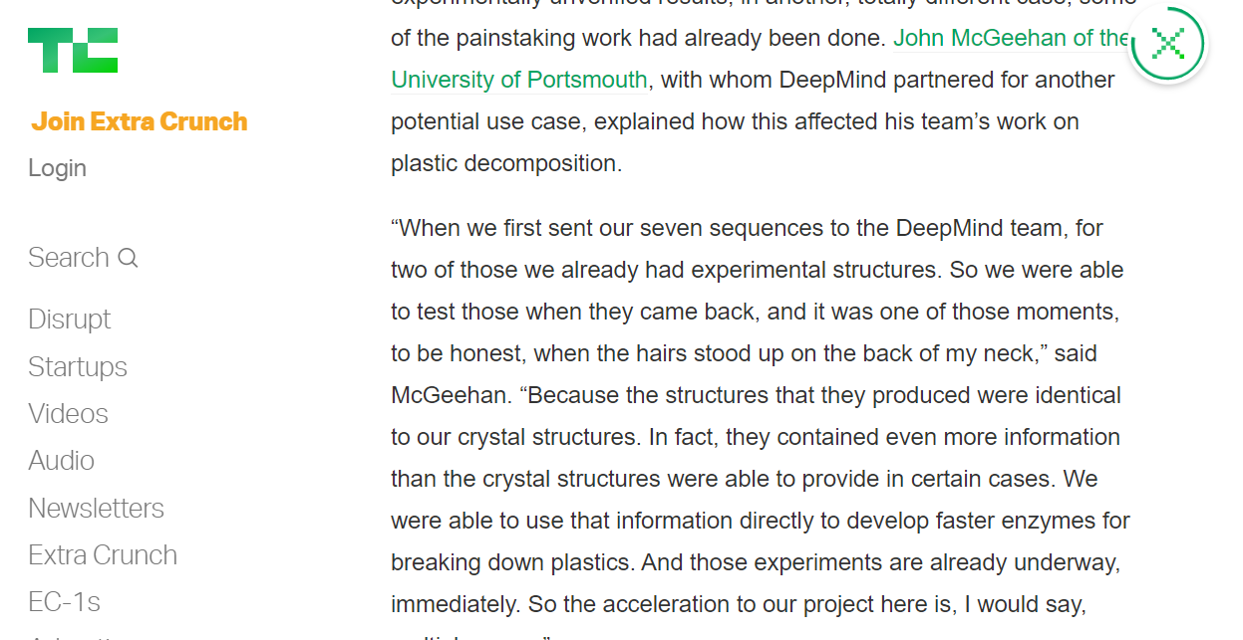
On the basic/translational side…

Slide 6
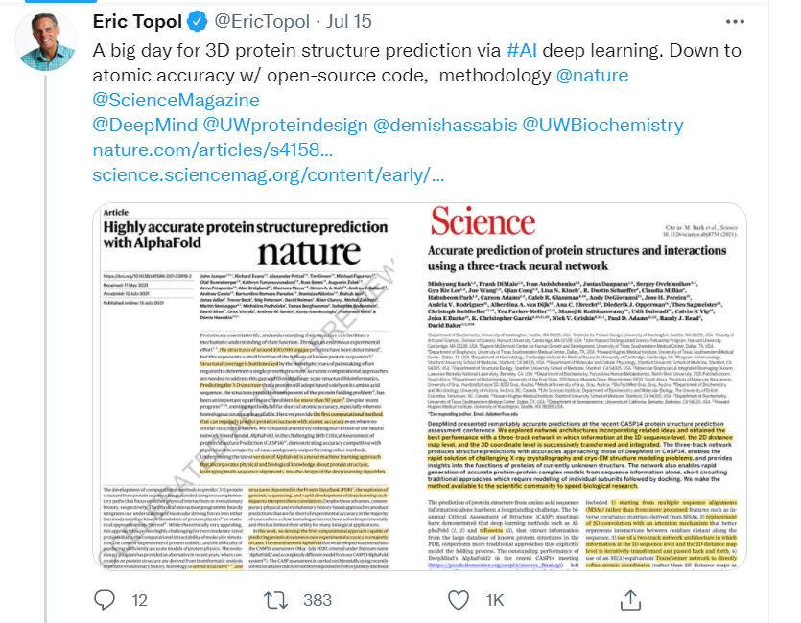
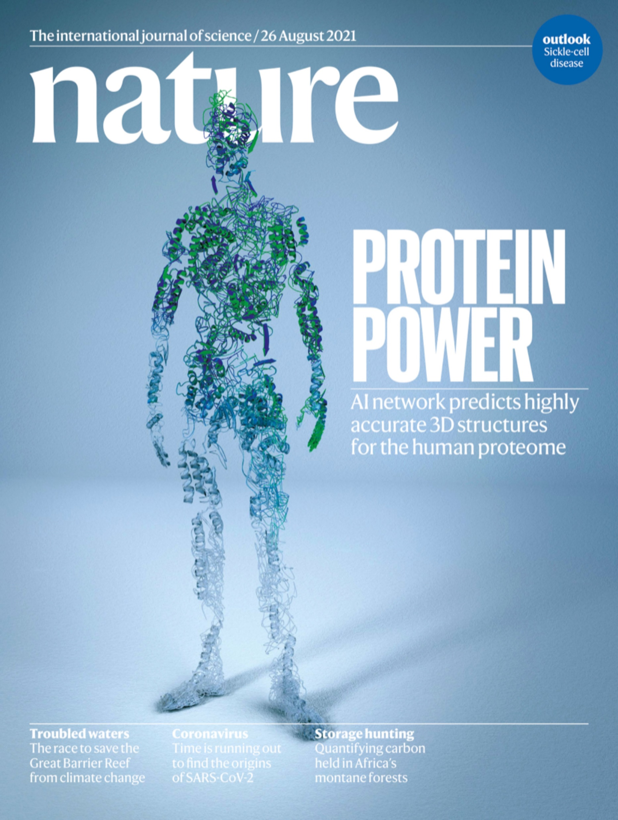

Slide 7
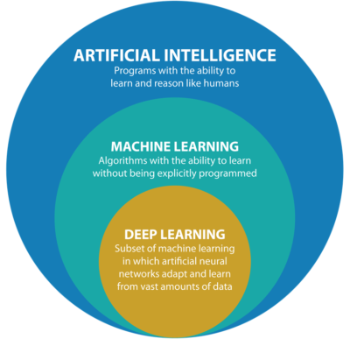
Some first definitions

Slide 8
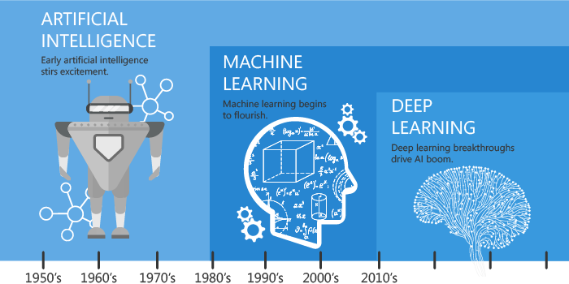

Slide 9
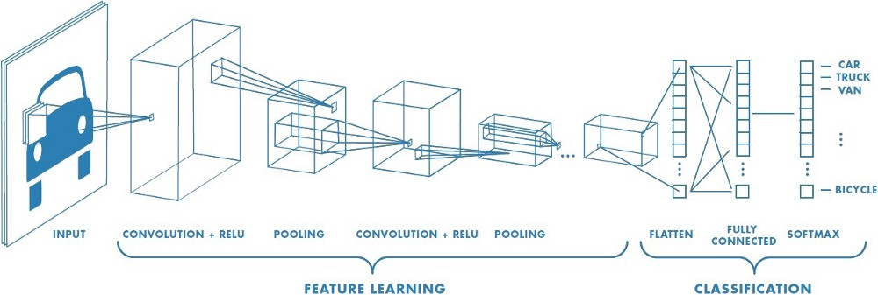
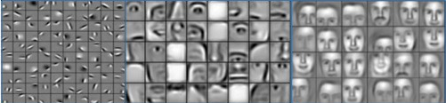

Slide 10

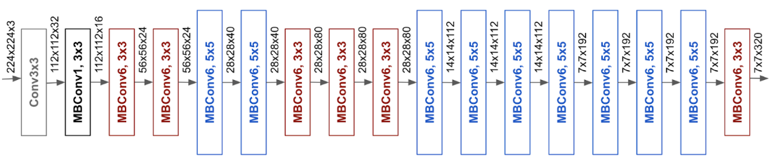
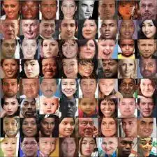


Slide 12
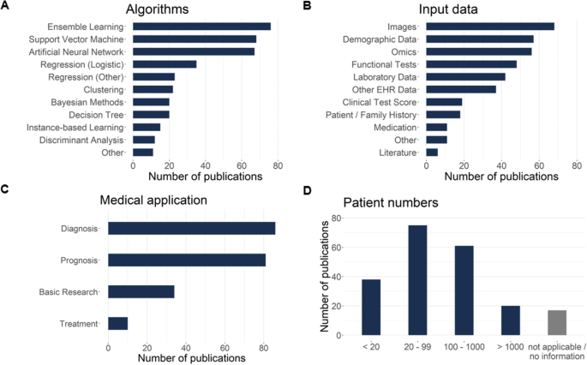
Schaefer et al., OJRD 2020

Slide 13
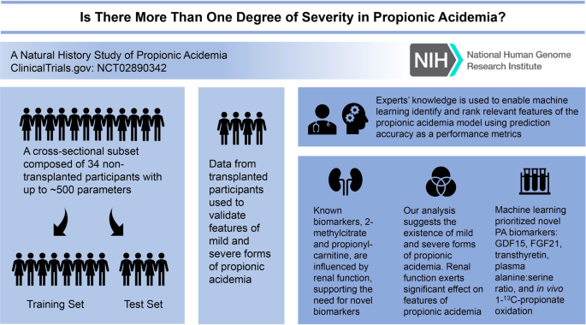
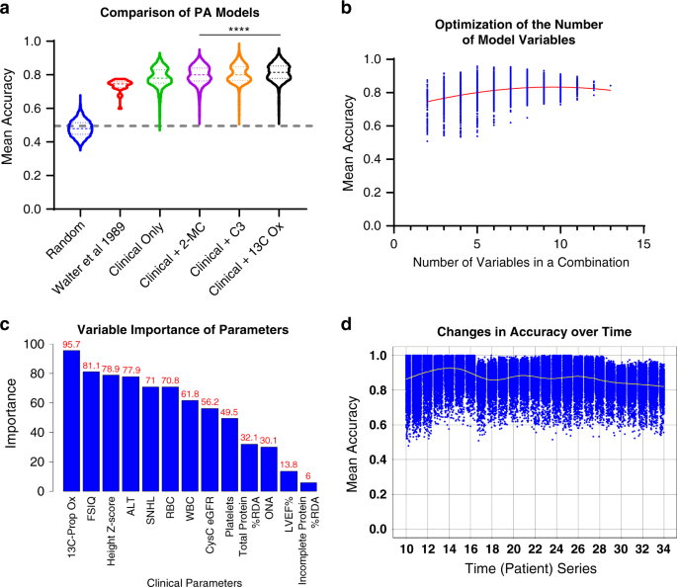
Shchelochkov et al., Genet Med 2021

Slide 14
Deep learning studies of genetic conditions (n = 135)
[in preparation]

Slide 15
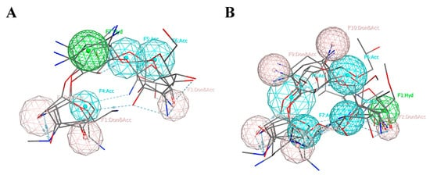
Wang et al., Molecules 2020

Slide 16
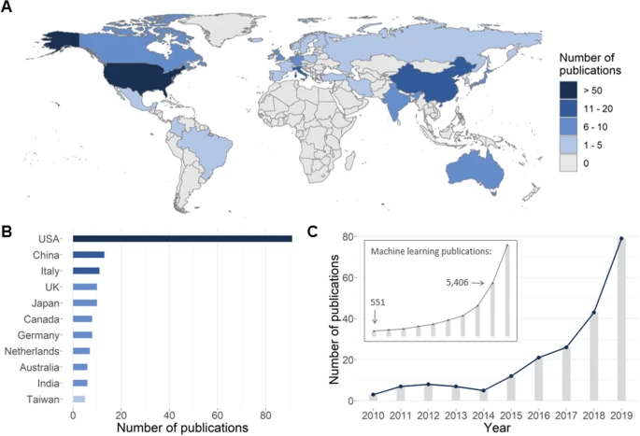
Schaefer et al., OJRD 2020

Slide 17
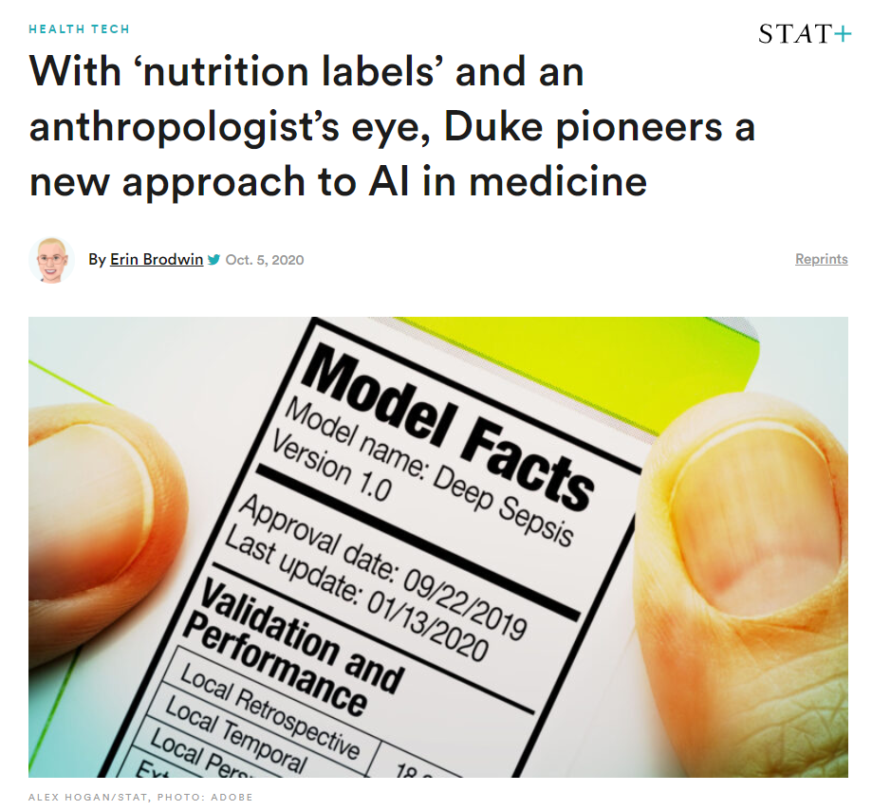
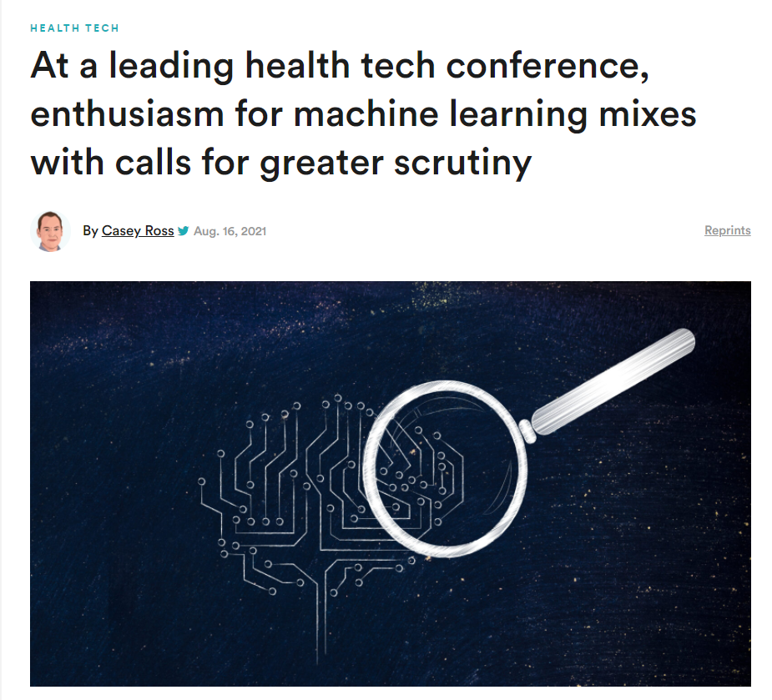
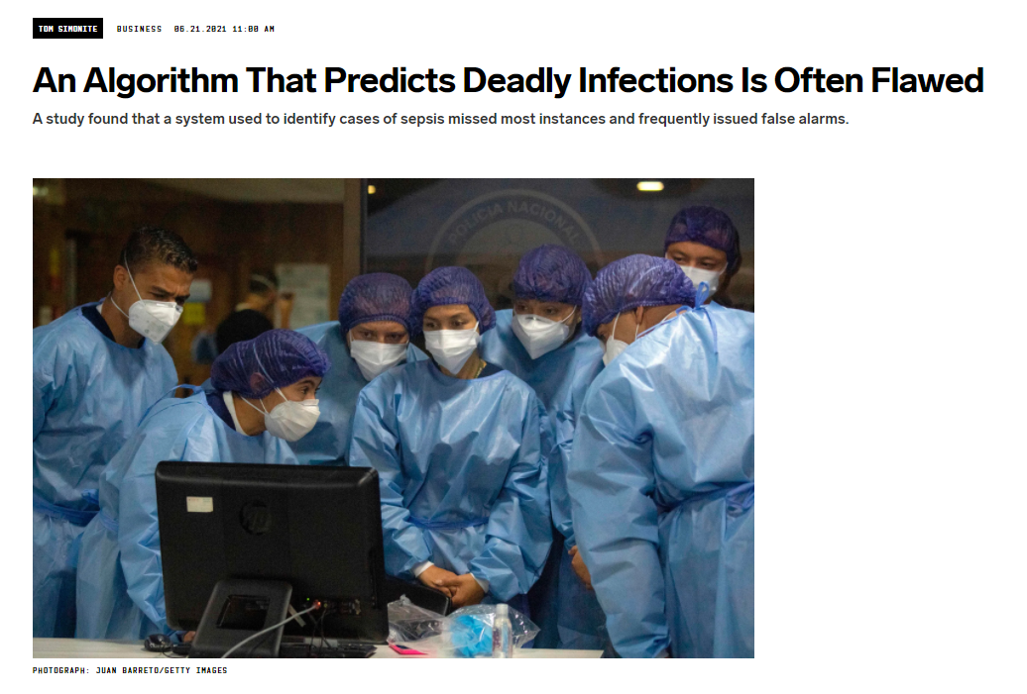
Regulatory questions

Slide 18
Duong et al., HGG Advances 2021

Slide 19
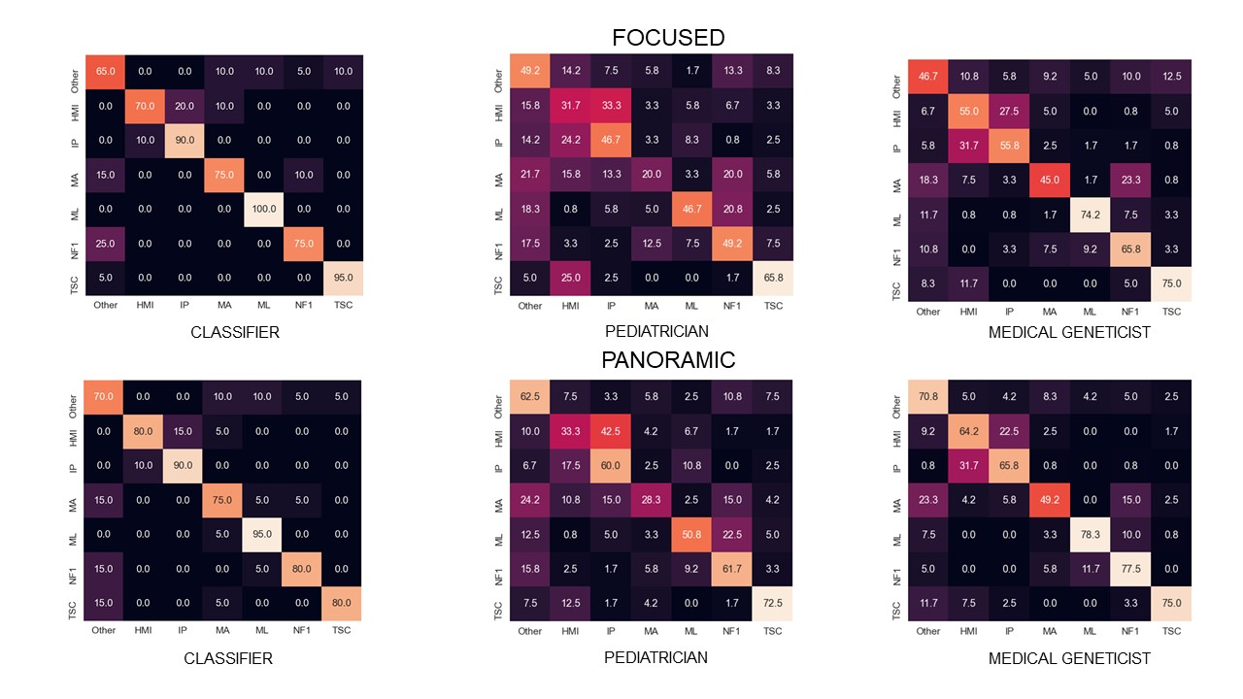
Duong et al., HGG Advances 2021

Slide 20
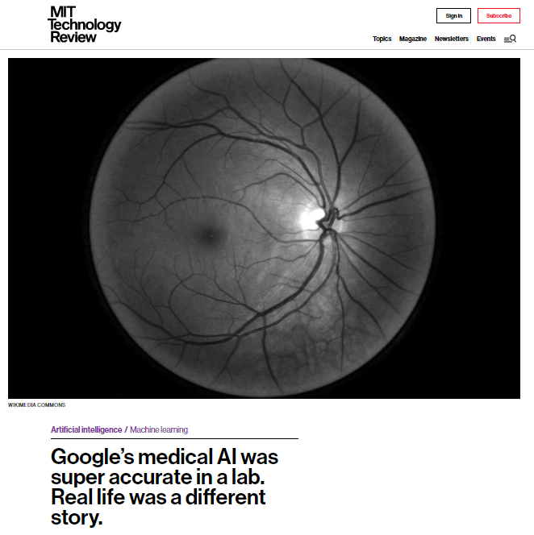
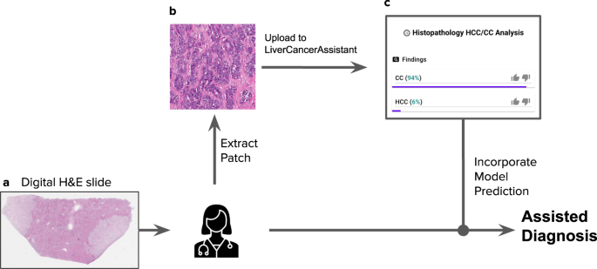
Paper success ≠ real life
Kiani et al., NPJ Digit Med 2020

Slide 21
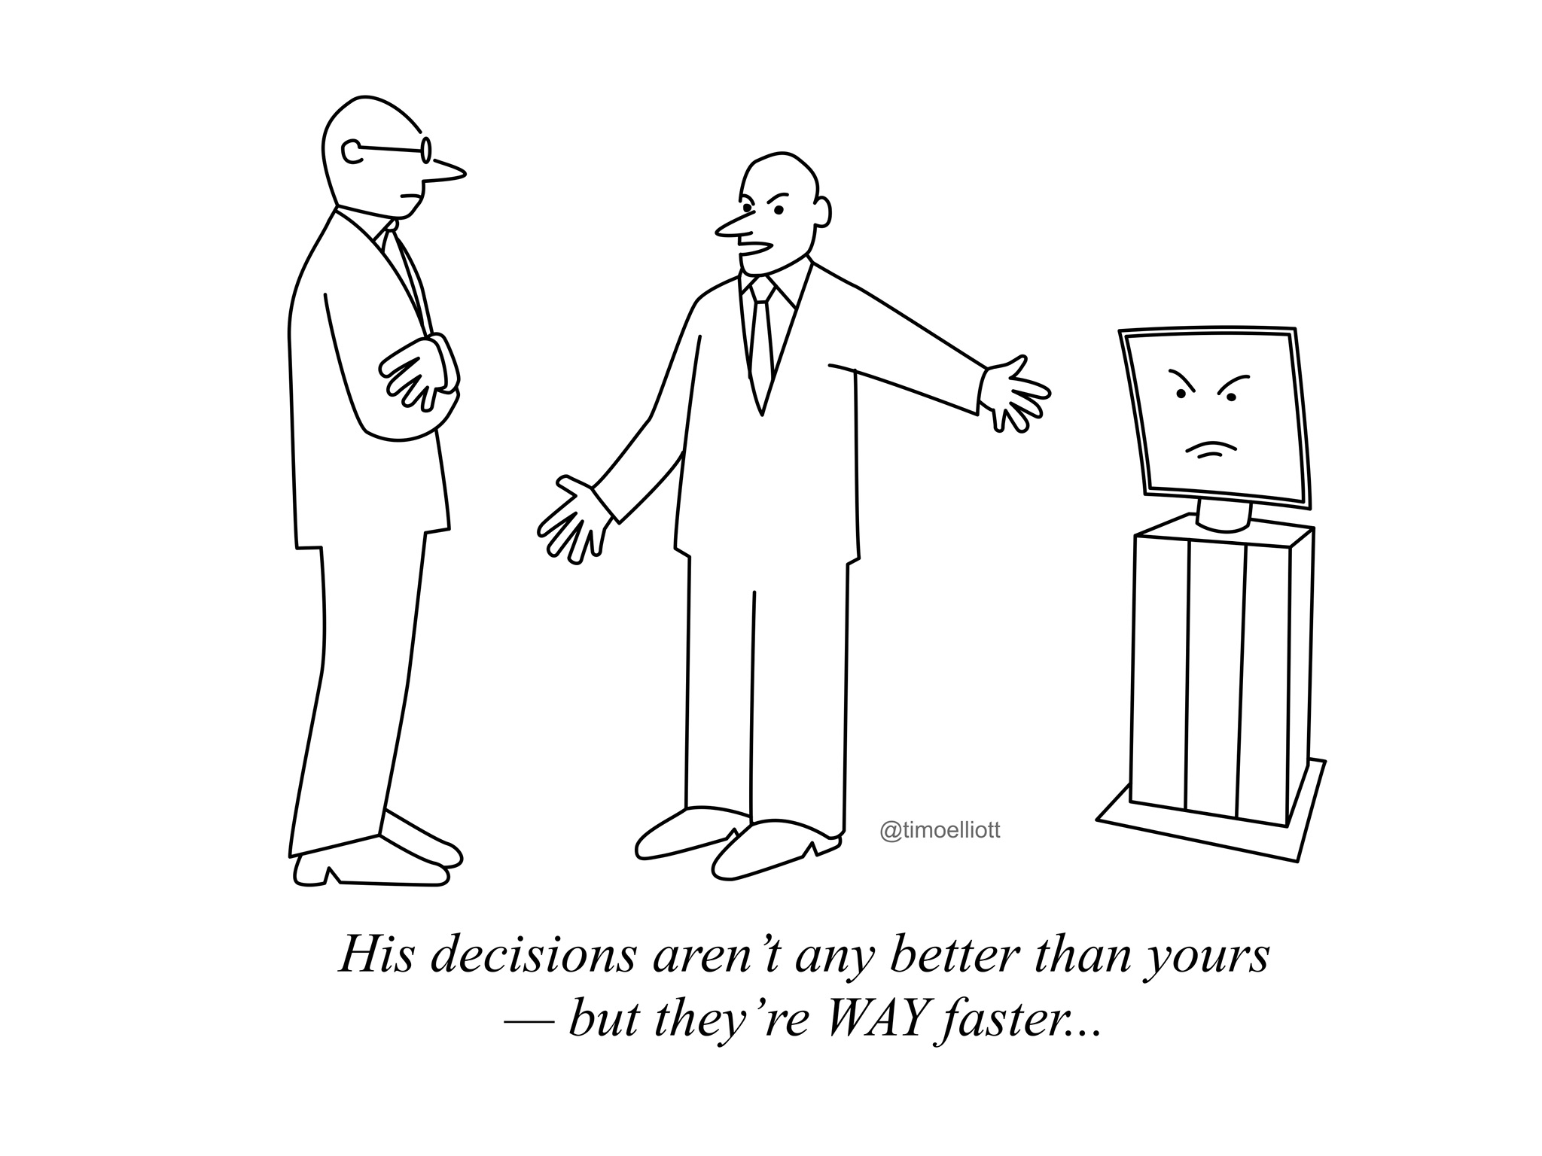

Slide 22
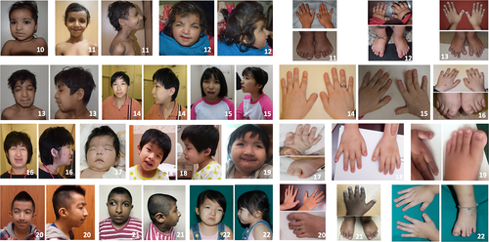
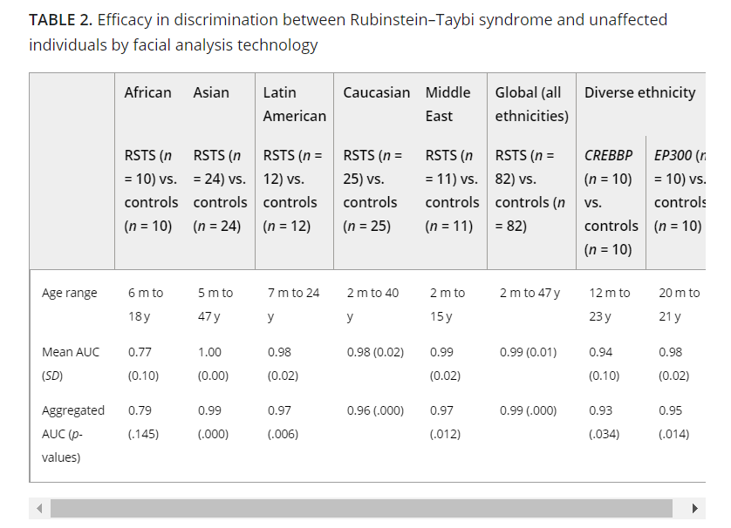
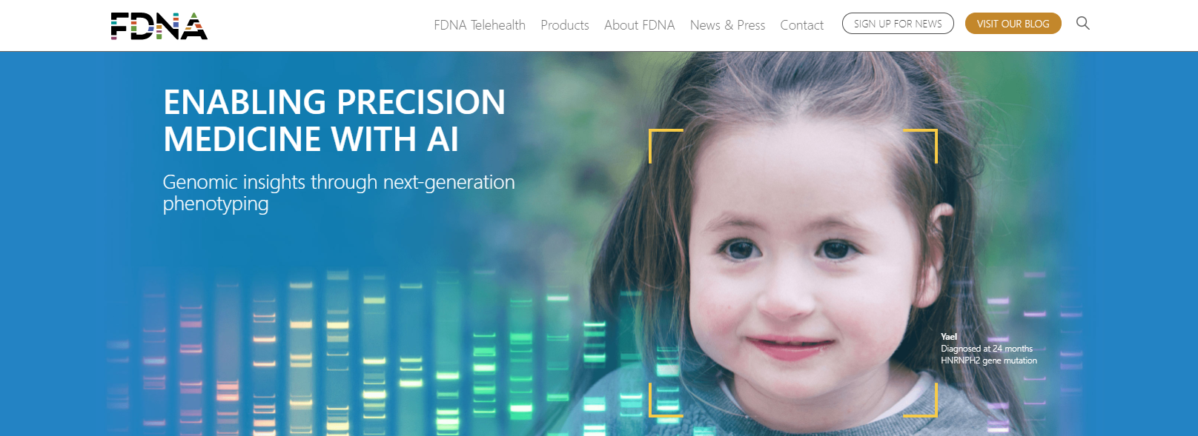
The importance of diversity…
Tekendo-Ngongang, AJMG 2020

Slide 23
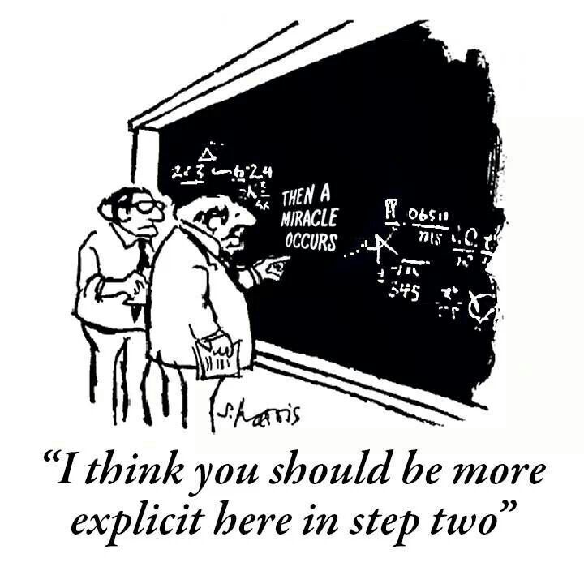
(Yet another) issue

Slide 24
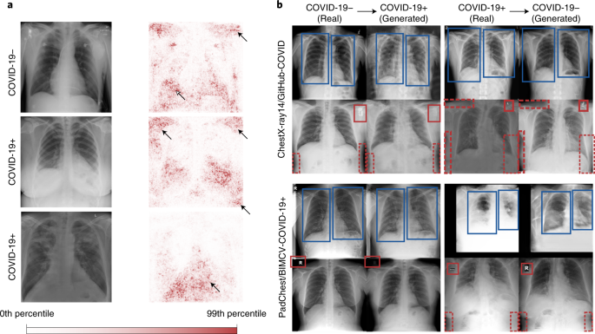
(Yet another) issue
DeGrave et al., Nature 2021

Slide 25
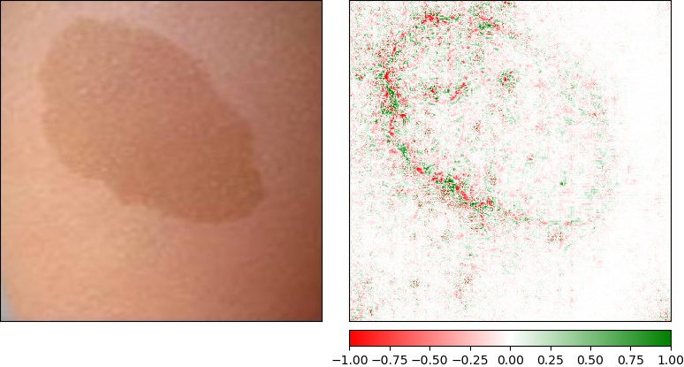
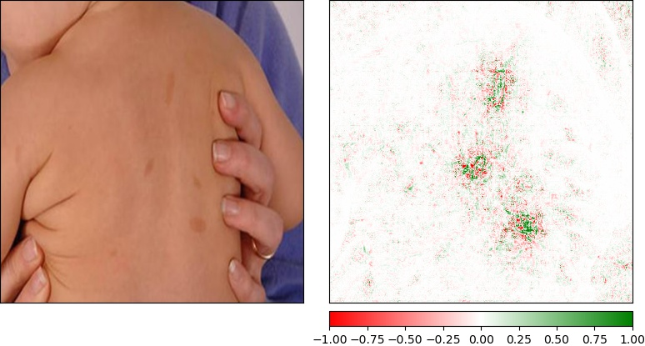
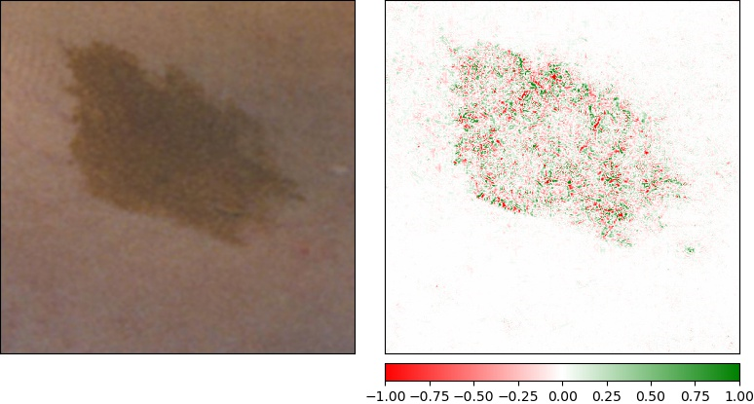
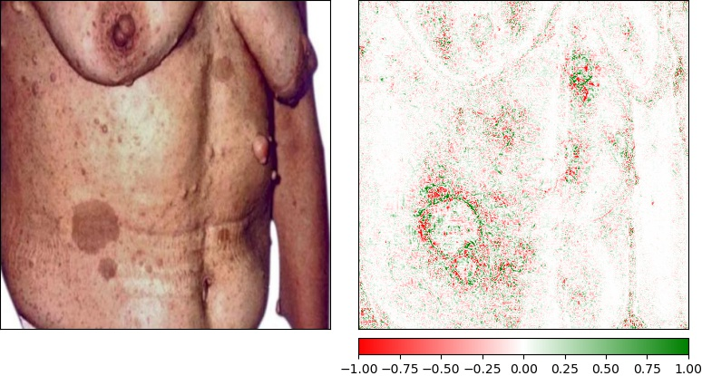
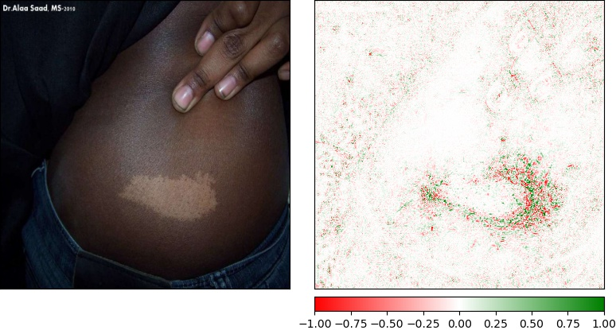
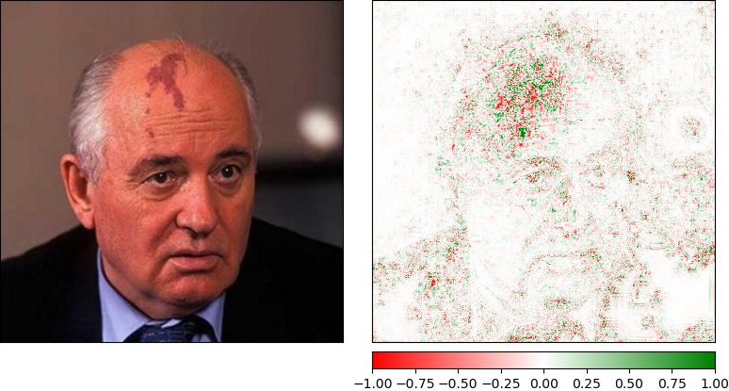
Duong et al., medRxiv 2021

Slide 26
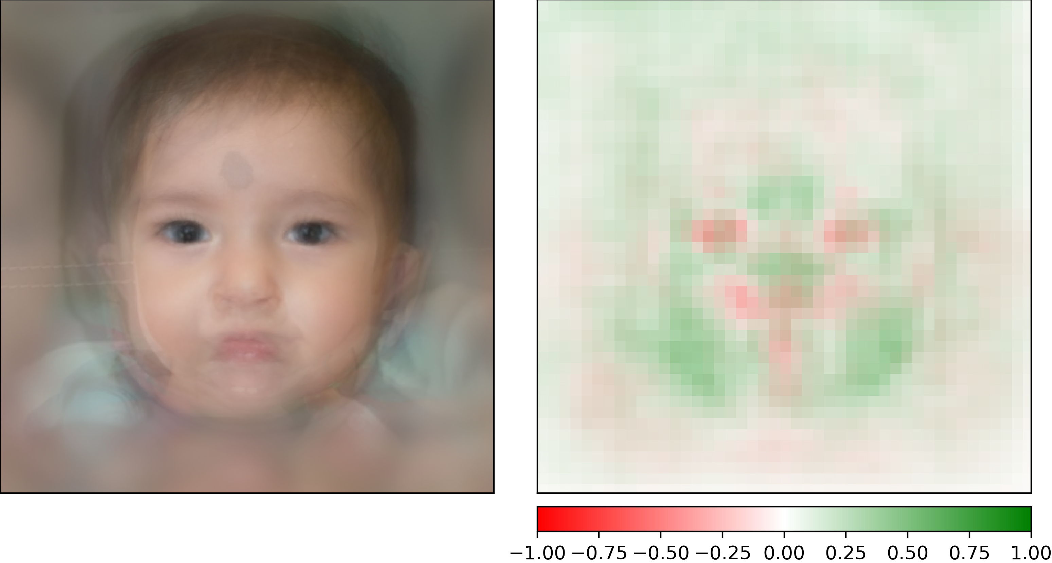
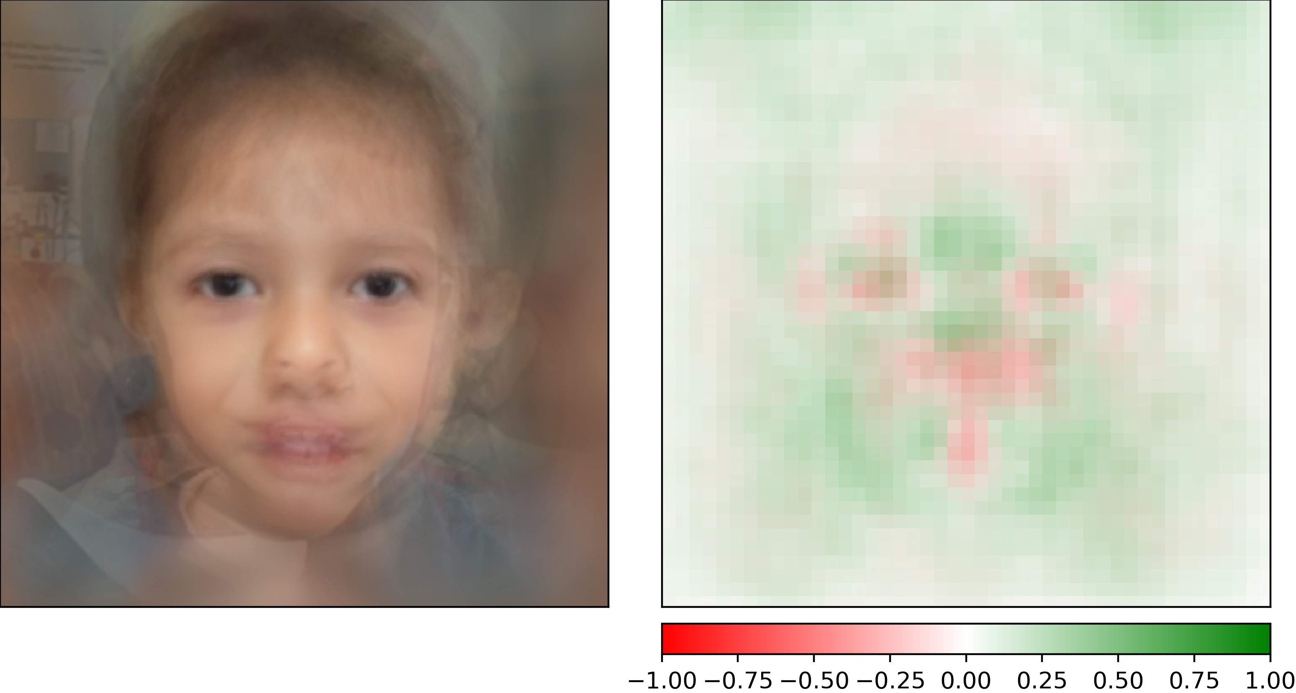
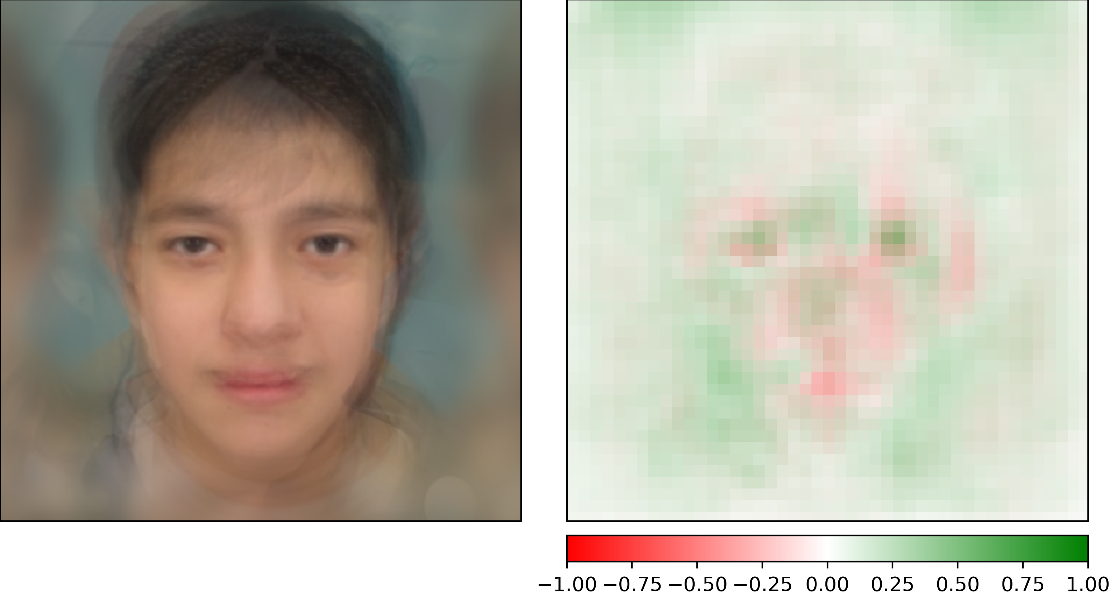
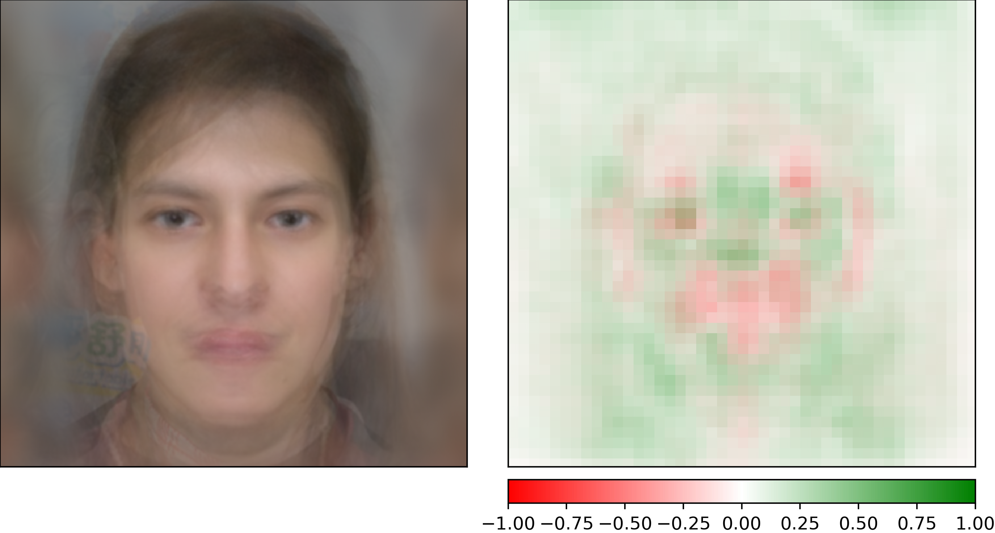
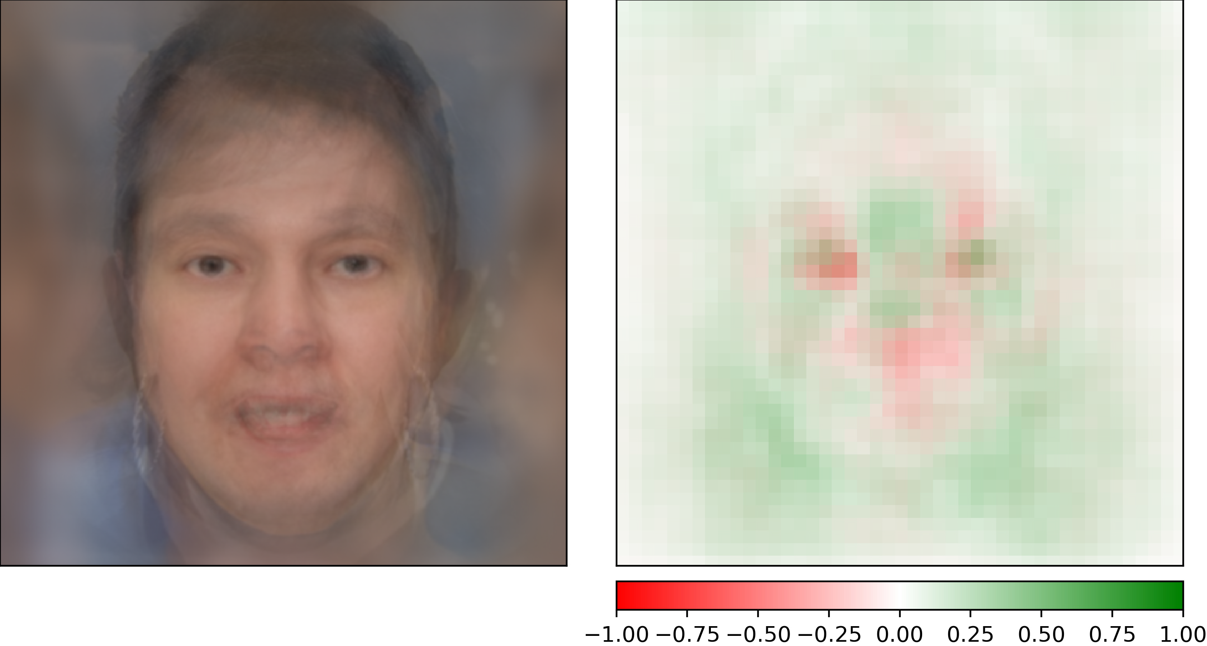
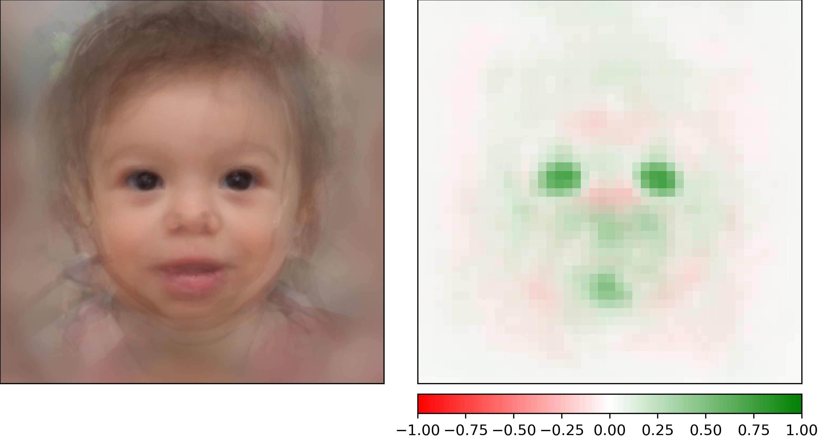
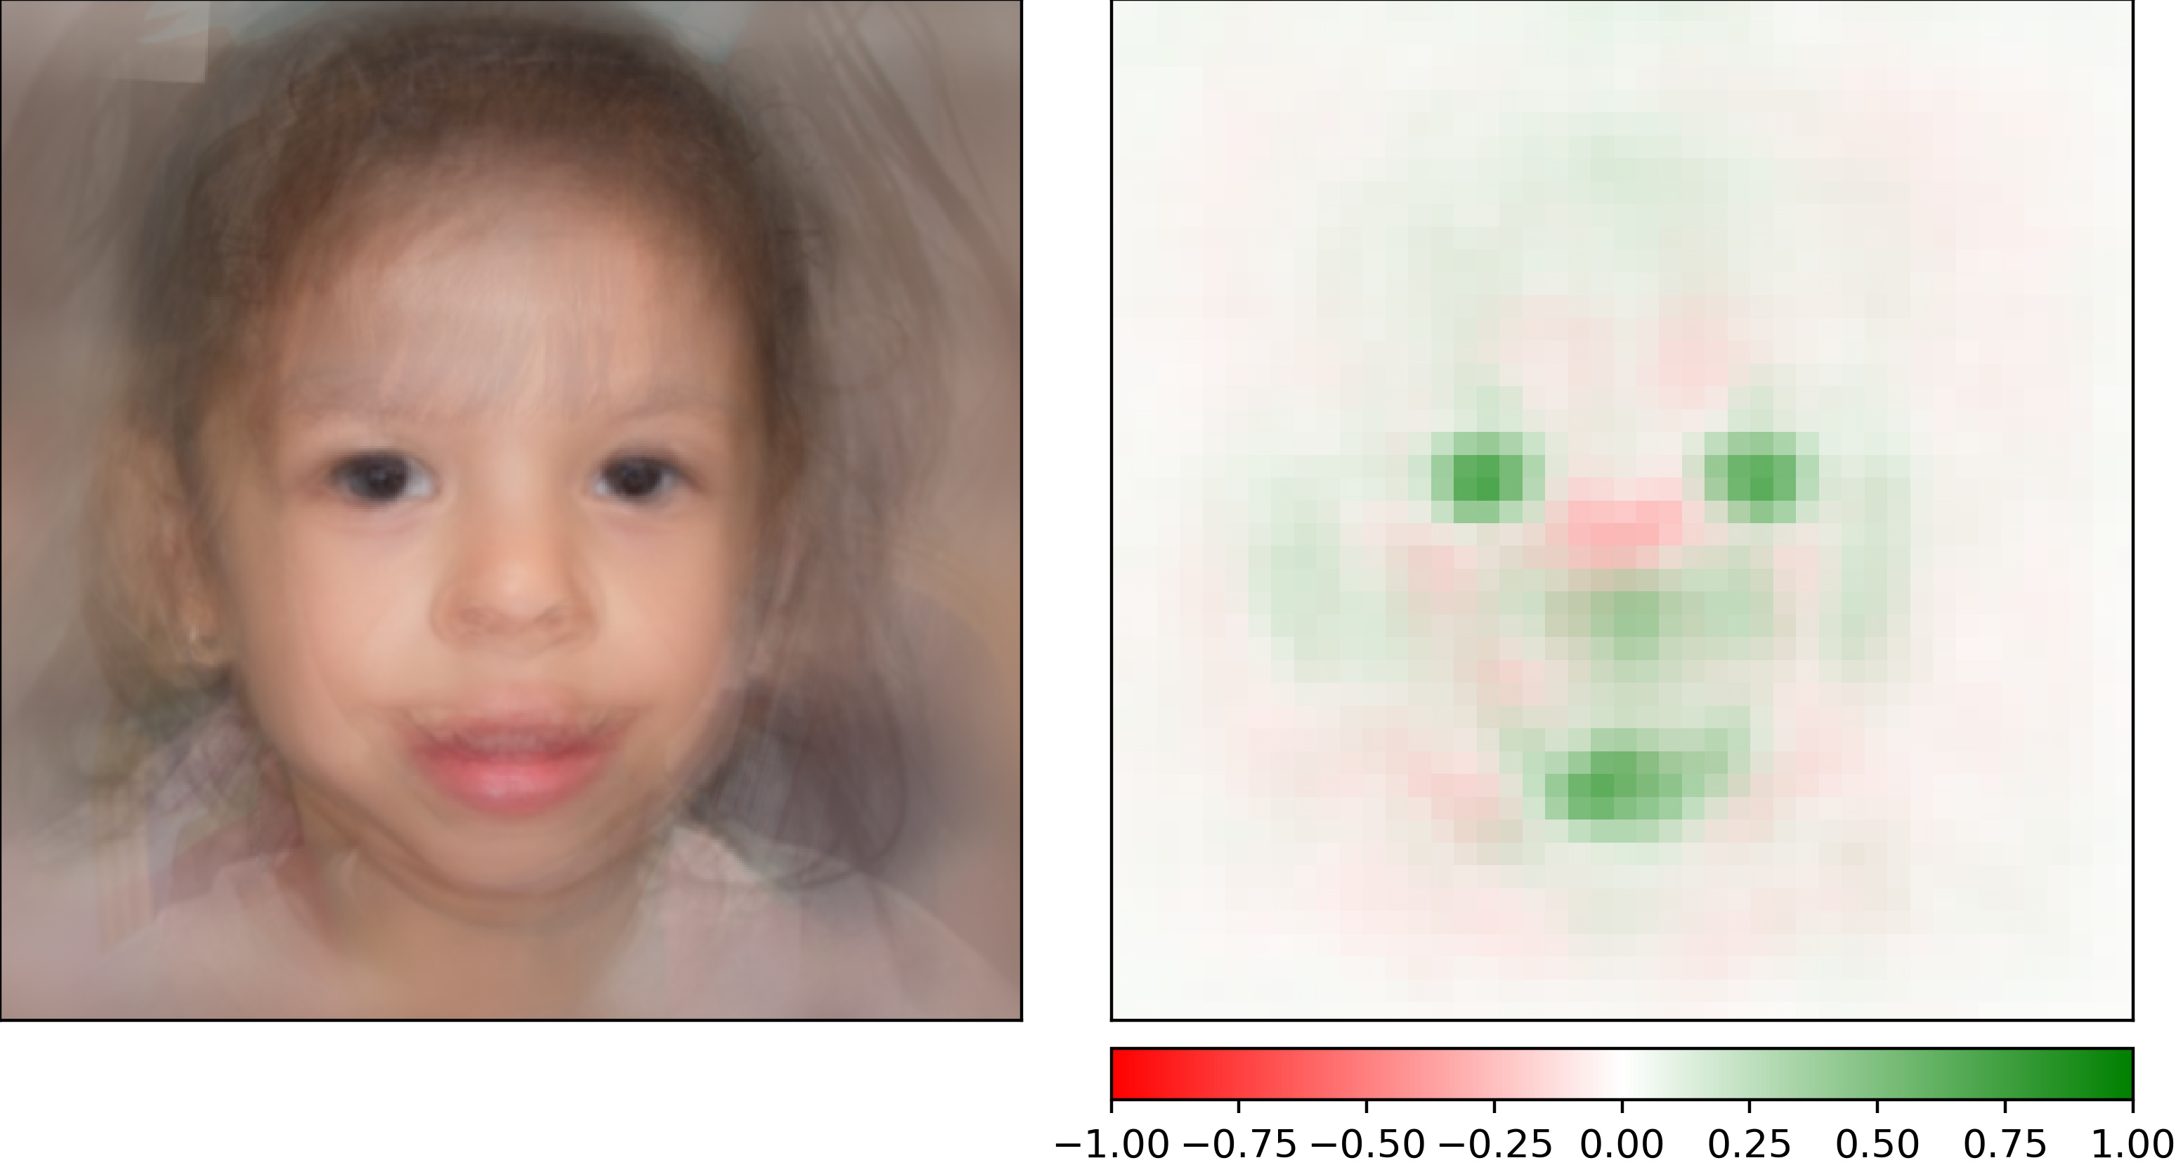
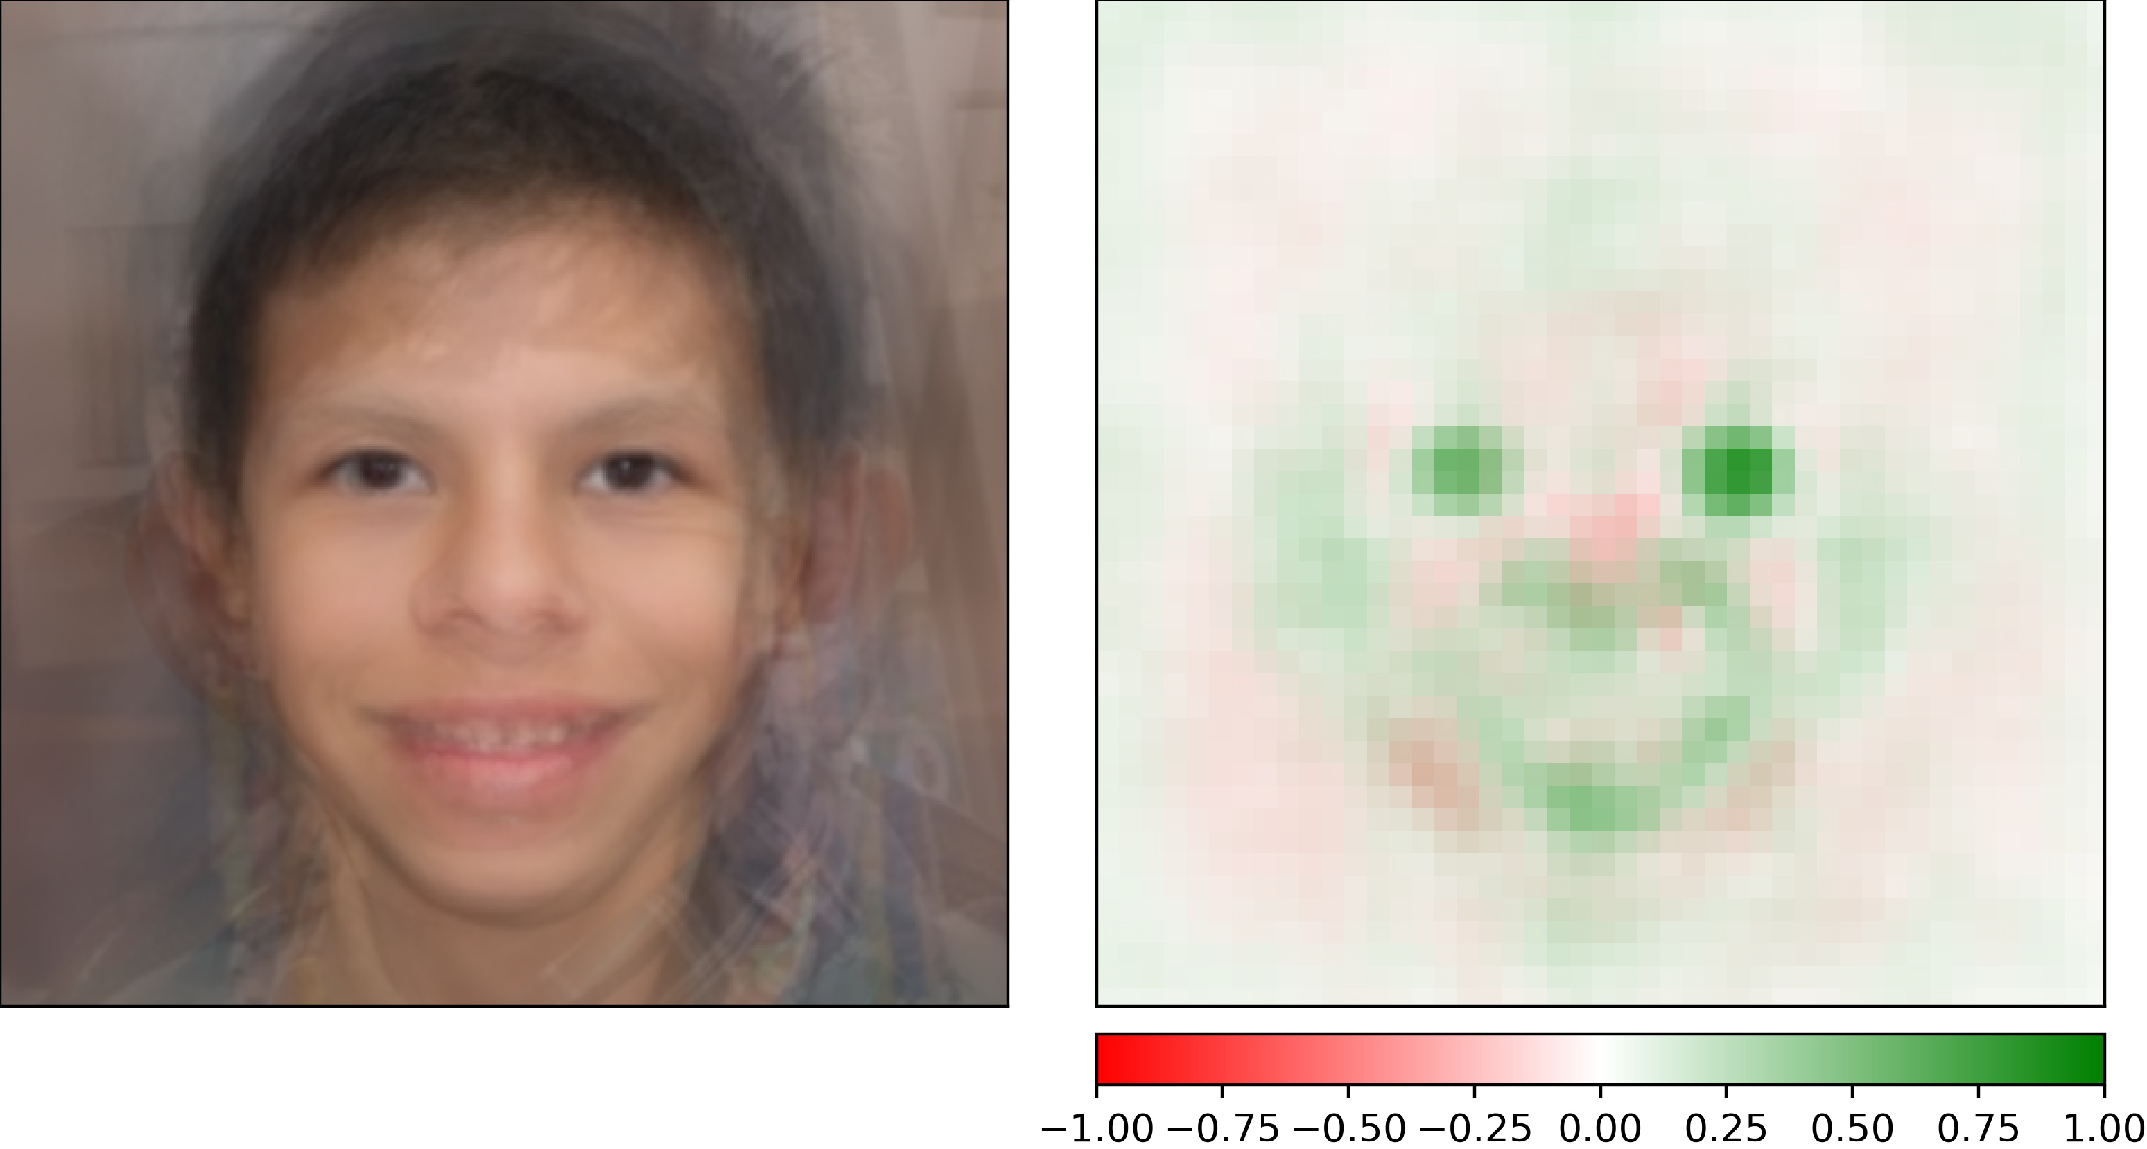
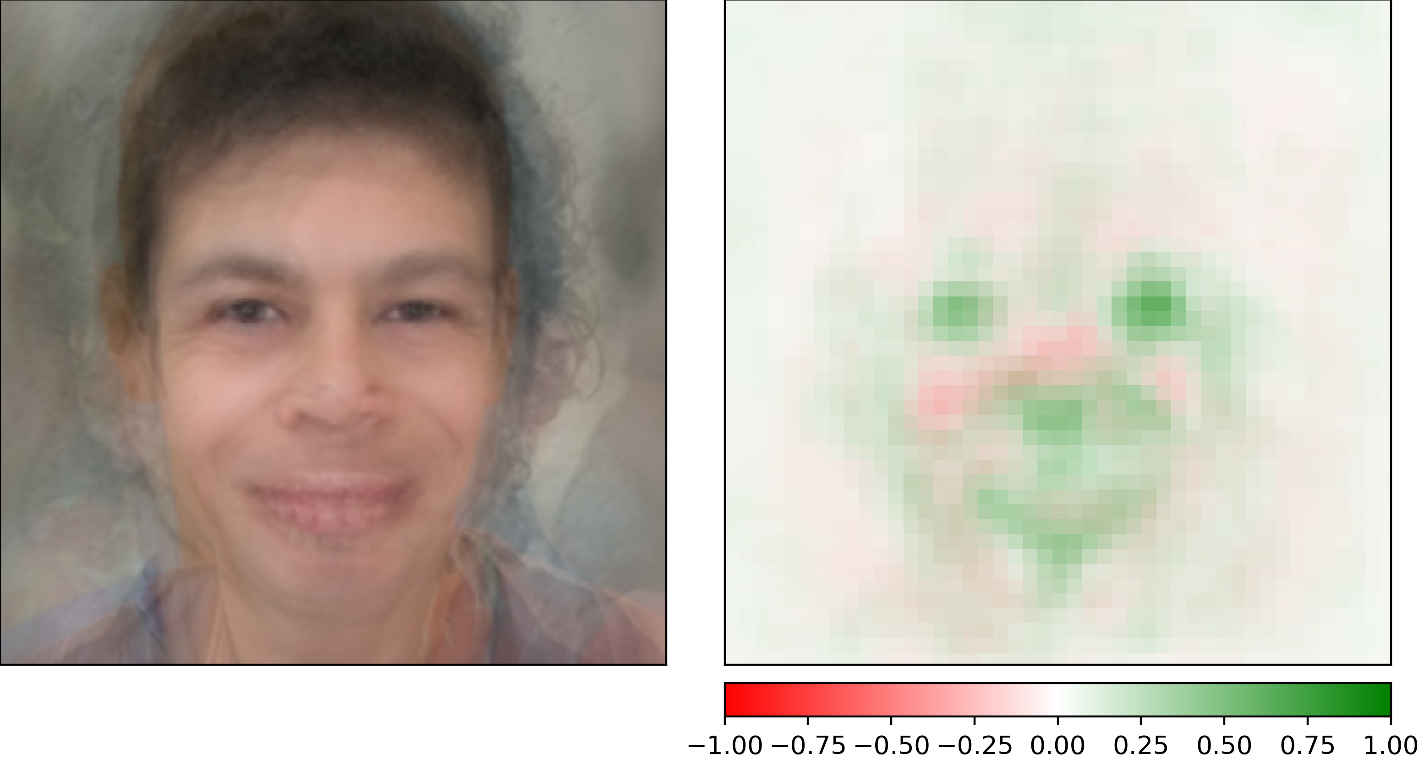
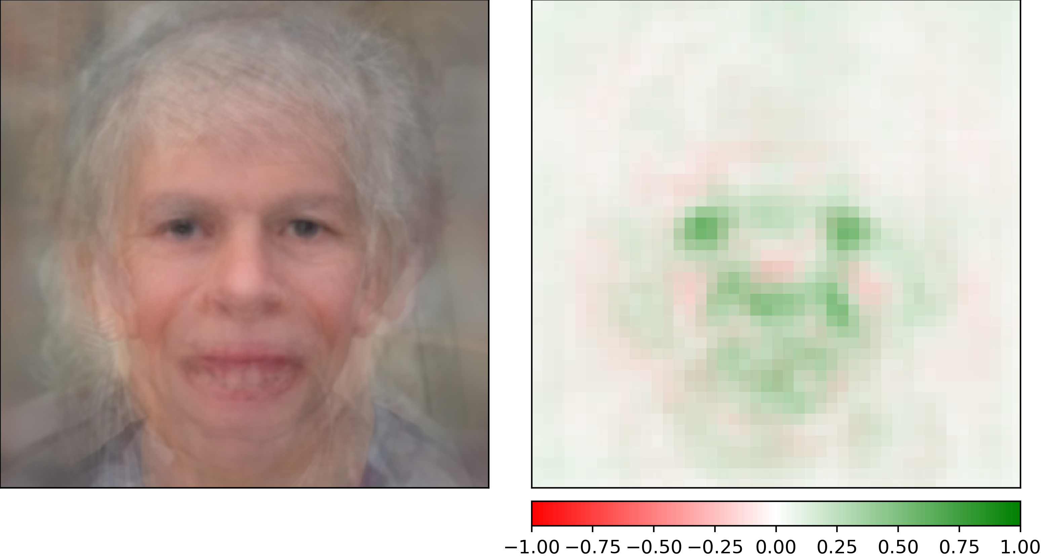
22q11.2 deletion syndrome
Williams syndrome
[in preparation]

Slide 27
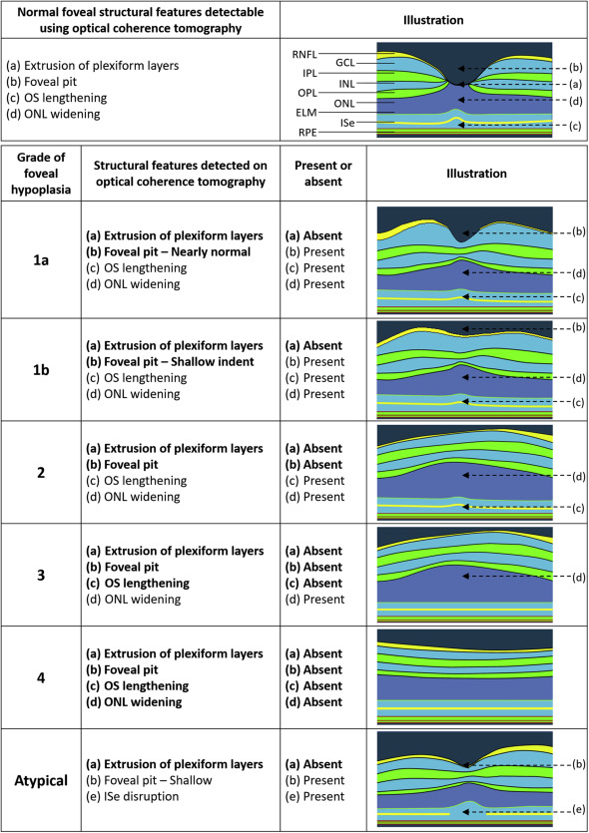
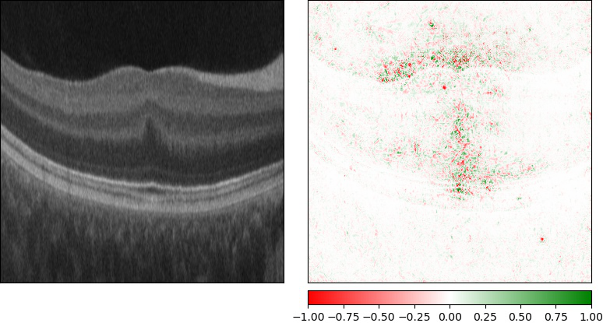
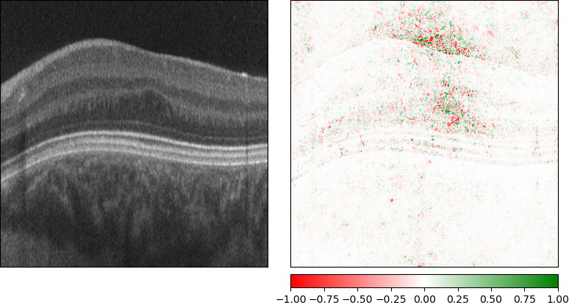
[in preparation]

Slide 28


Generative adversarial networks (GANs)

Slide 29


Slide 30


Slide 31



[in preparation]

Slide 32




Which ones are fake?
[in preparation]

Slide 33

www.nytimes.com

Slide 34
[in preparation]

Slide 35

Using GANs to improve classifiers
Finlayson et al., arXiv 2018

Slide 36


A recommendation…

Slide 37


Thanks!
David Adams
Michelle Dwyer
Dat Duong
Bill Gahl
Suzanna Hanchard
Ping Hu
Rob Hufnagel
Simon Liu
Ellen Macnamara
Volha Malechka
Cedrik Ngongang
Nick Singh-Miller
Rebekah Waikel

