Slide 1
Novel genetic associations for rare diseases with GWAS and trans-ethnic analysis of self-reported medical data
Suyash Shringarpure
23andMe, Inc.
National Press Foundation, Sep 14, 2021

Slide 2
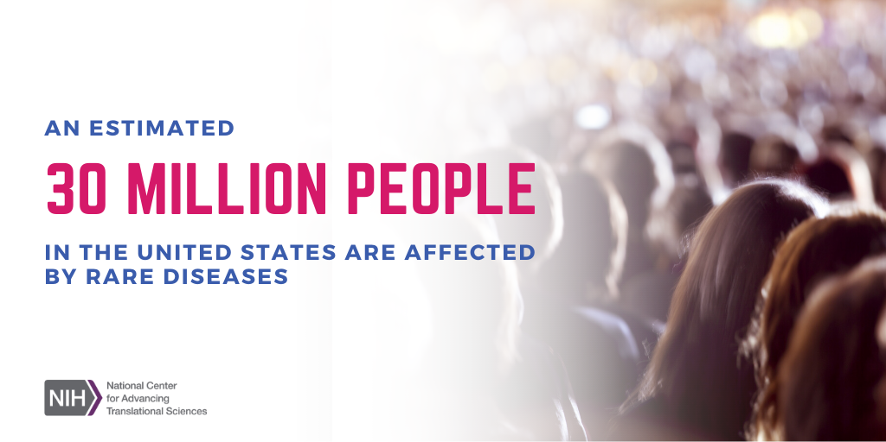
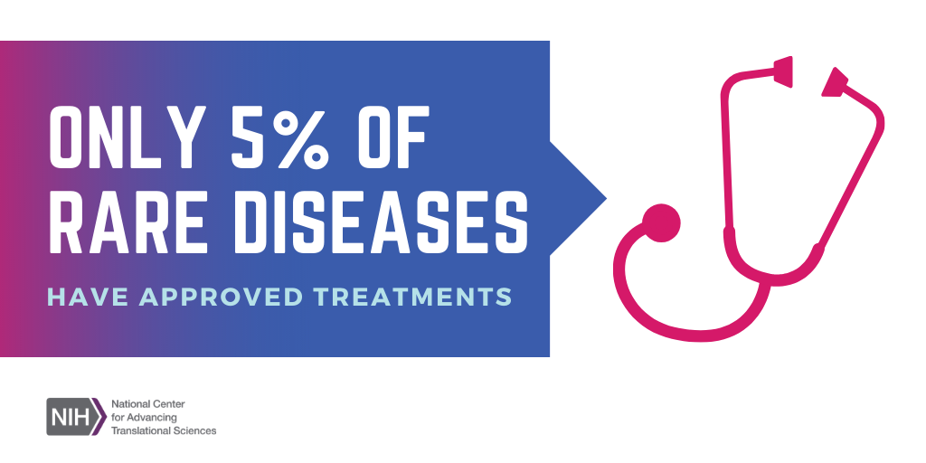
Why study rare diseases?
A rare disease is defined (in the United States) as one affecting less than 200,000 people. Each disease is individually rare, but with nearly 7,000 known rare diseases, rare diseases are collectively common.

Slide 3
Outline
Brief overview of rare disease genetics research
Using self-reported data for rare disease genetics research
Study setup and validation
Novel associations
Next steps and conclusions
More details on everything discussed today in our preprint: https://www.medrxiv.org/content/10.1101/2021.06.09.21258643v1

Slide 4

Rare disease genetics research

Slide 5
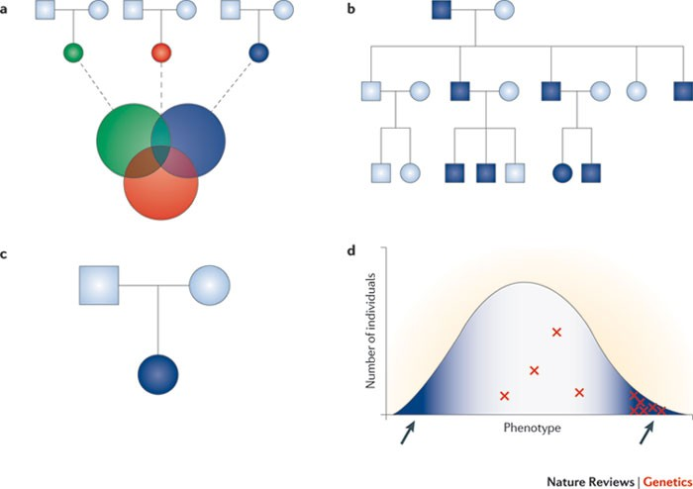
Rare disease gene discovery (1)
Sequencing of multiple unrelated disease cases to identify genes enriched for rare variation
Sequencing of multiple affected family members to identify genes in shared genomic regions
Sequencing of a trio (mother, father, affected child) to identify causal de novo mutations
Sequencing extremes of a trait distribution to identify shared genetic variation
Figure from Bamshad et al., Nature Reviews Genetics, 2011

Slide 6
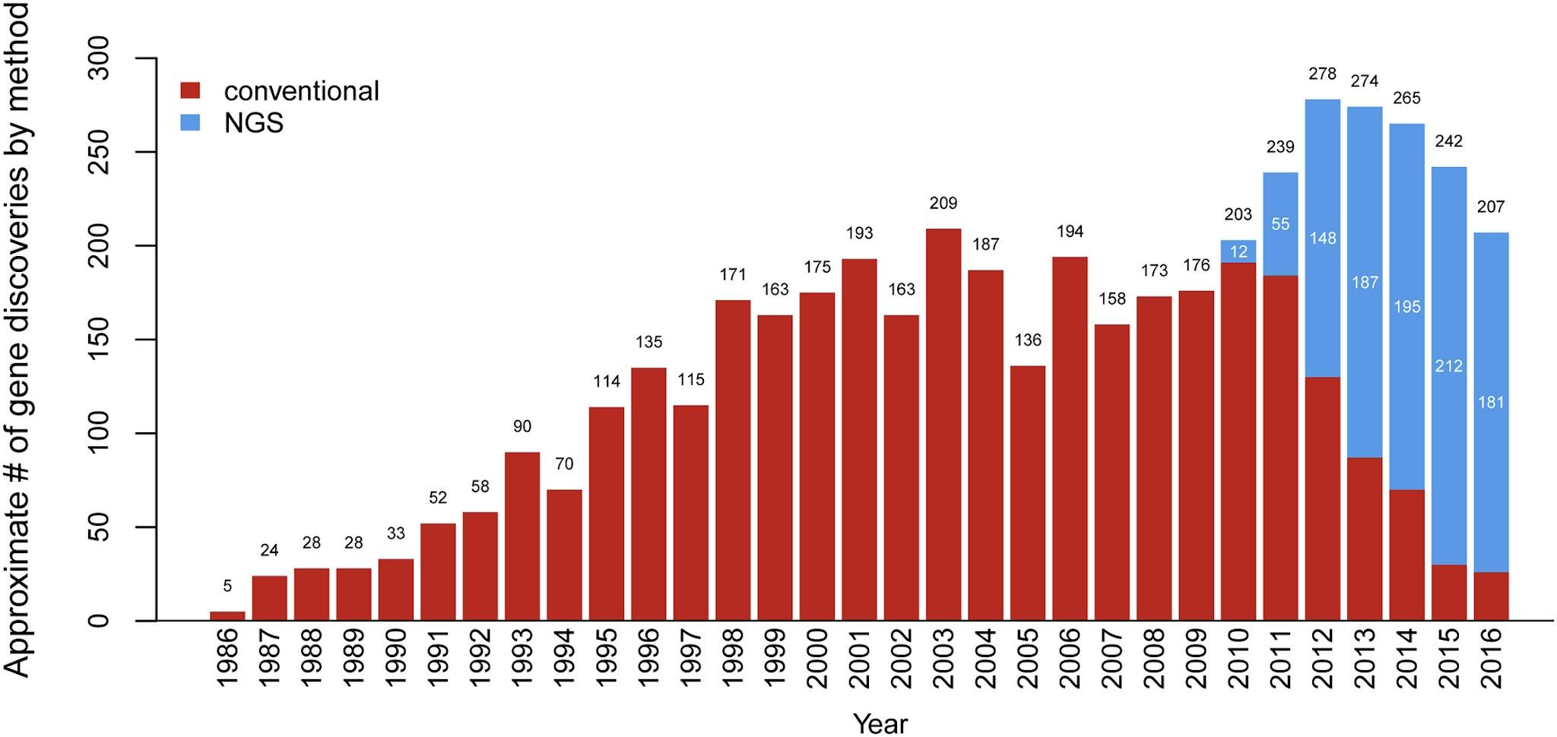
Rare disease gene discovery (2)
Successful in increasing the number of genetic discoveries in rare diseases
Limitations:
Mainly effective for Mendelian diseases (defect in a single gene can cause disease)
Constrained by sample size
Figure from Boycott et al., AJHG, 2017

Slide 7
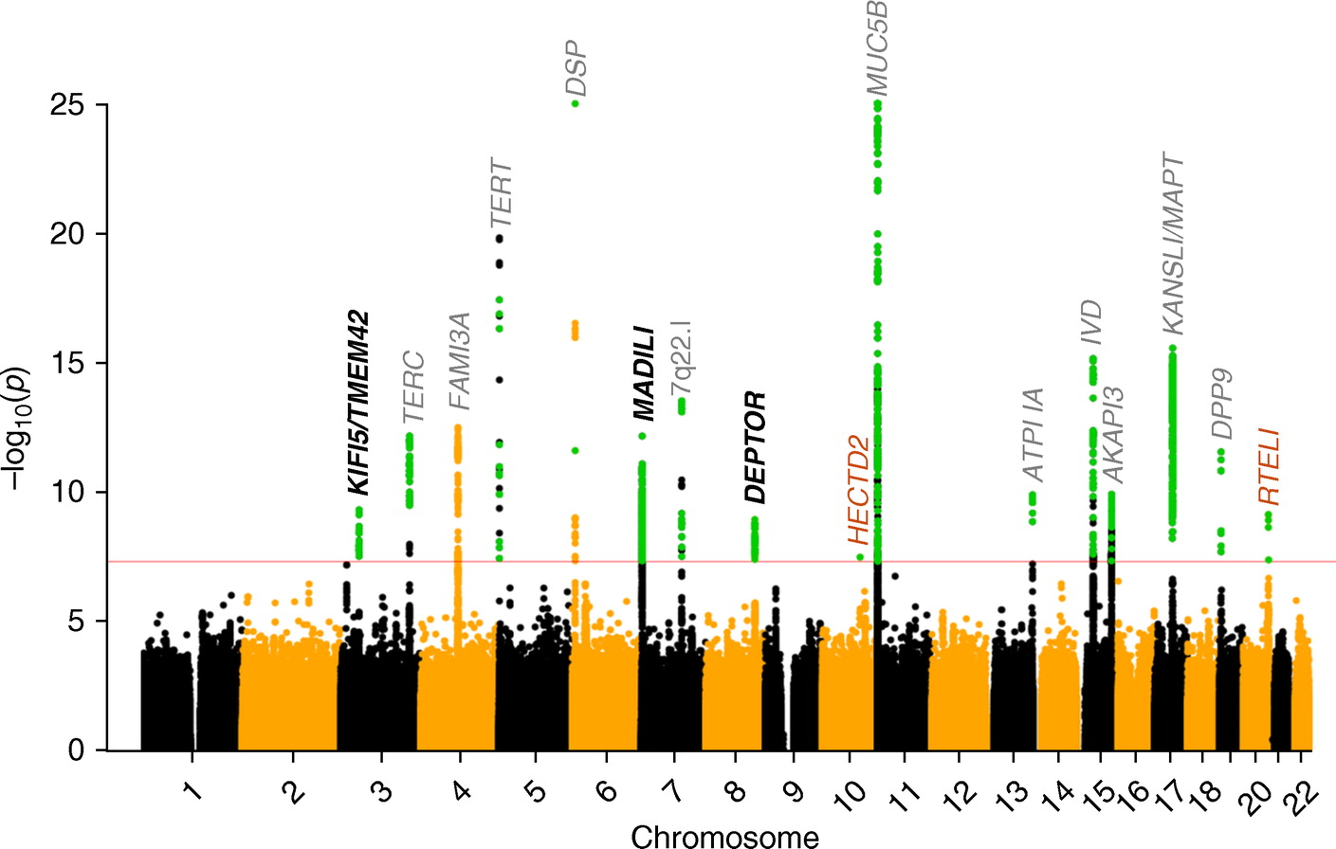
Rare disease gene discovery (3)
Polygenic rare diseases can be studied through genome-wide association studies (GWAS)
Involves comparing the DNA of affected individuals (cases) to unaffected individuals (controls)
Limitation – Large sample sizes required for discovery
Figure from Allen et al., AJRCCM, 2019. Genome-wide association study for idiopathic pulmonary fibrosis.

Slide 8
23andMe Research

Slide 9

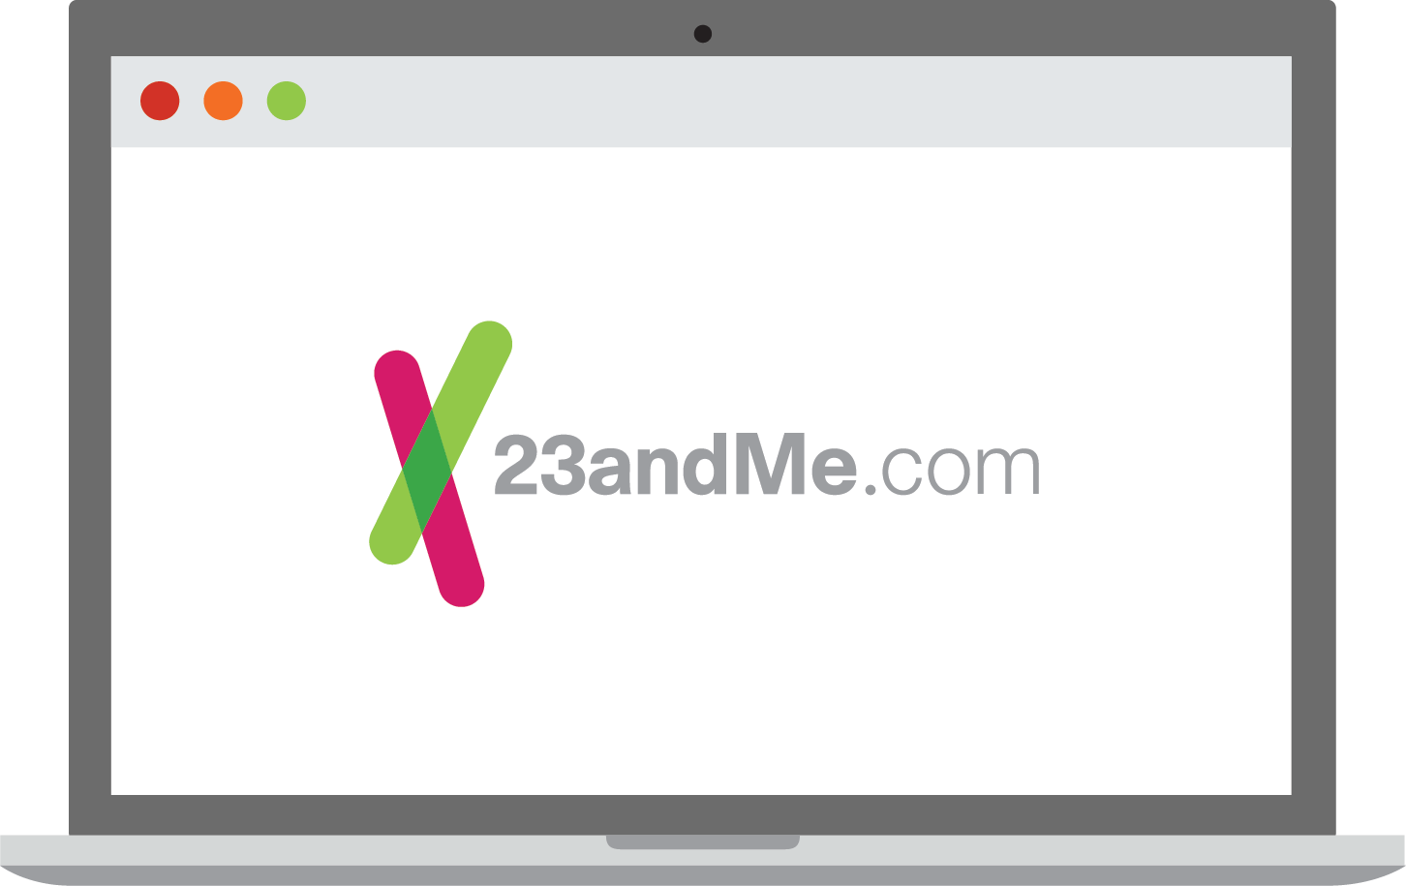


How it works
Order
Spit
Send
Discover

Slide 10

23andMe Research
Opt-in
IRB-approved protocol and consent form
Broad protocol and consent – not phenotype specific
Research participants can cease participation at any time
Data is aggregated and anonymized

Slide 11



Advantages of online research
Participation is easy
Geography not a barrier
Everyone in multiple studies

Slide 12
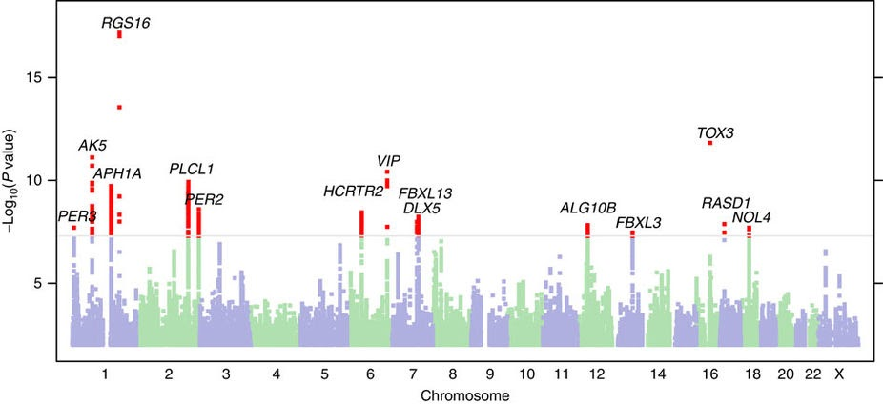
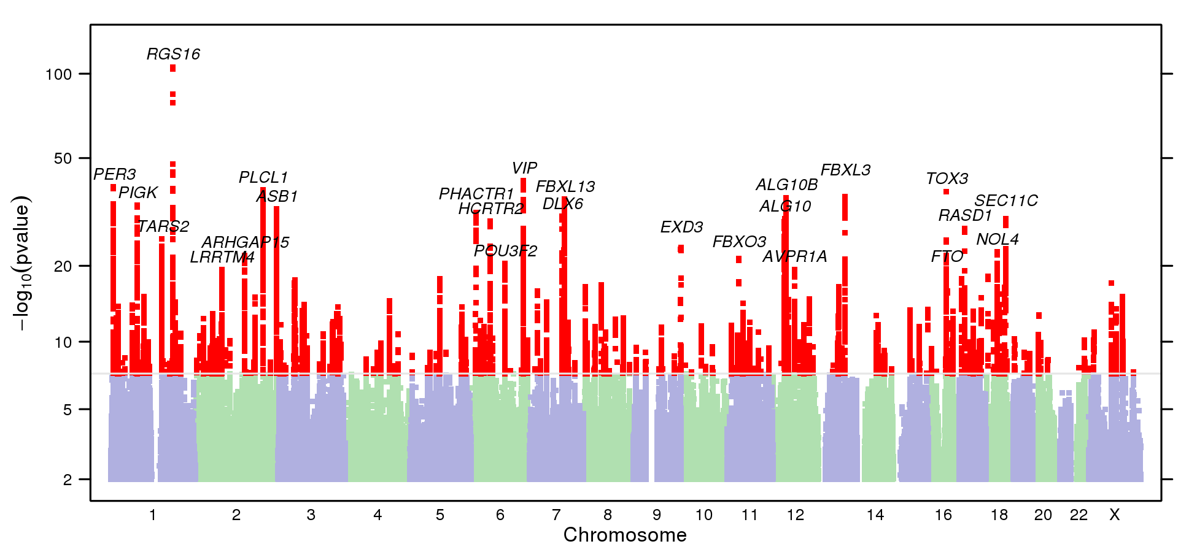
Studying diseases using self-reported data
~39k cases, versus 50k controls
~250k cases versus ~220k controls

Slide 13
The 23andMe cohort is well-suited for study of rare diseases
11M+
genotyped
customers
80%
~30K
consent
to
research
surveys completed per day

Slide 14
23andMe Rare Disease Genetics

Slide 15
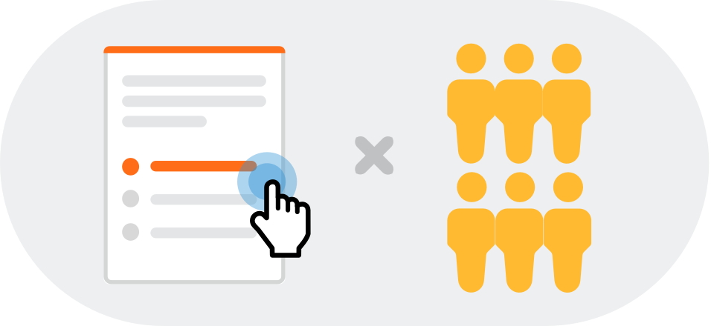
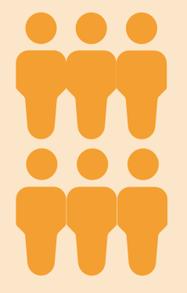
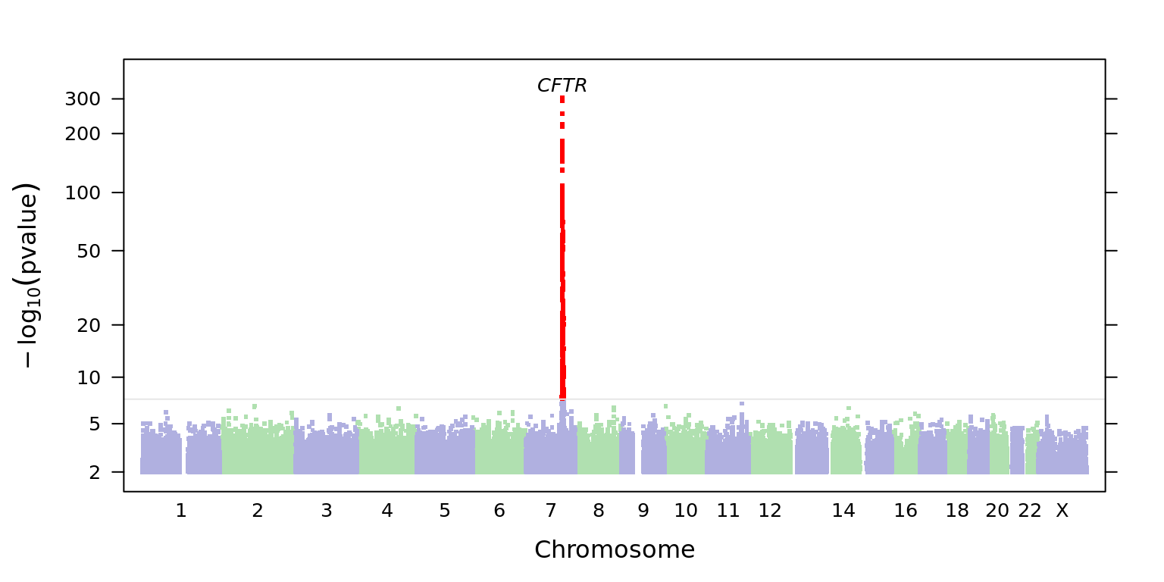

Approach: self-reported diagnoses + GWAS
Typed in ‘cystic fibrosis’
Selected “no rare diseases”
Cases
Rare disease survey with 7000 diseases (autocomplete to choose)
Answered “yes” to CF question
Answered “no” to CF question
Health history survey
E.g: Have you been diagnosed with cystic fibrosis?
Controls

Slide 16
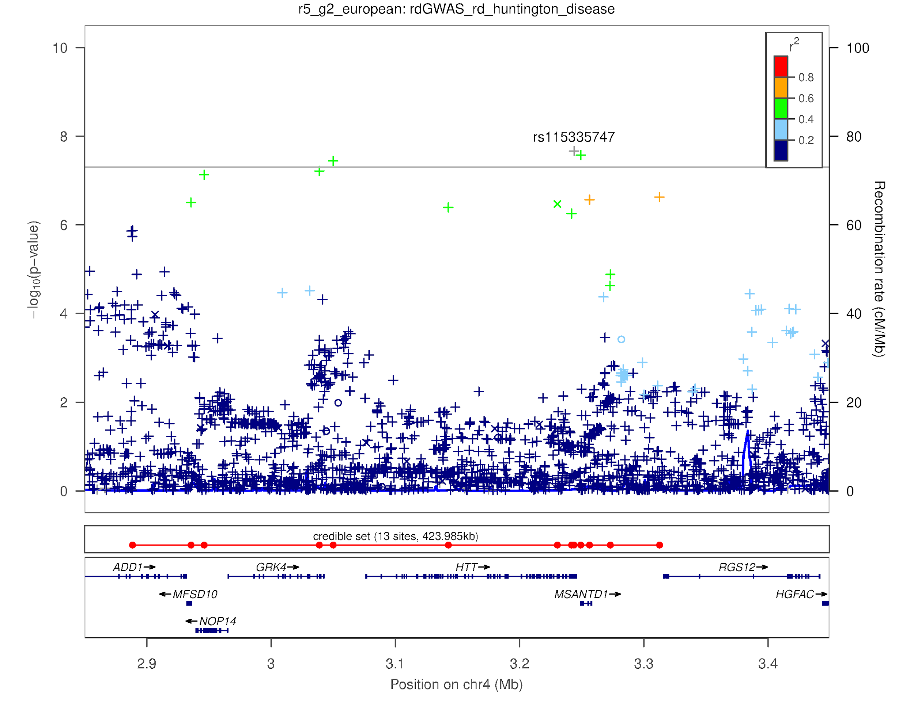
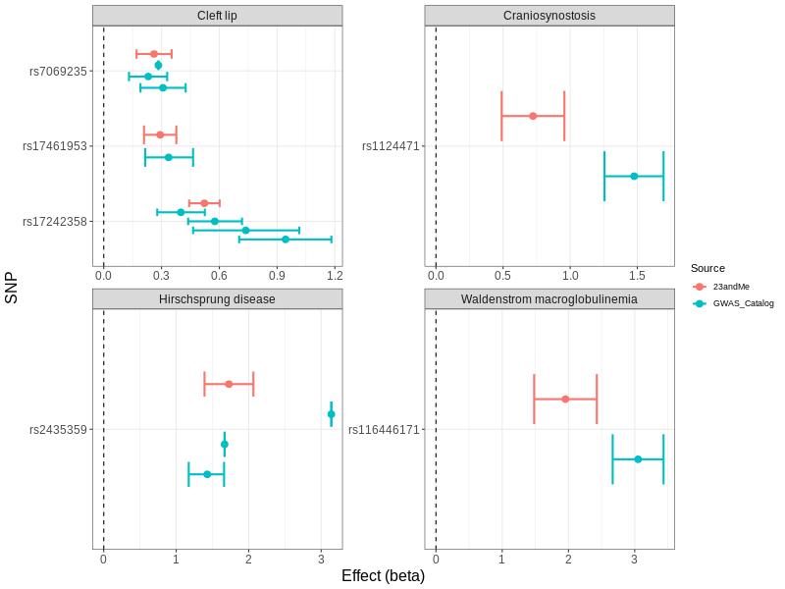
Validation through re-discovery of known associations
We found 29 known associations in 33 rare diseases
Examples
Cystic fibrosis
Phenylketonuria
Lynch syndrome
Beta thalassemia
Cleft lip
Retinitis pigmentosa
Regional plot for Huntington disease association
Effect sizes from GWAS on self-reported rare disease data are comparable to those from GWAS on clinical cohorts

Slide 17
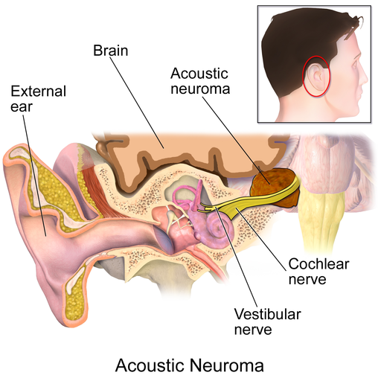
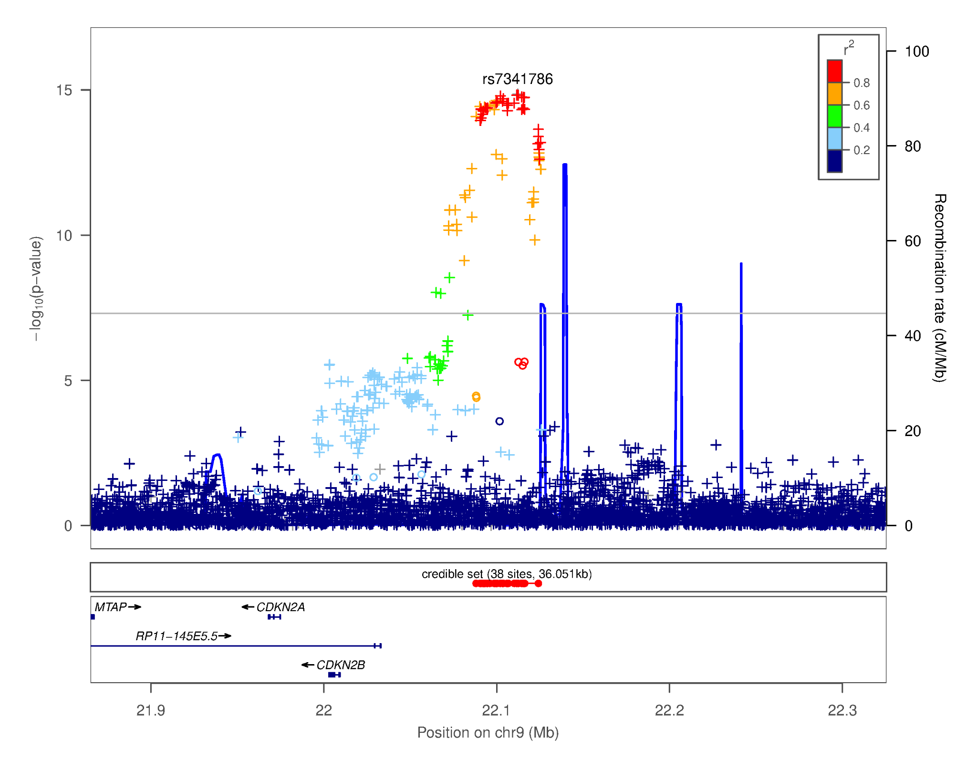
A novel association for vestibular schwannoma
FAMM syndrome (melanoma)
Meningioma
Colorectal cancer
Glioma
Acute lymphoblastic leukemia
Germline associations
CDKN2A/CDKN2B
Image from https://commons.wikimedia.org/wiki/Category:Vestibular_schwannoma
Somatic
associations
Vestibular schwannoma (or acoustic neuroma): Benign, usually slow-growing tumor that develops on the vestibular or cochlear nerve.
Esophageal adenocarcinoma
Head and neck cancer
Lung adenocarcinoma
Lung squamous cell carcinoma
Melanoma
Regional plot for vestibular schwannoma novel association highlighting CDKN2A/CDKN2B

Slide 18
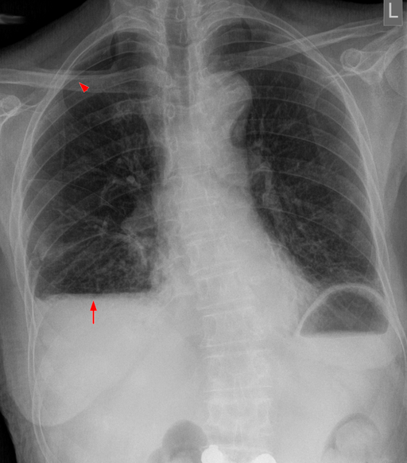
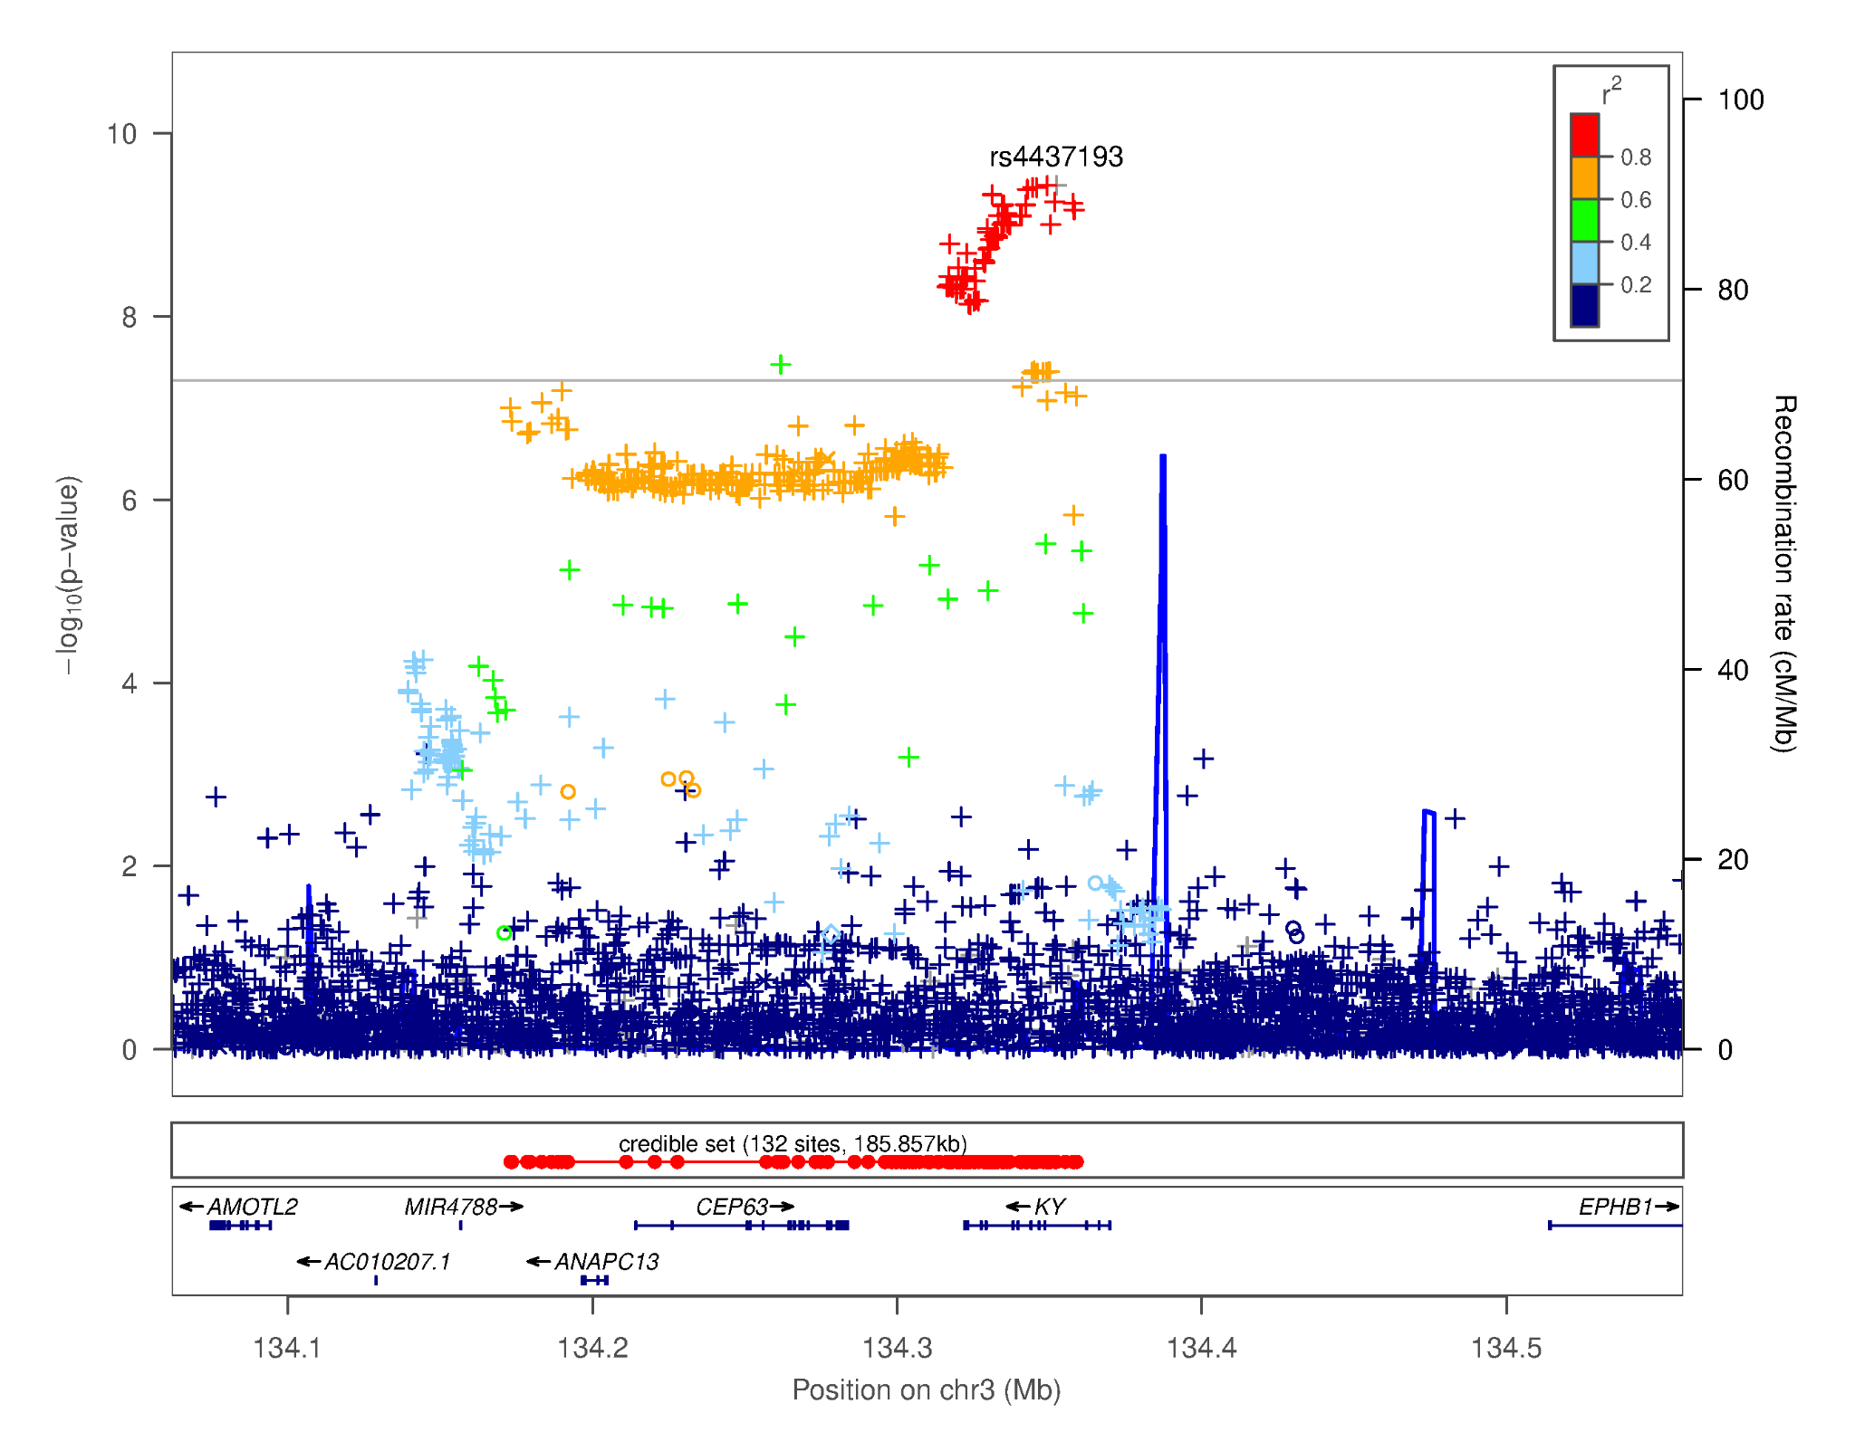
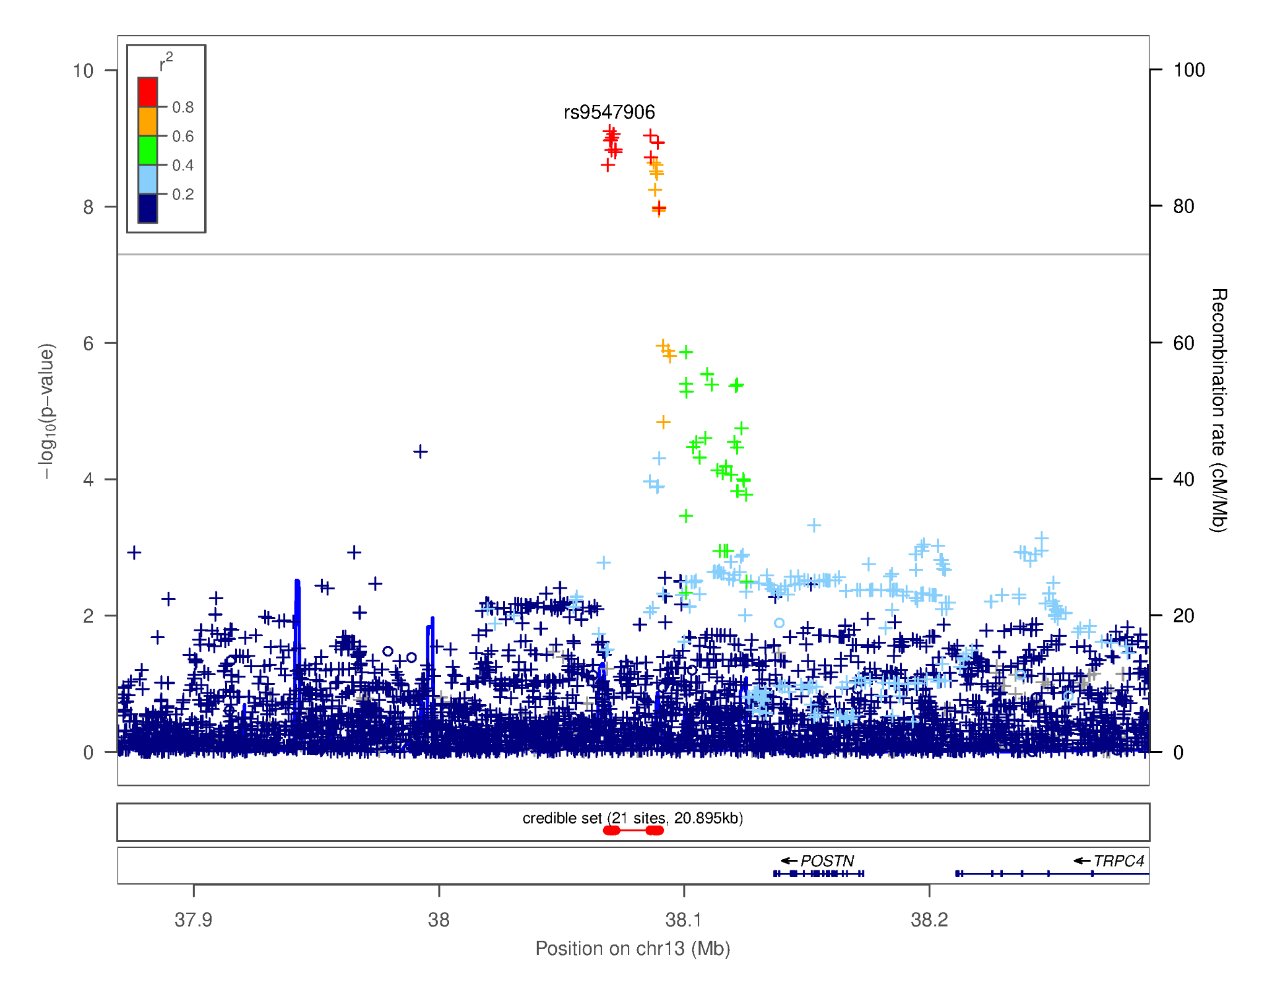
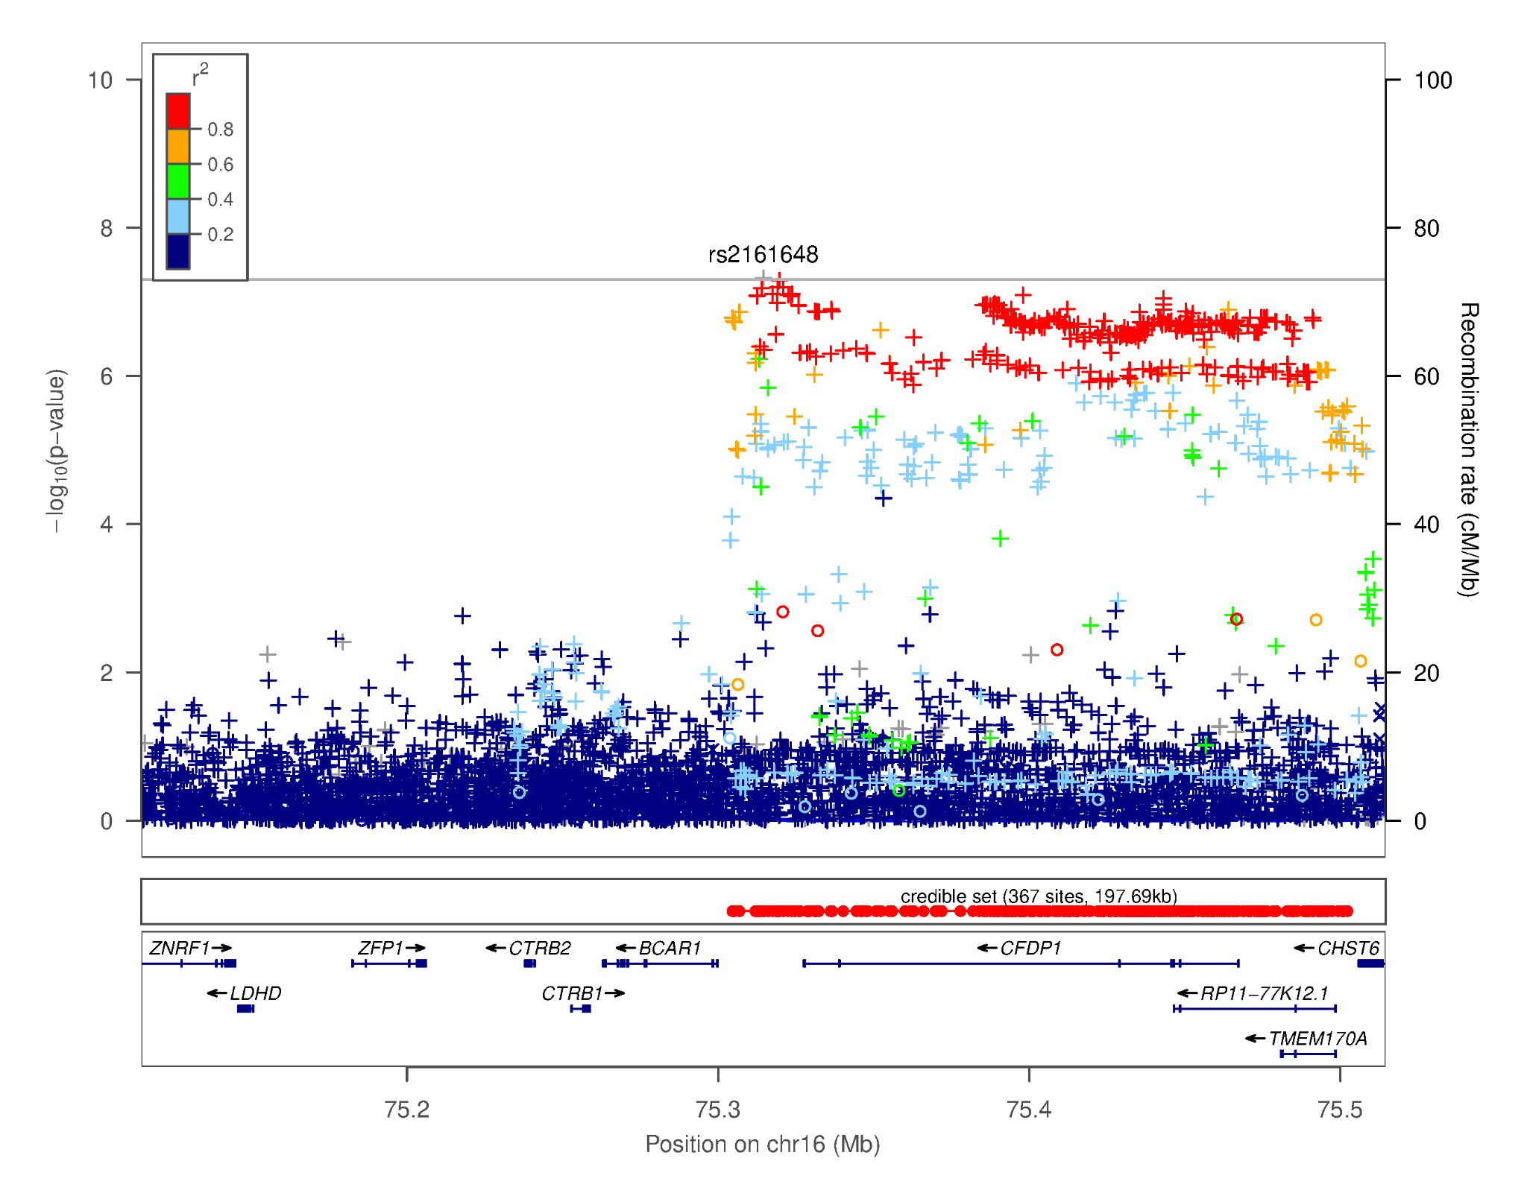
3 novel associations for spontaneous pneumothorax
Image from https://commons.wikimedia.org/wiki/Category:X-rays_of_pneumothorax
Spontaneous pneumothorax: Lung collapse without apparent cause (such as injury or lung disease)
POSTN
KY
CFDP1
Genes linked to lung function

Slide 19
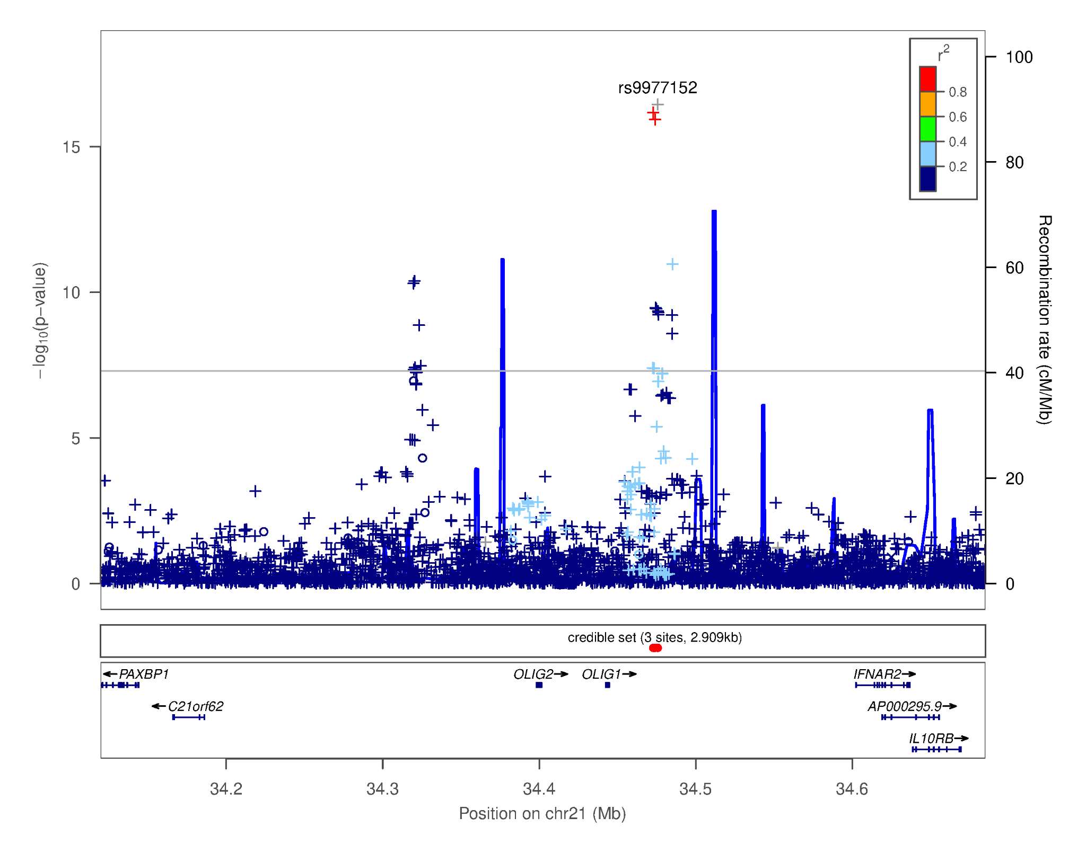
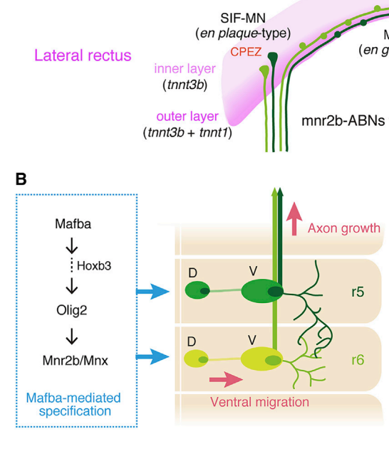
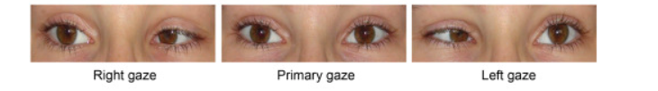
A novel association for duane retraction syndrome near OLIG1/OLIG2
Known to cause Duane syndrome in humans and mice
Figure from Park et al, 2016, AJHG
Duane retraction syndrome: Eye-movement disorder characterized by limited abduction or adduction due to maldevelopment of motor neurons in the abducens nucleus and aberrant innervation of the lateral rectus muscle
Known to affect abducens nerve development in mice, but no known link in humans
Regional plot for Duane retraction syndrome novel association highlighting OLIG1 and OLIG2
Figure from Asakawa & Kawakami, 2018, Cell Reports

Slide 20
Novel associations replicate in UK Biobank
Phenotype | Lead SNP | Replication cohort | Discovery p-value | Replication p-value | Replication cases | Effect direction match
Vestibular schwannoma​ | rs7341786 | UKBB | 1.4e-15​ | ​1.56e-2 | 232​ | True
Spontaneous pneumothorax | rs4437193 | UKBB | 3.7e-10 | 9.69e-1 | 707 | True
Spontaneous pneumothorax | rs9547906 | UKBB | 7.8e-10 | 5.29e-3 | 707 | True
Spontaneous pneumothorax | rs2161648 | UKBB | 4.8e-08 | 2.48e-1 | 707 | True
Duane retraction syndrome​ | rs9977152​ | 23andMe | 3.5e-17​ | 7.01e-06​ | 44 | True
Cleft lip​ | rs72419458​​ | 23andMe | 2.4e-8​ | 8.06e-01​ | 310 | False

Slide 21
Trans-ethnic analyses improve discovery power
Phenotype | Cases | Lead SNP | MAF | P-value | OR | More significant than European GWAS
Vestibular schwannoma | 3,353 | rs9644860 | 0.49 | 1.1e-15 | 1.21 | True
Duane retraction syndrome | 284 | rs137945400 | 0.39 | 2.2e-08 | 0.62 | False
Spontaneous pneumothorax | 1,464 | rs9547906 | 0.32 | 3.4e-11 | 1.31 | True
Spontaneous pneumothorax | 1,464 | rs4437193 | 0.38 | 1.0e-09 | 0.79 | False
Spontaneous pneumothorax | 1,464 | rs144877450 | 0.42 | 1.6e-08 | 1.25 | True
Mixed-model GWAS using SAIGE to analyze all individuals jointly, including:
Related individuals
All ancestries

Slide 22
Next steps
GWAS of more diseases as survey completions increase
Enroll additional rare disease cases for increased discovery power
Idiopathic pulmonary fibrosis - https://www.23andme.com/idiopathic-pulmonary-fibrosis/
Systemic sclerosis - https://www.23andme.com/systemic-sclerosis-study/

Slide 23
Conclusions
Self-reported rare disease data can be combined with GWAS to identify novel genetic associations
Novel associations for vestibular schwannoma, spontaneous pneumothorax, and duane retraction syndrome
Trans-ethnic analysis for rare diseases is important since sample size is limited, and it increases power to find associations
Increasing sample sizes will allow more associations to be found for understudied rare diseases.
Other biobanks, such as UK Biobank, All of Us, will also enable more rare disease gene discovery

Slide 24
Acknowledgements
We would like to thank the research participants and employees of 23andMe for making this work possible.
Wei Wang
Yunxuan Jiang
Alison Acevedo
Devika Dhamija
Briana Cameron
Adrian Jubb
Peng Yue
23andMe Research Team
Lea-Sarov Blat
Robert Gentleman
Adam Auton

