Slide 1
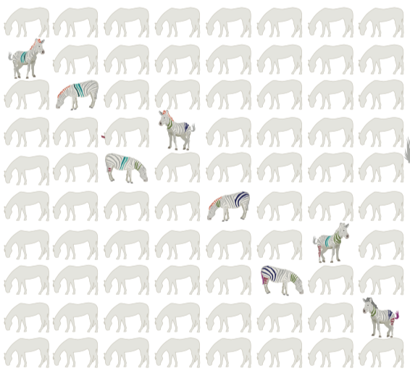

How many rare diseases are there?
and why knowing matters
Melissa Haendel, PhD
University of Colorado Anschutz
https://doi.org/10.1093/jamiaopen/ooaa030
@ontowonka

Slide 2

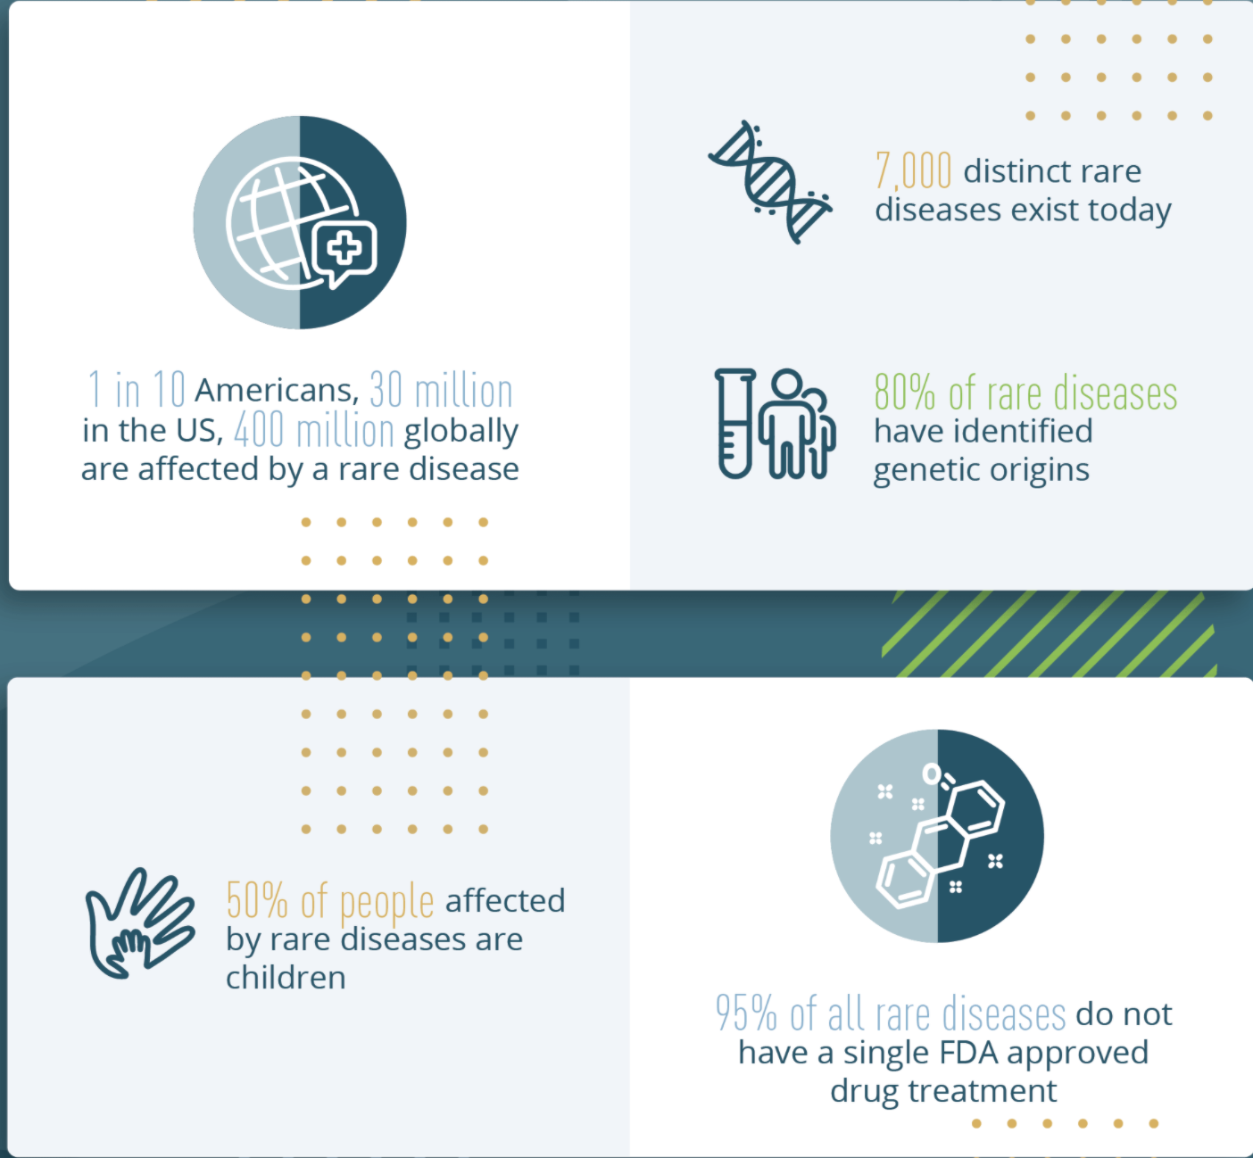
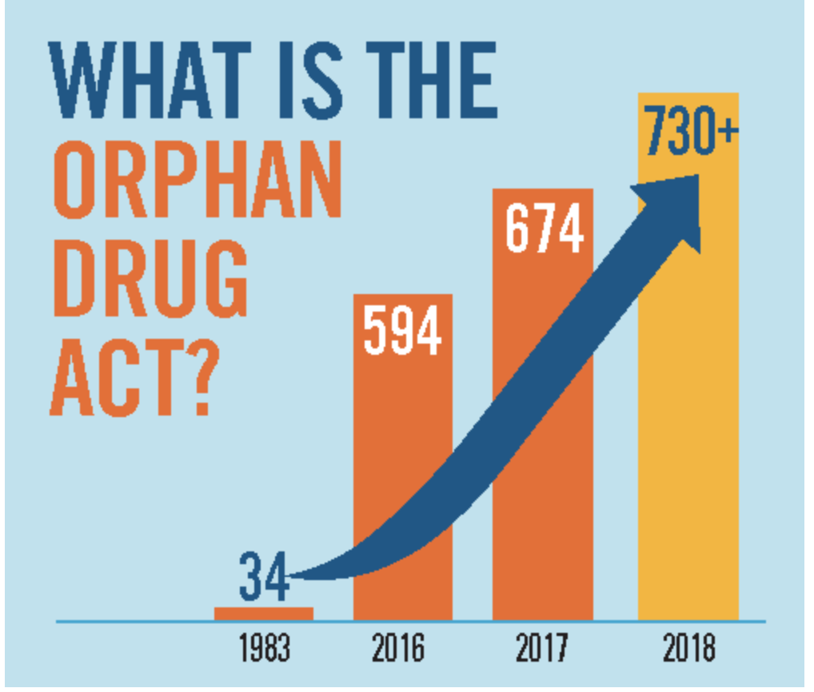
Orphan Drug Act of 1983
https://rarediseases.org/orphan-drug-act-resolution-introduced-in-congress/
https://globalgenes.org/rare-facts/
Notes:
Prior to the ODA, there were only 34 therapies indicated to treat a rare disease. The ODA was enacted to provide research and development incentives to encourage the development of new therapies for diseases affecting fewer than 200,000 people in the United States. Now, there are over 700 and counting! However, approximately 95 percent of rare diseases are still without a single treatment approved by the FDA. Last year, Congress cut one of the incentives for companies to manufacture orphan drugs contained within the ODA in half.

Slide 3
Why the number of rare diseases is hard to determine (and is not 7000!)
We don’t have the same criteria for “rare” around the world:
1983: From the Orphan Drug Act: A rare disease affects fewer than 200,000 people
2000: European Union considers a disease to be rare when it affects fewer than 1 in 2,000 people.
We add new diseases all the time, but don’t update the number:
New rare diseases are discovered every week by organizations such as the Undiagnosed Disease Network
The literature and public databases abound with new weekly entries
N-of-1s are matched, defining new diseases
We don’t define or IDENTIFY diseases in the same way
Dozens of terminologies and disease registries exist, each with their own identifier systems or lack thereof
Rare diseases are often not included in standard clinical terminologies (such as ICD)
Fundamentally, the definition of a rare disease and how to model it computationally has remained more an art than a science, preventing interoperability

Slide 4

Why care about how many diseases there are?
Not having clear definitions of rare diseases makes it hard to diagnose people and develop therapies
Despite ~10% of the population having a rare disease, inability to count = an inability to identify rare disease patients
Clinical information systems fail to fully support diagnosis and care for rare disease patients and don’t help clinicians enough

Slide 5
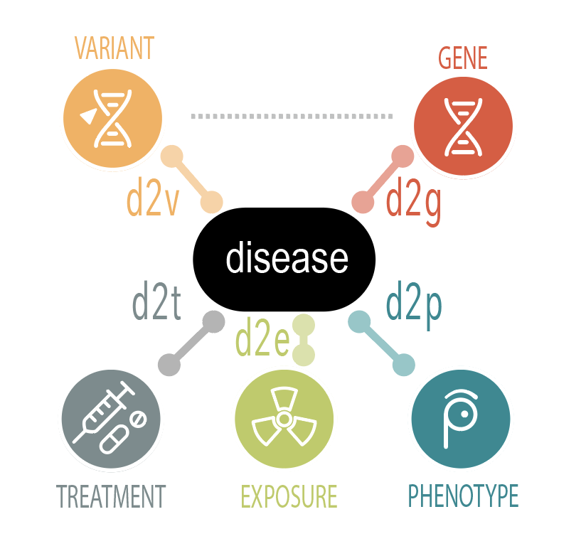
Each disease is really a “model” defined by the disease attributes
heritability
onset

Slide 6
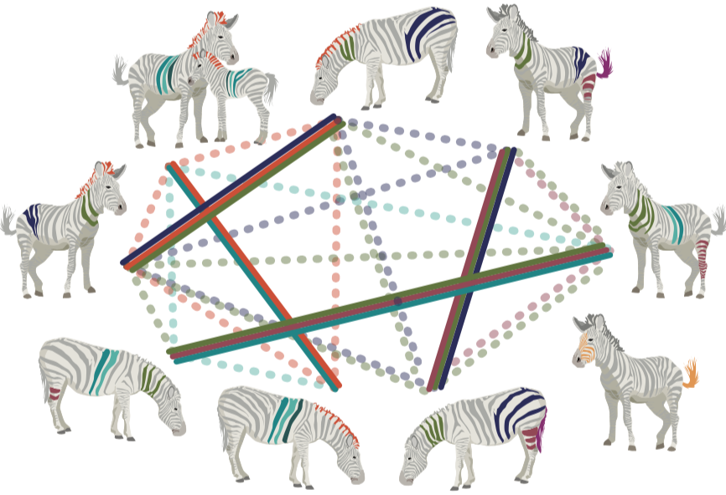
Matching and diagnosing patients requires fuzzy matching of phenotypes.
“Textbook” cases are rare, and no two patients are exactly alike.
All phenotypes match
Some phenotypes match

Slide 7
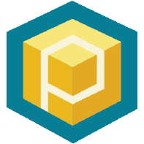



We need to match these!
subject:
id: "family"
proband:
id: "14 year-old boy"
subject:
id: "14 year-old boy"
timeAtLastEncounter:
age:
iso8601duration: "P14Y"
sex: "MALE"
phenotypicFeatures:
- type:
id: "HP:0009830"
label: "Peripheral neuropathy"
excluded: true
evidence:
- evidenceCode:
id: "ECO:0000033"
label: "author statement supported by traceable reference"
reference:
id: "PMID:30808312"
description: "COL6A1 mutation leading to Bethlem myopathy with recurrent hematuria: a case report."
diseases:
term:
id: "MONDO:0008029"
label: "Bethlem myopathy”
Phenopacket
Individual patient
Generalized reference model of this specific disease
heritability
onset
Notes:
https://dissolve.com/stock-photo/Teenage-boy-pushing-himself-royalty-free-image/101-D1910-25-320

Slide 8

What is the most clinically useful way to
define and group diseases?
CANCER
COMPLEX
INFECTIOUS
RARE
MENDELIAN

Slide 9


Evidence-based alignment of disease concepts
OMIM
kBOOM
Bayesian
OWL
Ontology
Merging
Logical +
Probabilistic
Inference
iterative curator-assisted equivalence inference
Orphanet
NCIT
GARD
EFO
DO
DC
evaluate
MESH
MEDIC
Curated Equivalence
Relations
curate
...
feedback
doi.org/10.1101/048843

Slide 10
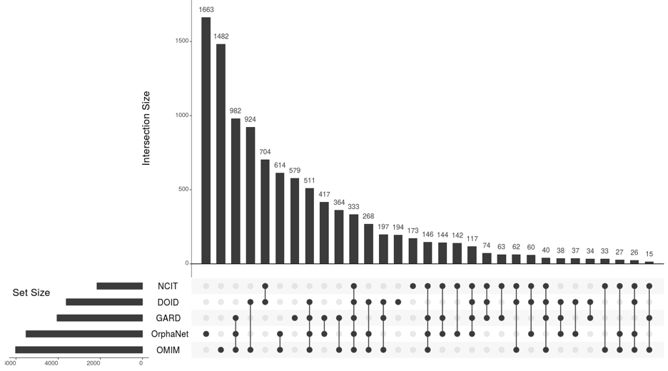
If rare diseases are not counted,
rare disease patients will not count
Just 5 sources comprise 10,577 unique rare disease concepts
(prior estimates ~7,500)
Many diseases are in only one source
Intersection size
Only 333 shared disease concepts in all five sources
5 selected sources
NCIT
DOID
GARD
Orphanet
OMIM
Nature Reviews Drug Discovery (bit.ly/nature-rare-diseases)
Notes:
The horizontal bars on the left represent the total number of disease concepts in each of five disease resources. The vertical bars count disease “leaf” concepts and are sorted in descending order. The dots highlight the visual overlap between the five sources within the harmonized Mondo resource. Orphanet and OMIM have the highest number of “unique” rare disease concepts, with the next one showing overlap between GARD, Orphanet and OMIM for 982 unique rare disease leaf terms. Only 333 rare diseases match across all five resources (the bar with 5 black dots). We consider that the combination of all five resources provides a much better approximation of the number of rare diseases than historical values.

Slide 11
Take homes
To know how many rare diseases there are, we need globally shared definitions
Clinical systems require a common set of definitions to best aid diagnosis and care
We need publicly available information about individuals with rare diseases because
Better counting of rare diseases will lead to better patient outcomes

