Slide 1

Covering Cyberconflict: Disinformation, Ransomware, and Hacking for Non-Experts
Marek N. Posard, Todd Helmus, William Marcellino, Jon Welburn, and Tom Wingfield
CiceroCastro via Adobe Stock

Slide 2
NARRATIVE LAUNDERING Move a narrative from its state-run origins to the wider media ecosystem
HACK AND LEAK OPERATIONS Illegally procure information and share via platforms such as WikiLeaks
FALSE ONLINE PERSONAS Create false personas to hide real identities
MEMES AND SYMBOLS Use memes to create easy-to-share snippets of information that emotionally resonate with people
SOCIAL MEDIA GROUPS Exacerbate existing issues, gather information, and recruit for events by creating social media groups dedicated to divisive issues
SECESSIONIST SUPPORT Undermine the United States by establishing links with & supporting secessionist ideas and movements
FRINGE MOVEMENT SUPPORT Build support for Russia’s values and society by establishing links to extremist groups
Who dislikes whom— And how to exploit it
TAILORED DISINFORMATION Identify content and topics with which to pit different groups against each other
AMPLIFIED CONSPIRATORY NARRATIVES Promote or denigrate an issue, sow distrust, and spread confusion by disseminating constitutional narratives, rumors, and leaks
PAID ADVERTISING Push people to like pages, follow accounts, join events, and visit websites
AMERICAN ASSET DEVELOPMENT Reduce the likelihood of detection by recruiting Americans to perform tasks for handlers
Notes:
There is a logic to Russian efforts to interfere in our elections
This logic is outlined in a Soviet-era theory called Reflexive Control Theory
Russia and proxies identify the preexisting fault lines in American society
Then, flood the information space with the goal of amplifying group-based differences

Slide 3
Russian propaganda seeks to evoke audience emotion—which increases both the influence and virality of a post
Notes:
Russian propaganda seeks to evoke audience emotions, which increase both the influence and virality their content

Slide 4

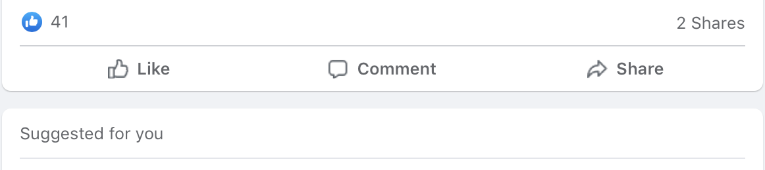

Two kinds of malign accounts interact with liberal and conservative audiences to exacerbate political divisions in the United States
TROLLS
fake personas spreading a variety of hyperpartisan themes
SUPERCONNECTORS highly networked accounts that can spread messages effectively and quickly
Notes:
We found two kinds of malign accounts interacting with specific liberal and conservative audiences and exacerbating political divisions in the United States.

Slide 5
Reverse image search:
https://images.google.com
https://tineye.com
Bot/spam detection:
https://botometer.osome.iu.edu
There are a range of different types of tools that journalists can use to investigate suspicious social media activity
Link Checking:
CrowdTangle Link Checker (Chrome extentsion
https://whopostedwhat.com
Media bias:
https://mediabiasfactcheck.com
Note: This is not an endorsement of these tools.
Notes:
https://images.google.com
https://tineye.com
https://botometer.osome.iu.edu
CrowdTangle Link Checker (Chrome extension)
https://whopostedwhat.com
https://mediabiasfactcheck.com

Slide 6
Journalists can also draw on other interventions to counter Russian propaganda content:
media literacy education
public warnings & “inoculation”
fact-checking, corrections. & labels
9,672
9,672
Notes:
Russian propaganda seeks to evoke audience emotions, which increase both the influence and virality their content

Slide 7
“…if we end up in a war - a real shooting war with a major power - it's going to be as a consequence of a cyber breach of great consequence.” President Biden, July 2021
Notes:
The escalation in ransomware is driven by hackers’ cost-benefit tradeoff
Ransom requests have increased from small dollars to millions.
The high societal costs of attacks on targets like the Colonial Pipeline offer higher rewards for attackers.
Hacking groups often operate outside the reach of U.S. law enforcement in countries that are unwilling to stop them and are even, in some cases, supportive.
We have argued for a stronger policy of deterrence that
Makes networks harder to breach through better security
Hits back harder against hackers – and host states
Claw back gains from those who succeed

Slide 8

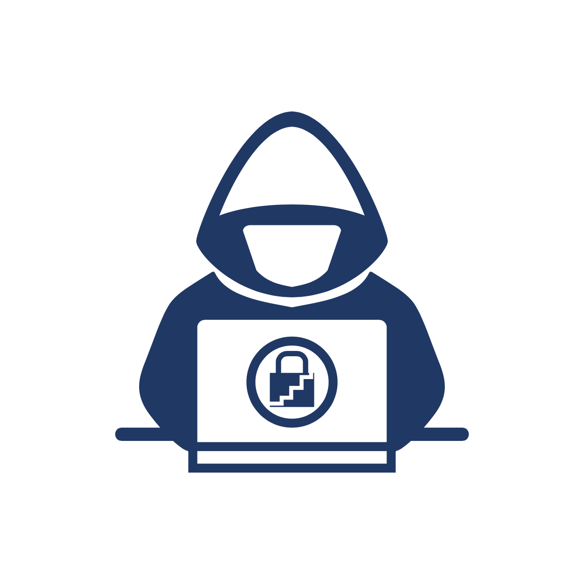


Ransom requests have increased
High societal costs = higher rewards
Hackers operate outside the reach of U.S. law enforcement
Notes:
We have argued for a stronger policy of deterrence that
Makes networks harder to breach through better security
Hits back harder against hackers – and host states
Claw back gains from those who succeed

Slide 9
Who did what, and why?
Is this a criminal action, a nation state attack, or a false flag incident?
What are the consequences?
What is the response?
Will there be an effort to hold hackers accountable?
Will host states cooperate?
Will the victim be held liable for negligence?
What journalists can ask after the next cyber incident:
Notes:
From first bullet: Attribution is notoriously difficult.
From second bullet: Cyber incidents increasingly pose systemic risks as outages drive costs for dependent services and organizations

Slide 10

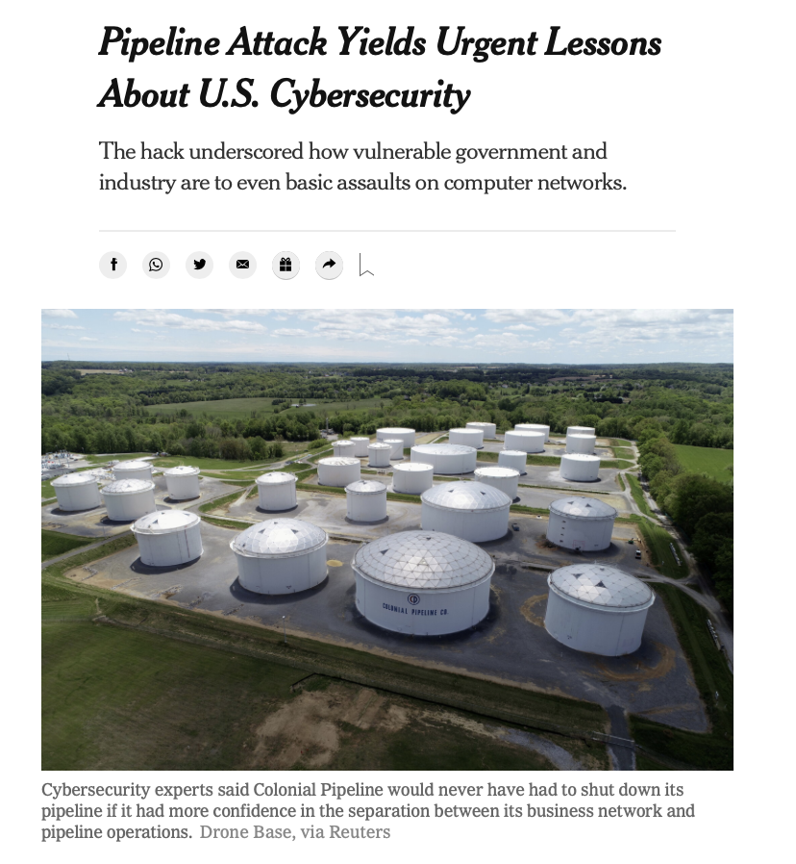
Who did what in the 2020 election cycle:
CISA—interference
FBI—influence
DoD—generating insights, recommending defenses, imposing costs
Disinformation—what’s ahead:
Open-ended threat
New approaches
AI
Reporting on a serious cyber event
Notes:
RAND
Research and analysis
Quotes and referrals

Slide 11
Questions?
mposard@rand.org helmus@rand.org
bmarcell@rand.org
jwelburn@rand.org
tomw@rand.org
CiceroCastro via Adobe Stock

