Slide 1
Rare Diseases Overview
Anne Pariser, MD
Director, Office of Rare Diseases Research
National Center for Advancing Translational Sciences, NIH
National Press Foundation
September 13, 2021

Slide 2
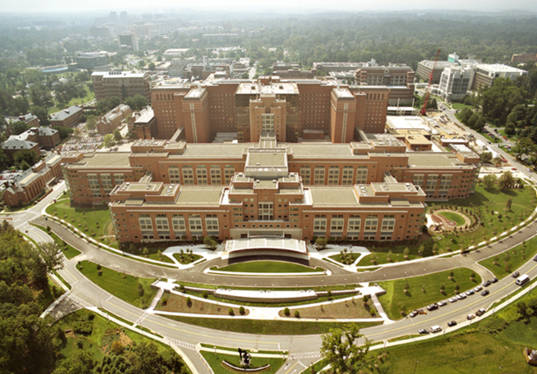
National Center for Advancing Translational Sciences (NCATS) at National Institutes of Health (NIH)
NIH = US’s medical research agency
  ~$42B in medical research in 2020
  ~$5-6B toward rare diseases
NCATS
  1 of 27 NIH Institutes/Centers (ICs)
  Established in 2012
  Only NIH Center focused on translational sciences
  Translation = process of turning observations (e.g., lab, clinic) into interventions that improve health
Office of Rare Diseases Research (ORDR) NCATS
  Mission: Advancing rare diseases research to benefit patients

Slide 3
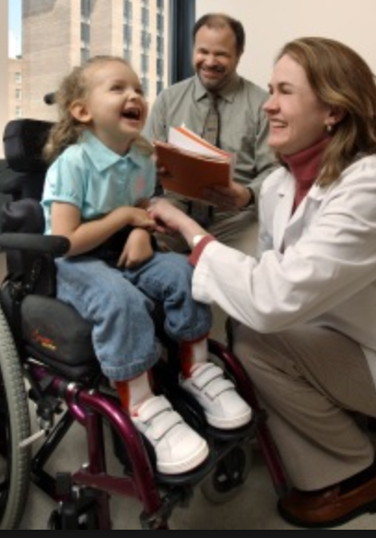
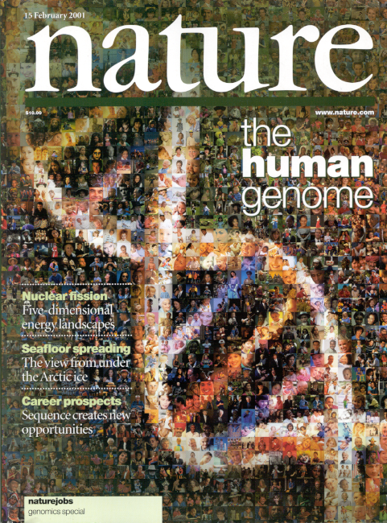
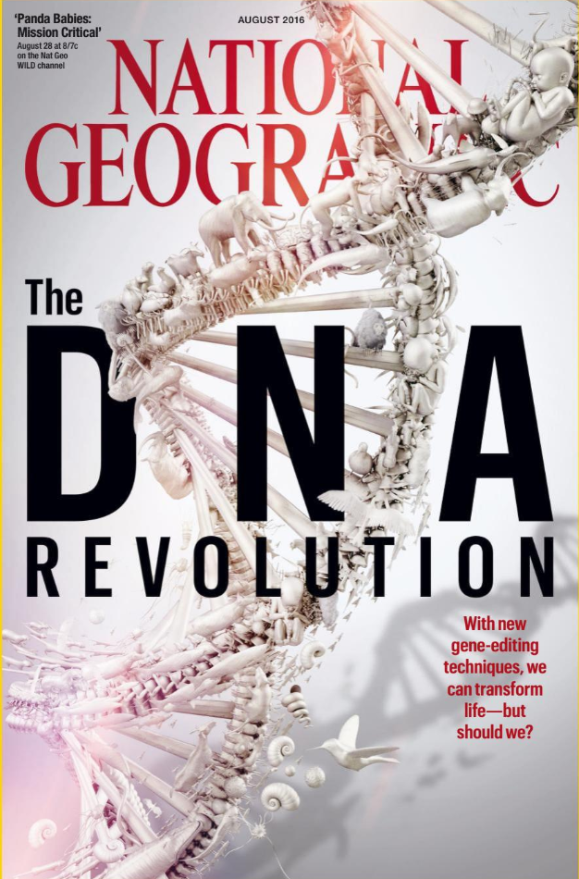
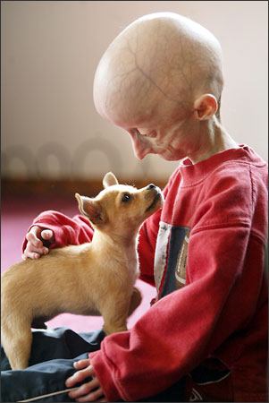
Where We Are in 2021
Tremendous scientific progress
Enormous potential to deliver on the promise of science for patients
But…
  Slow transition of scientific advances to improve human health
    ~15 years to develop a new treatment
How do we advance promising science more quickly to benefit patients?

Slide 4
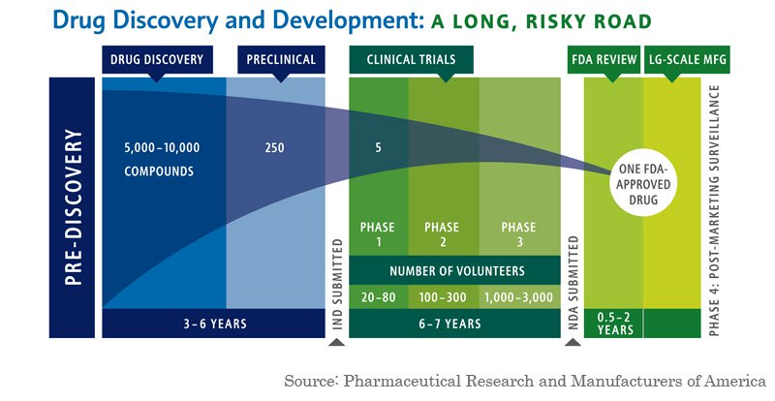
The Problem: Product Development Time and Costs: 10–15 Years and >$2.6 Billion USD
Sources:
Pharmaceutical Research and Manufacturers of America, Drug Discovery and Development: Understanding the R&D Process, www.innovation.org
DiMasi, JA and Grabowski, HG (2007), The Cost of Biopharmaceutical R&D: Is Biotech Different?, Managerial and Decision Economics 28 : 469-479

Slide 5
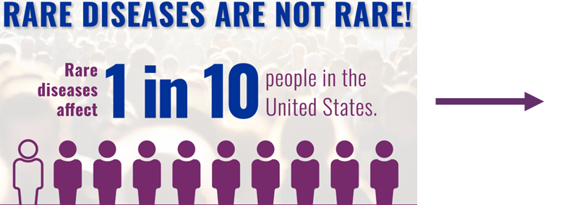
Rare Disease FAQs
What is a Rare Disease (RD)
  US: “disease or condition affecting fewer than 200,000 persons in the United States”
  EU: <1 person in 2,000
  Most far less prevalent than this, a few 100s -1000s (or fewer)
~7,000 -10,000 different RDs
~25-30M people in the US or in EU
~350M people worldwide
~8% of the population
Orphan Drug Act (ODA) 1983, amended for prevalence 1984
European Commission 2008
Notes:
Japan 1993, <50,000 persons in Japan

Slide 6
Types of Rare Diseases
~85% genetic diseases
  “single gene” disorders (monogenic)
  Affect fundamental biology → enhance understanding of human health and disease, rare and common
And
  Rare cancers, e.g.,
    All pediatric cancers are rare*
    Blood cancers
  Infectious diseases, e.g.,
    Mainly neglected tropical diseases (NTD)
      Malaria, Chagas, Ebola
  Acquired, environmental, e.g.,
    Snake bites, poisoning, toxic exposures
  Polygenic, e.g.,
    some autoimmune disorders
      Vasculitis
*Almost all serious diseases of childhood are rare

Slide 7


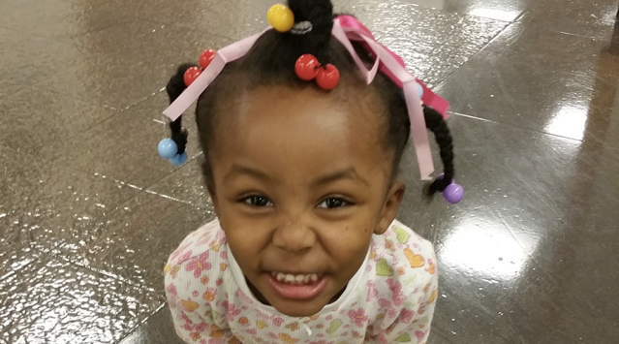
Rare Disease FAQs (2)
~7,000-10,000 Rare Diseases
  200-250 “new” diseases each year
  ~50% first manifest in children
Hard to diagnose, under-recognized
  ~5+ years to obtain an accurate diagnosis
~95% no approved therapy
  Hard to make a “business model” work for diseases with few patients
Notes:
Japan 1993, <50,000 patients in Japan

Slide 8
6,980
Human Genome Project
~500 with a therapy
*as of 9/7/21
OMIM, Online Mendelian Inheritance in Man: https://www.omim.org/statistics/geneMap

Slide 9
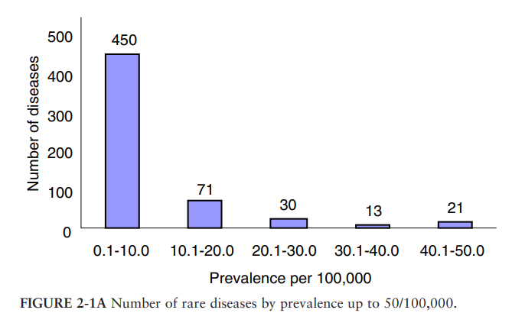
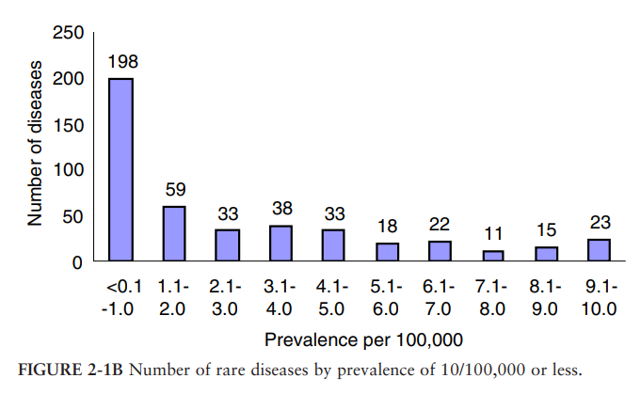
Rare Disease Prevalence
Number of diseases highly skewed toward very low prevalence disorders
  ~10% of rare diseases affect ~90% of rare disease patients; 90% of RD affect 10% of patients
Prevalence <50/100,000
(~<175,000 people)
Prevalence <0.1-1/100,00
(~<350-3500 people)
From: IOM. 2010. Rare Diseases and Orphan Products: Accelerating Research and Development. Ch.2: Profile of Rare Diseases.
Notes:
Data source: Orphanet
~70% of lowest prevalence conditions in Orphanet consist of case reports for individuals or families
50/100,000 ~175,000
0.1-10/100,000 ~350-3,500

Slide 10

Rare Diseases Research Challenges
Collaboration, data sharing, patient involvement are must-haves
Small numbers of patients
Many affect children
Many diseases, most poorly understood
High variability within
a disease
No/little clinical trial precedent
Most serious or life-threatening
Patients geographically dispersed
Few disease experts
10

Slide 11
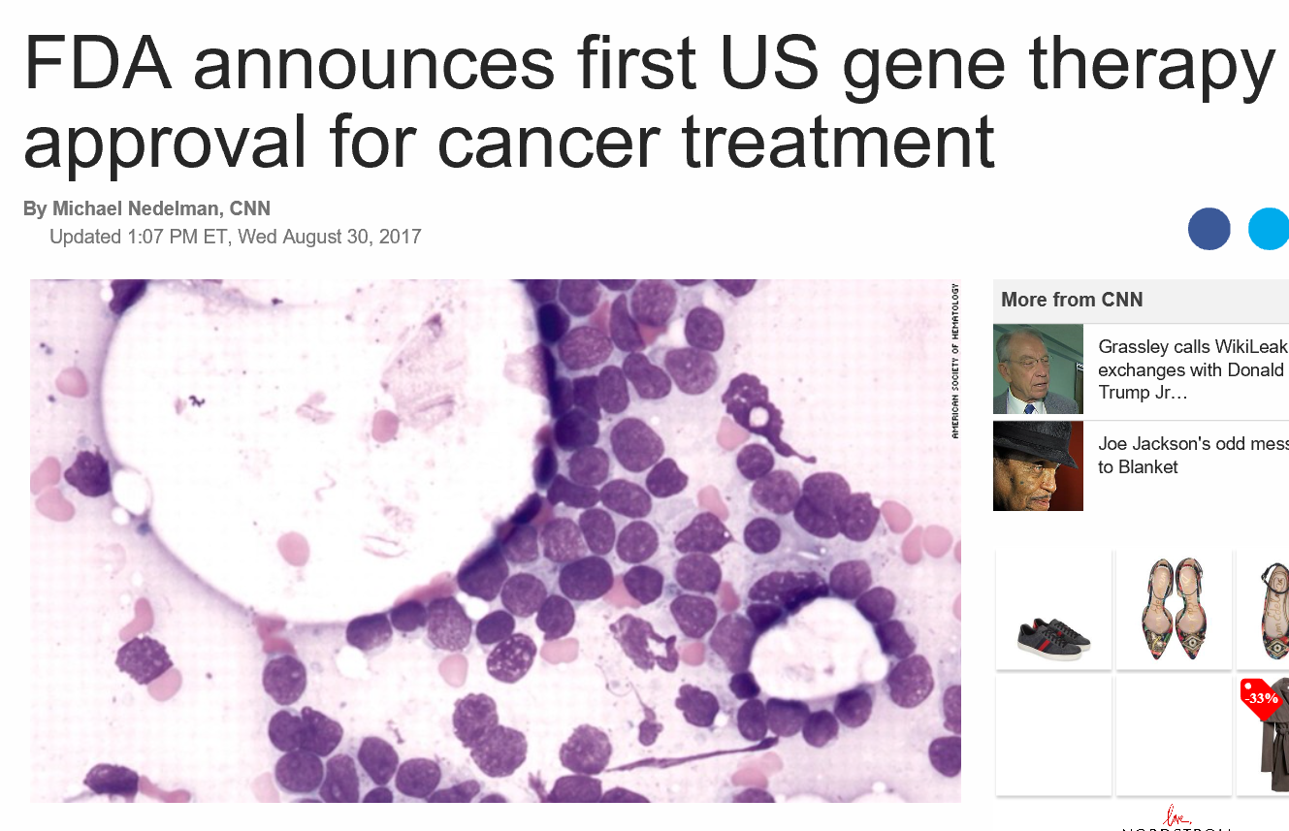
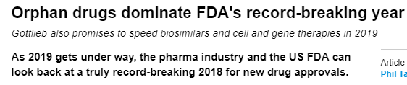
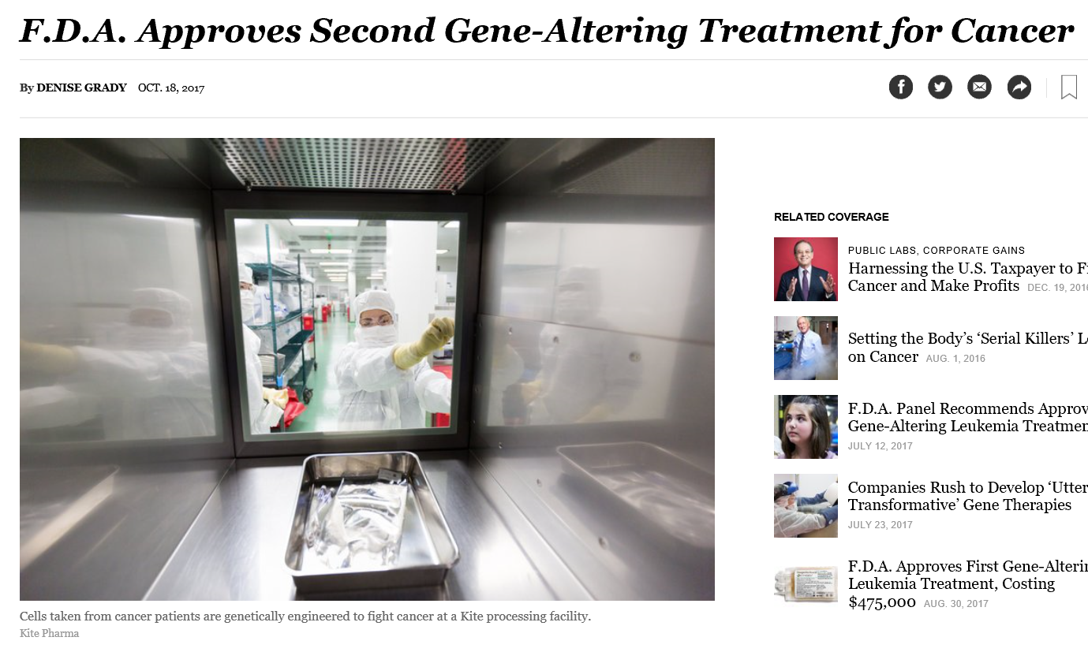
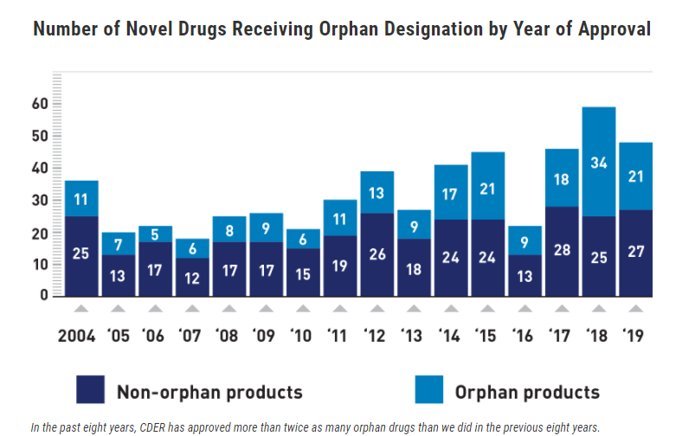
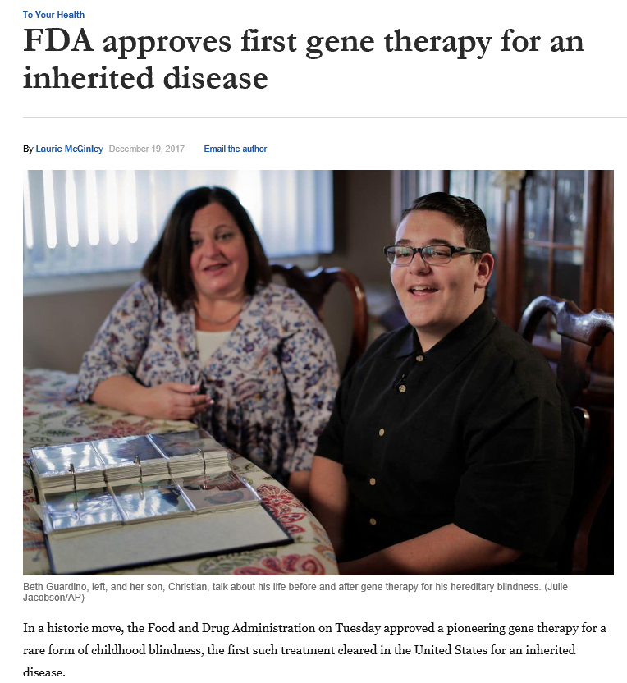
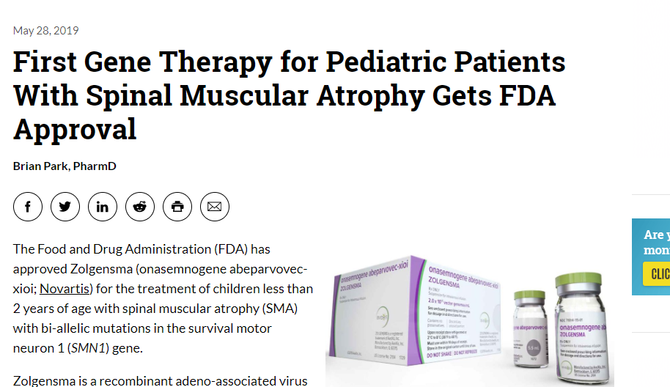
Rare Diseases – Model for Precision Medicine
https://www.cnn.com/2017/08/30/health/fda-first-gene-therapy-leukemia/index.html
https://www.nytimes.com/2017/10/18/health/immunotherapy-cancer-kite.html
https://www.washingtonpost.com/news/to-your-health/wp/2017/12/18/fda-approves-first-gene-therapy-for-an-inherited-disease-childhood-blindness/?utm_term=.c5ca8ed7ed5f
https://www.empr.com/home/news/first-gene-therapy-for-pediatric-patients-with-spinal-muscular-atrophy-gets-fda-approval/
http://www.pmlive.com/pharma_news/orphan_drugs_dominate_fdas_record-breaking_year_1273631
https://www.fda.gov/news-events/fda-voices/innovation-new-drug-approvals-2019-advances-patient-care-across-broad-range-diseases
Notes:
FDA >250 active gene therapy INDs

Slide 12

What Can We Do
Many diseases at a time
Fewer diseases
More patients
Many diseases at a time
Fewer diseases
More patients

Slide 13
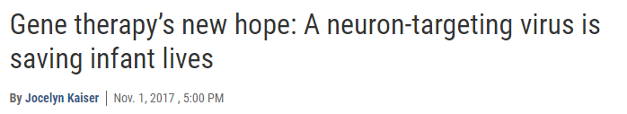




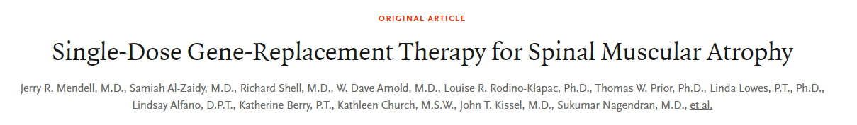

The Promise of Gene Therapy
Evelyn, age 3
https://www.sciencemag.org/news/2017/11/gene-therapy-s-new-hope-neuron-targeting-virus-saving-infant-lives
https://www.nejm.org/doi/full/10.1056/NEJMoa1706198
https://www.npr.org/sections/health-shots/2019/05/24/725404168/at-2-125-million-new-gene-therapy-is-the-most-expensive-drug-ever
Notes:
Evelyn’s older sister Josephine died at age 15 months, one of the first patients in Phase 1/2 trial, rec’d gene therapy
Trial n = 15 SMA1 patients aged 0.9-7.9 months (mean age ~4 months) All 15 alive and event-free at age 20 months. Historical control cohort rate of survival 8%
Dashed line 40 – historical controls never reach 40. CHOP Intend maximum score of 64, up to 4 points in 16 categories

Slide 14
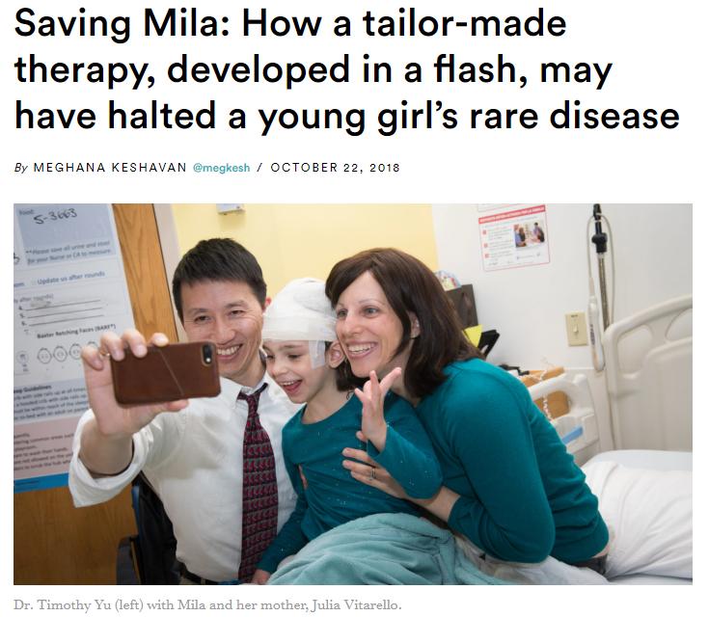
Precision Medicine
Individualized Medicine – “Milasen”
Anti-sense Oligonucleotide (ASO)
Targeted to a single patient
<2 years to the clinic
  But… ~$2M US
Keshavan, Stat News, 2018. https://www.statnews.com/2018/10/22/a-tailor-made-therapy-may-have-halted-a-rare-disease/

Slide 15
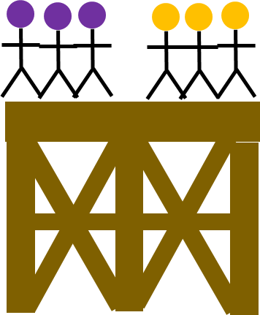
Platforms
Platform = durable infrastructure to support testing of multiple therapies and diseases
  E.g., Lung-MAP, ISPY 2
Lung Cancer Master Protocol (Lung-MAP): https://www.lung-map.org/
I-SPY 2 Breast cancer platform: https://www.ispytrials.org/

Slide 16
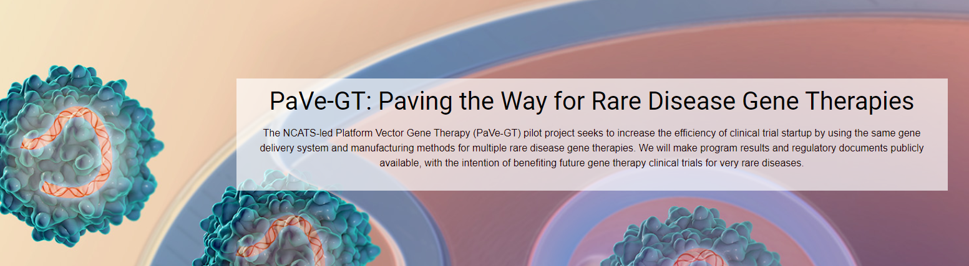
Platform Vector Gene Therapy (PaVe-GT)
NIH research pilot intended to develop 4 gene therapies for rare monogenic disorders at the same time using a platform design
Platform = durable infrastructure to support testing of multiple gene therapies and diseases
Vector = organism (virus) that delivers something (gene) to something else (cell of interest)
https://pave-gt.ncats.nih.gov

Slide 17
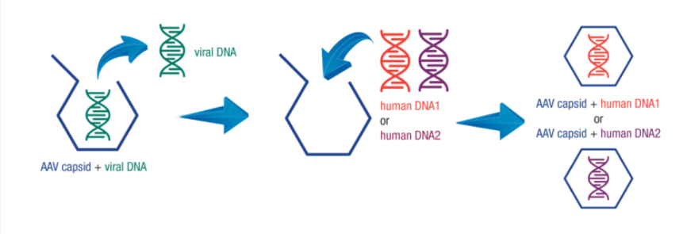
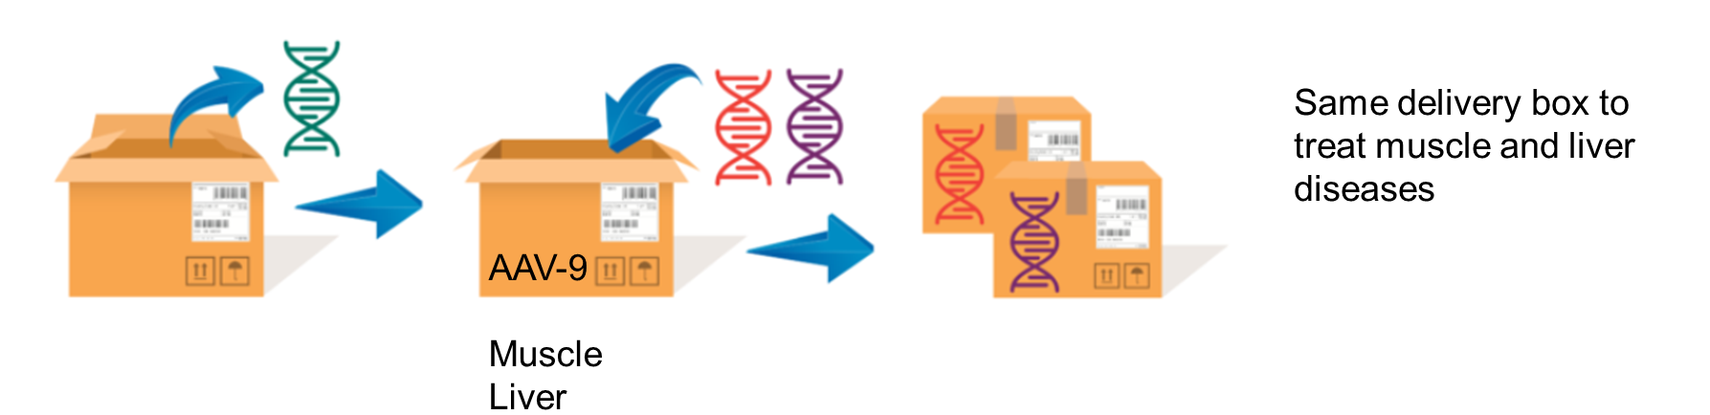
AAV

Slide 18
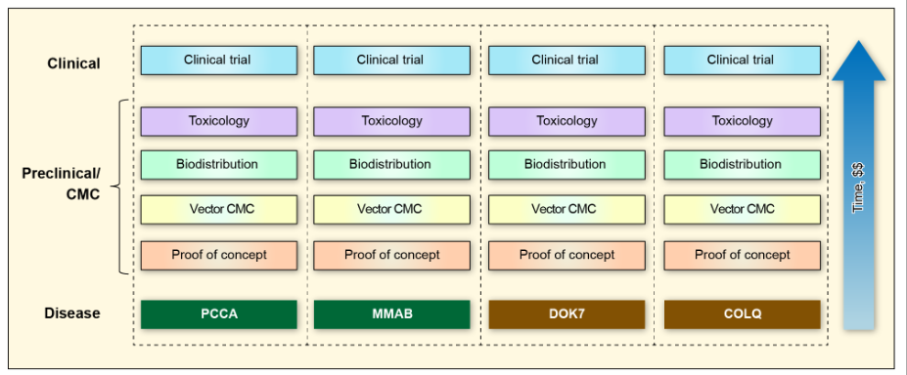
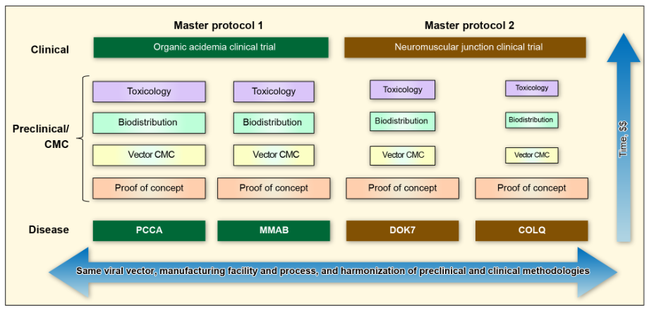
Traditional clinical development paradigm
PaVe-GT clinical development paradigm

Slide 19

“Umbrella” Trial
= More than 1 different treatment arm within one trial. People are assigned to an arm based on the specific genetic mutation of the underlying disease*
Master Protocol
Common protocol
Common outcome measures
Same sites/investigators
OA or NMJ
Gene Tx 1A
Patients 1A
Genetic Dx
Gene Tx 1B
Patients 1B
*American Society of Clinical Oncology (ASCO):
https://www.asco.org/research-progress/clinical-trials/clinical-trial-resources/clinical-trial-design-and-methodology

Slide 20

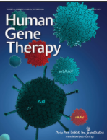
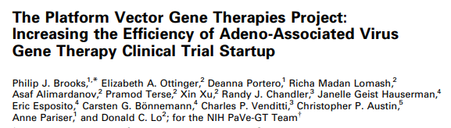
PaVe-GT
Pilot
  Public platform vector gene therapy trial: https://pave-gt.ncats.nih.gov
    4 diseases
    Same viral vector
    Same route of administration: IV
    Same production and purification methods (‘the process is the product”)
    Different therapeutic gene therapy
Make all data, including communications with FDA, publicly available
Status
  Early stage

Slide 21
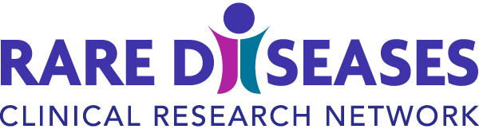
Rare Diseases Clinical Research Network
Network of “Centers of Excellence” grouped around rare disease (RD) therapeutic areas
RDCRN’s purpose
  Facilitate RD research through the establishment or continuation of RD clinical research consortia
  >3 diseases or conditions with a consortium
  Patients, researchers, clinicians work together
Established in 2002
4th awardee cohort = RDCRN4 (2019-2023)
Priorities
  Clinical Trial Readiness
  Data sharing/standards

Slide 22
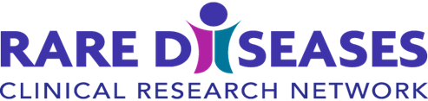
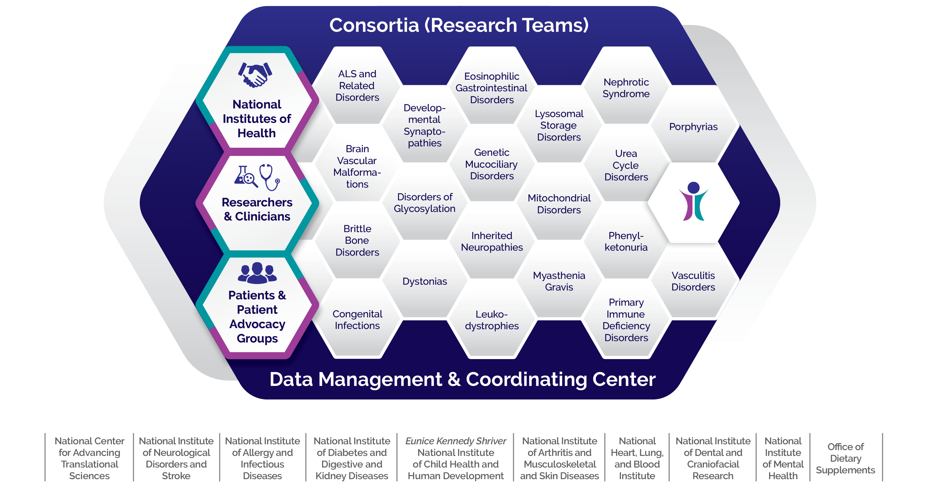
RDCRN4: Collaboration

Slide 23
What Can We Do
Many diseases at a time
Fewer diseases
More patients
Many diseases at a time
Fewer diseases
More patients

Slide 24
Shared Molecular Etiologies
Traditionally, diseases identified and treated based on clinical manifestations (phenotype)
Thousands of rare genetic diseases, BUT far fewer underlying genetic etiologies, such as:
  Premature stop codon (nonsense mutation)
  Abnormal protein folding (missense)
  Splice site mutations
  Dominant/gain of function
Can we group diseases in non-traditional ways to create larger patient pools and gain efficiencies in development?

Slide 25
Shared Molecular Etiology Paradigm
Disease B
Disease D
Disease A
Disease C

Slide 26

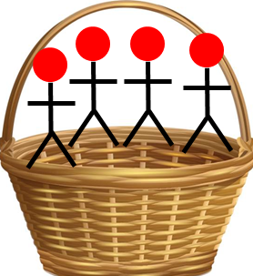
Shared Molecular Etiology Paradigm
*
*Basket trial = Different diseases, one therapeutic agent
SaME Therapy
Outcome(s)

Slide 27
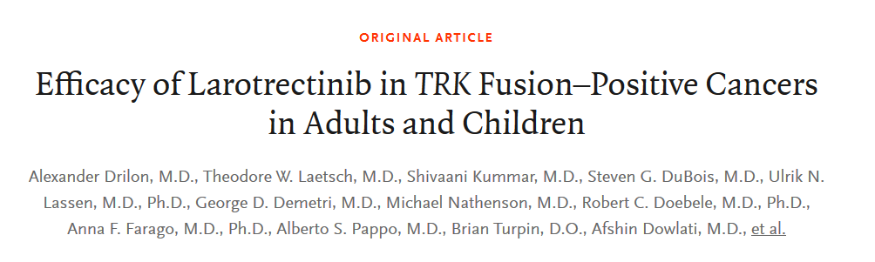
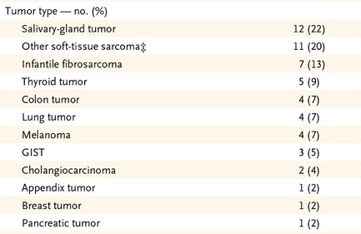

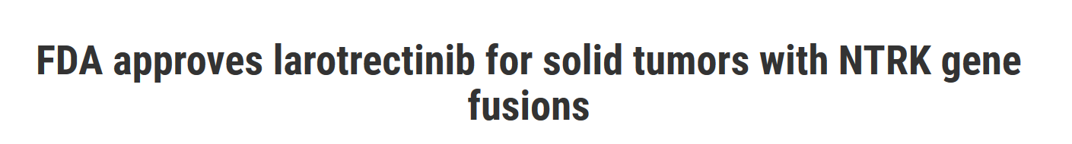
Precedent: Genomically Driven Oncology Basket Trial
“ Larotrectinib had marked and durable antitumor activity in patients with TRK fusion–positive cancer, regardless of the age of the patient or of the tumor type “
https://www.fda.gov/drugs/fda-approves-larotrectinib-solid-tumors-ntrk-gene-fusions-0
February 22, 2018 N Engl J Med 2018; 378:731-739

Slide 28
What Can We Do
Many diseases at a time
Fewer diseases
More patients
Many diseases at a time
Fewer diseases
More patients

Slide 29


More Patients → Diagnosis
Often long latency between clinical findings and diagnosis (~3-8 years)
  “Diagnostic odyssey”, many contributing factors
  Substantial monetary and human cost to un/mis-diagnosis
    Not well documented across rare disease spectrum
    Mainly small cohorts, single centers/diseases, mainly from EU
Quantifying “burden”
  Survey on direct and indirect costs in US of ~ 379 rare diseases/~15.5M people: $966B in 2019
https://everylifefoundation.org/wp-content/uploads/2021/02/The_National_Economic_Burden_of_Rare_Disease_Study_Summary_Report_February_2021.pdf
Notes:
Can’t test everyone, some potential escalators

Slide 30

Diagnosis (2)
  Healthcare Cost and Utilization in 2016: Total charges nearly equal between rare and common disorders, ~$768B
  Substantially higher per-patient healthcare utilization in rare diseases
NCATS IDeaS Study: 14 rare diseases, on average 3-5X higher costs ($US) for rare diseases than age-matched controls
GAO study underway
https://doi.org/10.1038/s41436-021-01241-7

Slide 31
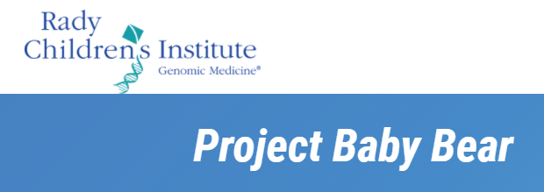



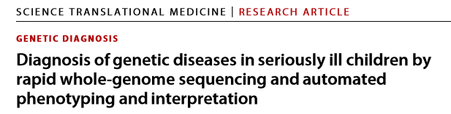
Project Baby Deer
Rapid WGS in NICUs in California cohort
Median time to genetic disease dx ~20 hours
Now, adding automated (machine) extraction of a deep digital phenome from the EHR
Initial study: ~15-30% diagnostic yield
18-mo program ~$2.5M savings in medical costs
Stephen Kingsmore MD, DSc
Clark et al., Sci Transl Med 11, eaat6177(2019)
Partially funded by a CCIA award: U01TR002271-01
https://radygenomics.org/case-studies/project-baby-bear/
Notes:
“saving babies, saving cash”

Slide 32
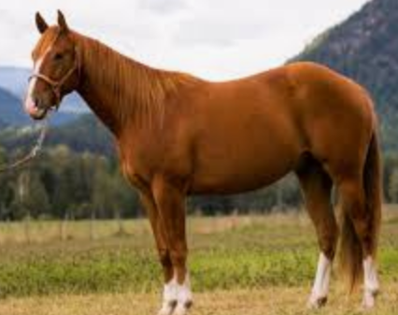
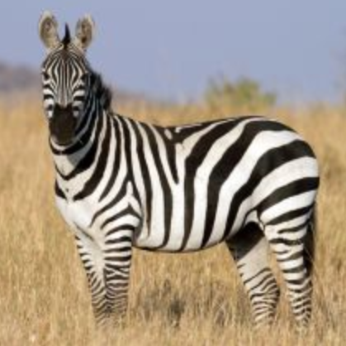
“Zebra Triggers”
Old medical school adage
“When you hear hoofbeats, think of horses not zebras”
New adage → think zebra when…
Potential zebra triggers
Young age
High utilization
Multiple consults, “geography”
Imprecise diagnostic codes, e.g.,
    Failure to thrive/delay in growth
    Developmental/motor delay
    Refractory seizures
    Recurrent serious infections
Notes:
Can’t test everyone, some potential escalators

Slide 33
Take Home Points
Many diseases, small number of patients each, few treatments
  → collectively, a large public health problem
Unprecedented scientific opportunities
  Operational/logistical barriers to progress
  Rare diseases often lead the way, benefits common diseases too
Think differently, adopt/adapt new strategies
  Many-at-a-time models and non-traditional approaches

Slide 34
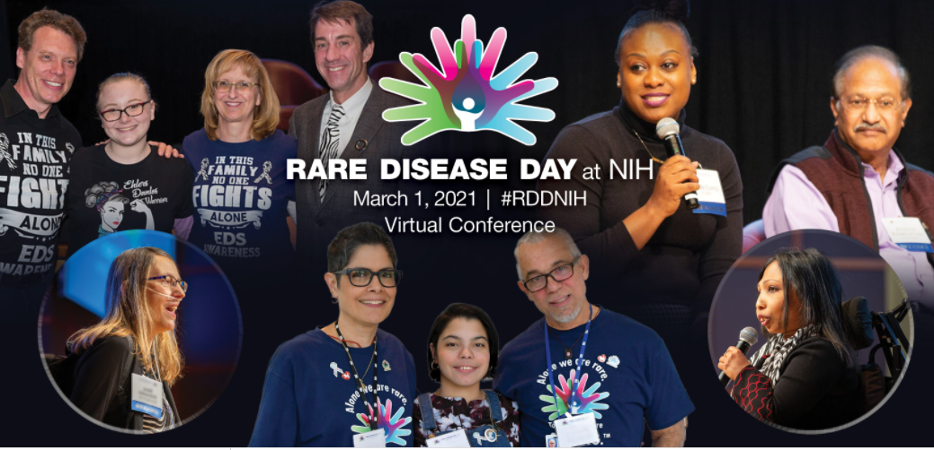
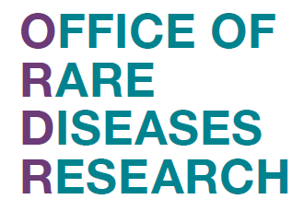

A Few Resources for You
Genetics and Rare Diseases information center (GARD)
  Information on >6,500 rare diseases https://rarediseases.info.nih.gov/
Meetings and conferences
  Rare Disease Day February 28, 2022
  https://ncats.nih.gov/news/events/rdd
  International RDD https://www.rarediseaseday.org/
Contact us:
ORDR@nih.gov
Anne.pariser@nih.gov
Notes:
168 days to go to RDD 2022

Slide 35


Slide 36


