Slide 1

Approach to rare diseases in Europe
DARIA JULKOWSKA
EJP RD coordinator
INSERM, France
NPF Rare Diseases Programme
13-14 of September 2021, Online

Slide 2


7.9 billion people in the world
176 millions
Patients
300 millions
1 disease
Diseases
7000 diseases
15 min – 24h
Time to diagnosis
5 years
Hampered/
scattered
Access to care
Hampered/
scattered
Difficult/
progressive
Treatment
No treatment for 95%
Impact on health
High
High

Slide 3
What are the major challenges?
Managing uncertainty & need to adapt the healthcare
New concepts of helthcare – telehealth
Management & reuse of patients data
Linkage between helthcare & research
Training of qualified personnel
Patient at the center – patient-need driven research & holistic care

Slide 4


COLLABORATION
Photo by Tim Marshall on Unsplash

Slide 5

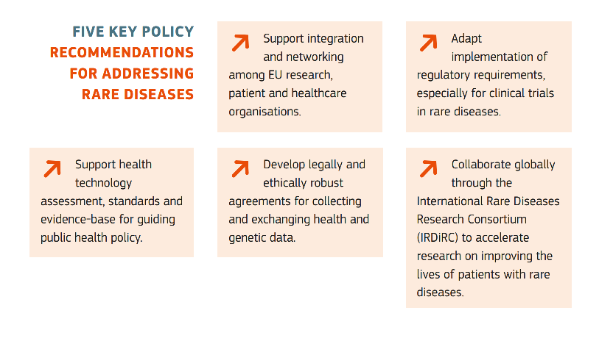
Rare diseases research is one of the EU priorities since the last two decades
More than 1.8 billion € invested in 320 RD research projects (2006-2020)
Adapted from ﻿RARE DISEASES - A major unmet medical need, EC Report 2017

Slide 6
Rare diseases research is one of the EU priorities since the last two decades
Over 1 billion € invested since 2020
More than 1.8 billion € invested in 320 RD research projects (2006-2020)

Slide 7

National Plans on Rare Diseases
Establish and implement plans or strategies for rare diseases at the appropriate level or explore appropriate measures for rare diseases in other public health strategies, in order to aim to ensure that patients with rare diseases have access to high-quality care, including diagnostics, treatments, habili­ tation for those living with the disease and, if possible, effective orphan drugs
Aim to ensure that rare diseases are adequately coded and traceable in all health information systems
Identify needs and priorities for basic, clinical, translational and social research in the field of rare diseases and modes of fostering them, and promote interdisciplinary co- operative approaches to be complementarily addressed through national and Community programmes
Identify appropriate centres of expertise throughout their national territory by the end of 2013, and consider supporting their creation. Gather national expertise on rare diseases and support the pooling of that expertise with European counterparts
Consult patients and patients′ representatives on the policies in the field of rare diseases and facilitate patient access to updated information on rare diseases
Together with the Commission, aim to ensure, through appropriate funding and cooperation mechanisms, the long-term sustainability of infrastructures developed in the field of information, research and healthcare for rare diseases

Slide 8
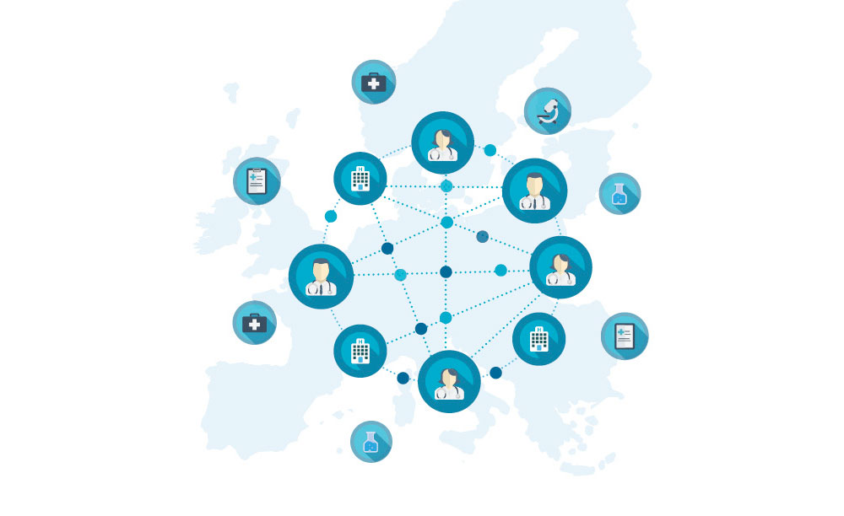
EUROPEAN
REFERENCE
NETWORKS
Adapted from ERN Flyer, EC 2017

Slide 9
RARE DISEASES LANDSCAPE IN EUROPE (resuming 20 years of efforts)
HEALTHCARE +
European Reference Networks (ERN)
More than 900 units from 300 hospitals covering 26 countries
PATIENT NEEDS
EURORDIS
962 patient organisations from 73 countries
RARE DISEASES RESEARCH
FUNDING
ERA-Net Rare (2006-2018) + EC
INFRASTRUCTURES
RD-specific: Orphanet, RD Connect, ERDRI, Solve-RD
ECRIN, EATRIS, BBMRI-ERIC, ELIXIR, EU-OPENSCREEN, EPTRI, INFRAFRONTIER, Conect4Children
STRATEGY
International Rare Diseases Research Consortium (IRDiRC), EC, Member States

Slide 10


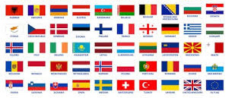
?
International, European & national research strategy & funding

Slide 11

Main objective:
Create a research and innovation pipeline "from bench to bedside" ensuring rapid translation of research results into clinical applications and uptake in healthcare for the benefit of patients
Mode of action:
Large programme that integrates existing infrastructures, trainings, funding programmes and tools, expands them and develops new essential ones to offer harmonized (and centralized) RD research ecosystem that is easy to use for scientists and produces benefits for patients in the most efficient way

Slide 12









Coordinated by
1339 people
EJP RD in numbers
91 beneficiaries
10 hospitals
12 research institutes
31 research funding bodies/ministries
27 universities/hospital universities
5 EU infrastructures
5 charities/foundations
EURORDIS
+ 52 linked third parties
+100% associated networks
35 participating countries
26 EU MS, 7 associated (AM, CH, GE, IL, NO, RS, TK), UK and CA
CA
85% of
European RD research community
(directly or indirectly)
involved in EJP RD
FI
ALL 24 ERNs
NO
SE
EE
DK
LV
LT
IE
UK
NL
DE
PL
101 M€
Budget
Union contribution: 55 M€ (70% reimbursement rate)
BE
CZ
LU
SK
FR
CH
AT
HU
SI
RO
HR
RS
IT
BG
GE
PT
ES
GR
TR
AM
MT
IL

Slide 13
EJP RD STRUCTURE
Coordinated by
Coordination & transversal activities
(strategy, sustainability, ethics, communication)
Accelerating of research translation & clinical studies
RD research funding
Capacity building & empowerment
Access to data, tools & services – Virtual Platform

Slide 14





EJP RD – single entry point & solutions for all
RESEARCHERS
CLINICIANS
PATIENTS
POLICY MAKERS & FUNDERS
INTERNATIONAL
PARTNERS
Funding
Research support services
Training at every stage
Access to resources & tools
Access to extensive network & expertise
Clinical studies support services
Support for registries
Access to resources & tools to accelerate diagnosis
Access to extensive network & expertise
Funding
Access to RD specific expertise
Networking
Training at every stage
Access to resources & tools
Access to extensive network & expertise
Funding
Joint funding & strategy
Optimisation of investment in research
Access to support for national RD community
Access to extensive network & expertise
Holistic impact evaluation
Access to extensive RD network & expertise
Multiple collaboration opportunities
Possibility of alignment
Access to resources & tools

Slide 15



THANK YOU
www.ejprarediseases.org
coordination@ejprarediseases.org
helpdesk@ejprarediseases.org
Follow us on social media
@EJPRarediseases
The EJP RD initiative has received funding from the European Union's Horizon 2020 research and innovation programme under grant agreement N°825575

