Slide 1

ONE VOICE,
ONE ASIA PACIFIC
13 SEP 2021
PRESENTED BY
RITU JAIN
We Are RARE

Slide 2
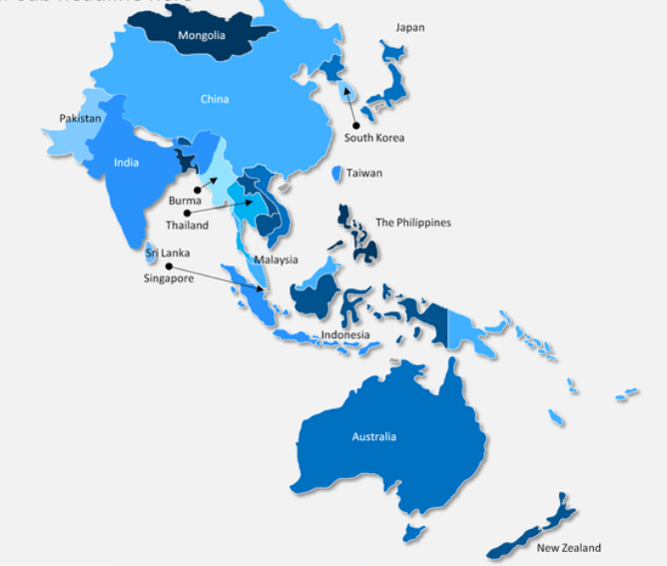
APAC
POPULATION
4.3 BILLION
(~60% of global
population)

Slide 3
258 m
6% of APAC population
affected – the irony of rare
1
ESTIMATED PREVALENCE 2020
BY COUNTRY (assumption: 1.2%)
Country | Affected by RD
China | 16.8 m
India | 16.1 m
Indonesia | 3.2 m
Japan | 1.4 m
Philippines | 1.2 m
Vietnam | 1.1 m
Thailand | 0.8 m
Country | Affected by RD
South Korea | 0.5 m
Malaysia | 0.3 m
Australia | 0.5 m
Taiwan | 0.2 m
Singapore | 68 k
New Zealand | 56 k
CSL Behring report : The Economist “Suffering in Silence: Assessing Rare Disease Awareness and Management in Asia-Pacific”, 2020
Notes:
Ref: CSL Behring The Economist report --China = 1.17%
global prevalence rate = 3.5% to 5.9% as a % of the total population for APAC but the data here is adjusted for sensitivity analysis
Australia = 2%

Slide 4
RARE DISEASE – APAC: PREVALENCE & GAPS
~258 m
6% of APAC population affected by
RD ²
Lack of priority ¹
Lack of official definition
3
Limited studies & data
Limited capacity and capability for diagnostics ¹
Limited screening
Limited capacity & training
Limited accessibility of treatment ¹
Limited availability
Limited affordability
KPMG Blog “A quest for sustainable healthcare models in APAC”, 29 Jan 2021
CSL Behring report : The Economist “Suffering in Silence: Assessing Rare Disease Awareness and Management in Asia-Pacific”, 2020
Notes:
Capacity and capability: Screening: lack of genetic counselling, pre-natal screen and new born monitoring -- contribute to late-stage diagnoses of RD; Limited capacity and training: HCPs not trained to recognize RD – average time to diagnosis is 7 years
Accessibility of treatment: spcialised and coordinated care challenging in countries with under-dev health systems and socio-economic constraints.

Slide 5





Rare Disease Financing Gaps in Asia-Pacific*
Traditional sources of funding:
Tax
Social health insurance contribution
Private insurance
& External Aid
Limited tax base:
Tax to GDP ratio in majority of the region
Unsustainable tax base:
Shrinking taxable workforce due to aging population
Informal workforces not captured by tax system
Limited participation from informal workforce:
The need to enrol and pay premium manually
Adverse selection:
Selective enrolment from informal workforce when they are sick
Inaccessibility of private insurance::
Only high-income households can afford private insurance
(<5% penetration)
Unsustainability of donations:
Rare Disease networks rely on select donors to support patients
Causes of macro health system financing
Challenges:
>50%
Implications for Rare Disease:
Implications for Rare Disease:
Limited Rare Disease coverage and Funding:
For example:
Unsustainable financial burdens -- residual medical expense of patients exceeded 3X their own income
Public Reimbursement of orphan drugs generally unavailable
KPMG Blog “A quest for sustainable healthcare models in APAC”, 29 Jan 2021
Notes:
Capacity and capability: Screening: lack of genetic counselling, pre-natal screen and new born monitoring -- contribute to late-stage diagnoses of RD; Limited capacity and training: HCPs not trained to recognize RD – average time to diagnosis is 7 years
Accessibility of treatment: spcialised and coordinated care challenging in countries with under-dev health systems and socio-economic constraints.

Slide 6

RARE DISEASE APEC
AUSTRALIA
NATIONAL STRATEGIC ACTION PLAN FOR RARE DISEASE, 2020
Some
Wins
1
SOUTH KOREA
RARE DISEASE MANAGEMENT ACT, 2015
TAIWAN
WORLD'S 5TH ORPHAN DRUG ACT, 2000
JAPAN
RARE DISEASES ARE 1 OF THE 9 PRIORITY AREA SINCE 2015
CHINA
EXPERT COMMITTEE OF RD TREATMENT & SUPPORT 2016
CSL Behring report : The Economist “Suffering in Silence: Assessing Rare Disease Awareness and Management in Asia-Pacific”, 2020

Slide 7

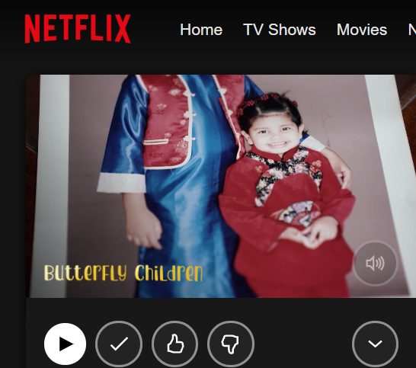
CASE STUDY: DEBRA
YouTube/Netflix: Butterfly children (Singapore)

Slide 8

Diagnosis
Treatment Access
Affordability
Research
Support
Data
Cultural factors
Stigma

Slide 9

SO WHERE DO YOU COME IN??

