Slide 1
A Right to Know?
Tips and Strategies for Using FOIA and Public Records
Mark Walker, The New York Times, Reporter and FOIA Director

Slide 2
Overview
The Good: Who can you FOIA? What can you FOIA? How can you FOIA?
The Bad: FOIA exceptions
The Ugly: A broken system?
Making the request: formulating the request; expedited processing; fee waiver
After the request: FOIA diplomacy; administrative appeals; litigation
State requests
FOIA as part of reporting
Tips/resources

Slide 3
The Good: A Statutory Right of Access
President Johnson:
This legislation springs from one of our most essential principles: a democracy works best when the people have all the information that the security of the Nation permits. No one should be able to pull curtains of secrecy around decisions which can be revealed without injury to the public interest.

Slide 4
The Good: A Statutory Right of Access
The Freedom of Information Act, 5 U.S.C. § 552, provides a right of access to existing “records” held by federal executive branch “agencies.”
FOIA reflects a philosophy of disclosure and requires that government records be made available unless a statutory exemption applies.
  Does not include Congress, the courts, or the White House Office (i.e., President and his aides).
  State/local agencies covered by state laws

Slide 5
What can you FOIA, and how?
Any “agency record”
  Very broad
  Means the agency “created or obtained” the records and is “in control of the requested materials at the time the FOIA request is made.”
  Agency has no obligation to make records for you
Form of request: in writing and submitted via email, web portal, etc.
Notes:
Al-Amyn

Slide 6
The Bad: FOIA Exceptions
Exemption 1: Classified information (material “specifically authorized under criteria established by an Executive order to be kept secret in the interest of national defense or foreign policy” and “in fact properly classified pursuant to such Executive order”).
🡪 Ex: Rules governing lethal force abroad (Glomar)
Exemption 2: Information related solely to the internal personnel rules and practices of an agency.
Exemption 3: information “specifically exempted from disclosure” by another statute (e.g., grand jury materials exempt under Federal Rule of Criminal Procedure 6(e), tax returns exempt under Internal Revenue Code)

Slide 7
The Bad: FOIA Exceptions
Exemption 4: Trade secrets and privileged or confidential commercial or financial information
🡪 Ex: Volkswagen lawsuit, JUUL lawsuit
Exemption 5: “inter-agency or intra-agency memorandums or letters that would not be available by law to a party other than an agency in litigation with the agency”
  Main privileges: deliberative process privilege; attorney work product; attorney-client privilege
  🡪 Ex: Parkland lawsuit

Slide 8
The Bad: FOIA Exceptions
Exemption 6: “personnel and medical files and similar files the disclosure of which would constitute a clearly unwarranted invasion of personal privacy”
  Requires balancing between privacy interest and value of public disclosure (must “let citizens know what their government is up to”)
  Redaction is your friend!

Slide 9
The Bad: FOIA Exceptions
Exemption 7: “records or information compiled for law enforcement purposes,” but only if disclosure:
“could reasonably be expected to interfere with enforcement proceedings”
  “would deprive a person of a right to a fair trial or an impartial adjudication”
  “could reasonably be expected to constitute an unwarranted invasion of personal privacy”
  “could reasonably be expected to disclose the identity of a confidential source”
  “could reasonably be expected to endanger the life or physical safety of any individual”
  would disclose techniques, procedures, or guidelines for law enforcement investigations or prosecutions, if such disclosure could reasonably be expected to risk circumvention of the law

Slide 10
The Bad: FOIA Exceptions
Exemption 8: information “contained in or related to examination, operating, or condition reports prepared by, on behalf of, or for the use of an agency responsible for the regulation or supervision of financial institutions”
Exemption 9: “geological and geophysical information and data, including maps, concerning wells.”

Slide 11
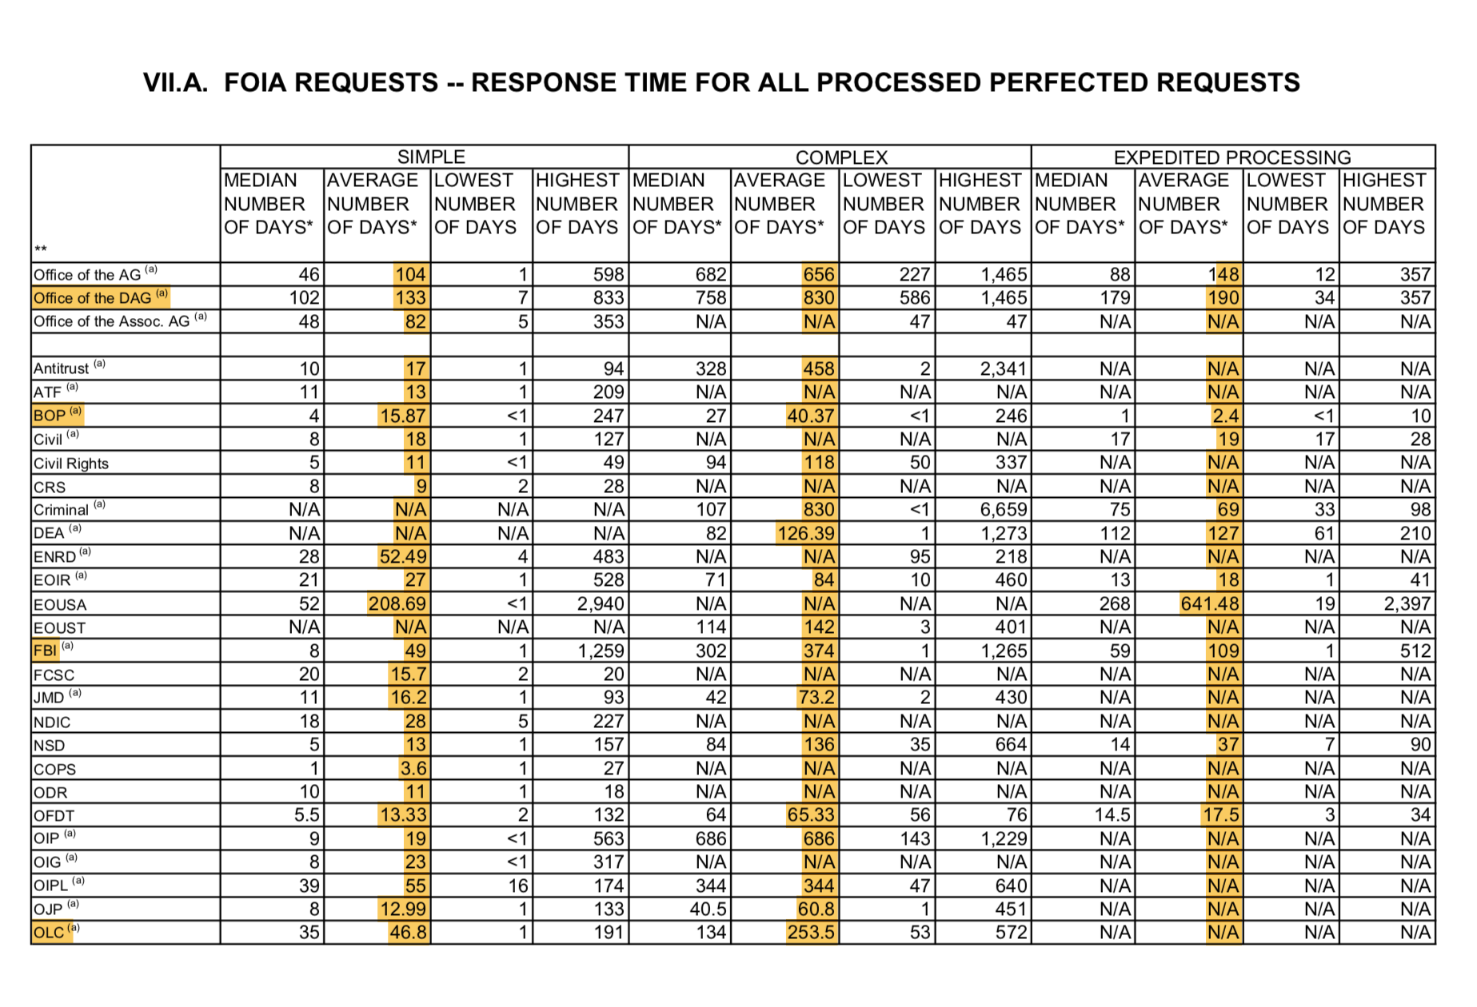
The Ugly: A Broken System?

Slide 12
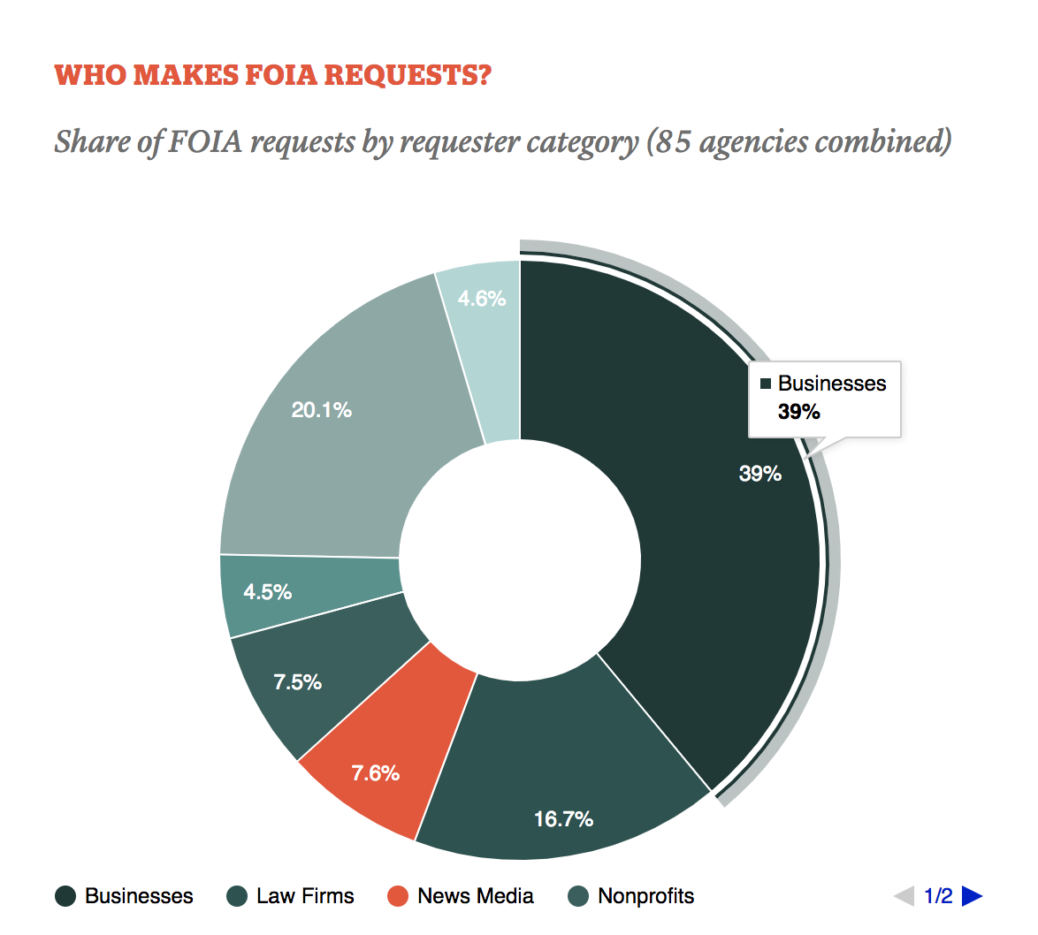
The Ugly: A Broken System?

Slide 13
Before you file
What are you looking for?
  FOIA applies to documents, not information
Can you get the information elsewhere?
  Check web sites and agency e-reading rooms
  Try calling the agency to see if you can get the data without filing a request. (If you can, avoid the communications office)
Do your homework
  Know what you’re looking for
  Learn how/where/why that information is kept
Notes:
Al-Amyn

Slide 14
“Keep It Simple and Specific”

Slide 15
Do and Dont’s
Some advice for filing a successful FOIA request can be distilled into a few simple phrases. Here are some basic dos and don’ts for your next request:
Do:
be simple and straightforward;
be specific and precise; and
be polite and respectful
Don’t:
be complicated or convoluted
be vague and imprecise; and
be inconsiderate and antagonistic

Slide 16
Formulating the request
Be specific. Be clear. Be human.
The request must “reasonably describe” the records
  It should enable “a professional employee of the agency who is familiar with the subject area of the request to locate the record with a reasonable amount of effort” (i.e., think like a FOIA officer)
You can’t ask questions, and you can’t make “broad, sweeping requests”
  Be specific: keywords, custodians, date ranges, domains etc.
  Avoid ambiguity (words like “related to”).
Notes:
Al-Amyn

Slide 17
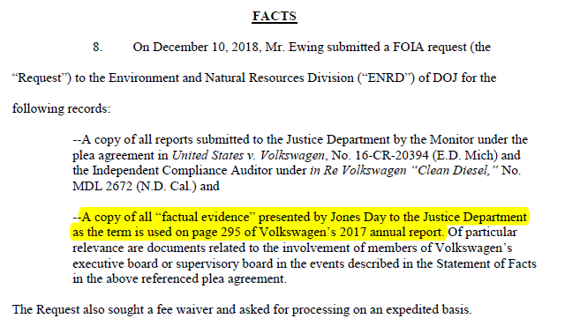
Formulating the request: an example

Slide 18
Key components of your request
Format of requested documents: Requestors are entitled to have the records given to them in whatever format the agency maintains it in.
Response time: State and federal agencies have a statutory timeframe on when they need to initially respond to your request.
Fee Waiver: Ask that all fees for producing your FOIA be waived because you are member of the media. Beware some state don’t have media fee waivers.
Expedited Processing: Seeks to continue to have your FOIA processed on the Requires a bit a research.

Slide 19
Cite the law:

Slide 20
Cite the law:
“This is a request under the Freedom of Information Act (“FOIA”) from Mark Walker of The New York Times. ”

Slide 21
Be clear and concise

Slide 22
“Any reports produced by Integritas Creative Solutions LLC investigators regarding Stanley Patrick Weber. The investigators gathered a detailed account of how specific IHS officials ignored explicit warning about Stanley Patrick Weber continuing to practice and how concern about the doctor spread more widely across the agency earlier than previously known. ”

Slide 23
FORMAT OF REQUESTED RECORDS

Slide 24
“Under FOIA, you are obligated to provide records in the format requested. See, e.g., 5 U.S.C. § 552(a)(3)(B) (”In making any record available to a person under this paragraph, an agency shall provide the record in any form or format requested by the person if the record is readily reproducible by the agency in that form or format.”). We request all records in an electronic .pdf format. ”

Slide 25
RESPONSE TIME

Slide 26
“We appreciate your help in expeditiously obtaining a determination on the requested records. As mandated in FOIA, we anticipate a reply within the statutory timeframe of 20 business days. 5 U.S.C. § 552(a)(6)(A)(i).”

Slide 27
FEE WAIVER

Slide 28
I respectfully request that you waive all fees in connection with this request as provided by 5 U.S.C. § 552(a)(4)(A)(iii). FOIA was designed to provide citizens a broad right to access government records. FOIA’s basic purpose is to “open agency action to the light of public scrutiny,” with a focus on the public’s “right to be informed about what their government is up to.” U.S. Dep’t of Justice v. Reporters Comm. for Freedom of the Press, 489 U.S. 749, 773–74 (1989). In order to provide public access to this information, FOIA’s fee waiver provision requires that “[d]ocuments . . . be furnished without any charge or at a [reduced] charge . . . if disclosure of the information is in the public interest because it is likely to contribute significantly to public understanding of the operations or activities of the government and is not primarily in the commercial interest of the requester.” 5 U.S.C. § 552(a)(4)(A)(iii). Disclosure to The New York Times will contribute to public understanding of the operations and activities of the government and is not in the commercial interest of the requester.

Slide 29
Format & fees
Format of the records
  Must be produced “in any form or format requested by the person if the record is readily reproducible by the agency in that form or format.”
Fees
  Fee category – representative of news media (only duplication fees for 100+ pages – scanning, uploading, etc.)
  Fee waivers – limited or no fees where information is “likely to contribute significantly to public understanding of the operations or activities of the government” 🡪 be specific

Slide 30
EXPEDITED PROCESSING

Slide 31
Seek expedited processing
An agency must make a determination on a request for expedited processing within 10 calendar days.
If an agency grants a request for expedited processing, it must process the request “as soon as practicable”
At least 2 bases for expedited processing:
  Failure to obtain records on an expedited basis could reasonably be expected to pose an imminent threat to the life or physical safety of an individual
  With respect to a request made by a person primarily engaged in disseminating information, there is an urgency to inform the public concerning actual or alleged Federal Government activity

Slide 32
There can be little doubt that The Times constitutes a requester "primarily engaged in disseminating information." 5 U.S.C. § 552(a)(6)(E)(v)(II). There can also be little doubt that the requests relate to federal government activity; I am requesting expedited processing of this request because it concerns a matter of both urgency and of public concern. Mr. Weber is a former South Dakota Indian Health Services pediatrician convicted of abusing Native American children while he was a doctor on the Pine Ridge reservation. Weber was accused of committing crimes between 1995 and 2011. Weber is currently in prison for abusing children while he was a pediatrician in Montana. Many questions remain about whether or not officials within the agency knew about Mr. Weber’s behavior and ignored it and allowed him to practice regardless. In an attempt to answer some of those questions, IHS commissioned a report that identifies the officials responsible for mishandling a government pediatrician. This report would provide the public insight into how the agency allow this abuse to take place for more than 15 years.

Slide 33
Timing of agency response
In principle, the agency must make a “determination” within 20 business days
  In “unusual circumstances,” agency may extend deadline, usually by no more than 10 additional business days
  Agency doesn’t necessarily have to give you records then, but it has to tell you when it will do that
Ask for an estimated date of completion

Slide 34
Tips for obtaining expedited processing
  Tie your request to a concrete event in the near future 🡪 be specific
  Don’t forget to certify (i.e., statements are “true and correct to the best of [the requester’s] knowledge and belief”)
  Appeal!

Slide 35
State and local requests (FOIL)
Every state has an open records law
States vary dramatically
When dealing with state public records requests I always spend time reading through the sections that pertain to the agency I’m seeking records from.
Also, NFOIC, the National Freedom of Information Coalition, provides great templates for requests and great summarizes of what the state will and won’t release.

Slide 36
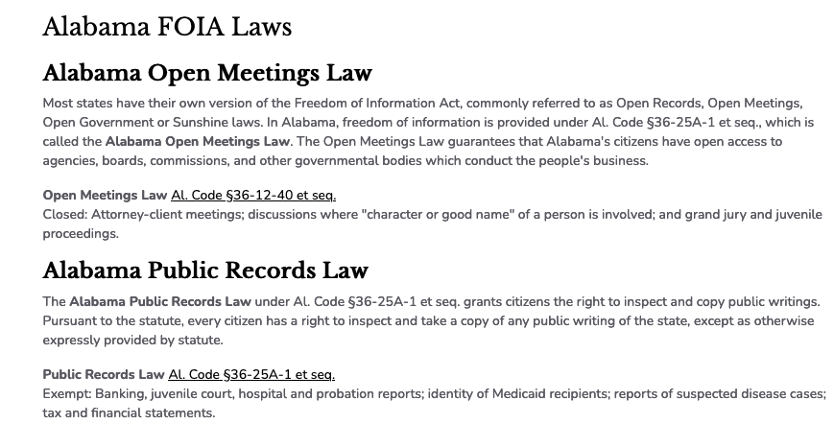

Slide 37
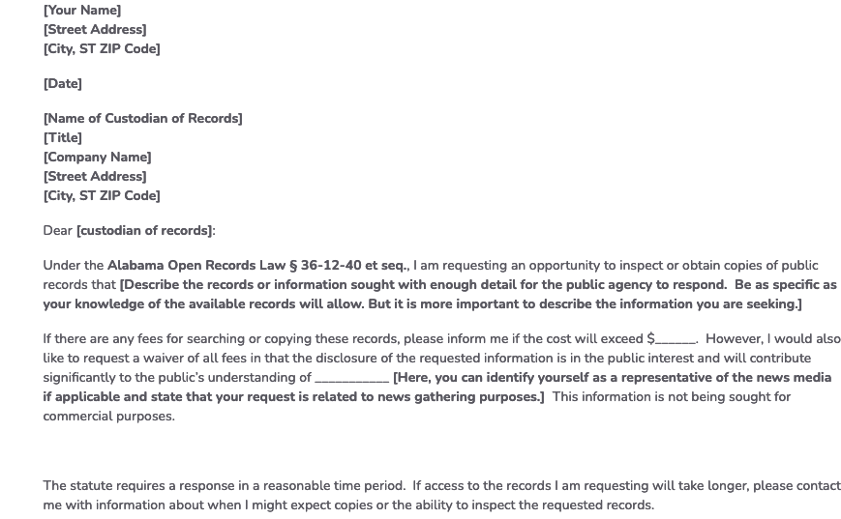

Slide 38
New York’s Freedom of Information Law
Article 6 of the New York State Public Officers Law, also known as the Freedom of Information Law (FOIL), allows members of the public to obtain records of state and local government.

Slide 39
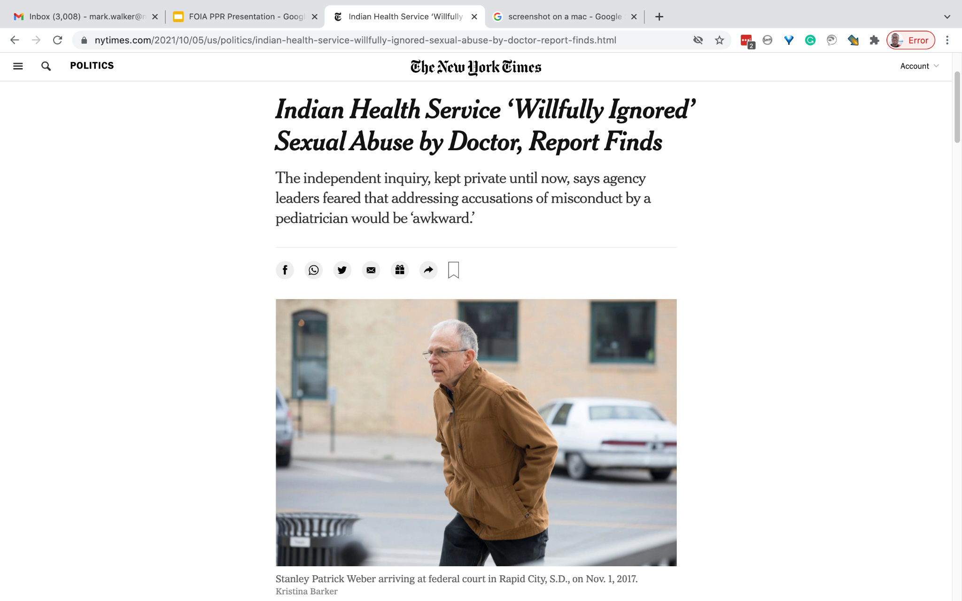
Story from FOIA lawsuit

Slide 40
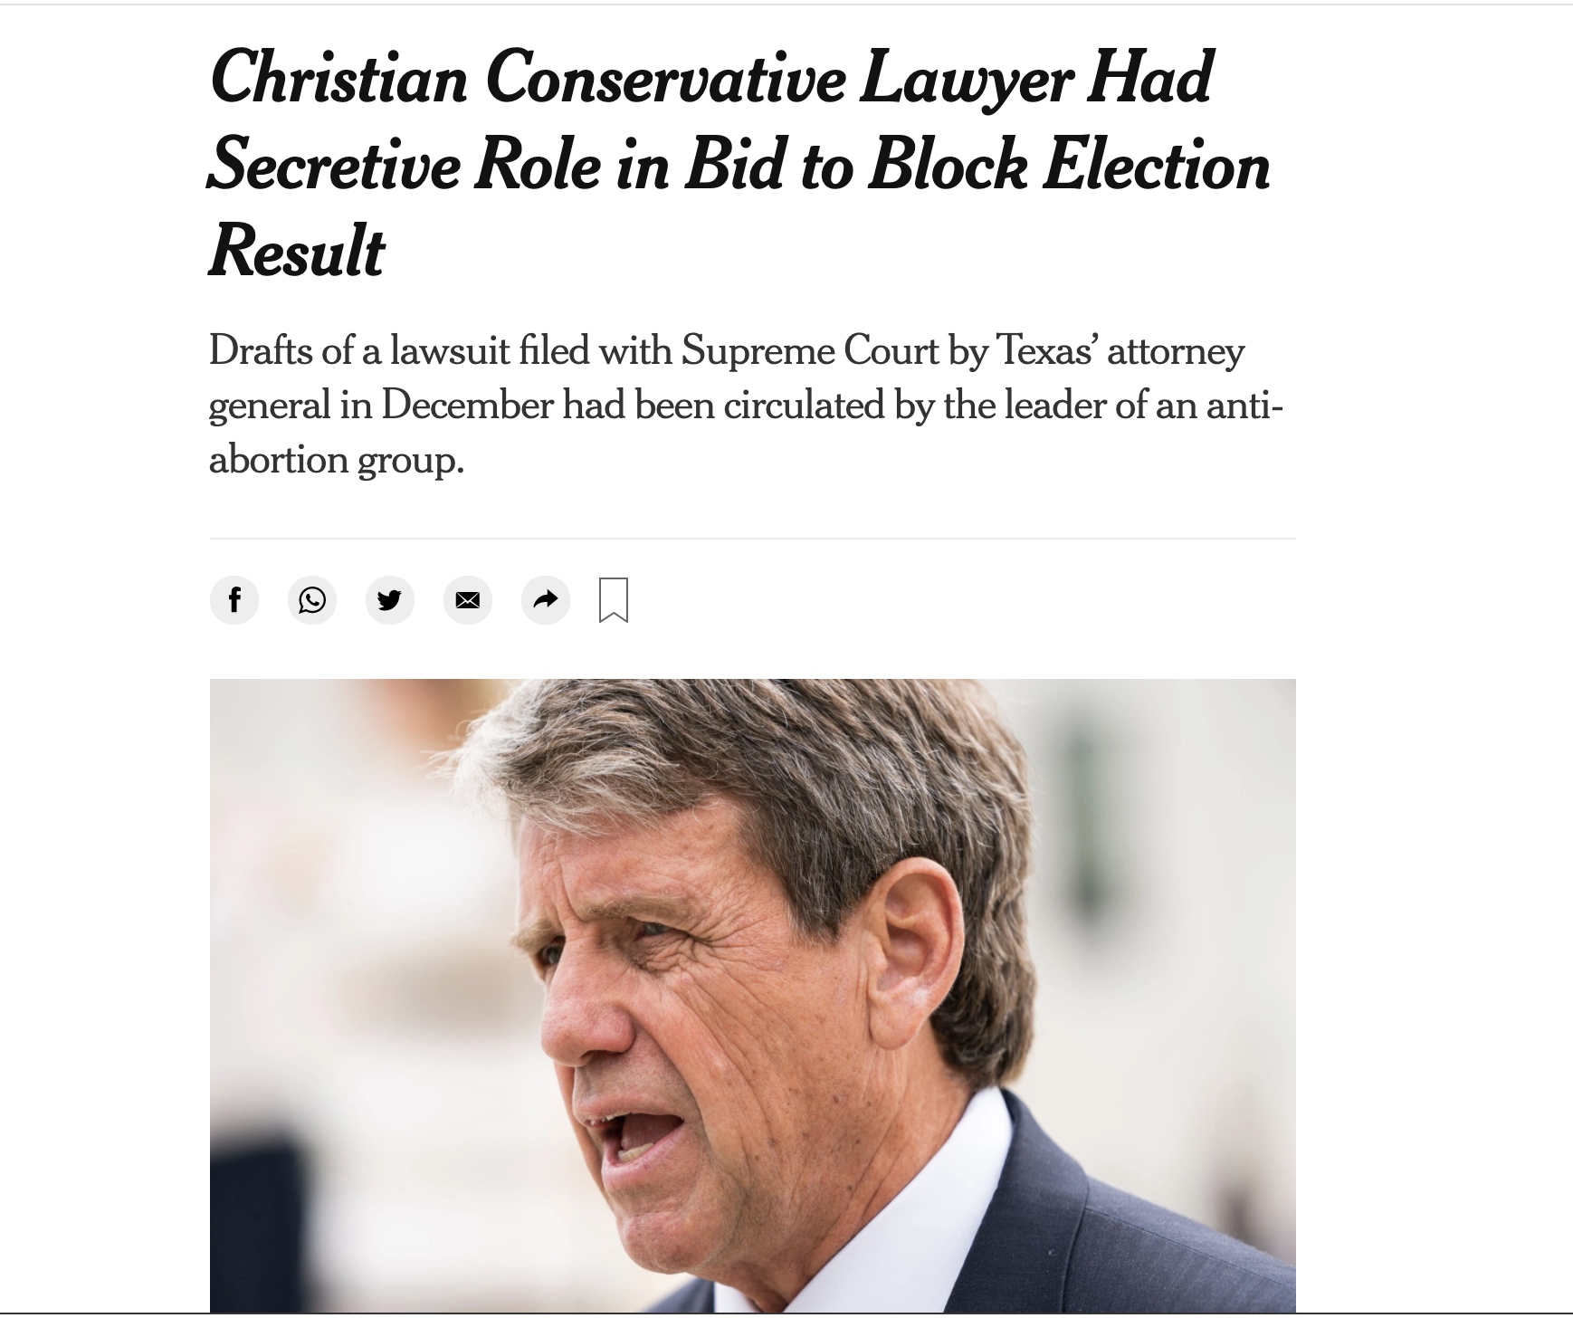
FOIA as part of reporting
Notes:
Seth

Slide 41

Story from state public records

Slide 42

Story from Federal FOIAs

Slide 43
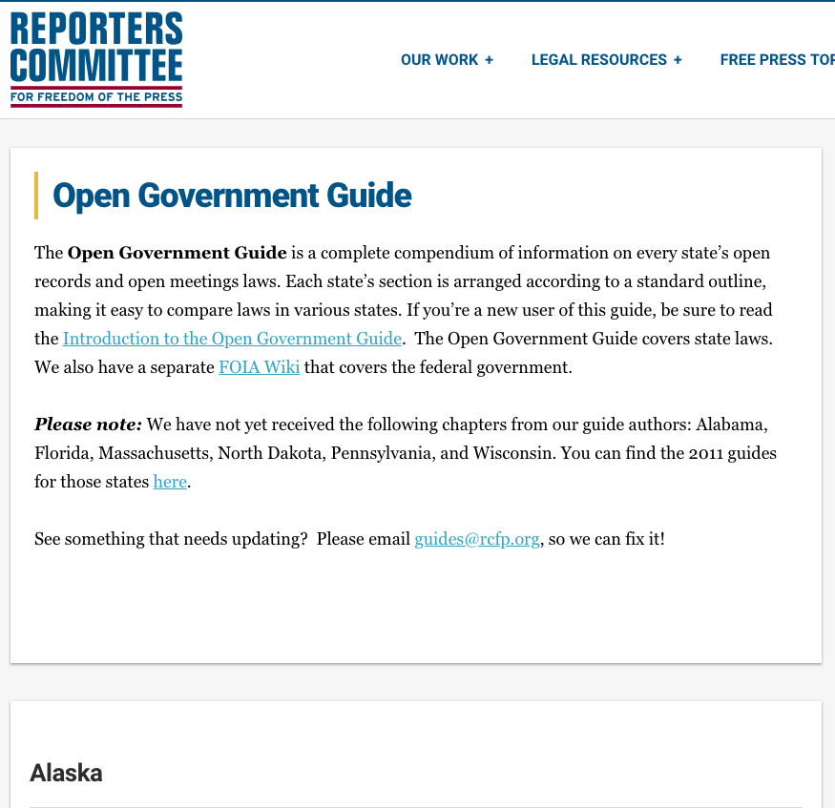

Resources
Reporters Committee for Freedom of the Press
https://www.rcfp.org/open-government-guide/
MuckRock Public Records Guides
https://www.muckrock.com

