Slide 1

Tips, tools and resources for journalists

Slide 2
The National Press Foundation would like to thank the Evelyn Y. Davis Foundation and Arnold Ventures for their support for this project.
NPF also thanks the expert speakers who have given so generously of their time.
Finally, we thank DataKind DC, whose volunteer data scientists provided invaluable support to NPF fellows.

Slide 3
Guidebook overview
This guidebook will teach journalists to use investigative and data-journalism techniques to track the $4 trillion in coronavirus pandemic relief spending approved by Congress in 2020.
It summarizes lessons from top experts in public finance, taxpayer accountability, data science and investigative journalism. It is divided into brief units to help journalists find materials that are most relevant to their reporting.
This material is adapted from a National Press Foundation training program held July 13-17, 2020, and follow-up sessions.

Slide 4

Topics covered

Slide 5
Topics covered (1 of 3)
How to use a variety of databases to track COVID stimulus spending
Free online tools for backgrounding companies and individuals
Tips and techniques for investigating companies, including how to use SEC records

Slide 6
Topics covered (2 of 3)
Tracking lobbying and special interest spending in Congress
Three tools, your choice: How to analyze Paycheck Protection Program (PPP) loan recipients’ data in Excel, Tableau and Python
Best practices in financial investigative journalism

Slide 7
Topics covered (3 of 3)
Scraping data from the web using Google Sheets
Overview of stimulus spending: CARES Act and other federal programs, and their effect on the federal budget
Scoops by NPF fellows using data journalism techniques
List of resources

Slide 8

How to use a variety of databases to track COVID stimulus spending

Slide 9
This database is from the Committee for a Responsible Federal Budget. It breaks down each fiscal or monetary COVID action and shows its impact on the deficit, either from increased spending or foregone revenue.
COVID Money Tracker

Slide 10
The Paycheck Protection Program is administered by the U.S. Small Business Administration. The government has so far released only limited data on companies and nonprofits that received PPP loans greater than $150,000. The data include the names of recipients who received more than $150,000 and some information – without the names – of those who received less.
The data can be downloaded all at once or by state. Many private databases also track SBA data and combine it with other data.
Paycheck Protection Program

Slide 11
This database is maintained by the Project On Government Oversight.
It covers federal stimulus spending, including grants, loans and contracts.
From the Project On Government Oversight, senior policy analyst Sean Moulton explained the organization’s COVID relief spending data project.
COVID Tracker

Slide 12
Good Jobs First assembles CARES Act recipient data and combines it with information about each firm’s history of regulatory violations, previous government assistance, federal tax avoidance, and CEO and worker pay practices.
By using this database, you can find companies that receive PPP loans despite having poor records of corporate accountability.
Philip Mattera, research director of Good Jobs First, explains (11 minutes) how to use the database.
COVID Stimulus Watch

Slide 13
The Rockefeller Institute of Government’s COVID-19 State Relief Dashboard is an interactive tool for viewing state allocation data for programs such as the Coronavirus Relief Fund and PPP.
State Relief Dashboard

Slide 14
USA Spending tracks federal contract and grant awards and other federal spending at the state, congressional district and local levels. The database features new tools to search and display COVID-19 spending data.
USA Spending database

Slide 15
The Federal Procurement Data System tracks all contracts awarded by the federal government.
ProPublica created a dashboard to specifically track COVID contracts.
The dashboard tracks coronavirus contracts worth $10,000 or more.
Derek Willis, news application developer at ProPublica, demonstrates how to use the dashboard (20 minutes).
ProPublica dashboard

Slide 16
DataKind DC database
DataKind DC volunteers have produced their own PPP loans database with cleaner and enhanced data that is easier than the SBA’s to work with. Volunteers have also produced datasets that aggregate total loan amounts for multiple geographical areas, giving mapping capabilities and allowing journalists to drill down to federal spending in their coverage areas.
The aggregated datasets also include demographic information for each of the geographical areas, and recent election results data. Links to download each of those products are in the next slide.

Slide 17
Full database of loans: complete SBA dataset from Aug. 8, with some enhancements added, including low/mid/high loan estimates for larger loans, which were given as ranges in the raw data, and definitions of NAICS industry codes at multiple levels of granularity. Note that this is a very large file and therefore is zipped here for easier download.
Multi-loan addresses: spreadsheet helps quickly identify addresses that have received more than one loan. A video to help get started using this data is also available here.
Loans by congressional district: sum of the total loan amounts for each congressional district (in yellow). It also gives demographic information for each congressional district from the 2014-2018 U.S. Census Bureau’s American Community Survey (in blue), and 2018 election result data from the MIT Election Lab (in green).
Links to DataKind DC datasets

Slide 18
Loans by county: dataset gives a sum of the total loan amounts for each county (in yellow). It also gives demographic information for each county from the 2014-2018 American Community Survey (in blue), and 2016 election result data from the MIT Election Lab (in green).
GitHub repository: code that produced the above, more documentation about the project, and the additional datasets that were brought in as enhancements can be found here.
Additional links to
DataKind DC datasets

Slide 19
John McCambridge explains (15 minutes) the DataKind DC datasets. His tutorial can be viewed here.
How to use DataKind DC datasets

Slide 20

Free online tools to find background on companies and individuals

Slide 21
You do not need paid services to do mind-blowing investigative reporting.
Mark Horvit, a University of Missouri professor and former executive director of Investigative Reporters and Editors, shows how to use Google Advanced Search (9 minutes) and other tools (5 minutes) to get better results online.
Free search tools: Google Advanced Search and more

Slide 22
Image search tools
Google
TinEye
Fotoforensics
Yandex
Notes:
Tools recommended by Mark Horvit

Slide 23
Finding people’s contacts
Cyber Background Checks: addresses, phone numbers and family connections
FastPeopleSearch: addresses, phone numbers and other contact information
AdvancedBackgroundChecks: addresses, phone numbers and other contact information
FamilyTreeNow: family genealogy
Notes:
Tools recommended by Mark Horvit

Slide 24
Tools for website search
Wayback Machine: retrieves deleted information from websites
Whois Lookup: details on who is behind a website
Million Short: removes the most popular web hits
Similarsites: finds websites similar to the one you enter into its search tool
Distill: tracks website changes
Notes:
Tools recommended by Mark Horvit

Slide 25
PeekYou
Social Mention
That’sThem
Tools for searching the Deep Web
Notes:
Tools recommended by Mark Horvit

Slide 26
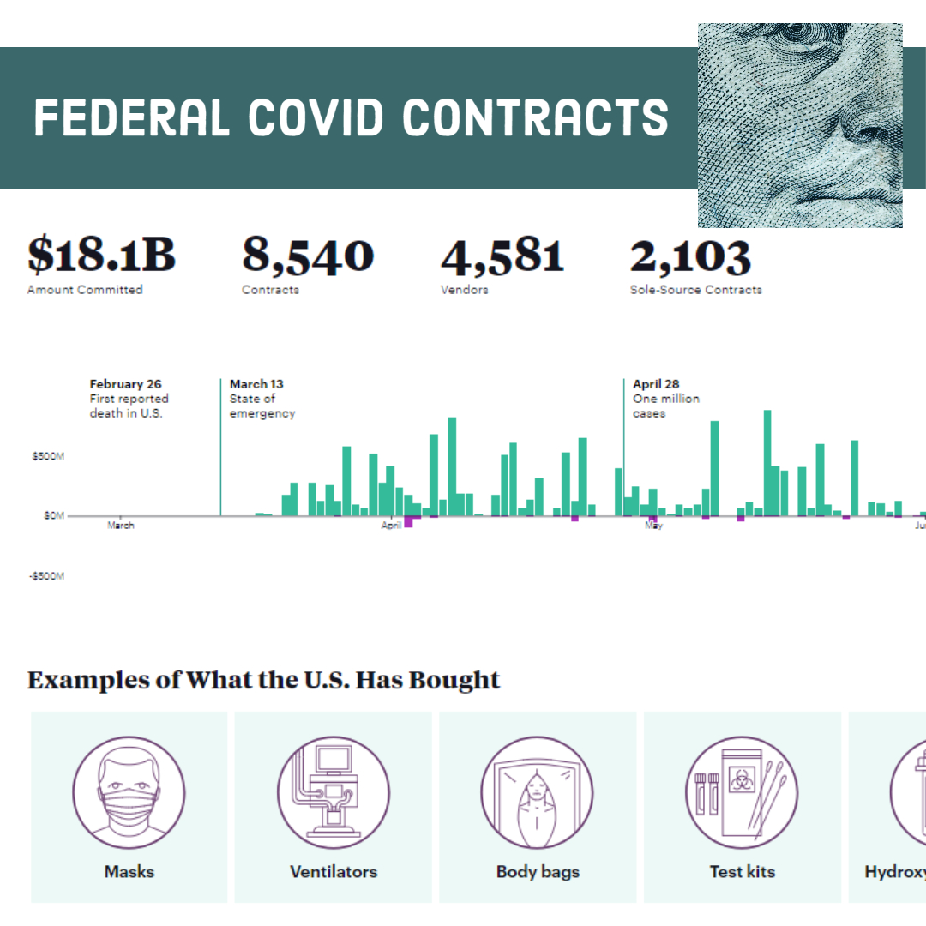
Techniques for investigating companies, including how to use SEC records

Slide 27
U.S. Securities and Exchange Commission records are generally used by investors and business reporters, but they can be used by state and local journalists to drill into companies in their region.
Making the most of SEC filings

Slide 28
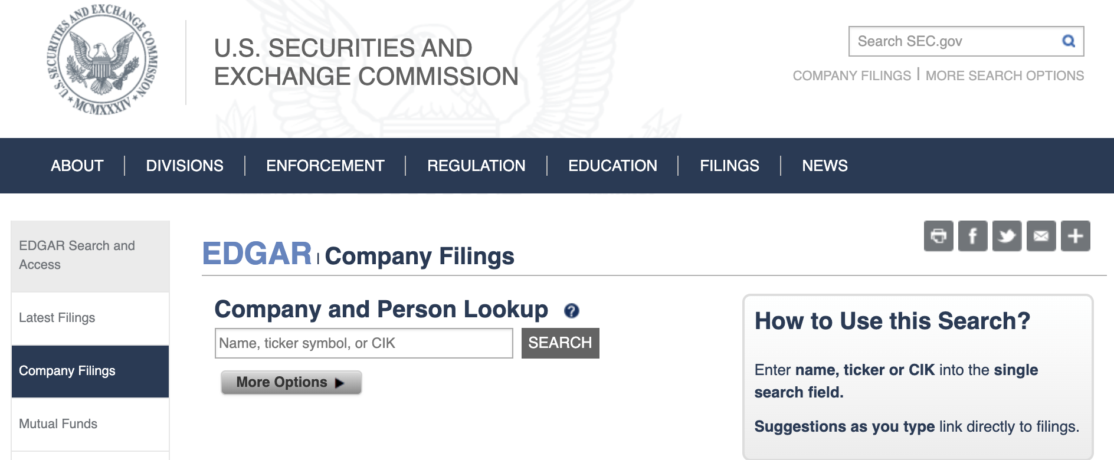
EDGAR

Slide 29
Breaking corporate news, earnings (Form 8-K)
Executive pay (10-K, Def 14A)
In-depth proﬁts/losses (10-Q)
Executive bios, photos (10-K, Def 14A)
Lawsuit summaries (10-Q, 10-K, 8-K)
Vital documents to
search on EDGAR
Notes:
Recommended by Rob Wells, University of Arkansas professor and author

Slide 30
How to make most of SEC fillings
Rob Wells, University of Arkansas professor demonstrates (38 minutes) how to:
Drill into companies by region
Find executive pay
Examine a company’s business prospects
Examine bios of key leaders
Find lawsuits involving a company
Discover material risks a company faces
See his GitHub page for further details.

Slide 31
Finding background information about companies can start with just the simple step of Google and social media searches and then narrow to specific websites.
This is one of the techniques that Cheryl Thompson, an NPR reporter, George Washington University professor and president of Investigative Reporters and Editors, has used over the years for backgrounding companies ( 17 minutes).
Top investigative reporters offer tips and strategy on backgrounding businesses

Slide 32
Pacer.gov: legal records
Law360.com: legal records
GuideStar: up-to-date data on nonprofit organizations
Charity Navigator: status and credibility of nonprofit organizations
Violation Trackers: companies’ misconducts and sanctions by regulators
Useful websites for
backgrounding companies

Slide 33

Tracking lobbying and special interest spending in Congress

Slide 34
Tracking lawmakers
Some members of Congress have received PPP loans for their companies or sold stock after getting intelligence briefing about the potential effect of coronavirus on the economy.
Pulitzer Prize-winner James Grimaldi explains (14 minutes) how to break these kinds of stories by tracing lobbyists’ money to lawmakers’ campaign war chests, and investigating lawmakers’ staffs, businesses, favorite charities and their spouses’ employers.

Slide 35
Congress.gov: information on legislation, committees, members and other activities of Congress
FEC.gov: federal campaign contributions
OpenSecrets.org: Center for Responsive Politics data on lobbyists, industries, companies and trade groups
FollowTheMoney.org: state and local campaign contributions
OpenCorporates.com: personal holdings of members of Congress
LegiStorm.com: financial data on congressional staff
Top resources for investigating lawmakers
Notes:
Recommended by Pulitzer Prize-winner James Grimaldi

Slide 36
Select Subcommittee on the Coronavirus Crisis: federal stimulus spending
Pandemic Oversight: pandemic response program spending
Congressional Research Services: coronavirus research reports
Congressional oversight
of pandemic spending
Notes:
Recommended by Pulitzer Prize-winner James Grimaldi

Slide 37
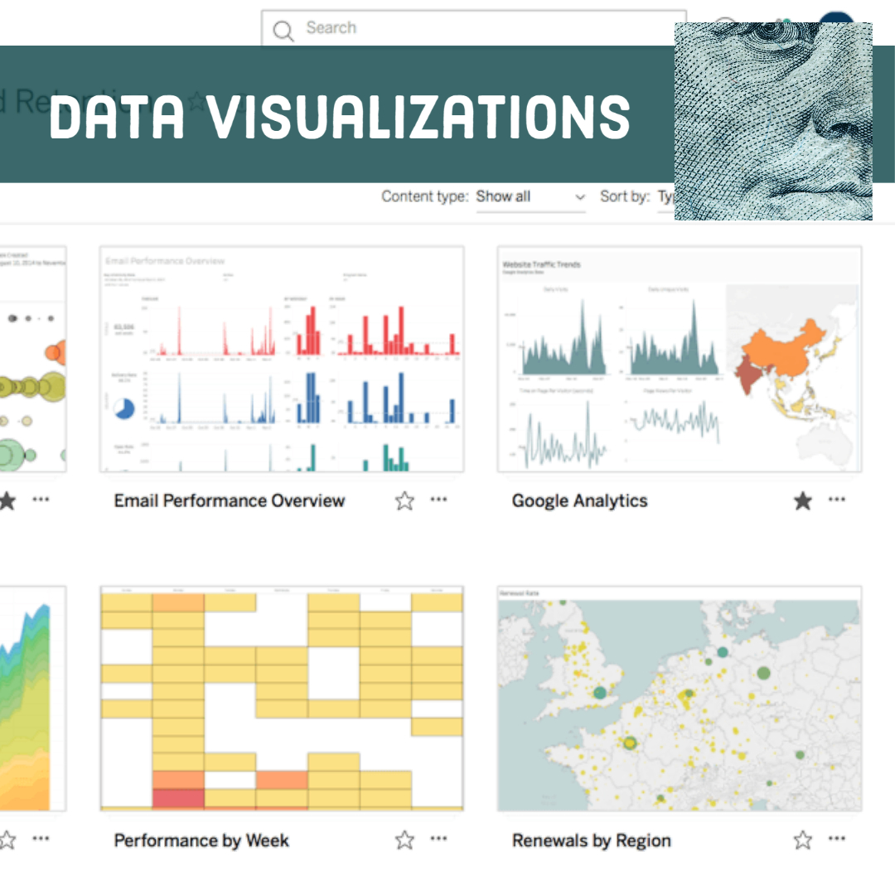
Three tools, your choice: how to analyze PPP loan recipients’ data in Excel, Tableau and Python

Slide 38
Chris Adams, director of training at the National Press Foundation, shows how to clean and analyze PPP loans data in Excel.
Download, import and format PPP loan data.
Filter PPP loans by industry, ZIP code, loan amount and other categories.
Use pivot tables to get sum and averages by category.
Use VLOOKUP to join NAICS codes to industry names.
How to import, clean and analyze PPP loan data in Excel

Slide 39
Chantilly Jaggernauth, vice president for data visualization and training at Lovelytics, shows reporters how to:
Import PPP loan recipients’ data into Tableau
Clean, analyze and visualize PPP loan recipients’ data
Easily create snappy graphics
To get started, download and install Tableau Desktop to follow along with the tutorial (38 minutes).
How to import, clean and analyze the PPP data and create simple visuals using Tableau

Slide 40
Susan E. McGregor, associate research scholar at Columbia University’s Data Science Institute, discusses why Python is an important programming language to handle big data and demonstrates (39 minutes) how it can be used to analyze PPP loan recipients’ data.
To follow the example of analyzing the PPP loans data in the latter part of the tutorial, click here for the Jupyter Notebook on Google Colab. To go along with the analysis, click on file and save a copy in drive.
How Python can help you track stimulus spending

Slide 41
Mark Walker, FOIA coordinator at the Washington bureau of The New York Times and former training director for Investigative Reporters and Editors, gives a walkthrough (11 minutes) on how Google Sheets can be used to pull datasets from websites.
But what if you have a different dataset? Here’s how to scrape it using Google Sheets.

Slide 42

Best Practices in Financial Investigative Journalism

Slide 43
Lessons from previous bailouts
Today’s pandemic-driven economic meltdown is different from the financial shocks of 2008.
But as Pulitzer Prize winner James Steele and author Kathleen Day explain, some of the lessons journalists learned in covering them are evergreen.

Slide 44
Four tips for journalists reporting on local businesses
Talk to local businesses about who got the money – or didn’t. They want to talk. And competitors love to rat on competitors.
Go to state regulators. Their documentation isn’t as rigorous as federal records, but they can spot anomalies. If they won’t talk, go to former state regulators.
Get to know your regional Federal Reserve members. They will know which institutions seek loans.
Look at the debt load of any corporations in your reporting areas.
Notes:
Tips from Kathleen Day, Johns Hopkins University business professor and previously a Washington Post reporter

Slide 45
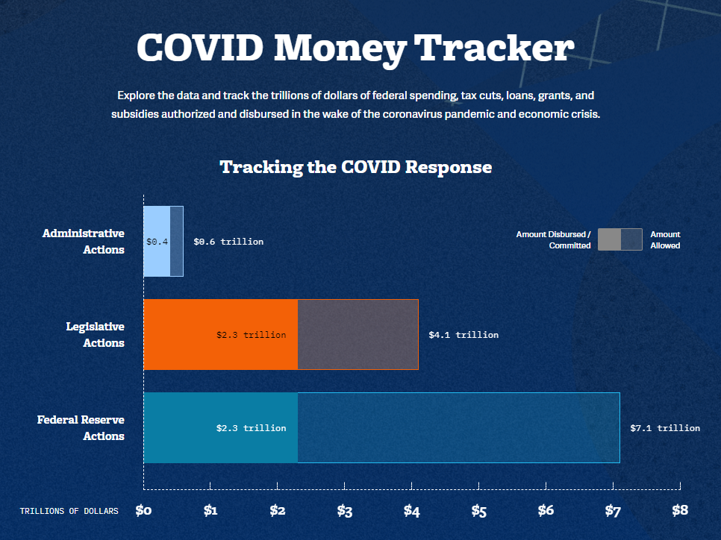
Overview of stimulus spending: CARES Act and other federal programs, and their effect on the federal budget
Notes:
Graphic by Maya MacGuineas, president of the Committee for a Responsible Federal Budget

Slide 46
Listen to Maya MacGuineas (8 minutes), president of the Committee for a Responsible Federal Budget, explain the parameters of the federal government’s COVID response, which included:
Federal reserve actions of $2.3 trillion
Administrative actions of $400 billion
Congressional actions of $2.3 trillion
Get the slides.
Overview of $5 trillion COVID response

Slide 47
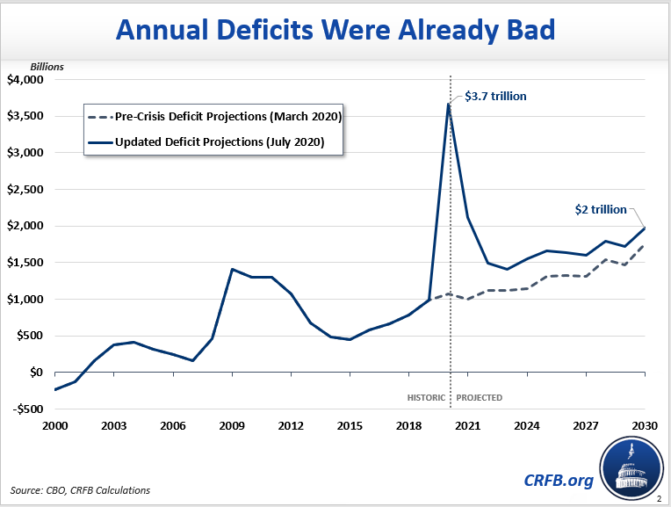
Effects on the U.S. deficit
Maya MacGuineas explains the economic impact (47 minutes)
Notes:
Graphic by Maya MacGuineas, president of the Committee for a Responsible Federal Budget

Slide 48
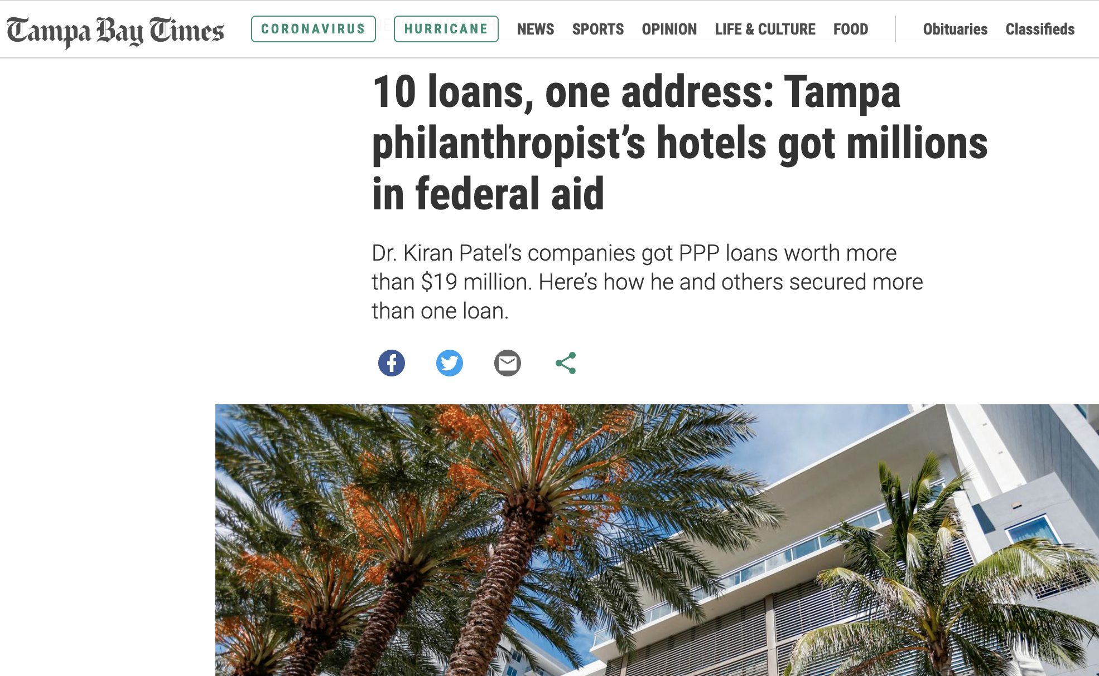
Scoops by NPF Fellows using data journalism techniques
Read the story

Slide 49
John McCambridge of DataKind DC helped Jay Cridlin of the Tampa Bay Times analyze the PPP loan data by using pivot table to find loans to businesses with common addresses.
They noticed that a Florida philanthropist got multiple loans for his hotels. Cridlin’s story exposed how the Tampa hotelier received millions in taxpayer-funded PPP loans but laid off hundreds.
Cridlin explains (5 minutes) how the story came together.
McCambridge discusses the data process (5 minutes).
How a data scientist and a journalist linked 10 different PPP loans to one philanthropist

Slide 50
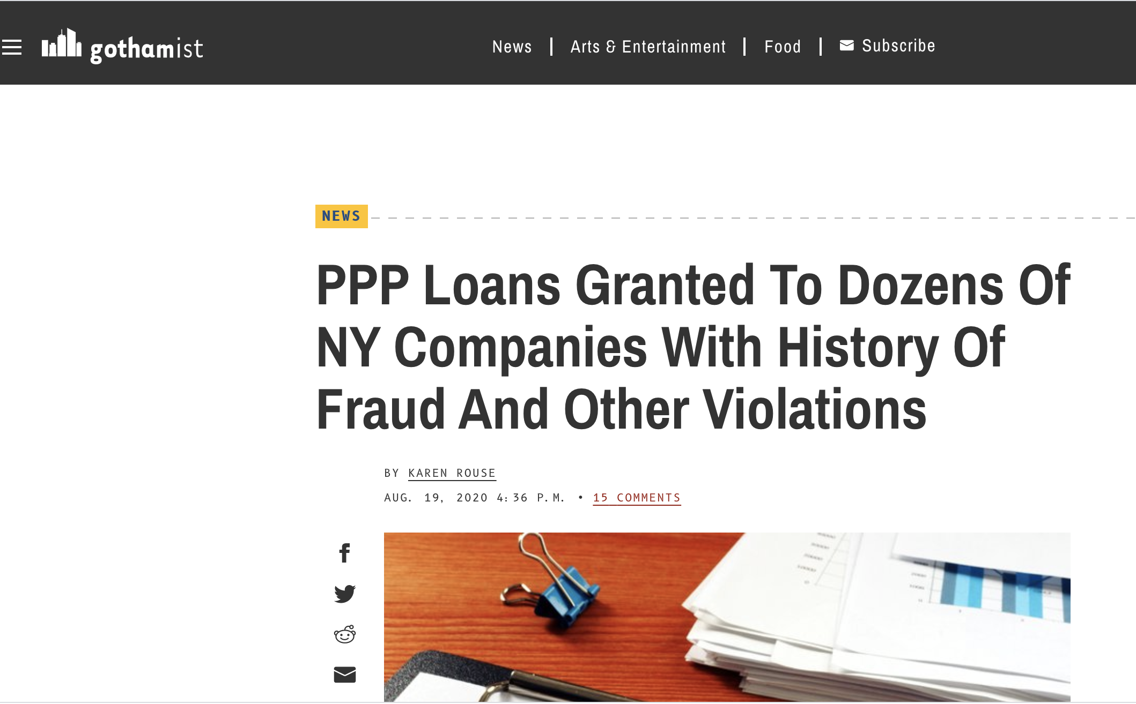
How NPF fellows used these resources to break stories
Read the story

Slide 51
Karen Rouse of WNYC and Gothamist used the COVID Stimulus Watch database created by Good Jobs First to expose New York based companies that received PPP loans despite having poor records of corporate accountability.
Good Jobs First’s Philip Mattera explains how to use the tracker in this tutorial (42 minutes).
Tracking companies that received PPP loans despite a history of fraud

Slide 52

Exposing fraud in PPP loans
Read the story

Slide 53
By delving into the PPP loans data released by the U.S. Small Business Administration, Johnny Edwards and his colleagues at The Atlanta Journal-Constitution identified questionable loans in Georgia.
The Atlanta Journal-Constitution exposes dubious loans

Slide 54
List of resources
NPF is maintaining an updated list of resources, including:
Government databases
Private databases and trackers
Documents and white papers
Resources on state responses to the pandemic
Video tutorials and trainings on how to use data analysis tools

Slide 55

This course is being updated periodically. If you have suggestions, additions or updates, please contact us at webmaster@nationalpress.org

